Slide 1
Simulation-Based Estimation of Continuous Time Models in R
R/Finance 2010
Eric Zivot
University of Washington
Joint work with:
Peter Fuleky
University of Hawaii

Slide 2
Introduction
Goal: Estimate parameters of continuous time diffusion model from discretely sampled data
Examples

Slide 3
Estimation Methods
MLE – often not feasible
MLE of approximated model – difficult
QMLE of discretized model – easy but biased
GMM – inefficient and biased
Bayesian MCMC Methods - promising
Indirect Inference – Corrects bias in QMLE
focus of talk

Slide 4
Indirect Inference
Distance-based methodology (aka II) developed by Smith (1993), Gourierioux, Monfort, and Renault (1993)
Score-based methodology (aka EMM) developed by Gallant and Tauchen (1996)

Slide 5
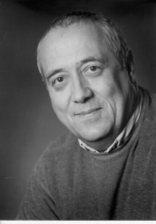




II
EMM

Slide 6
II
EMM
Computationally
less intensive
(Gallant and Tauchen, 1996;
Chumacero, 2001)

Slide 7
II
EMM
Smaller bias
and MSE
in MA models (Ghysels,
Khalaf and Vodounou, 2003)
Computationally
less intensive
(Gallant and Tauchen, 1996;
Chumacero, 2001)

Slide 8
EMM
II
Computationally
less intensive
(Gallant and Tauchen, 1996;
Chumacero, 2001)
Smaller bias
and MSE
in MA models (Ghysels,
Khalaf and Vodounou, 2003)
More accurate inference
for AR models
(Duffee and Stanton, 2008)

Slide 9
Research Agenda and R Contribution
Implement indirect inference estimation techniques for some commonly used continuous time models (e.g., OU, CIR, etc.)
Provide systematic comparison and evaluation of different estimators
Create indirectInference R package
Give practical advice on use of techniques

Slide 10
Indirect Inference Set-up

Slide 11
Example: OU Model

Slide 12
Example: OU Model
Estimating the “crude Euler” auxiliary model leads to biased estimates (Lo, 1988)
Asymptotic discretization bias = μ(θ) – θ
μ(θ) – θ → 0 as Δ → 0
μ(θ) is invertible giving analytic II estimates

Slide 13
Non-simulation based Estimation
Assume μ(θ) is known (very rare!)
EMM is GMM with population moment
II minimizes distance between
Asymptotically equivalent to MLE when auxiliary model encompasses structural model

Slide 14
Simulation-based EMM and II
μ(θ) is unknown
is used to estimate μ(θ_{true})
With EMM, simulations for a given θ are used to approximate the expectation of sample score
With II, simulations are used to approximate μ(θ) for any θ
Gouriéroux and Monfort (1996) describe 3 types of II estimators and 2 types of EMM estimators

Slide 15
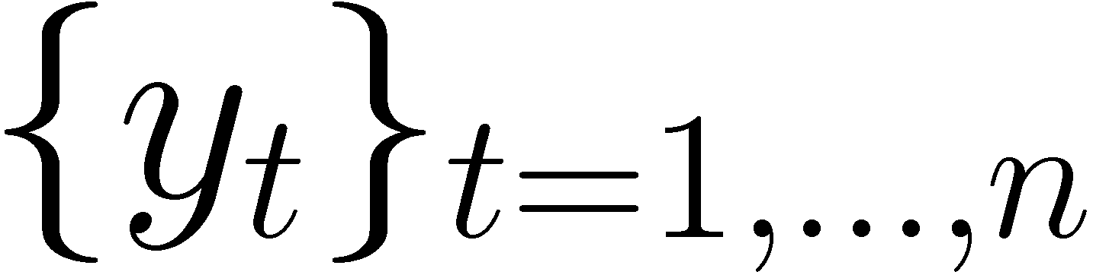
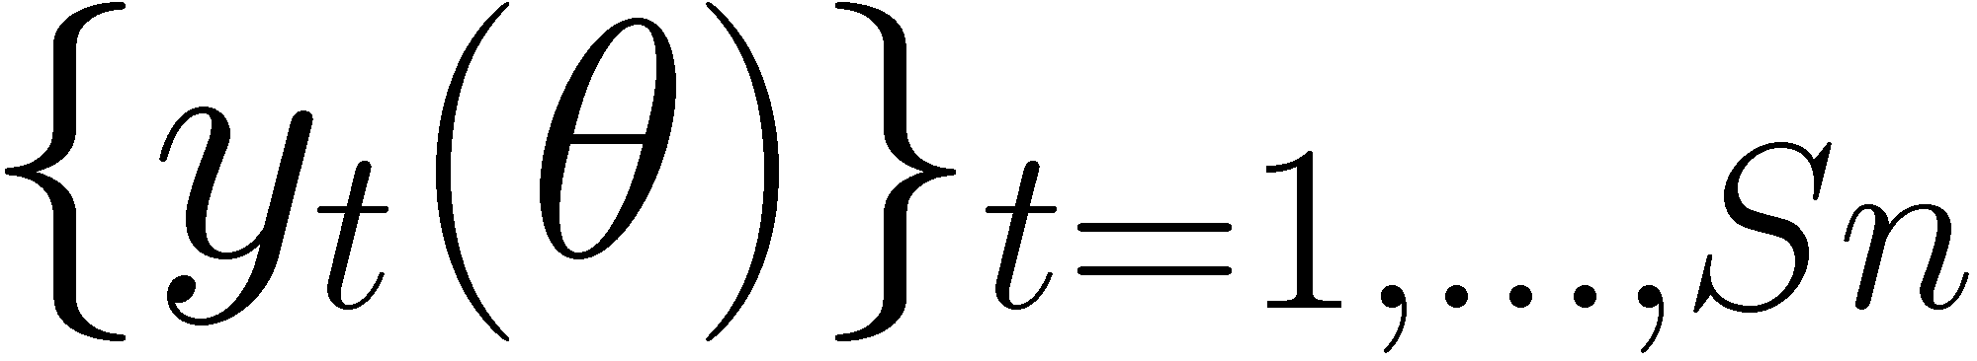
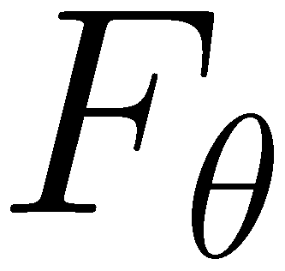
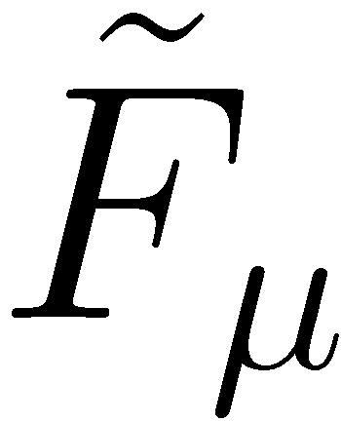

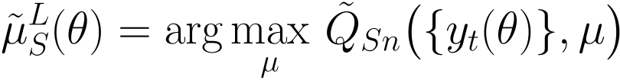

1st Type of Simulation-based II: IL
Real data:
Simulated data:
Simulations of pseudo-data
from the model
Computation of the auxiliary estimator of the model
Distance

Slide 16

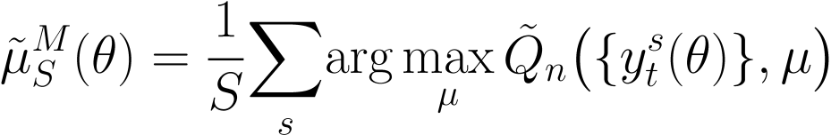
2nd Type of II: IM
Real data:
Simulated data:
Simulations of pseudo-data
from the model
Computation of the auxiliary estimator of the model
Distance

Slide 17
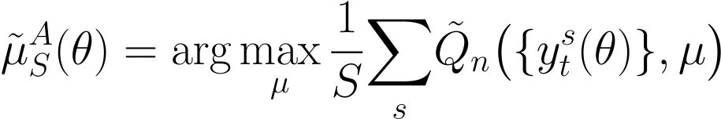
3rd Type of II: IA
Real data:
Simulated data:
Simulations of pseudo-data
from the model
Computation of the auxiliary estimator of the model
Distance

Slide 18

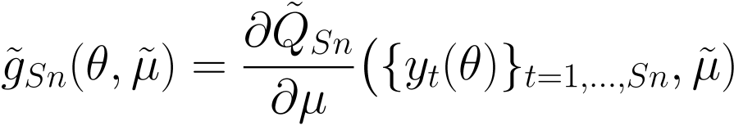
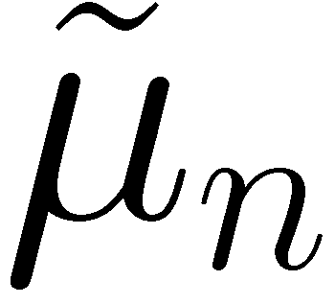
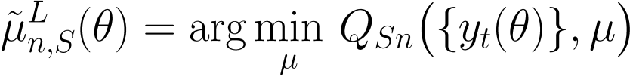

1st Type of EMM: EL
Real data:
Simulated data:
Simulations of pseudo-data
from the model
Computation of the auxiliary estimator and score of the model
Distance

Slide 19
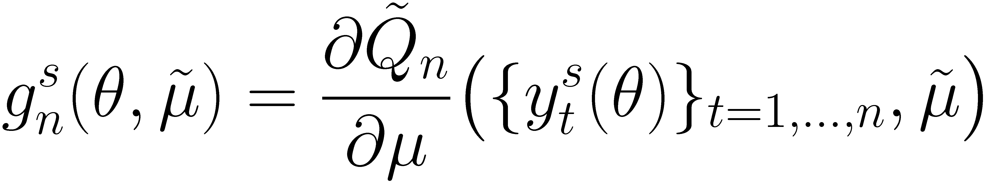
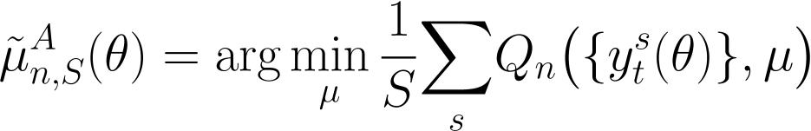
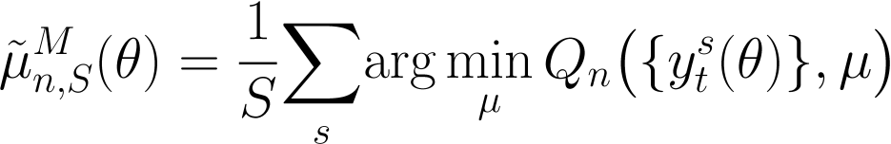
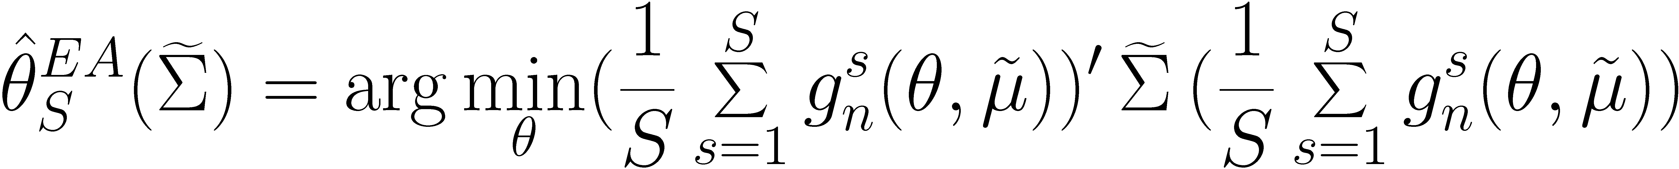
2nd Type of EMM: EA
Real data:
Simulated data:
Simulations of pseudo-data
from the model
Computation of the auxiliary estimator and score of the model
Distance

Slide 20
R Implementation of II
Estimate Euler auxiliary model parameters μ from observed data {y_{t}} by QMLE
Use function EULERloglik() from R package sde
Use R function optim()

Slide 21
R Implementation of II
Simulate from F_{θ}
In general, cannot do exact simulations because transition density is not known
Simulate from very fine Euler discretization
Use function sde.sim() from R package sde
Use custom C code for fast simulation
Need to worry about “inadmissible” or “explosive” simulations from inappropriate θ – need to “bullet proof” the simulator

Slide 22
R Implementation of II
For distance-based II, estimate binding function μ(θ) from simulated data
Use same random number seed for all θ

Slide 23
R Implementation of II
For score-based II, estimate auxiliary score from simulated data and evaluate at auxiliary parameter estimate
User specified function to evaluate score function
Use same random number seed for all θ

Slide 24
R Implementation of II
For distance-based II, estimate θ
For score-based II, estimate
If p = r then use identity matrix for weight matrix
For optimization, use R function optim() with Nelder-Meade simplex algorithm

Slide 25
Illustration
OU Process calibrated to US interest rates used by Phillips and Yu (2009)
θ₁ is the most difficult parameter to estimate

Slide 26
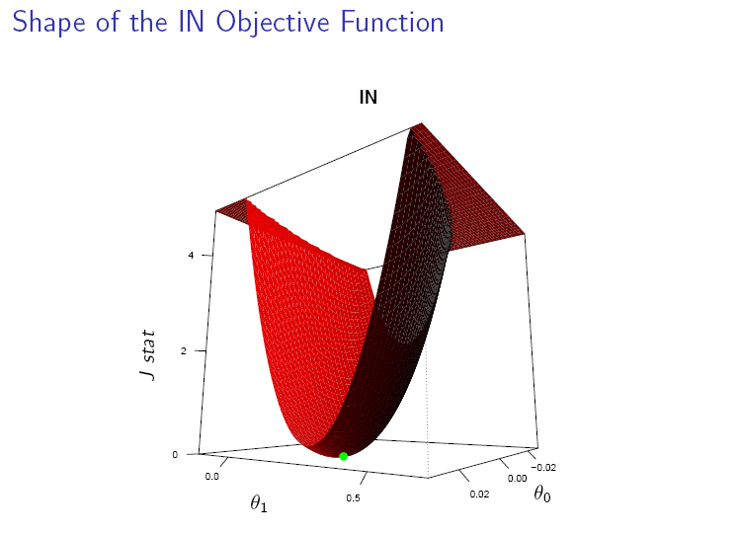
Shape of distance-based II Objective function

Slide 27
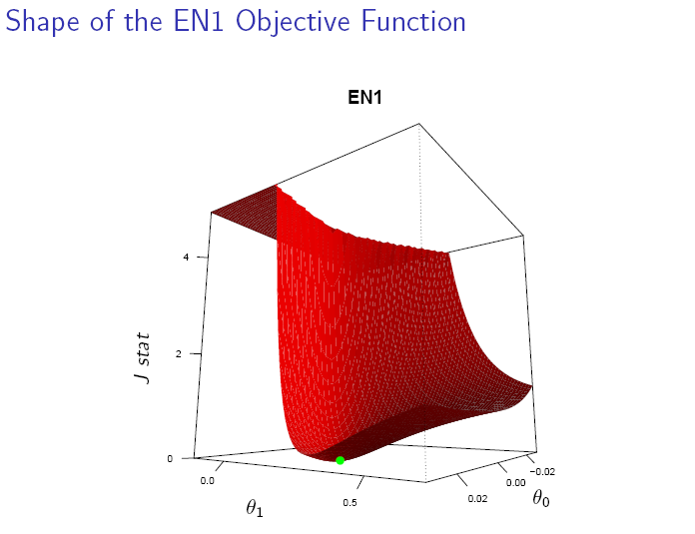
Shape of Gallant-Tauchen Score-based II Objective Function

Slide 28
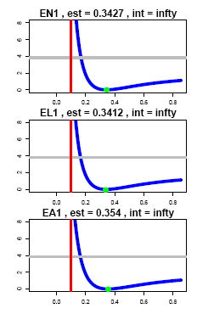
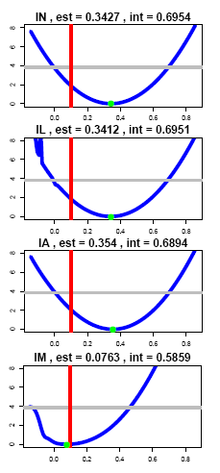
95% Confidence Intervals for θ₁
Note: S = 20 for simulation-based estimates

Slide 29
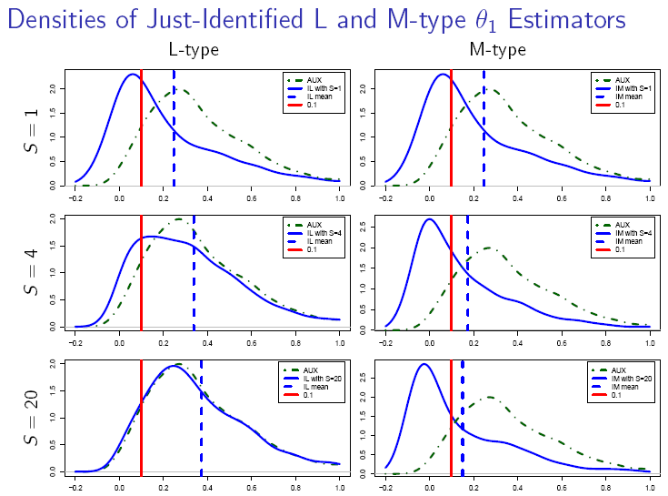
Impact of simulation Size S on Densities of θ₁ Estimates

Slide 30
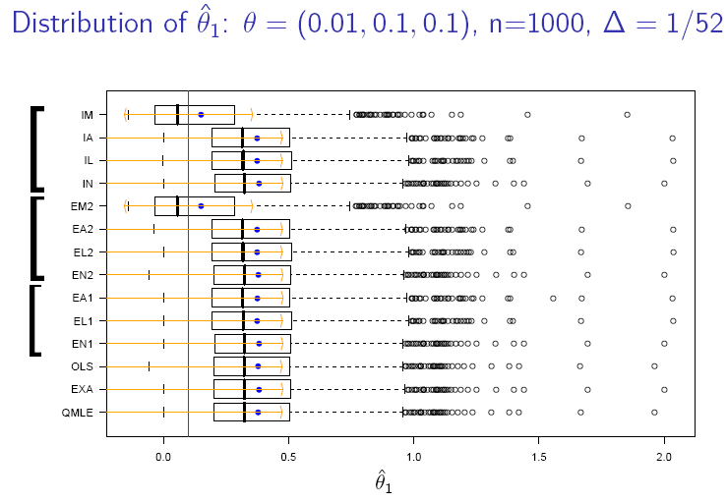

Slide 31
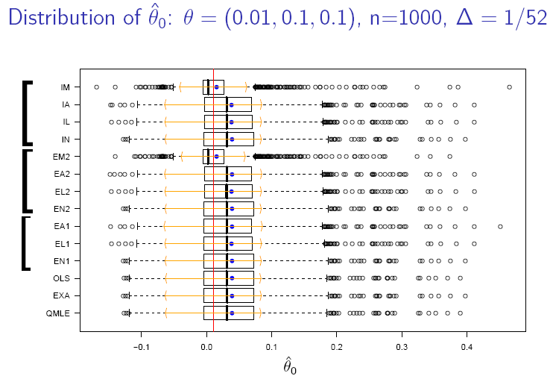

Slide 32
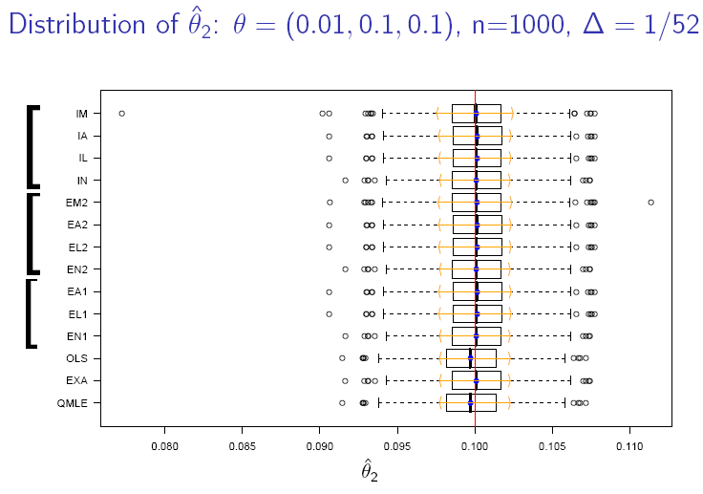

Slide 33
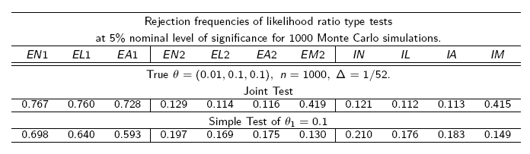

Slide 34
Research in Progress
Fuleky, P., and Zivot, E. (2010). Further Evidence on Simulation Inference for Near Unit Root Processes with Implications for Term Structure Estimation. Manuscript in preparation.
Fuleky, P., and Zivot, E. (2010). Indirect Inference Based on the Score. Manuscript in preparation.
Fuleky, P., and Zivot, E. (2010). indirectInference: R package for indirect inference.

Slide 35
References
Duffee, G. and Stanton, R. (2008). Evidence on Simulation Inference for Near Unit-Root Processes with Implications for Term Structure Estimation. Journal of Financial Econometrics, 6(1):108.
Gallant, A. and Tauchen, G. (1996). Which Moments to Match? Econometric Theory, 12(4):657-81.
Lo, A. (1988). Maximum Likelihood Estimation of Generalized Ito Processes with Discretely Sampled Data. Econometric Theory, 4(2):231-247.
Gourieroux, C. and Monfort, A. (1996). Simulation-Based Econometric Methods. Oxford University Press, USA.

Slide 36
References
Gourieroux, C., Monfort, A., and Renault, E. (1993). Indirect Inference. Journal of Applied Econometrics, 8:S85-S118.
Phillips, P. and Yu, J. (2009). Maximum Likelihood and Gaussian Estimation of Continuous Time Models in Finance. Handbook of Financial Time Series.
Smith Jr, A. (1993). Estimating Nonlinear Time-Series Models Using Simulated Vector Autoregressions. Journal of Applied Econometrics, 8:S63-S84.

