Slide 1
Trader's DFA
Marc Wildi - Statistician and Economist
Kent Hoxsey - Programmer and Trader
A Practioner's Introduction
to the Direct Filter Approach

Slide 2
Signalextraction
Noise
Filter
Signal

Slide 3
Signal
Notes:
Trend/SA

Slide 4
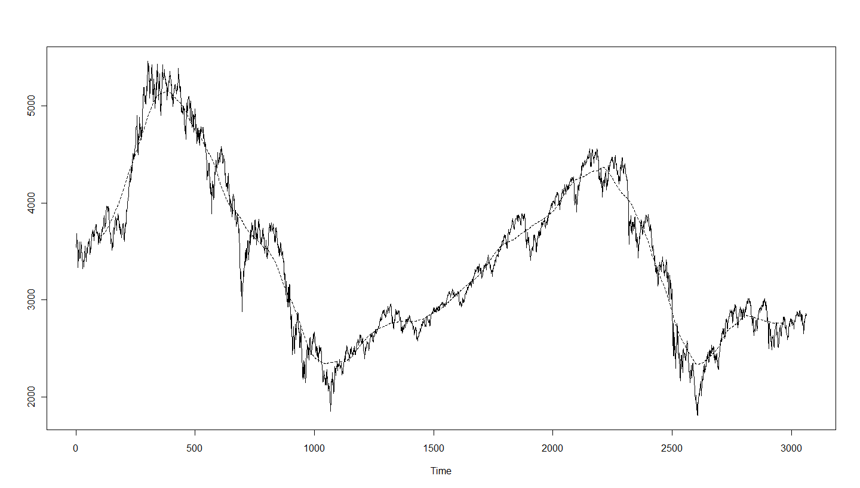
Eurostoxx50, MA(200) Equal-Weights (Faber 2009)

Slide 5
Real-Time Signalextraction
Notes:
Tight connection between `forecasting’ and (real-time) signal extraction

Slide 6
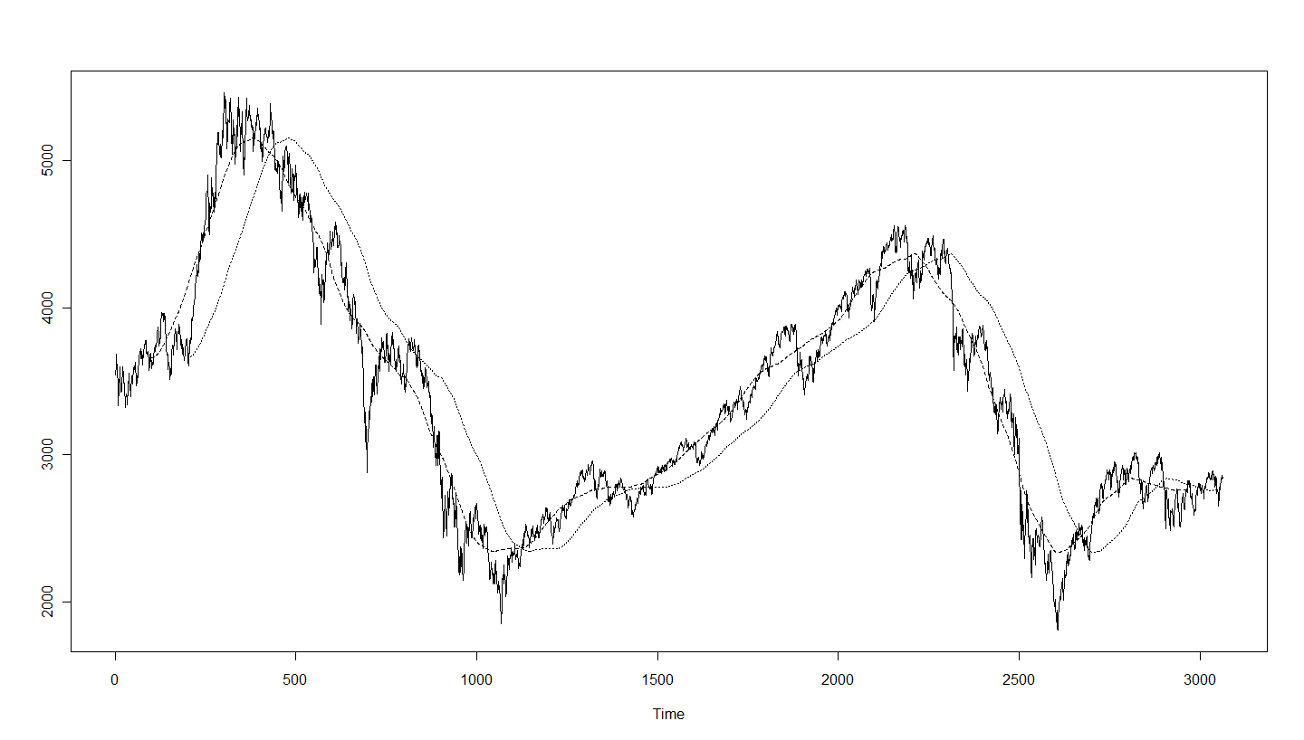
Eurostoxx50, MA(200) Symmetric and MA(200) Real-Time

Slide 7
Real-Time Perspective
Turning-points (trades) are delayed
Performances affected
Delay could be decreased by selecting shorter filters
Generate more `false’ alarms
Performances affected
Tradeoff: speed/timeliness vs. smoothness/reliability

Slide 8
Frequency Domain
Timeliness
Reliability
Both!

Slide 9
Real-Time Signalextraction Frequency Domain

Slide 10
Optimization Criterion: Mean-Square

Slide 11
Objectives
Real-time filters which are `fast’
Detect turning-points timely
Real-time filters which are `reliable’
Impose strong noise suppression

Slide 12
Cosine Law applied to

Slide 13
Decomposition of Mean-Square Criterion
Notes:
Lambda=1, lambda>1. No traditional time-domain model-based approach can do that!
Useful asymmetry: account for positive time-shifts only (mean-square is symmetric and does not discriminate leads from lags: both are to be avoided)

Slide 14
Timeliness and Noise Suppression
Notes:
Lambda=1, lambda>1. No traditional time-domain model-based approach can do that!
Useful asymmetry: account for positive time-shifts only (mean-square is symmetric and does not discriminate leads from lags: both are to be avoided)

Slide 15
Control: Interfacing with the Criterion
Notes:
Lambda=1, lambda>1. No traditional time-domain model-based approach can do that!
Useful asymmetry: account for positive time-shifts only (mean-square is symmetric and does not discriminate leads from lags: both are to be avoided)

Slide 16
Latest Developments (2011,2012)
Fast closed-form solutions
I-MDFA
Generic Approach
Replicate model-based approaches, HP-designs, CF-designs (see http://blog.zhaw.ch/idp/sefblog)
Customize traditional mean-square approaches
Alleviate/control overfitting
Regularization
Rmetrics-2012

Slide 17
Background
SEFBlog:
http://blog.zhaw.ch/idp/sefblog
Articles, books, applications, R-code, tutorials
Recent Articles:
Wildi/McElroy (2012)
http://blog.zhaw.ch/idp/sefblog/index.php?/archives/263-On-a-Trilemma-Between-Accuracy,-Timeliness-and-Smoothness-in-Real-Time-Forecasting-and-Signal-Extraction.html
Wildi (2012)
http://blog.zhaw.ch/idp/sefblog/index.php?/archives/262-Up-Dated-I-MDFA-Code-and-Working-Paper.html

Slide 18
Background
R-Code/tutorials
Check the categories `I-MDFA code repository’ or `tutorial’ on SEFBlog
Macro-indicators
http://www.idp.zhaw.ch/usri
http://www.idp.zhaw.ch/euri
Trading
http://www.idp.zhaw.ch/MDFA-XT
http://blog.zhaw.ch/idp/sefblog/index.php?/archives/157-A-Generalization-of-the-GARCH-in-Mean-Model-Vola-in-I-MDFA-filter.html

Slide 19
A Hybrid Approach
iMetrica
Access to State Space, ARIMA, I-MDFA, Stochastic Volatility, Hybrid
Chris Blakely: www.cd-blakely.com

Slide 20
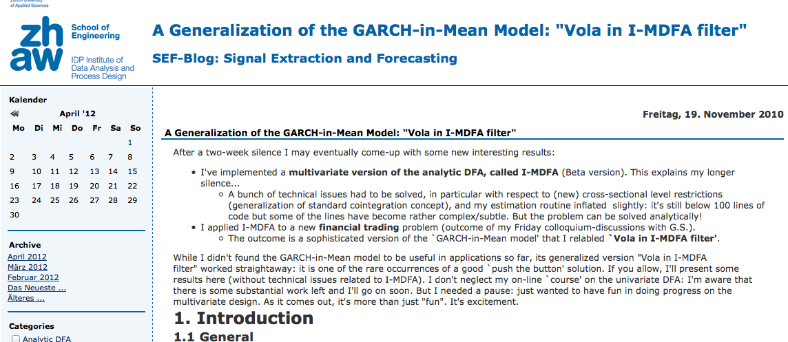
Vola in I-MDFA
Described in a blog post, and then in more detail later in a conference presentation.
http://blog.zhaw.ch/idp/sefblog/index.php?/archives/157-A-Generalization-of-the-GARCH-in-Mean-Model-Vola-in-I-MDFA-filter.html
Notes:
ckh: add links to the various mentions, pull in a chart or two from the prototype

Slide 21
Exercise: Reproduce the Example
Code available on SEF-Blog at:
http://blog.zhaw.ch/idp/sefblog/uploads/Vola_in_I-MDFA_prototype1.r
Runs as-is, but you need a "trading" function
Zero-crossing function:
start with your filter weights and data series
create a vector of NAs as long as your index to be your signal
set signal to 1 where filtered data > 0
set signal to 0 where filtered data < 0
fill your NAs - na.locf() is your best friend
Not sophisticated, but tricky: watch your lags
Veddy importante: signal *today* means returns *tomorrow*

Slide 22
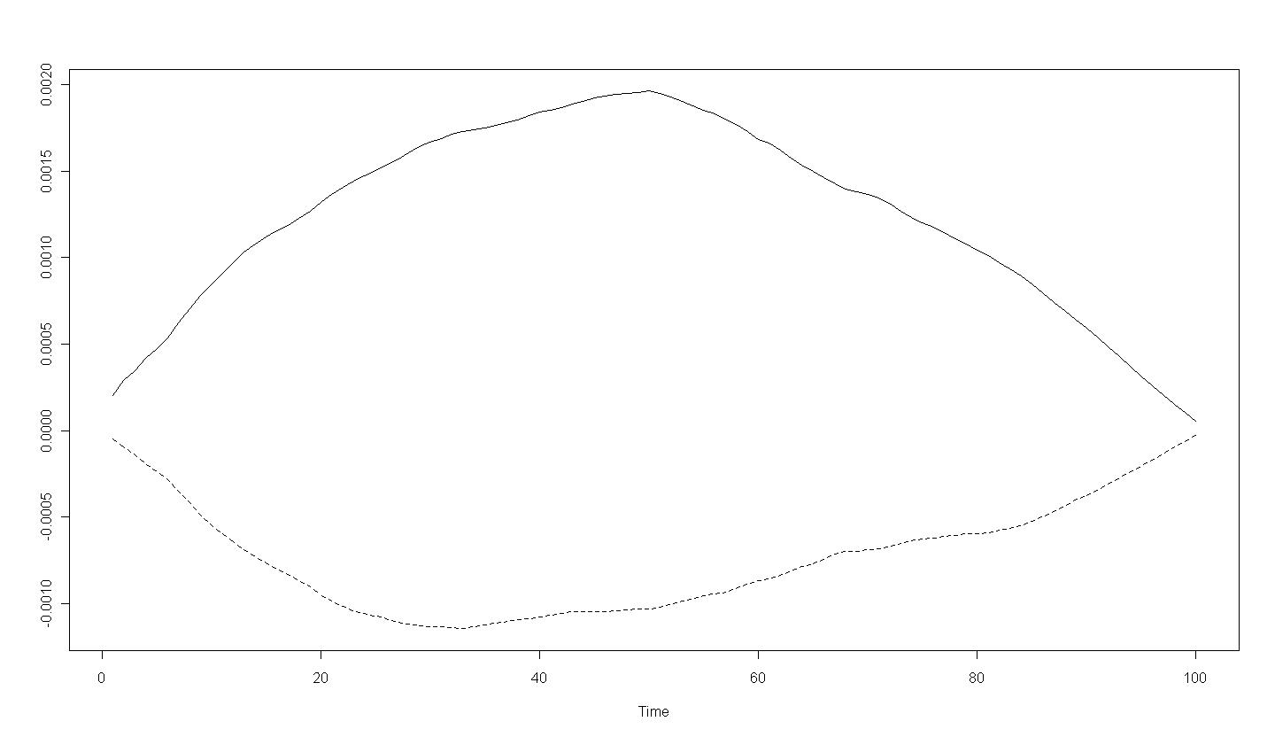
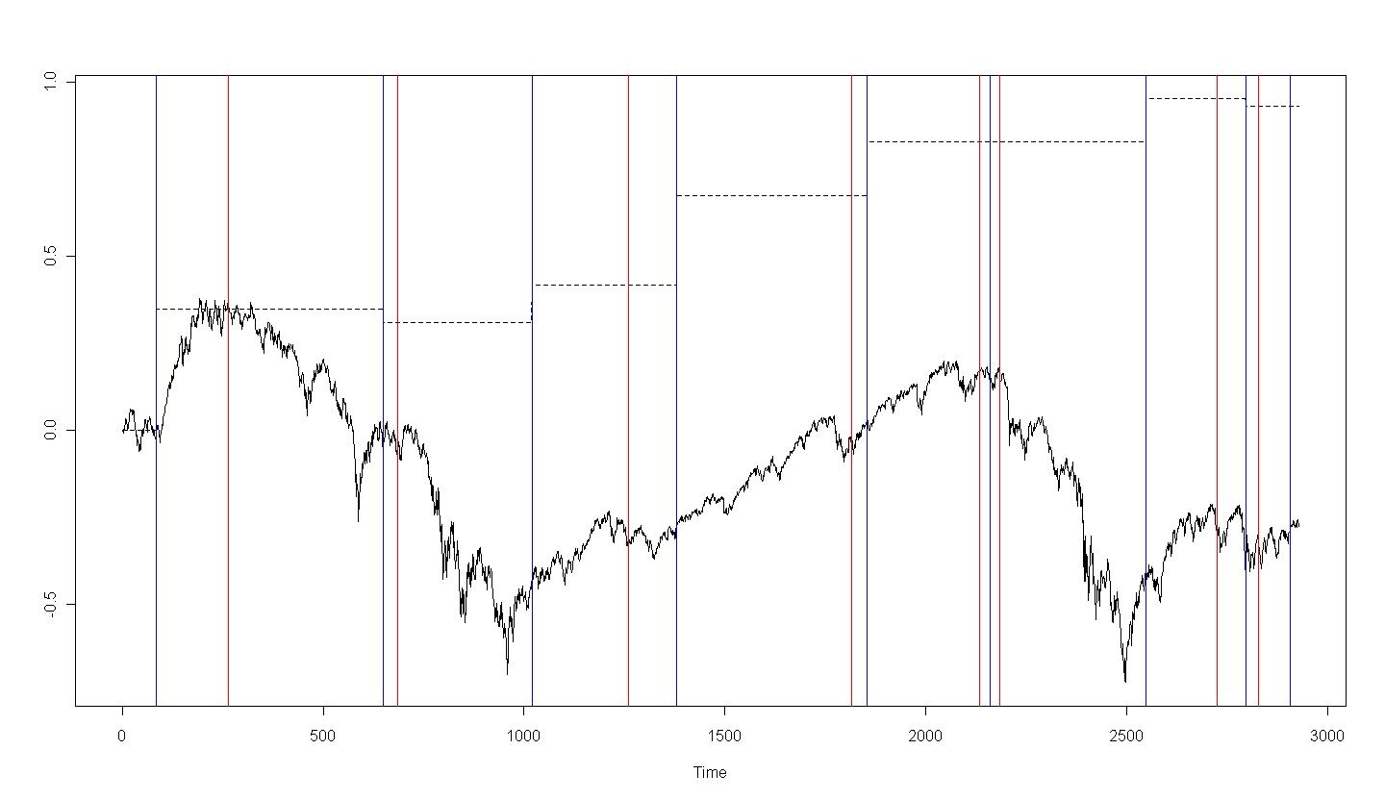
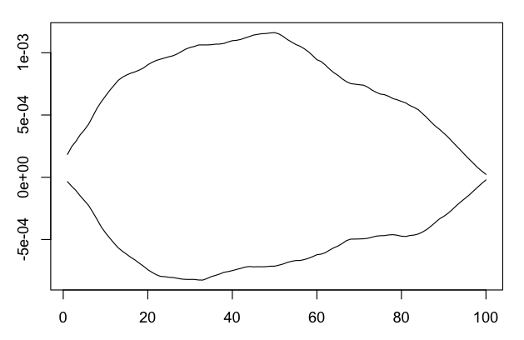
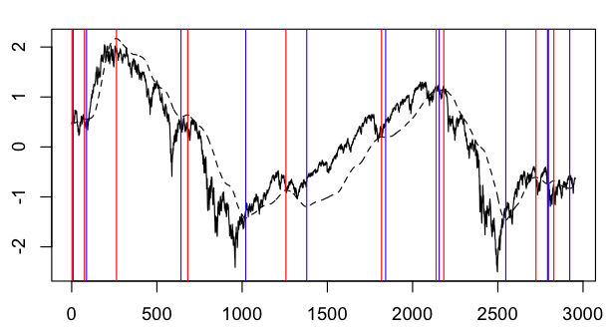
Exercise: Reproduce the Example (2)
Notes:
marc's images from blog (top)
my reproductions - bottom

Slide 23
Corollary: Understand the Behavior
Reference code runs a multi-stage loop
calculates filters for combinations of params
runs an optimizer over the param space
Effective, but not illuminating for me
parameter changes not intuitive (for me)
needed a feel for sensitivity
And I just happen to have a lot of machines...
easy code changes: expand.grid and foreach
lots of cpu time
eventually, lots of results
Notes:
note that marc mentions a week of effort for
the second customized solution

Slide 24
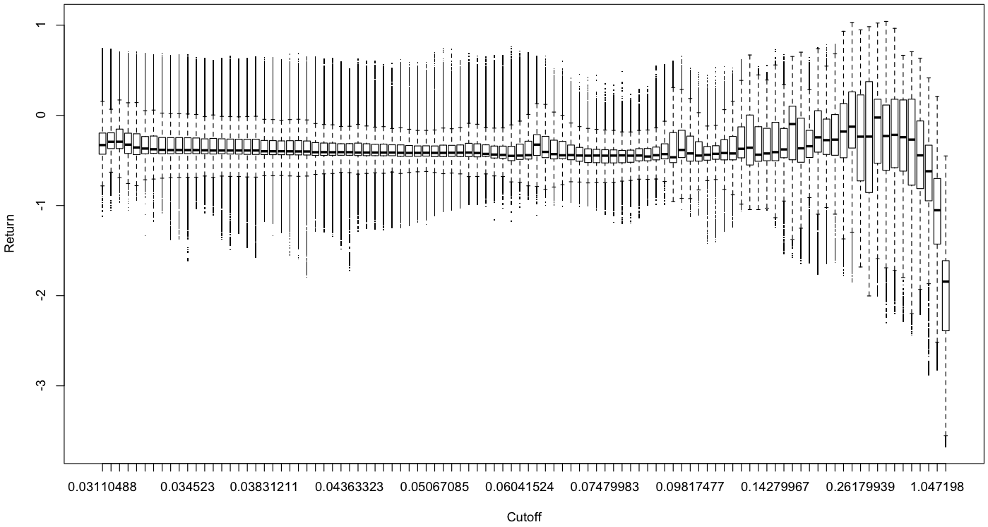
Finale: Descend into Obsession
Notes:
cutoff, all

Slide 25
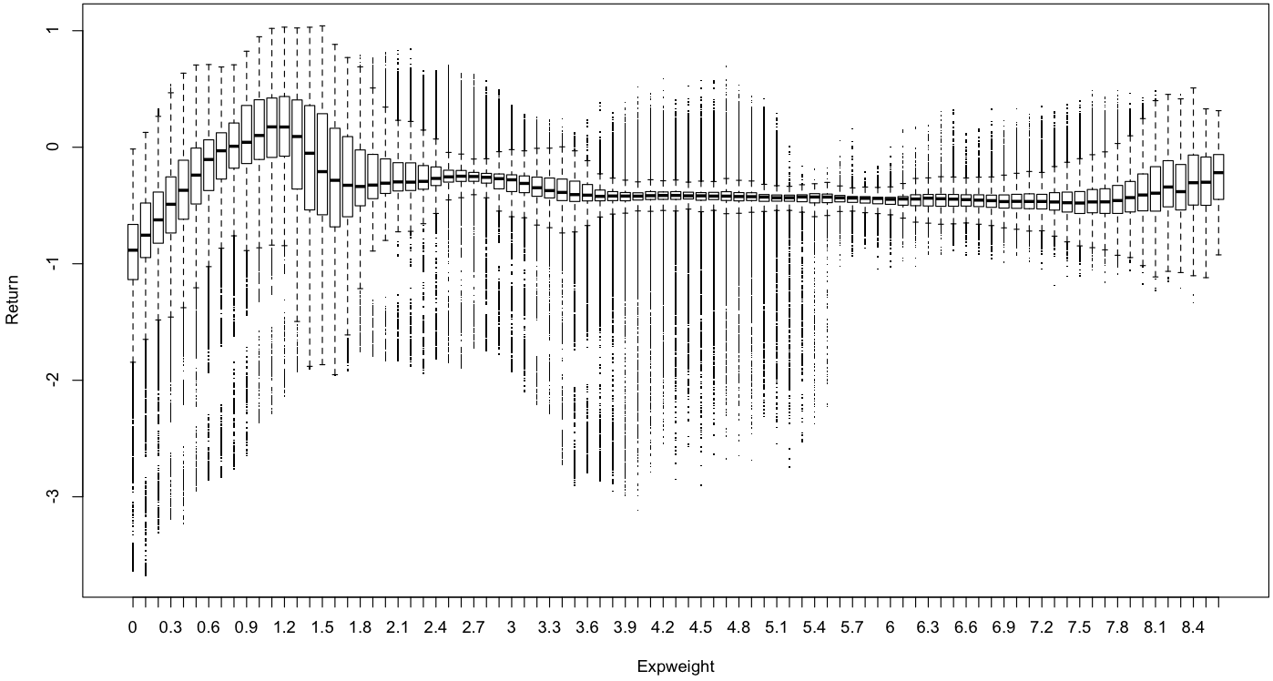
Finale: Descend into Obsession
Notes:
expweight, all

Slide 26
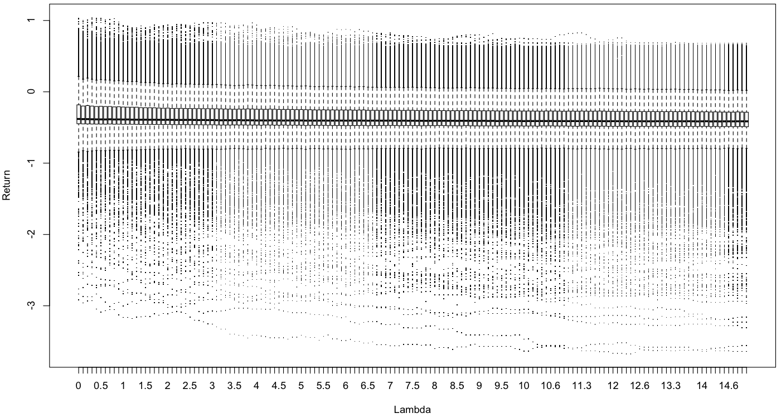
Finale: Descend into Obsession
Notes:
lambda, all

Slide 27
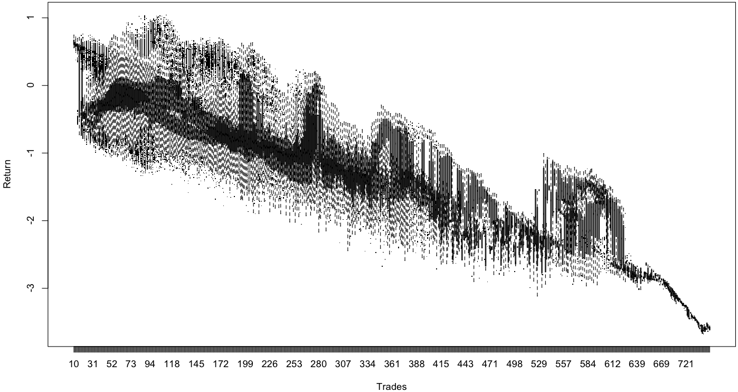
Finale: Descend into Obsession
Notes:
trades, all

Slide 28
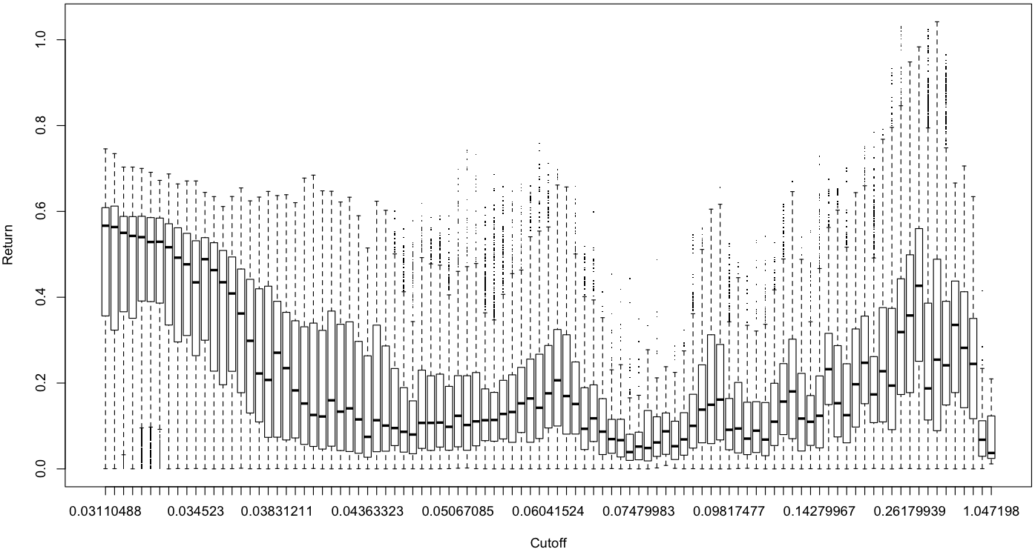
Finale: Descend into Obsession
Notes:
cutoff, positive only

Slide 29
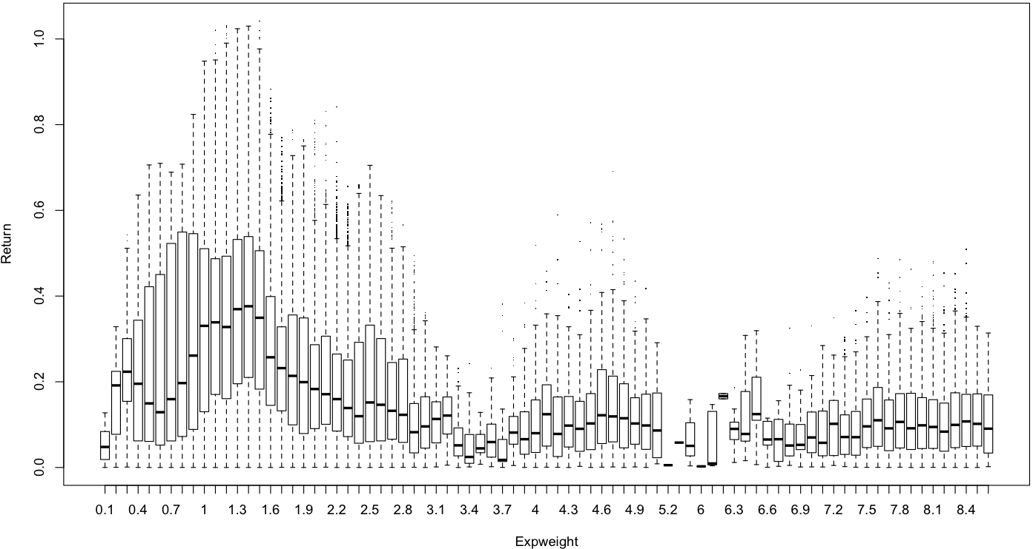
Finale: Descend into Obsession
Notes:
xpw, positive only

Slide 30
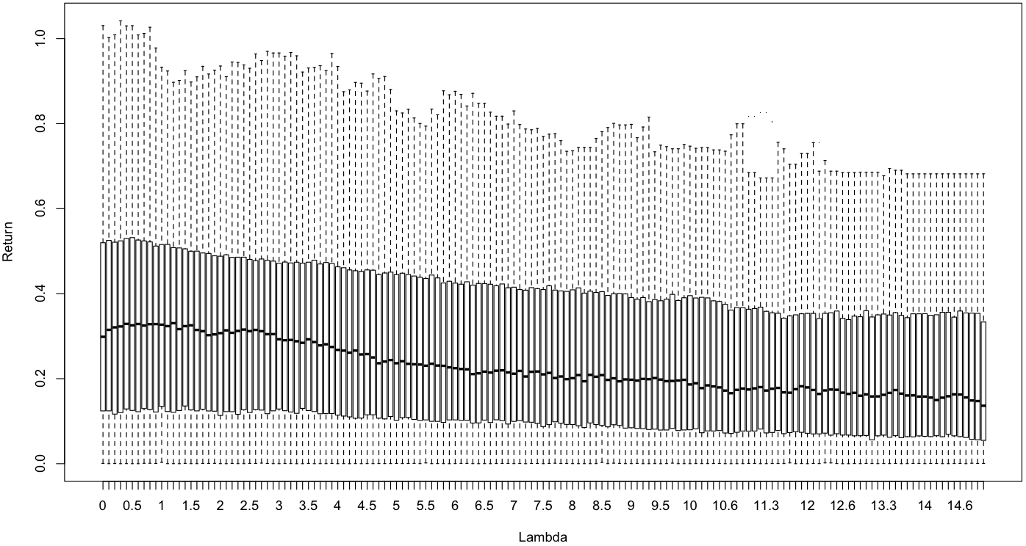
Finale: Descend into Obsession
Notes:
lambda, positive only

Slide 31
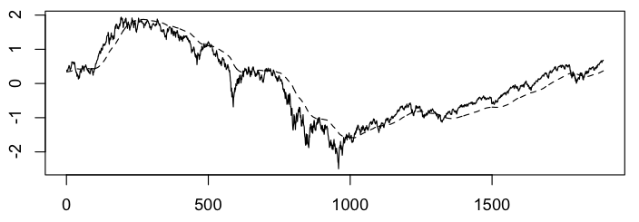
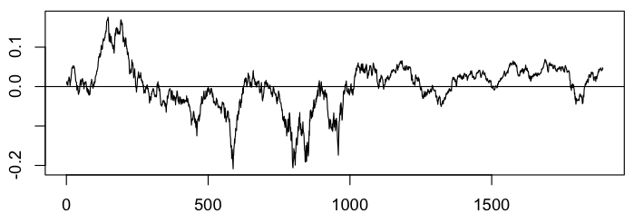
Results: Qualitative Analysis of M/S
Notes:
Mean-square filter for cutoff <- pi/100
Lame quantitative performance
Reasonable qualitative performance

Slide 32
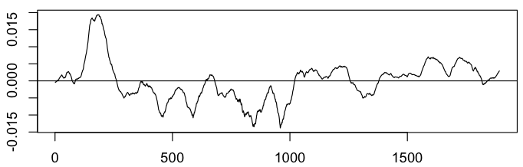
Results: Qualitative Analysis of M/S
Notes:
Now compare M/S filter (bottom) with smoothed (top)
Much fewer whipsaws. Much cleaner.

