Slide 1

MONETARY POLICY ANALYSIS BASED ON LASSO-ASSISTED VECTOR AUTOREGRESSION (LAVAR)
Jiahan Li
Assistant professor of Statistics
University of Notre Dame
R/Finance 2012

Slide 2
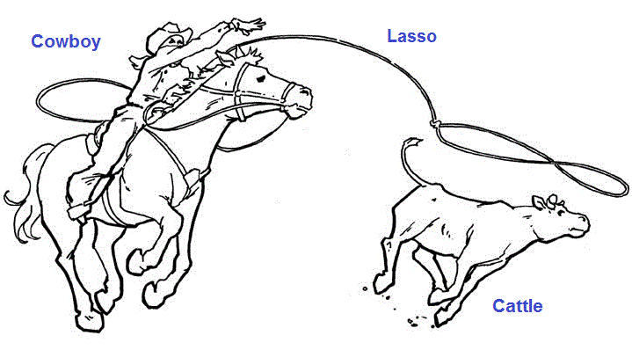

Slide 3
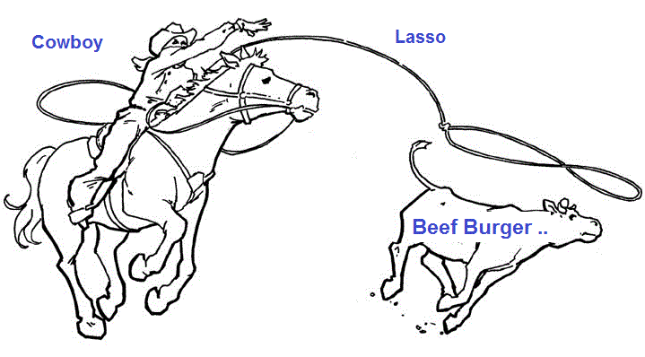

Slide 4
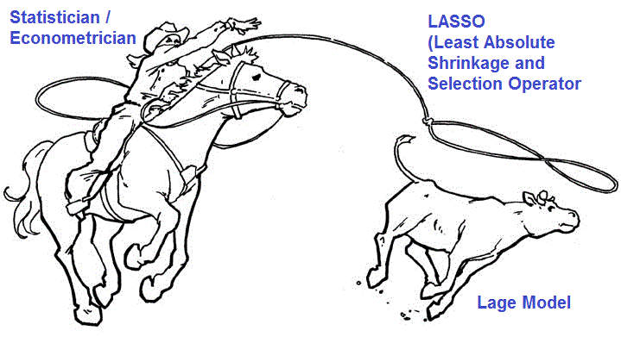

Slide 5

Motivation
Large models with many parameters
Large vector autoregressions
Multivariate GARCH
Dynamic correlation models
Do NOT try to estimate all parameters
Some parameters are estimated exactly as zero

Slide 6
Lasso (a model selection tool)
y_{i} = x_{1i}*b₁ + … + x_{pi}*b_{p} + error_{i}, p ~ n, or p > n
Option 1: Least squares
Option 2: Least squares with constraint: |b₁|+ … + |b_{p}| < S
Result: A subset of (b₁ ,... ,b_{p}) will be estimated exactly as 0
Result: small S gives fewer nonzero estimates
1000 parameters
50 nonzero parameters estimates
Lasso regression

Slide 7
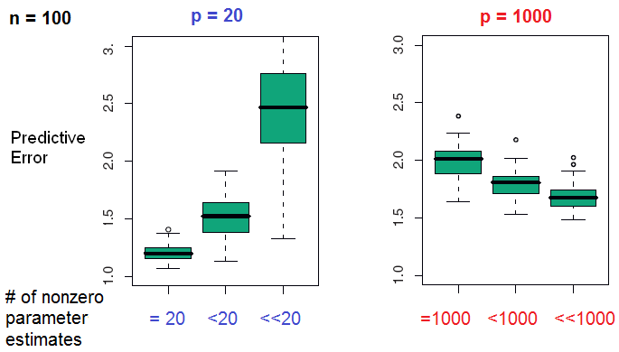
Fewer nonzero parameters
Simple model
Better predictions

Slide 8
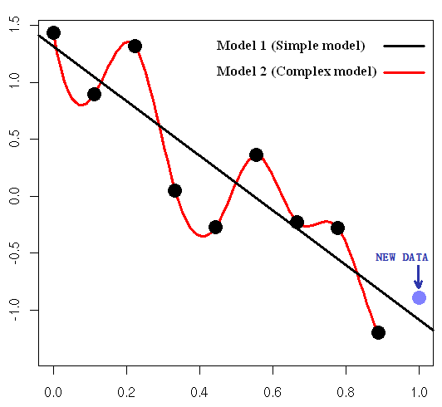
Fewer nonzero parameters
Simple model
Better predictions

Slide 9
Take-home message..
Be cautious when fitting complex models
If you are greedy in estimation, the prediction will NOT be optimal.

Slide 10
Applications
Forecast short-term interest rate
Forecast yield curve (by no-arbitrage assumption)
Forecast the effects of monetary policy
Forecast monthly foreign exchange return
Forecast the bond risk premia
Forecast the equity risk premia

Slide 11
Monetary policy
Monetary policy: Central banks’efforts to promote economic growth and stability
Policy instrument: federal funds rate (short-term interbank lending rate)
Federal funds target rate is determined by the Federal Open Market Committee
Effective federal funds rate is controlled by money supply

Slide 12
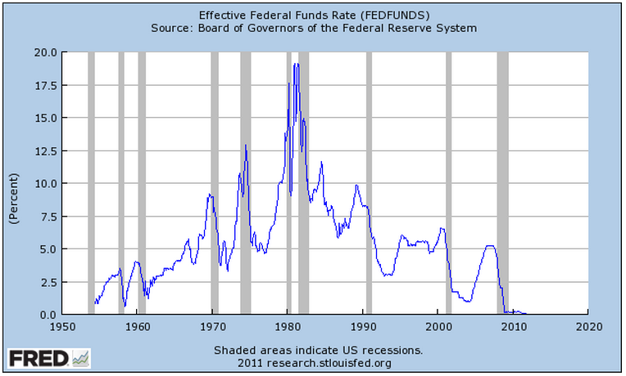
Federal fund rate (FFR)
Data Source: Federal Reserve Bank of St. Louis

Slide 13
Monetary policy
Goal of monetary policy (in U.S.):
Maintain stable prices and low unemployment rate

Slide 14
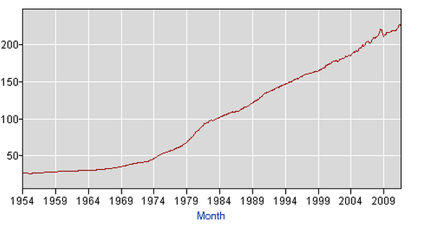
Consumer Price Index (CPI)
Data Source: Bureau of Labor Statistics Data

Slide 15
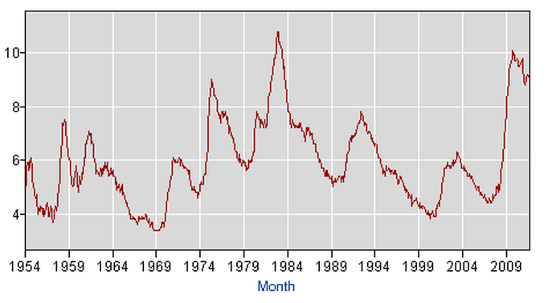
Unemployment rate
Data Source: Bureau of Labor Statistics Data

Slide 16
Monetary policy
Goal of monetary policy (in U.S.):
Maintain stable prices and low unemployment rate
Goal of monetary policy analysis:
1. Predict the change of federal funds rate
2. Based on the predictions, estimate its effects on the whole economy

Slide 17
Monetary policy analysis
Monetary policy analysis measures the quantitative effects of increasing / decreasing federal funds rate on the rest of the economy
Prices levels, Economic activities, Money supplies, Consumptions, Exchange rate, Employment, Unemployment, Consumer expectations, …
federal funds rate

Slide 18
Monetary policy analysis
Vector Auto-Regression (VAR)
Three categories of VAR models
Low-dimensional VAR
Factor-augmented VAR (FAVAR)
LASSO-assisted VAR (LAVAR)

Slide 19
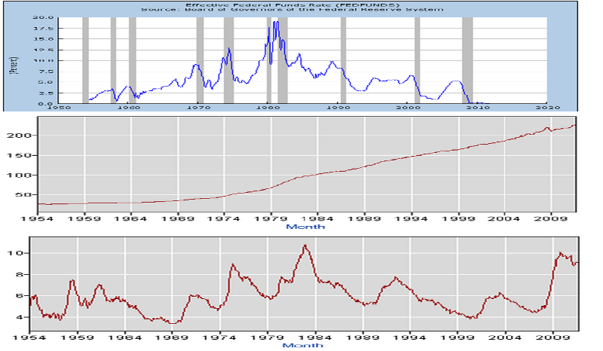
Low-dimensional VAR

Slide 20

Low-dimensional VAR
Vector regression (lag p)
This system of equations characterize the interplay of CPI, Unemployment rate and FFR.

Slide 21

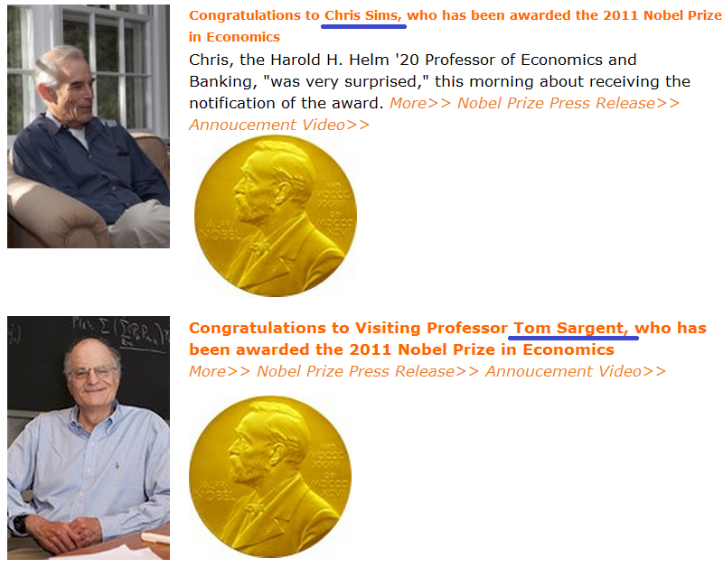

Slide 22
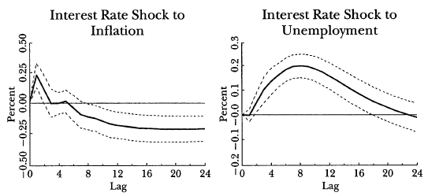
Vector autoregression
Impulse response functions
An example from Stock and Watson (2001)

Slide 23
Problems
Low-dimensional VAR characterizes the interplay of CPI, Unemployment rate and FFR
More than 3 variables are monitored by central banks and market participants.
High-dimensional VAR in a data-rich environment.

Slide 24
Data (120 time series)
Real output and income | 21
Employment and hours | 27
Consumption | 5
Housing starts and sales | 7
Real inventories, orders and unfilled orders | 5
Stock prices | 7
Exchange rates | 4
Interest rates | 15
Money and credit quantity aggregates | 10
Price indexes | 16
Average hourly earnings | 2
Consumer expectation | 1
 | 120

Slide 25
Monetary policy analysis
Vector Auto-Regression (VAR)
Three categories of VAR models
Low-dimensional VAR
Factor-augmented VAR (FAVAR)
LASSO-assisted VAR (LAVAR)

Slide 26
Factor-augmented VAR (FAVAR)
Bernanke, Boivin and Eliasz (2005)
Use principle component analysis (PCA)
K is usually 3 or 5
120 macroeconomic data series
K dynamic factors
Principle component analysis

Slide 27
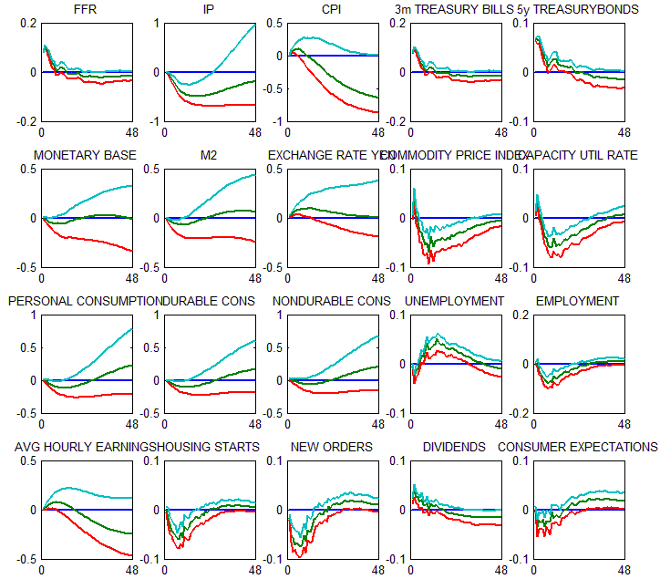
Impulse
Response Functions from 3-factor FAVAR

Slide 28
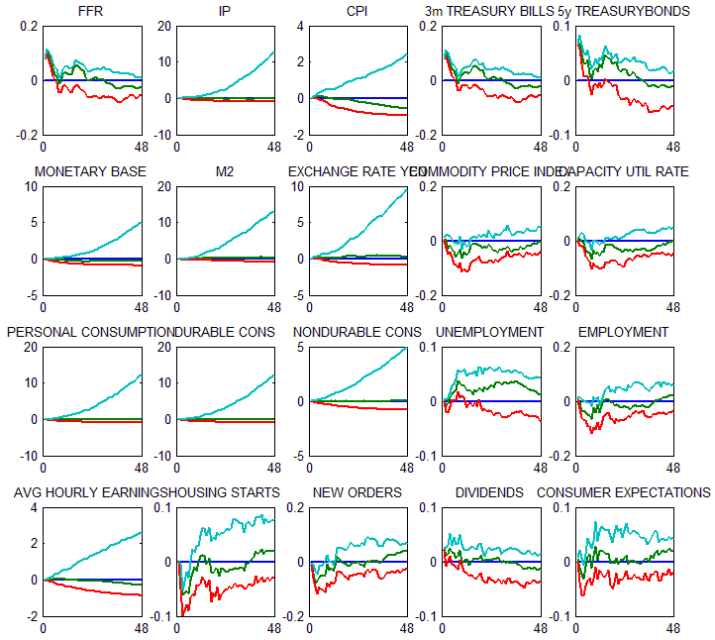
20 factors
Impulse
Response Functions from 20-factor FAVAR

Slide 29
Problem of FAVAR
Bad inference !
More factors
More information in VAR
Too many parameters give high-dimensional VAR again

Slide 30
Monetary policy analysis
Vector Auto-Regression (VAR)
Three categories of VAR models
Low-dimensional VAR
Factor-augmented VAR (FAVAR)
LASSO-assisted VAR (LAVAR)

Slide 31

Lasso estimation
# of nonzero estimates < 120*120 = 14400, which is determined by S
S is further determined by data (data-driven method)
Fewer nonzero parameters
Simple model
Better predictions

Slide 32
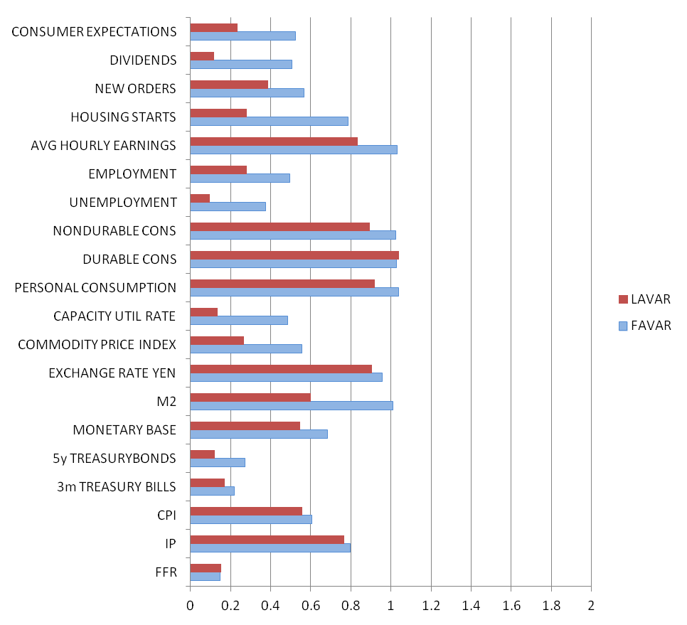
Error of
in-sample fit from January 1959 to August 1996

Slide 33
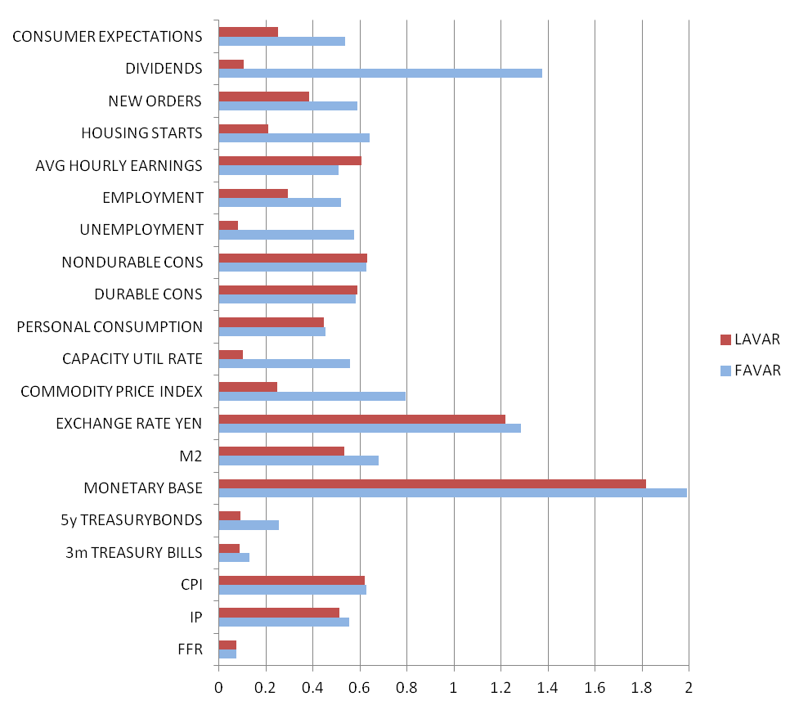
Predictive error of
one-step ahead forecasts over 60 months after
August 1996

Slide 34
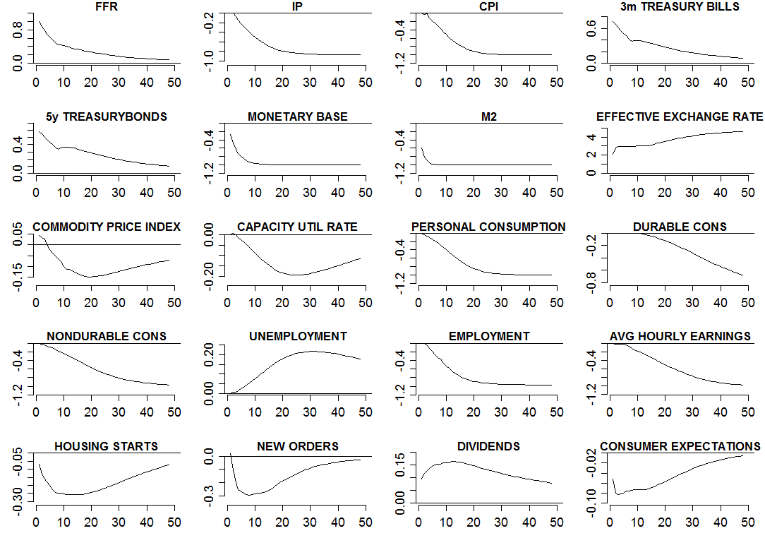
Impulse Response Functions

Slide 35
Other applications of lasso
Forecast FX rates, bond risk premia, equity premia by selecting important predictors
R Package: lars, elasticnet, glmnet

Slide 36

Thank you!

Slide 37
