Slide 1
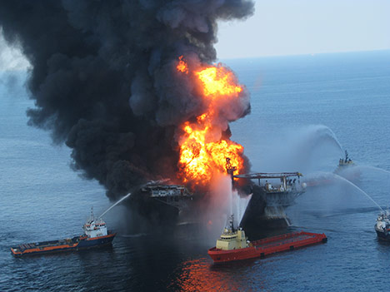
Liquid Gold, Illiquid Assets: Hedging Event Risk in Fixed Income Securities— BP Bonds in the Oil Disaster of 2010

Slide 2
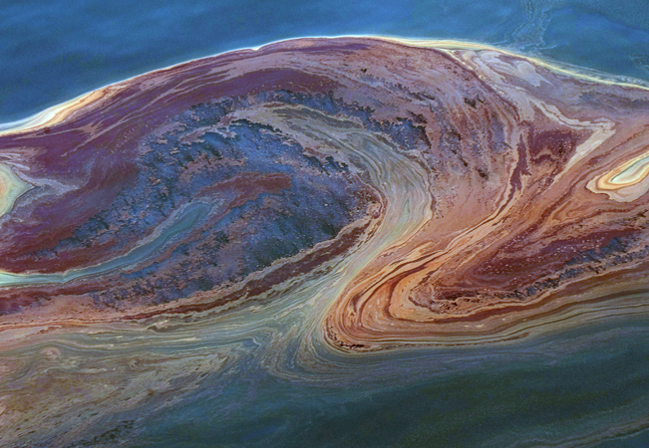
William Casey King, PhD
Yale University
Phronesis, LLC
Michael J. Kane, PhD
Yale University
Phronesis, LLC

Slide 3
Corporate Bonds
The corporate bond market: roughly 6.3 trillion dollars
Larger than the US Treasury bond market and municipal bond markets combined

Slide 4
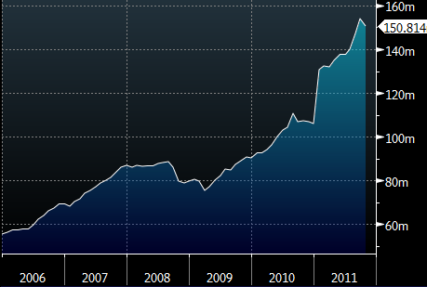
Not Just for Institutional Investors Anymore: Growth in Corporate Bond Mutual Fund Assets Source: Investment Co. Institute, Bloomberg

Slide 5
Why the Sudden Interest?
Corporate Bonds are seen as safer investment alternatives to equities
The most significant “risk” in corporate bonds is interest rate risk
While interest rate risk does not concern investors who hold bonds to maturity, for the active trader it is considered the primary concern, and something that needs to be hedged against

Slide 6
Traditional Corporate Bond Hedge:
Treasury instruments
Effective hedge for interest rate fluctuations

Slide 7
But a trader is not fully hedged if he or she hedges against interest-rate risk alone

Slide 8
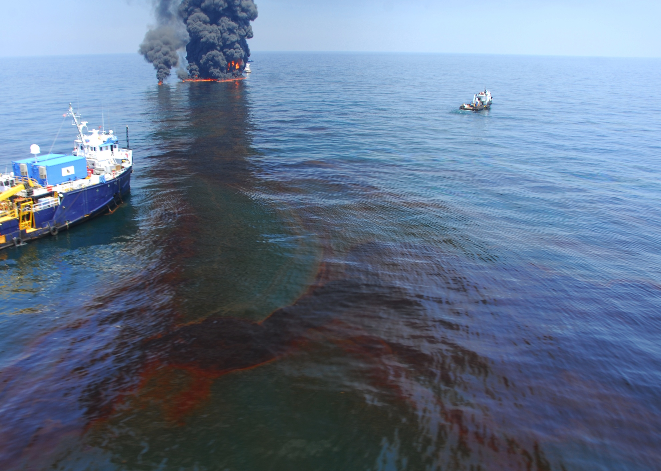

Slide 9
Financial Times
May 12, 2012
“Fixed income traders face risk model change”
By Brooke Masters, Chief Regulation Correspondent
“Under the “fundamental review” proposed by the Basel Committee on Banking Supervision, banks around the world would have to rewrite their risk models for assets they plan to buy and sell to take into account rare but damaging events”

Slide 10
Possible Solution:
Mixed-Asset Hedging
Why not use a combination of treasuries and equity instruments to hedge risk in corporate bonds?
Treasuries-interest rate hedge
Equities-event risk hedge

Slide 11
Some Attempts at Mixed-Asset Hedging Models:
1986-R. Grieves, “Hedging Corporate Bond Portfolios,” Journal of Portfolio Management
1999-Michalis Ioannides and Frank Skinner, “Hedging Corporate Bonds,” Journal of Business Finance and Accounting
2000-Andrew Clare, Frank Skinner and Michalis Ioannides, “Hedging Corporate Bonds with Stock Index Futures: A Word of Caution,” Journal of Fixed Income

Slide 12
To Date, No One Has Considered the Application of a Complex Event Processing Engine to Fixed Income Hedging

Slide 13

CASE STUDY: British Petroleum Bonds 2010

Slide 14
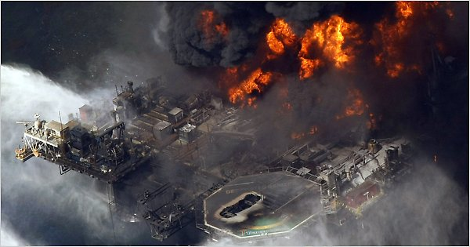
Dow Jones Ticker: April 21, 2010 9:22AM GMT
Dow Jones News Feed
April 21, 2010
“Transocean Rig Drilling For BP In US Gulf Hit By Explosion"

Slide 15

British Petroleum Stock: April, 2010 Share Price
April 20, 2010……………Explosion……………………...........59.49
April 21, 2010……………Coast Guard Report………………59.10
April 22, 2010……………Rig Sinks……………………………… 58.57
April 23, 2010………….. Slick Grows to 1x12 miles……..58.90
April 24, 2010……………Saturday…………………………………….….
April 25, 2010……………Sunday…………………………………….…….
April 26, 2010……………Spill Estimate Increase………..…56.96
April 27, 2010…………...BP “Long Struggle Likely”………55.41
April 28, 2010…………...Efforts To Contain Slick Falter..56.40
April 29, 2010……………LA State of Emergency…………..51.70
April 30, 2010……………BP seen as “oversold”…………...51.29

Slide 16
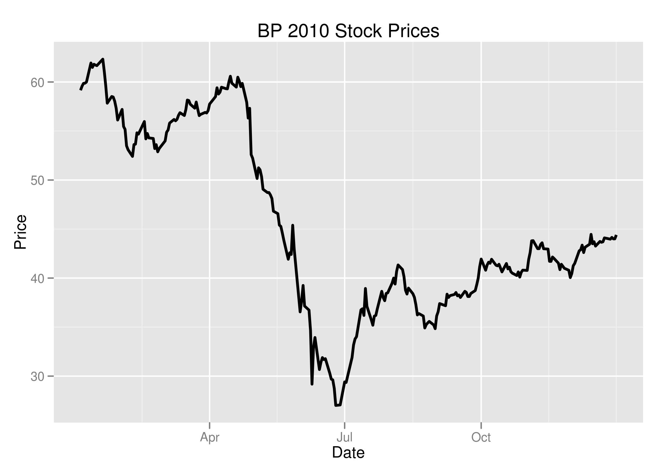
British Petroleum Stock Price 2010
June 25, 2010
BP SHARES: $27.02

Slide 17
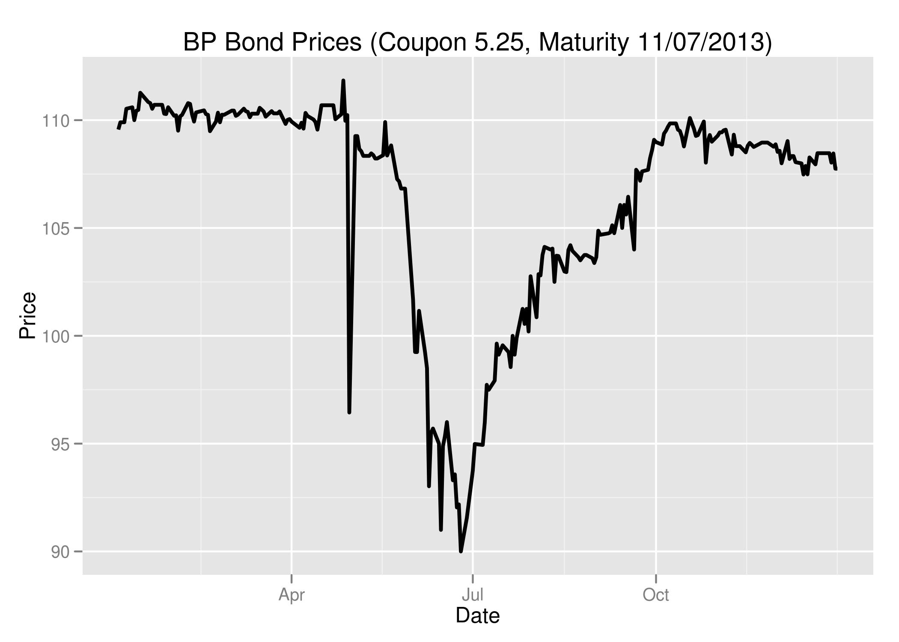
BP 5.25’s of 13

Slide 18
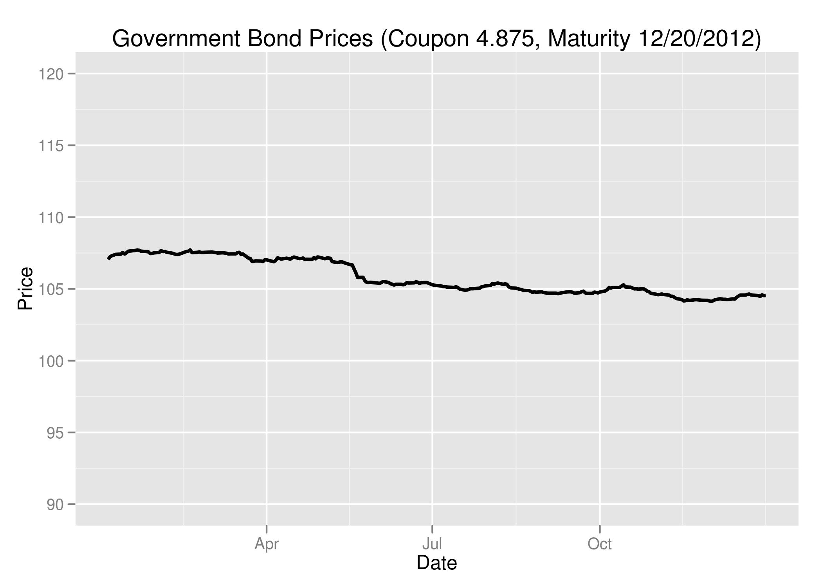
Government Bond 4.875’s of 12

Slide 19
Example: Traditional Hedge
Long: 5 Million Dollars, BP 5.25, 11/07/2013
Short: 5 Million Dollars, Gov. 4.875, 12/20/2012
Result: Not an Effective Hedge:
Net Loss: 750,000 USD (6/28/10)

Slide 20
Mixed-Asset Alternative:
Long 5 Million BP 5.25, 11/07/2013
Short 5 Million Gov. 4.875, 12/20/2012
Short $1.6million BP Stock (4/21/10)
Effectively Hedged
No Loss
Profit of roughly 1.3% (150,000)

Slide 21
How do you know how much stock to short?
Our analysis of oil disasters in the past twenty years reveals that oil stocks rebound after hitting a 9% loss.
Caveat: Historic data. Historic data on catastrophic events short of default provides a model, not an absolute answer.

Slide 22
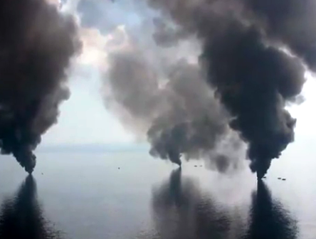
How can you hedge event risk without carrying stock, or other equity instruments?

Slide 23
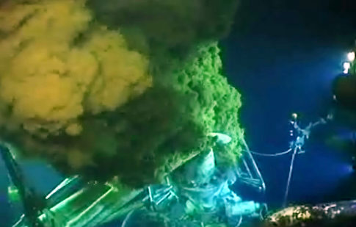
Answer:
Automated response to news feed in real time.

Slide 24
Mixed-Asset Hedge Demands Quick Response and a Carefully Tailored Sentiment Analysis
At Phronesis, we have developed a sector-by-sector proprietary lexicon that signals catastrophic event for different corporate sectors

Slide 25
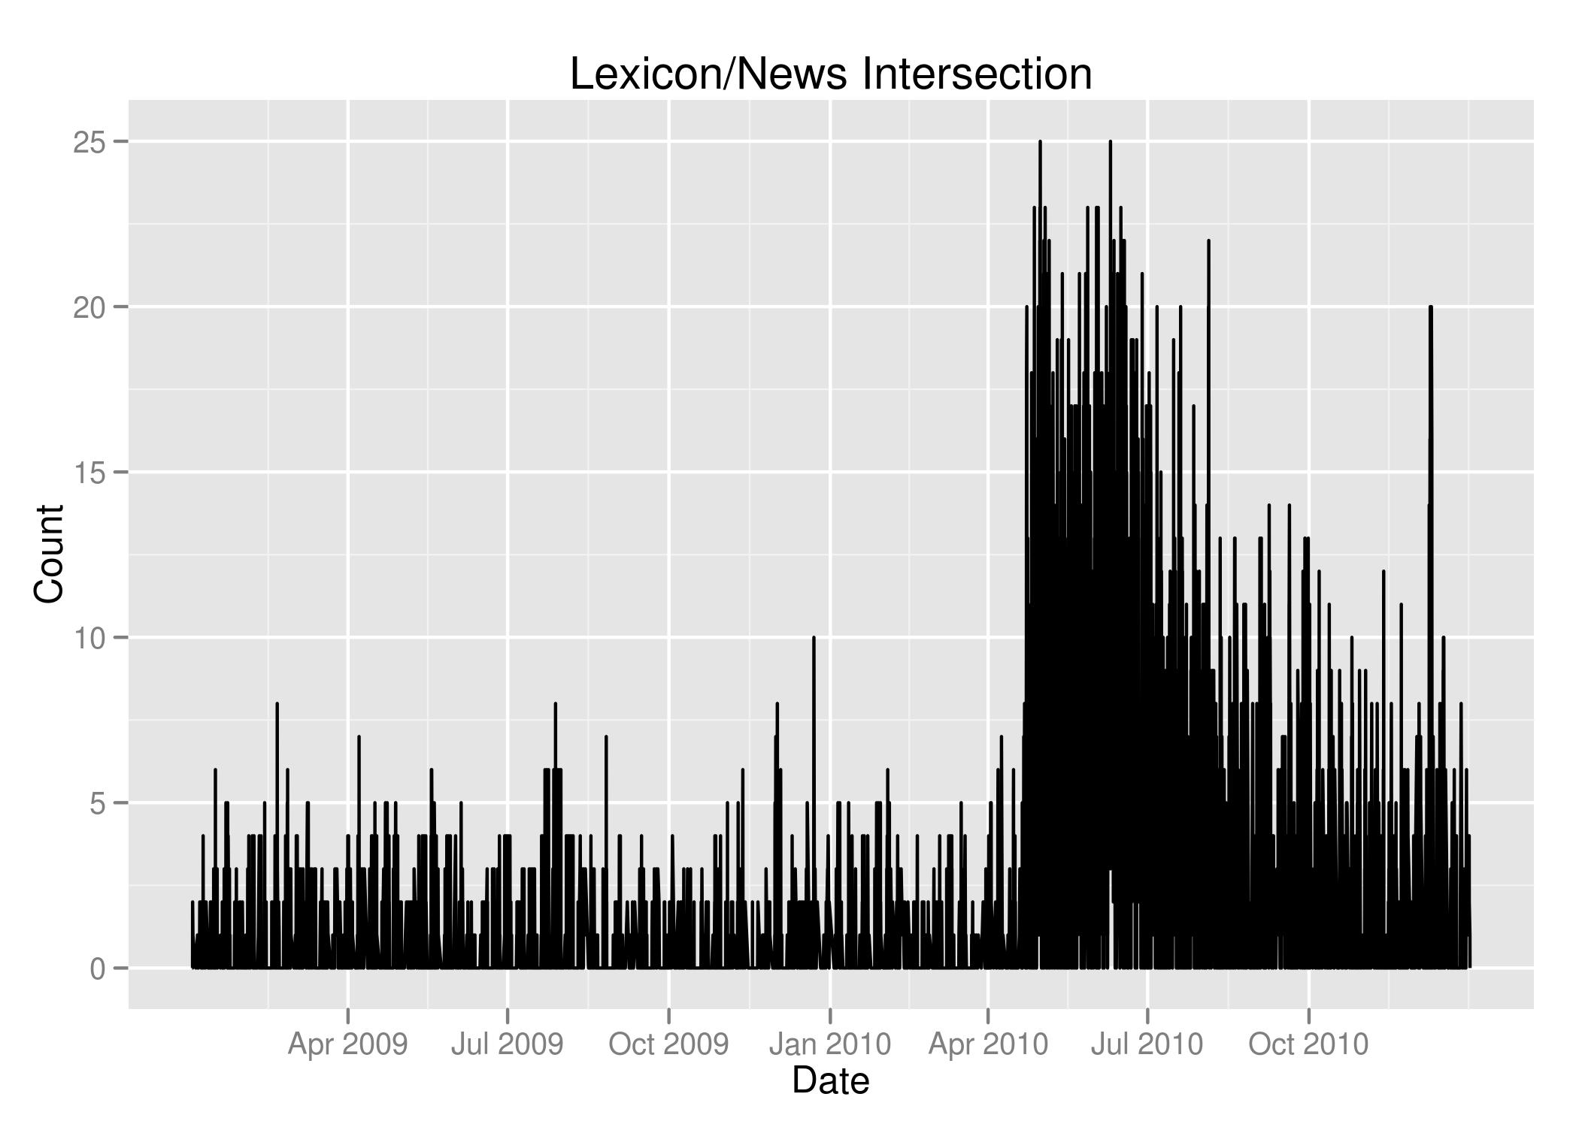

Slide 26
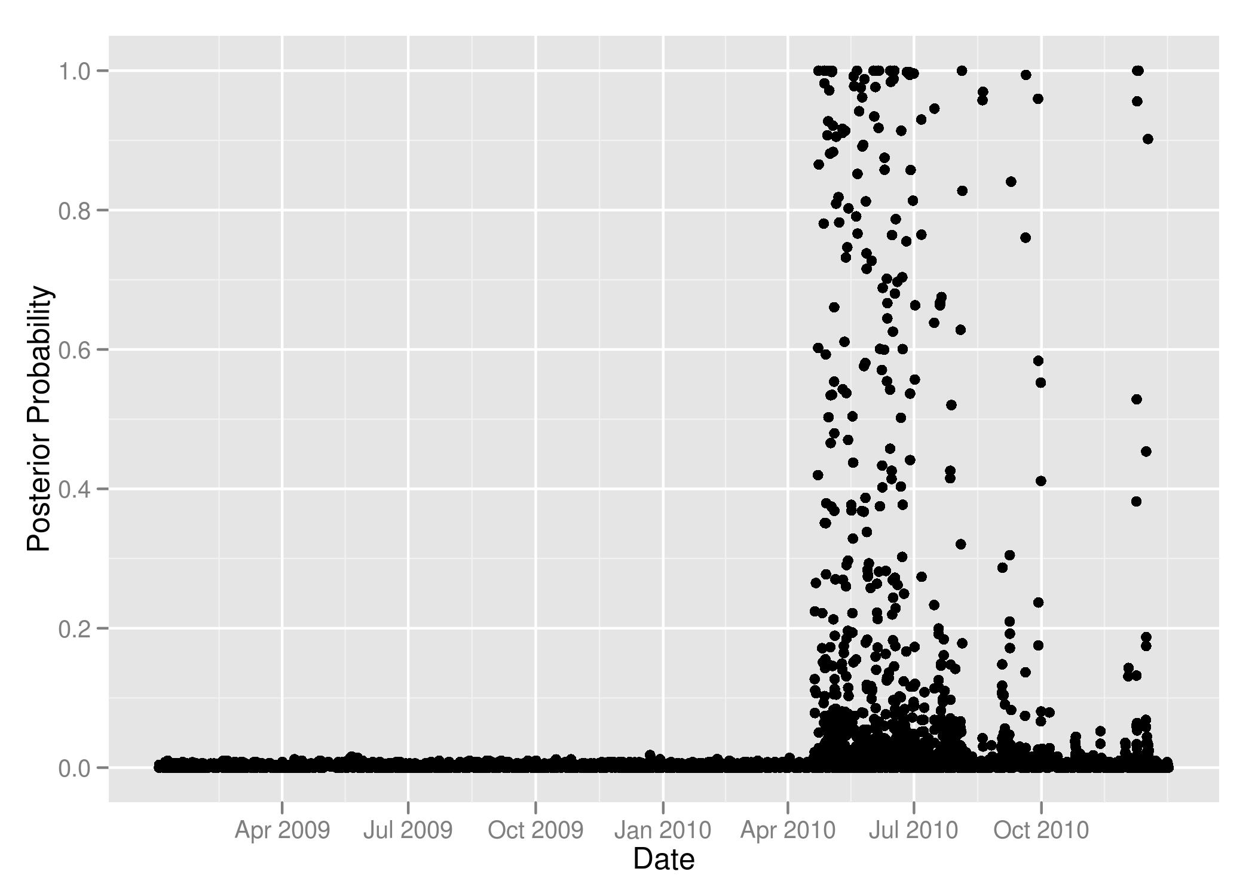
Bayesian Change-Point Analysis of Our Lexicon for Catastrophic Oil Industry Events IndustryDisasters:

Slide 27

So How Does This Work?

Slide 28
Articles
Total number of articles:1/2009-2/2012: 10,238,426
Total number of BP articles (2009-2010): 20,262

Slide 29
Some R Code
wordsByHours <- foreach (file=files) %dopar% {
# Get the time-stamped text for each article
# for a day of news.
articles <- articlesFromFile(file)
foreach (article=articles) %do%
# Use xts and tm to get the unique
# words in the BP articles.
unionWords(file, on="hours")
}
}

Slide 30
Some More R Code
# Load the lexicon
lex <- scan("BPLexicon.csv", what=character(), sep="\n")
# Get the intersection between the
# lexicon and the words in an article.
lexCount <- foreach(words=wordsByHours, .combine=c) %do% {
sum(lex %in% words)
}

Slide 31

Mixed-Asset Hedging for Corporate Bonds in Real-Time
1. Develop lexicon based on a qualitative analysis of historic news feed data for catastrophic events in relevant sectors
2. Develop an analysis that extracts sentiment from a news feed based on the lexicon
3. Bind news feed to a buy/sell strategy based on previous analysis
4. Operationalize the strategy through a complex event processing engine like ESPERR

Slide 32

Michael J. Kane, PhD
Yale University
Phronesis, LLC
michael.kane@yale.edu
William Casey King, PhD
Yale University
Phronesis, LLC
casey.king@yale.edu

