Slide 1

Solutions from OneTick and R
Lightning Talk…. 6 Minutes Only… Watch out!!! ☺
For Market Data Time Series Analysis
Maria Belianina, Ph.D.
Director, Pre-Sales Engineering Support

Slide 2
OneTick: Sample Business Cases
Our clients:
Business Cases:
Hedge Funds & Proprietary Trading Firms
Large Asset Managers
Banks / Brokers
Marketplaces
Technology & Information Providers
Backtesting & Quantitative Research
High frequency trading signal generation
Pre- & Post- Trade TCA
Backbone for Charting / Time and Sales
Compliance & Regulatory Reporting
Risk & Portfolio Analytics
Let’s look at a sample…

Slide 3


Sample Multi-Asset Class Business Case
WHAT THE CLIENT IS LOOKING FOR: now and later
Asset Classes
Equities & Futures, Levels I & II
FX
Later: Options, CDS and more classes
“Must Have” Features
Real-Time collection from Bloomberg & Reuters; later - directly from exchanges & custom feeds
Back-fill history
Historical & Real-Time Market Data Analysis
Use existing R analytics libraries
Order Book Building Analytics
Corporate actions, symbol name mapping
High compression, low latency, high throughput
KEY
TARGET CLIENT SYSTEMS:
C++ Trading
App
Get real-time query signals
C# & Java Back-Testing Apps
Test strategies against historical data
R
Historical time-series research & analysis
Excel
P&L, daily bars
Forgot to mention: it will eventually be global!
And we’ll be loading news feed too…
Panopticon
Vizualize
Notes:
Sample data flow with sample real-time and historical data sources spanning multiple asset classes.
End of Slide ON-Click Pop-Up: All presently supported real-time and historical interfaces

Slide 4
OneTick Solution: Sample Multi-Asset Class Data Flow
Real-Time [Bloomberg] Feed for
Trades & Quotes
Levels I & II
OneTick Collection & Loading
OneTick File Databases
OneTick Analytics
Continuous Event Processing
(CEP) real-time,
intraday
& historical
Extend analytics with:
R (any libraries)
MatLab
C++, C#, Java, Python
OneTick GUI
Design, debug, view, tune queries
real-time CEP subscription (equities,futures)
Equities & Futures
History + Intraday
equities, futures
API
C++ Trading
App
Get real-time query signals
Back fill
Trade & Quote History from [Reuters]
& [CME]
10 years, Levels I&II
equities, futures
API
API
C# & Java Back-Testing Apps
Test strategies against historical data
Derived Daily Statistics
Real-Time [Wombat]
Exchange Rates
real-time CEP subscription (FX)
R
Historical time-series research & analysis
FX Data
History + Intraday
FX
Corp Actions, Continuous Contract s,
Symbol Name Mappings
Excel
P&L, daily bars
Reference Data
reference
CSV files with portfolio compositions
CSV file with portfolio compositions
CSV file with portfolio compositions
Panopticon
Vizualize
Notes:
Sample data flow with sample real-time and historical data sources spanning multiple asset classes.
End of Slide ON-Click Pop-Up: All presently supported real-time and historical interfaces

Slide 5
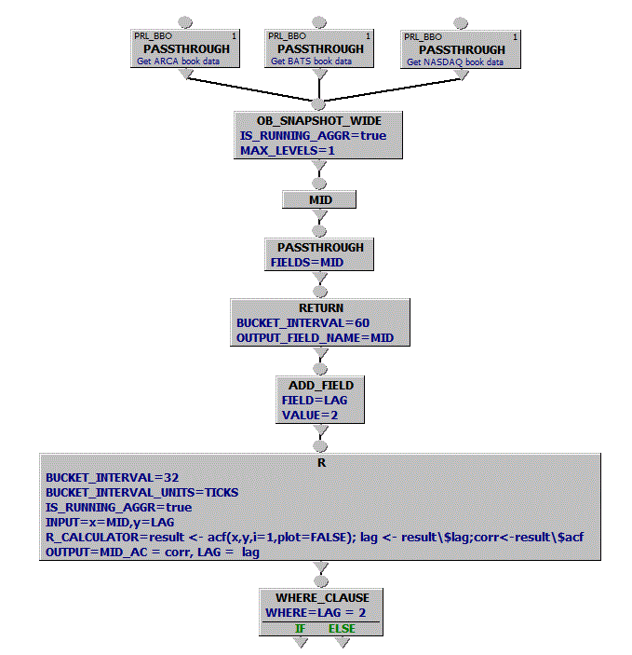
Sample Query: OneTick Consolidated Book + R ACF
Retrieve 3 order books
Consolidate books, build level 1 “running” ASK/BID snapshots
Add tick-by-tick MID
What else:
Add any number of R nodes
Load any R libraries
Run this query in Historical, Intraday or Real-Time CEP mode
Any asset classes, any number of books and symbols
Calculate RETURN(MID) over every 60 seconds
Add field LAG
Filter, view results…
Create running (a.k.a. sliding) aggregation of 32 RETURN ticks Call R function acf(…) for each sliding group Pass values of MID and LAG
Notes:
Sample data flow with sample real-time and historical data sources spanning multiple asset classes.
End of Slide ON-Click Pop-Up: All presently supported real-time and historical interfaces

Slide 6
Thank you
Stop by our desk
for a quick demo
Contacts:
maria.belianina@onetick.com
info@onetick.com

