Slide 1
Estimating The Dynamics of Price Discovery
by
Bingcheng Yan
Numeric Investors
and
Eric Zivot
Robert Richards Chaired Professor of Economics
Adjunct Professor of Finance, Statistics and Applied Mathematics
University of Washington
May11, 2012

Slide 2
Presentation Outline
Background
Objectives and Contributions
Reduced Form Cointegration Model and Price Discovery Measures
Structural Cointegration Model
Dynamic Price Discovery Measures
Empirical Example Using Fx Data
Concluding Remarks

Slide 3
Background: Definitions
Price discovery
“The search for an equilibrium price” (Schreiber and Schwartz, JPM, 1986)
“The dynamic process by which markets impound new information” (Hasbrouck, JF, 1995)
The incorporation of the information implicit in investor trading into market prices (Lehmann, JFM, 2002)
One of the most important functions of financial markets

Slide 4
Background: Questions
Research questions
Does the proliferation of alternative trading venues and the resulting market fragmentation adversely affect price discovery?
How do the dynamics of price discovery depend on market characteristics such as trading costs, liquidity?
What institutional factors and trading protocols facilitate information aggregation and price discovery?
Which markets move first in incorporating new information?
Answers require econometric methodology for measuring the dynamics of price discovery

Slide 5
Background: Methodology
Institutional trend of financial markets
Trading of identical or closely related assets in multiple markets;
cross-listed stocks
stock index and index futures,
stock and stock options,
direct and implied exchange rates
Provides a mechanism to measure price discovery

Slide 6
Background: Methodology
A common implicit efficient price shared by multiple market prices – cointegration framework
Hasbrouck (1995) proposed a reduced form cointegration model for arbitrage linked multiple market prices and defined the information share measure of price discovery
Booth et al. (1999) used Granger-Gonzalo permanent-transitory decomposition and defined the component share measure of price discovery.
There exists substantial confusion regarding the interpretation of existing price discovery measures because they are based on reduced form residuals
Existing measures of price discovery are static in nature

Slide 7
Objectives and Contributions of This Paper
Propose structural cointegration model with identified permanent and transitory shocks
Borrow SVAR methodology from empirical macroeconomics
Propose a new methodology for measuring the dynamic price discovery process
Price discovery impulse response functions
Price discovery efficiency loss measures
Illustrate the new approach with an empirical application to Fx markets
Price discovery between the US dollar implied JPY/EUR and the direct JPY/EUR rates
Investigate impact of trading costs and liquidity on price discovery dynamics

Slide 8
Reduced Form Cointegration Model
Same asset trading in two arbitrage linked markets
Note: time index represents high frequency intra-day data
MA (Wold) Representation

Slide 9
Reduced form Cointegration Model
Common Trends Representation:

Slide 10
Reduced Form Cointegration Model
Common Efficient Price Representation:

Slide 11
Reduced Form Cointegration Model
Empirical Model: Reduced Form VEC Model:
Assume approximating VEC(K-1) model implied by infinite order cointegrated VAR
Note: Johansen (1991) factorization

Slide 12
Structural Cointegration Model

Slide 13
Permanent and Transitory Shocks
Long-run impact of transitory shock
Long-run impact of permanent shock
Long-run impact matrix
Normalization imposed by common fundamental value

Slide 14
Common Efficient Price Representation
Pricing error contains reactions to both permanent and transitory shocks

Slide 15
Identification of Structural Cointegration
Parameters of structural model can be uniquely identified using a modification of the P-T decomposition of Gonzalo and Ng (2001, JEDC)
Identification does not depend on the ordering of the variables in the VAR

Slide 16
New Dynamic Measures of Price Discovery
Price Discovery Impulse Response Function (PDIRF): New information → market price response
permanently moves the efficient price, m_{t}, and drives multiple market prices to m_{t} in the long run
A direct characterization of how market prices discover the new efficient price

Slide 17
Dynamic Measures of Price Discovery
Price Discovery Efficiency Loss (PDEL)
f_{ik} – 1 = pricing error w.r.t. new information
L( ) = non-negative loss function
K* = truncation lag

Slide 18
PDIRF and PDEL from Partial Adjustment Model
L(∙) = abs(∙)
PDEL = 1.5
PDEL = 0.25
PDEL = 4.0

Slide 19
Empirical Example: Price Discovery in Fx Markets
Empirical analysis of price discovery dynamics of the direct JPY/EUR rate and the US dollar implied rate (from JPY/USD and USD/EUR)
US dollar, major vehicle currency in Fx markets, has trillions of dollar daily turnover
Any news regarding JPY(EUR) may first or
Does liquidity and high trading volume imply more efficient price discovery in US dollar markets?
Who moves first?
JPY/USD (USD/EUR)
JPY/EUR

Slide 20
Data Set and Variables
Bid-ask quotes on spot Fx rates: USD/EUR, JPY/USD, and JPY/EUR, time stamped up to milliseconds in GMT
EBS (Electronic Brokerage Service)
Quotes are firm (tradable)
Sample: 12 business weeks, July 6 – September 26, 2003
One business week: 22:00 Sunday – 22:00 Friday, GMT
Prices = log of mid quotes * 10000 (price changes in basis points)
Irregularly spaced quotes for all rates aligned to common time clock using “previous tick” method.

Slide 21
Data Set and Variables
Dollar implied rate for JPY/EUR
log mid quote (JPY/USD) + log mid quote (USD/EUR)
Spreads (measures of transaction costs & liquidity)
Bid/Ask spread
Bid/Ask spread ratio:

Slide 22
Intraday Trading Sessions
 | Asian | European | American | Post-American
Hours in GMT | 22:00 - 06:00 | 06:00 - 12:00 | 12:00 - 18:00 | 18:00 - 22:00

Slide 23
One Episode in Foreign Exchange Markets
At 23:50 on Aug. 11, 2003, Japan released the first GDP estimates for the second quarter of 2003

Slide 24
Asian
European
American
Post-American

Slide 25
Asian
European
American
Post American

Slide 26
Figure 3 – 6. Price Discovery IRFs (15 – second resolution)
Asian
European
Dollar implied JPY/EUR
Direct JPY/EUR
American
Post-American

Slide 27
Figure 7 – 10. Price Discovery IRFs (5 – minute resolution)
Asian
European
Dollar implied JPY/EUR
Direct JPY/EUR
American
Post-American

Slide 28
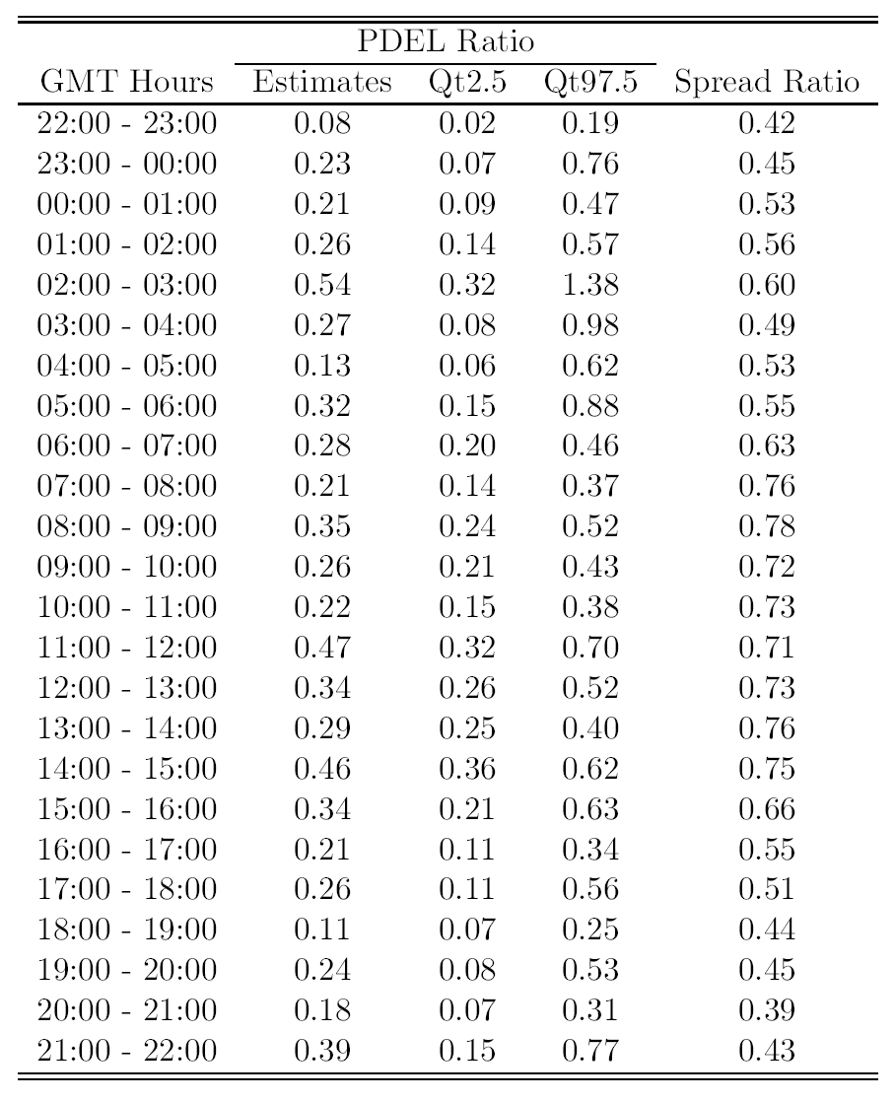
Asian
European
American
Post American

Slide 30
Conclusions
Propose new approach for the econometric analysis of price discovery dynamics based on structural cointegration model
Propose new measures of the dynamics of price discovery: PDIRF, PDEL
In application to Fx markets, show implied dollar JPY/EUR rate incorporates new information faster than direct JPY/EUR rate

