Slide 1

Variational Autoencoders for Cardiac Shape Modeling
IMA206
Professors:
Elsa Angelini
Loïc Le Folgoc
Students:
Alice Valença De Lorenci
Artur Dandolini Pescador
Giulia Mannaioli
Lais Isabelle Alves dos Santos
IMA206 @ Telecom Paris, IP Paris
Variational Autoencoders for Cardiac Shape Modeling

Slide 2


Table of Contents
01
Dataset
02
Method
05
Results
IMA206 @ Telecom Paris, IP Paris
Variational Autoencoders for Cardiac Shape Modeling

Slide 3
Dataset
IMA206 @ Telecom Paris, IP Paris
Variational Autoencoders for Cardiac Shape Modeling

Slide 4
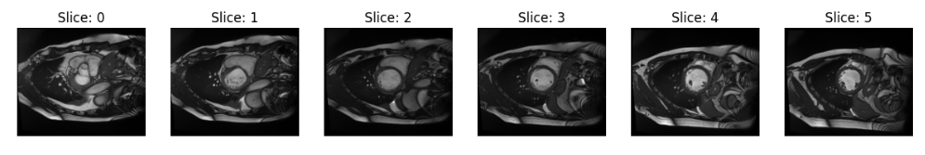
Dataset
ACDC database
150 subjects
4 pathological + 1 healthy subject groups
a series of slices covering the LV from the base to the apex
end diastole (ED) and end systole (ES) images
MRI images and corresponding segmentation maps
IMA206 @ Telecom Paris, IP Paris
Variational Autoencoders for Cardiac Shape Modeling

Slide 5

Dataset
Segmentation map
0. Background
1. Right ventricle cavity (RV)
2. Myocardium (MY)
3. Left ventricle cavity (LV)
IMA206 @ Telecom Paris, IP Paris
IMA206 @ Telecom Paris, IP Paris
Variational Autoencoders for Cardiac Shape Modeling
Variational Autoencoders for Cardiac Shape Modeling

Slide 6
Method
IMA206 @ Telecom Paris, IP Paris
Variational Autoencoders for Cardiac Shape Modeling

Slide 7
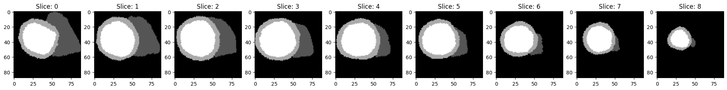
Preprocessing
1
Alignement
2
Cropping
IMA206 @ Telecom Paris, IP Paris
Variational Autoencoders for Cardiac Shape Modeling

Slide 8
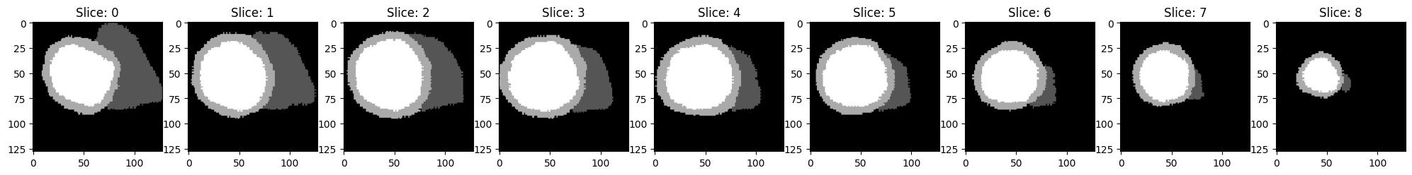

Preprocessing
3
Resize
4
Labelling
IMA206 @ Telecom Paris, IP Paris
Variational Autoencoders for Cardiac Shape Modeling

Slide 9
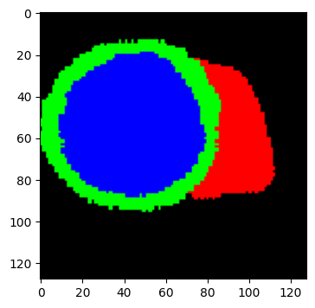
Preprocessing
5
Decouple slices
6
Multi channel masks (one-hot encoding)
IMA206 @ Telecom Paris, IP Paris
Variational Autoencoders for Cardiac Shape Modeling

Slide 10
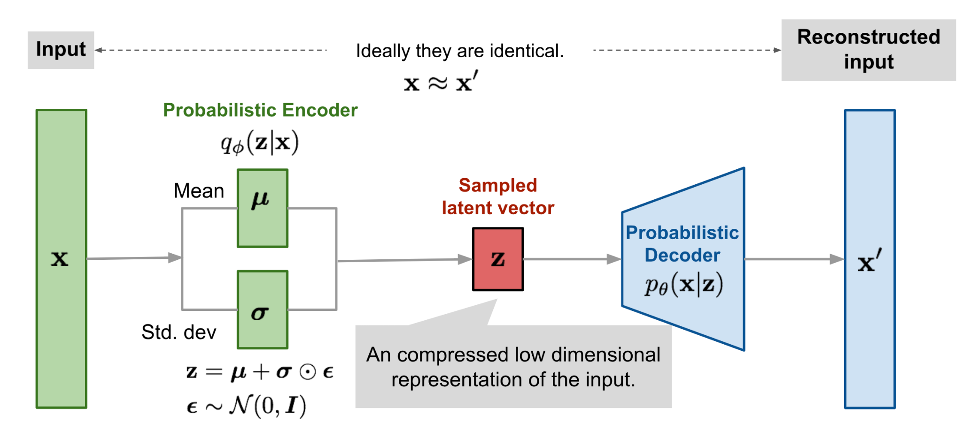
Variational Autoencoder (VAE)
IMA206 @ Telecom Paris, IP Paris
Variational Autoencoders for Cardiac Shape Modeling
Notes:
The objective of this project is to use a VAE to reconstruct heart segmentation masks.
Essentially, an autoencoder is an unsupervised approach for learning a lower-dimensional feature representation from unlabeled training data and. In VAE we model the latent space in a probabilistic manner. So the encoder network generates two vectors, the mean and variance that are used to sample z, the latent representation, and then the decoder reconstructs the input from z.

Slide 11
VAE Implementation
Architecture
Encoder
Decoder
4 convolutional blocks:
2x2 convolutional layer (stride 2)
3x3 convolutional layer (stride 1)
Duplicate number of output channels per block
4 convolutional blocks:
2x2 transpose convolutional layer (stride 2)
3x3 transpose convolutional layer (stride 1)
Halve number of output channels per block
Softmax activation
Latent space dimension = 32
IMA206 @ Telecom Paris, IP Paris
Variational Autoencoders for Cardiac Shape Modeling

Slide 12
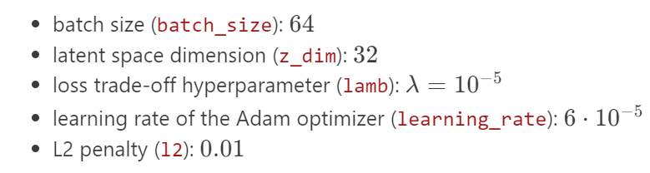
VAE Implementation
Parameters
IMA206 @ Telecom Paris, IP Paris
Variational Autoencoders for Cardiac Shape Modeling

Slide 13

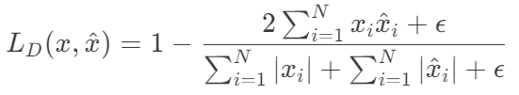


Loss function
Loss to minimize
Reconstruction Error (Soft Dice Loss)
: predicted value
: ground truth value
: small constant
IMA206 @ Telecom Paris, IP Paris
Variational Autoencoders for Cardiac Shape Modeling

Slide 14
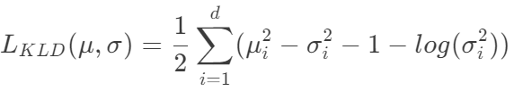
Loss function
Loss to minimize
Kullback-Leibler Divergence (KLD) loss:
𝜇 : mean of the latent space distribution
𝜎 : standard deviation of the latent space distribution
d : size of the latent space
IMA206 @ Telecom Paris, IP Paris
Variational Autoencoders for Cardiac Shape Modeling

Slide 15
Loss function
Loss to minimize
Hyperparameter 𝝺 was introduced to control the influence of each term on the loss
IMA206 @ Telecom Paris, IP Paris
Variational Autoencoders for Cardiac Shape Modeling

Slide 16
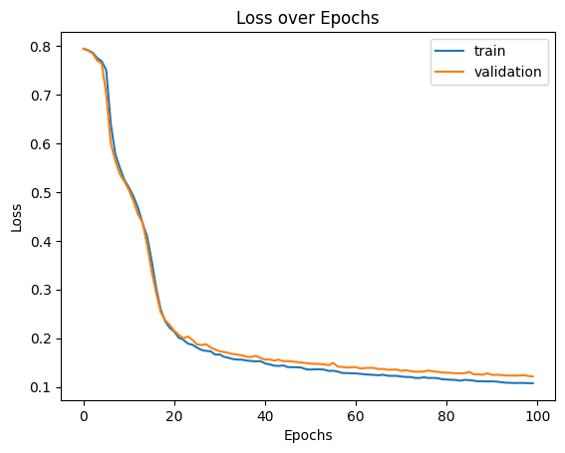
Loss
100 epochs:
Train loss: 0.11
Validation loss: 0.11
Test loss: 0.12
IMA206 @ Telecom Paris, IP Paris
Variational Autoencoders for Cardiac Shape Modeling

Slide 17
Results
IMA206 @ Telecom Paris, IP Paris
Variational Autoencoders for Cardiac Shape Modeling

Slide 18
Results
Reconstruction
Generation
1
2
3
Latent Space Analysis
IMA206 @ Telecom Paris, IP Paris
Variational Autoencoders for Cardiac Shape Modeling

Slide 19
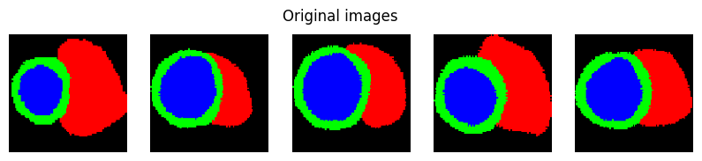
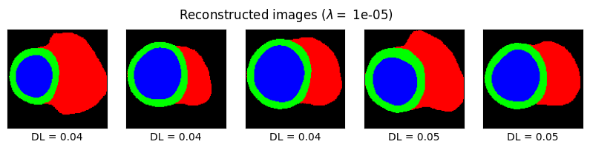
Best reconstructions
IMA206 @ Telecom Paris, IP Paris
Variational Autoencoders for Cardiac Shape Modeling

Slide 20
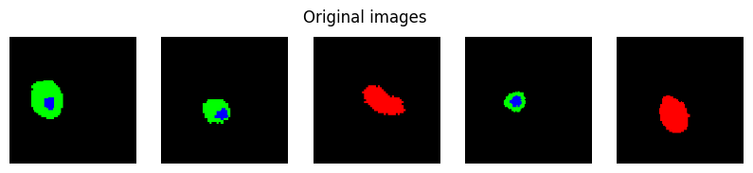
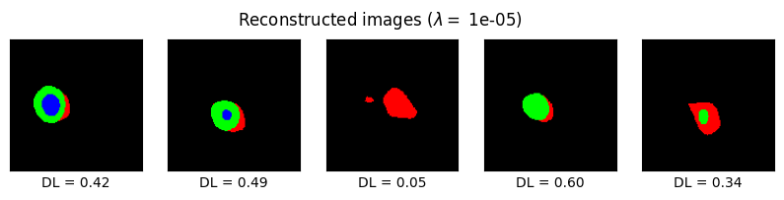
Worst reconstructions
IMA206 @ Telecom Paris, IP Paris
Variational Autoencoders for Cardiac Shape Modeling

Slide 21
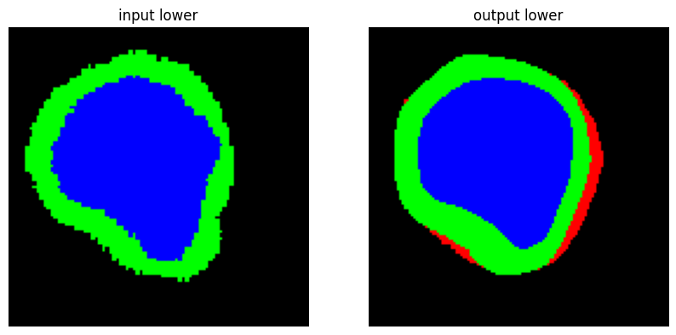
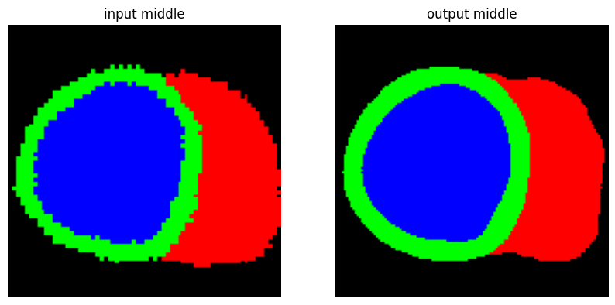
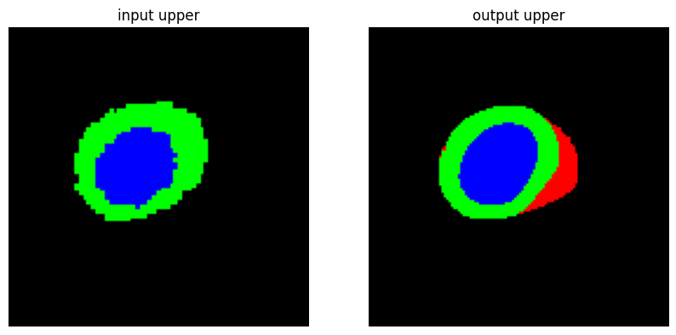
Influence of slice
Lower Slices - ADL = 0.36
Middle Slices - ADL = 0.27
Upper Slices - ADL = 0.28
Input
Reconstruction
IMA206 @ Telecom Paris, IP Paris
Variational Autoencoders for Cardiac Shape Modeling

Slide 22
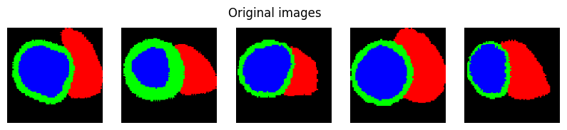
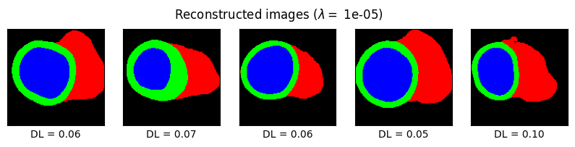
Influence of 𝝺
IMA206 @ Telecom Paris, IP Paris
Variational Autoencoders for Cardiac Shape Modeling

Slide 23
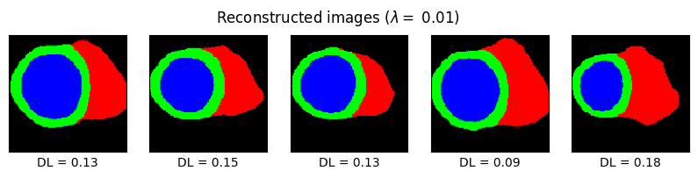
Influence of 𝝺
IMA206 @ Telecom Paris, IP Paris
Variational Autoencoders for Cardiac Shape Modeling

Slide 24
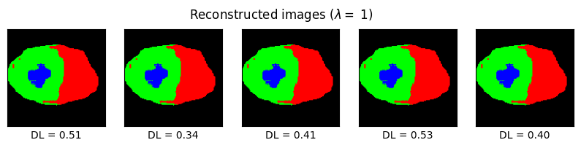
Influence of 𝝺
IMA206 @ Telecom Paris, IP Paris
Variational Autoencoders for Cardiac Shape Modeling

Slide 25
Results
Reconstruction
Generation
1
2
3
Latent Space Analysis
IMA206 @ Telecom Paris, IP Paris
Variational Autoencoders for Cardiac Shape Modeling

Slide 26
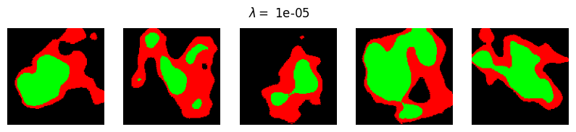
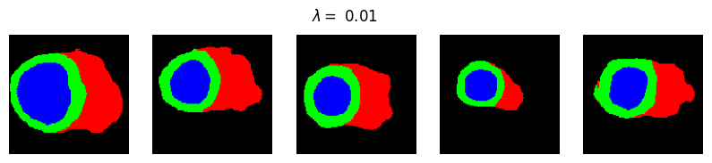
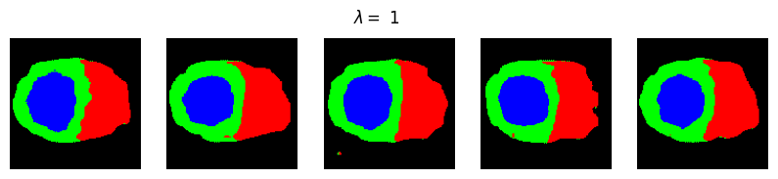
Influence of 𝝺
IMA206 @ Telecom Paris, IP Paris
Variational Autoencoders for Cardiac Shape Modeling

Slide 27
Best results
IMA206 @ Telecom Paris, IP Paris
Variational Autoencoders for Cardiac Shape Modeling

Slide 28
Results
Reconstruction
Generation
1
2
3
Latent Space Analysis
IMA206 @ Telecom Paris, IP Paris
Variational Autoencoders for Cardiac Shape Modeling

Slide 29
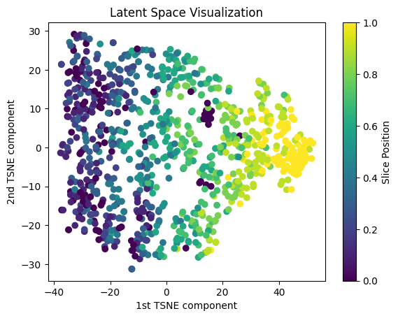
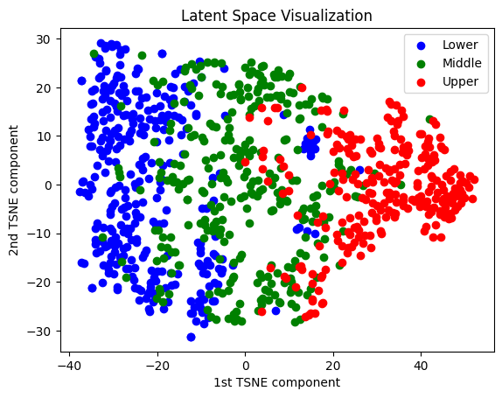
Latent space analysis (t-SNE)
IMA206 @ Telecom Paris, IP Paris
Variational Autoencoders for Cardiac Shape Modeling

Slide 30
References
Biffi, Carlo et al. (2018). “Learning interpretable anatomical features through deep generative models: Application to cardiac remodeling”. In: Medical Image Computing and Computer Assisted Intervention–MICCAI 2018: 21st International Conference, Granada, Spain, September 16-20, 2018, Proceedings, Part II 11. Springer, pp. 464–471.
Painchaud, Nathan et al. (2020). “Cardiac segmentation with strong anatomical guarantees”. In: IEEE transactions on medical imaging 39.11, pp. 3703–3713.
IMA206 @ Telecom Paris, IP Paris
Variational Autoencoders for Cardiac Shape Modeling

