Slide 1
Domain-driven design from theory to practice
Artur Trosin
Notes:
Synopsis: Domain Driven Design (DDD) – is a buzzword nowadays, and is more and more widely adopted and applied, why? Because nowadays more and more often are automated complex business domains to reduce human work or expand it to compete for market place, so DDD is a proven set of patterns and practices that makes a manageable shape for complex business domains. Instead of going inevitably with each change or feature to the legacy software, applying DDD you will discover and open new patterns and practices horizons in dealing with software complexity.
“The key to controlling complexity is a good domain model.” – Martin Fowler, in foreword for the book “Domain-Driven Design: Tackling Complexity in the Heart of Software” written by Eric Evans.
Artur Trosin is software architect; he has practical experience applying Domain Driven Design using .Net technologies and is very interested in various methods and techniques of improving software quality through simple and maintainable solutions. His focus is to turn modern tools and technologies into software building blocks that align with well known discovered principles.

Slide 2
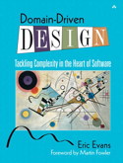

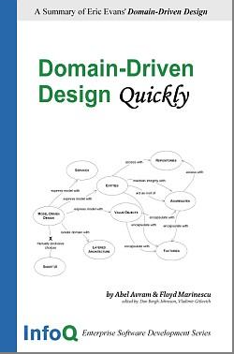

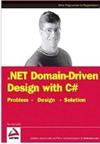
Who’ve read…?

Slide 3
Why DDD nowadays?
Automation of various business domains
High competition for a market place
Growing business complexity
Notes:
Most of the software solutions in nowadays are designed to automate different domains, and a large number of systems are specific to particular needs of a business, so common software solutions in high competitive business less and less find their place in market. Why I’m discussing that? Because DDD is not only about the pure design but also teach how to abstract a complex Domain in a software solution where you will discover new ways of dealing with complexity, changes, communication ,… Instead of making the system ugly, very hard to understand, un-maintainable and where any change in the system leads to a deeper legacy.

Slide 4
What is DDD?

Slide 5
Domain - particular field of knowledge
Notes:
Domain examples: Banking, Accounting, Public Relationship..

Slide 6
Complexity of most software projects is understanding the business domain and not a technical one.
Notes:
For most of the project it’s true!... For other it’s not Frameworks, router, etc.. Are not in that category.

Slide 7
They are two different worlds!
Business Domain
(business experts)
Software Development
(development team)
We need to bring them together
(business domain & technical)
Successes depends on “how well you bring them together”
Notes:
Cu cit mai bine ar sa fie inteles business domainul si cu atit mai mari sansele ca softul produs de developeri va fi
Anume aceea ce se cere de business experti.
Problema este ca Business expertii nu inteleg partea tehnica a lucrurilor dar developerii nu cunosc domainul,
Cum rezolvam problema?

Slide 8
A: How we bring them together?

Slide 9
We need common view and language!
Business Domain
Domain Model
&
Ubiquities Language
Software Development

Slide 10
Why domain models?

Slide 11
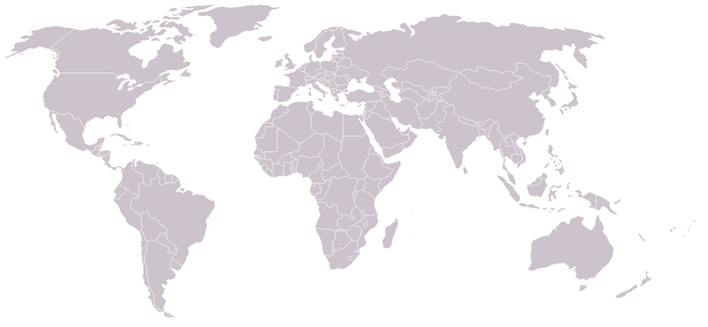

Notes:
The key to controlling complexity is a good domain model, a model that goes beyond a surface
vision of a domain by introducing an underlying structure, which gives the software developers the
leverage they need. A good domain model can be incredibly valuable, but it's not something that's
easy to make. Few people can do it well, and it's very hard to teach.

Slide 12
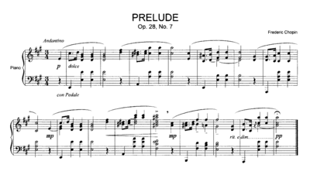
Notes:
Sheet music can be used as a record of, a guide to, or a means to perform, a piece of music. Although it does not take the place of the sound of a performed work, sheet music can be studied to create a performance and to elucidate aspects of the music that may not be obvious from mere listening. Authoritative musical information about a piece can be gained by studying the written sketches and early versions of compositions that the composer might have retained, as well as the final autograph score and personal markings on proofs and printed scores
Enstein: Theory of all… theory on atom level and on stars level

