Slide 1

Domain-Driven Design (DDD) from theory to practice
Artur Trosin
Presentation for: Software as Craft 2009, 14-16 May
Notes:
Buna ziua, Ma numesc Artur Trosin si sunt Software Architect la Endava.
Astazi vreau sa fac o prezentare pe Domain Driven Design sau DDD. Intentia prezentarii de astazi este
de a face o introducere cit in teorie atit si in practicile folosite in DDD.
Contentul prezentarii este bazat pe un set de carti, topic-uri discutate in grupul de discutii DDD, si practica personala.
De asemenea in aceasta prezentare voi atinge un set de probleme care apar in practica dar raspunsul carora nu este
asa de simplu de gasit in carti, bloguri, ect…
------------------------------
Synopsis: Domain Driven Design (DDD) – is a buzzword nowadays, and is more and more widely adopted and applied, why? Because nowadays more and more often are automated complex business domains to reduce human work or expand it to compete for market place, so DDD is a proven set of patterns and practices that makes a manageable shape for complex business domains. Instead of going inevitably with each change or feature to the legacy software, applying DDD you will discover and open new patterns and practices horizons in dealing with software complexity.
“The key to controlling complexity is a good domain model.” – Martin Fowler, in foreword for the book “Domain-Driven Design: Tackling Complexity in the Heart of Software” written by Eric Evans.
Artur Trosin is software architect at Endava; he has practical experience applying Domain Driven Design using .Net technologies and is very interested in various methods and techniques of improving software quality through simple and maintainable solutions. He is also open source project coordinator for DDD Sample application C# version. His focus is to turn modern tools and technologies into software building blocks that align with well known discovered principles and Agile practices.

Slide 2
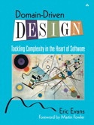
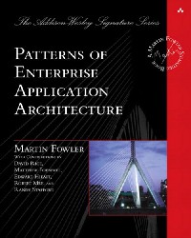
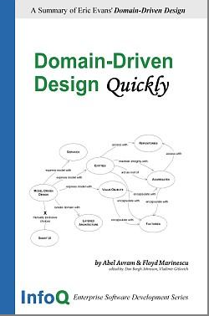
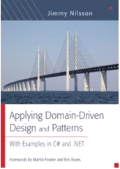
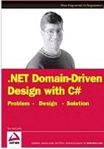
Before start
Notes:
Cine a auzit de DDD mai inainte? Ridicati va rog mina
Cine a citit cartea scrisa de Eric Evans? sau alte carti scrise de pe tematica DDD?
----------------------------------------------------
Who have heard about DDD before?
How've used DDD or some of its practices?

Slide 3
Why DDD nowadays?
Automation of various business domains
High competition for a market place
Growing business complexity
Complexity becomes inevitable
Notes:
In prezent tot mai mult si mai mult se automatizeaza diferite business domenii, lucru complex facut de om acum se incearca sa fie automatizat
cit se poate de mult, pentru a cistiga in viteza si costuri. Totodata in anii 90’ cind multe solutii software se elaborau in mod generic acum tot mai mult
predomina ramura solutiilor custom, deoarece pentru a concura pe piata curenta este nevoie de a fi cu un pas inainte fata de competitori. Totodata cu acesta tendinta complexitatea insasi business-ului creste in continuu.
Ca rezultat complexitatea devine ceva inevitabil.
Sunt multe lucruri care pot face procesul de software development sa fie complex, dar dupa cite vedem ca des nucleul complexitatii este insasi
business domain-ul. Pentru a automatiza un sistem enterprise complexitatea nu poate fi ocolita, unica ce se poate face asta sa fie CONTROLATA.
------------------------------------------------------------------------------------------------
Most of the software solutions in nowadays are designed to automate different domains, and a large number of systems are specific to particular needs of a business, so common software solutions in high competitive business less and less find their place in market. Why I’m discussing that? Because DDD is not only about the pure design but also teach how to abstract a complex Domain in a software solution where you will discover new ways of dealing with complexity, changes, communication ,… Instead of making the system ugly, very hard to understand, un-maintainable and where any change in the system leads to a deeper legacy.

Slide 4
Domain - particular field of knowledge
Notes:
Haideti sa ne reamintim ce este Domain, acest termen este foarte important pe care se axaza
prezentare de azi si in general tematica prezentarii.
Domain - este o cunoastere a careiva sfere particulare
example: Banking, Accounting, Public Relationship, Insurance,..

Slide 5
Two main DDD premises
Primary focus should be on the domain and domain logic
Complex domain designs should be based on a model
Notes:
Aceste sunt 2 premize, care tot odata sunt 2 principii DDD, de la care DDD porneste, si toate urmatoarele principii si paterne SAU se bazeaza pe aceste 2 principii SAU
sunt pentru a le suporta.
Deci primul principiu este ca:
Pentru majoritatea proiectelor software, focusarea trebuie sa fie la domain si domain logic.
… acesta este adevarat pentru majoritatea proiectelor dar pentru o parte de proiecte ceasta nu e adevarat, de exemplu:
Pentru modeme,rutere unde trebuie sa fie efectuat un set de operatii simple dar foarte rapid
Framework-uri unde focusarea nu este in un business domain careva dar mai mult la partea tehnica.
O alta concluzie inportanta din aceasta premiza se poate face ca:
Complexitatea a majoritatii proiectelor NU este a cea tehnica sau tehnologica de implementare dar de a intelege business domain-ul,
si de-al exprima in software.
2) Urmatorul principui este ca: designul unui domain complex trebuie sa fie bazat pe un model
… in continuare ar sa vedem de ce anume MODEL

Slide 6
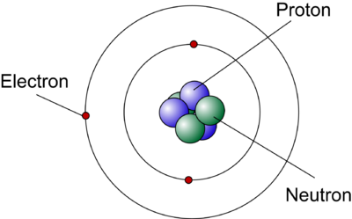
Atom Models Evolution
Why models?
Notes:
Oamenii creaza si folosesc diferite modele in diferite scopuri, citeva din ele sunt:
Comunica
Descoperi
Invata
Evalua
Explica
Experimenta
Collecta date
A arata ca aparent simplu poate fi destul de complex (sau invers)
Si multe atle scopuri…
Ca un exemplu am luat Modelul Atomului:
Aceasta imagine reprezinta un Model modern a atomului. ATOM care in traducere
inseamna “nedevizabil”. Acest model reprezinta o evolutie a urmatorului model
CLICK 1, deci modelul intial care
reprezenta teoria particulei fundamentale nedevizabile.
Acest model era un start pentru urmatoarele modele si teorii.
Cercetatorii au invatat si au descoperit noi modele cu noi structuri a atomului prin varioase
Experimente, modifind modelele pentru a le face valide la datele noi obtinute in aceste experimente.
In cele din urma modelul evalua in timp si discutii.
Deci, modele nu intodeauna represinta ceva real sau adevarat, modelel pot fi foarte valoroase fara a fi realistice.
Modele nu trebuie sa reprezinte neapart ceva realistic, deoarece modelele exista pentru a ilumina abstractii.
Pina in ziua de azi, desigur ca Modelul Atomului evalueaza prin noi descoperiri, deoarece chiar si cel mai puternic microsctop nu poate arata structura
reala a atomului. De aceea Modelel care nu treceau un test a experimentului se invalidau, celelalte traiau…
-------------------------------------------------------------------------------------------------------------------------------------
models can be invaluable without being "right," in an engineering sense. Indeed, by such lights, all the best models are wrong. But they are fruitfully wrong. They are illuminating abstractions. I think it was Picasso who said, "Art is a lie that helps us see the truth.“
ATOM - unbreakable
Model evolution
Model should not be realistic
Model helps us to enter to domain
Einstein: Theory of all… theory on atom level and on stars level
As scientists learned about the structure of the atom through experiments, they modified their models of the atom to fit their data.
This is how the Atomic model has changed over the years and talks about the scientists who made them all possible.
Some of the very best microscopes have produced images of groups of atoms, but no actual picture of an atom yet exists. How, then, can scientists be so completely certain of the existence of atoms and of the models they have created for them? The answer is that models of the atom, like other scientific models, can be tested by experimentation. Those models that pass the test of experimentation survive, while those that do not are abandoned.
Projects that have no domain model at all, but just write code to fulfill one function after another,
gain few of the advantages of knowledge crunching and communication discussed in the previous
two chapters. A complex domain will swamp them.
The key to controlling complexity is a good domain model, a model that goes beyond a surface
vision of a domain by introducing an underlying structure, which gives the software developers the
leverage they need. A good domain model can be incredibly valuable, but it's not something that's
easy to make. Few people can do it well, and it's very hard to teach.

Slide 7
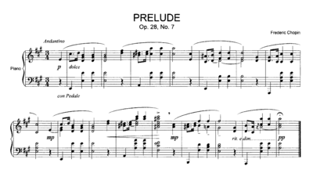
Even Music has a Model
Notes:
Chiar si muzica poate avea un Model, aceste model da posibilitate:
Sa a aveam o forma scrisa a muzicei
De a transmite aspectele care nu sunt evidente prin ascultarea muzicii
Ca Compositorul sa poata comunica pe baza acestui model pentru a discuta diferite aspecte
…etc..
Bine se cunosc cazuri in istorie cind simfoniile se scriau chiar de persoane care nu aveau auz.
Aceasta forma de redare a muzicii este una moderna, dar iarasi acesta forma a fost cu totul diferita in formele incepatoare.
-------------------------------------------------------------------------------------------------------------------------------------------------
Sheet music can be used as a record of, a guide to, or a means to perform, a piece of music. Although it does not take the place of the sound of a performed work, sheet music can be studied to create a performance and to elucidate aspects of the music that may not be obvious from mere listening. Authoritative musical information about a piece can be gained by studying the written sketches and early versions of compositions that the composer might have retained, as well as the final autograph score and personal markings on proofs and printed scores

Slide 8
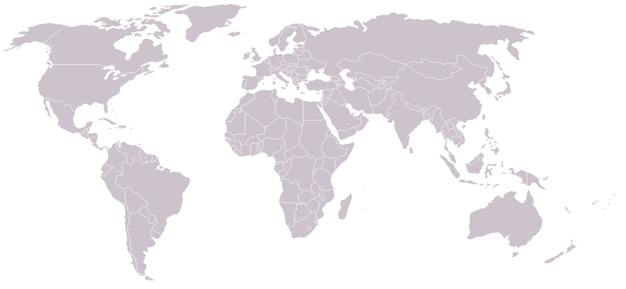
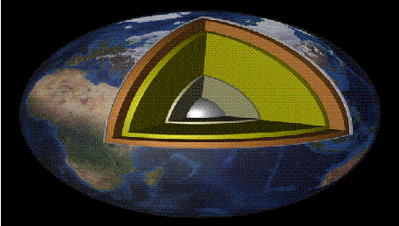
Notes:
Aceste sunt doua modele a pamintului, Acum am la dumnevoastra o intrebare,
Care dintre aceste 2 modele este mai bun?
Raspunsul este ca modelul de sus este bun pentru a reprezenta continentele si tarile dar modelul de mai jos pentru a
arata straturile din care este compusa planeta.
Si desigur ca ambele modele nu sunt realistice, dar fiecare are context, scop care vrem sa-l redam prin un set de abstractii
a lumii reale.

Slide 9
Domain Model - is a rigorously organized and selective abstraction of the (Business) Domain knowledge.
Notes:
Deci sa concludem, Domain Model in DDD este un set de abstractii bine chibzuite si organizate.
Aceste abstractii reprezinta niste abstractii a cunostintelor in careva domeniu anumit.
----------------------------------------------------------------------------------------------------------------
Proiectele care care nu au un domain model dar pur si simplu scriu code pentru a
realiza o functia dupa alta,
Projects that have no domain model at all, but just write code to fulfill one function after another,
gain few of the advantages of knowledge crunching and communication discussed in the previous
two chapters. A complex domain will swamp them.
-if a implementation is disconnected from the model then the model has a little or not value
A domain model is not a particular diagram; it is the idea that the
diagram is intended to convey. It is not just the knowledge in a domain
expert’s head; it is a rigorously organized and selective abstraction
of that knowledge. A diagram can represent and communicate a
model, as can carefully written code, as can an English sentence.
Domain modeling is not a matter of making as “realistic” a
model as possible. Even in a domain of tangible real-world things,
our model is an artificial creation. Nor is it just the construction of a
software mechanism that gives the necessary results. It is more like
moviemaking, loosely representing reality to a particular purpose.

Slide 10
Collaboration
Business Domain
(business experts)
Software Development
(development team)
Ubiquitous Language
Produce
Domain Model
&
Ubiquitous Language
Software
Reflected in
Based on
Direct mapping between business domain concepts and software artifacts
Notes:
Acum mai avem o problema de rezolvat,
Pe de o parte sunt Business Expertii care au un set de termeni, si jargon pe care developerii cu greu il inteleg.
CLICK 1
Tot asa se intimpla si cu business expertii care foarte putin inteleg termenii technici pe care software developerii ii folosesc
de zi cu zi, ca de ex: foreign key, table, row, constructor, ect..
Pina la urma termenologia folosita in discutii de zi cu zi este desconectata de termenologia utilizata in cod.Sau chiar aceeasi persoana poate folosi diferiti termeni in forma scrisa si pentru a discuta.
In asa caz inevitabil apar translarile intre limbaj tehnic si cel a domain expertilor ceeia duce la o colaborare anemica,
si pina la urma probleme serioase in proiect.
Solutia este UBIQUITOUS LANGUAGE,
CLICK 2
acest limbaj il folosim pentru a comunica cu business experti, cu echipa,
In diferite forme, diagrame, code, discutii ect…
Schimbarile in UBIQUITOUS LANGUAGE se reflecta in domain model, code, ect…
Si invers daca apar schimbari model apar si schimbari in limbaj, diagrame, ect…
CLICK 3
Pina la sfirsit Domain Model si Ubiquitious Language care reprezinta suma cunostintelor acumulate de la business experti
se reflecta in software. Este foarte important aceasta reflectare sa fie, dealtfel valoare modelului scade.
-----------------------------------------------------------------------
Problem:
A project faces serious problems when its language is fractured. Domain experts use their jargon while technical team members have their own language tuned for discussing the domain in terms of design.
The terminology of day-to-day discussions is disconnected from the terminology embedded in the code (ultimately the most important product of the software project). And even the same person uses different language in speech and in writing, so that the most incisive impression of the domain often emerges in a transient form that is never captured in the code or even in writing.
Translation blunts communication and makes knowledge crunching anemic.
Yet none of these dialects can be a common language because none serves all needs.
Solution:
Use the model as a backbone of a language. Commit the team to exercising that language relentlessly in all communication within the team and in the code. Use the same language in diagrams, writing and especially speech.
Recognize that a change in the UBIQUITOUS LANGUAGE is a change to the model.
Iteratively
Intention revealing interface
Binding the model and the implementation.
Cultivating a language based on the model.
Developing a knowledge-rich model. The objects had behavior and enforced rules. The model
wasn't just a data schema; it was integral to solving a complex problem. It captured
knowledge of various kinds.
Distilling the model. Important concepts were added to the model as it became more
complete, but equally important, concepts were dropped when they didn't prove useful or
central. When an unneeded concept was tied to one that was needed, a new model was
found that distinguished the essential concept so that the other could be dropped.
Brainstorming and experimenting. The language, combined with sketches and a
brainstorming attitude, turned our discussions into laboratories of the model, in which
hundreds of experimental variations could be exercised, tried, and judged. As the team went
through scenarios, the spoken expressions themselves provided a quick viability test of a
proposed model, as the ear could quickly detect either the clarity and ease or the
awkwardness of expression.
This kind of knowledge crunching turns the
knowledge of the team into valuable models.

Slide 11
Ubiquitous Language - A language structured around the domain model and used by all team members to connect all the activities of the team with the software.
Notes:
----------------------------------------------------------------------------
Problem:
A project faces serious problems when its language is fractured. Domain experts use their jargon while technical team members have their own language tuned for discussing the domain in terms of design.
The terminology of day-to-day discussions is disconnected from the terminology embedded in the code (ultimately the most important product of the software project). And even the same person uses different language in speech and in writing, so that the most incisive impression of the domain often emerges in a transient form that is never captured in the code or even in writing.
Translation blunts communication and makes knowledge crunching anemic.
Yet none of these dialects can be a common language because none serves all needs.
Solution:
Use the model as a backbone of a language. Commit the team to exercising that language relentlessly in all communication within the team and in the code. Use the same language in diagrams, writing and especially speech.
Recognize that a change in the UBIQUITOUS LANGUAGE is a change to the model.

Slide 12
Ubiquitous Language
Business terms
developers don’t
understand
Technical terms
Domain Model Terms
Technical aspects
of design
DDD Patterns
Technical design
patterns
Business terms
everyone uses that
don’t appear in design
Bounded Contexts
S.O.L.I.D design
principles
Candidates to fold into model
Notes:
Deci Ubiquitous Language – este un limbaj structurat pe baza la domain model si este folosit de toti membrii echipei pentru
A face legatura intre toate activitatile echipei cu software.
IN cercul de stinga
CLICK1
este multimea de termeni folositi de business experti pentru a conlucra intr-un business domein.
In cercul din dreapta sunt termeni folositi de developeri.
CLICK2
Intersectia lor dupa cite vedem este Ubiquitous Language.
------------------------------------------------------------------------------------------
Ubiquitous Language - A language structured around the domain model and used by all team members to connect all the activities of the team with the software.

Slide 13
They are two different worlds!
Business Domain
(business experts)
Software Development
(development team)
We need to bring them together
(business domain & technical)
Successes depends on “how well you bring them together”
Notes:
Cu cit mai bine ar sa fie inteles business domainul si cu atit mai mari sansele ca softul produs de developeri va fi
Anume aceea ce se cere de business experti.
Problema este ca Business expertii nu inteleg partea tehnica a lucrurilor dar developerii nu cunosc domainul,
Cum rezolvam problema?
Noi nici o data pina la urma nu ar sa invatam business expertii termini tehnici de programare si noi nu suntem interesati
sa invatam totul ce tine de inplementare, DAR noi putem sa gasim un puct comun care ne intereseaza pe ambii ca
Sa construim softul, si daca acest punct comun nu este inteles de experti atunci sau de noi atunci avem probleme.
Modelul trebuie sa fie inteles de experti, daca ei nu-l inteleg atunci e ceva gresit cu modelul dat.
Technical people often feel the need to "shield" the business experts from the domain model. They
say:
"Too abstract for them."
"They don't understand objects."
"We have to collect requirements in their terminology."
These are just a few of the reasons I've heard for having two languages on the team. Forget
them.

Slide 14
We need common view and language!
Business Domain
Domain Model
&
Ubiquities Language
Software Development

Slide 15
What is DDD?
DDD is OO done right
Semantics over technology
Is discovered and NOT invented
Etc..
Notes:
Deci, ce este DDD?
In general DDD nu este o tehnologie, un standard sau framework…
DDD este tehnology agnostic.
Este un mod de gindire ce se tine pe un set de principii, patterne si practici.
Ele nu au fost inventate dar au fost descoperite si folosite de mult timp,
pentru a reduce complexitatea accidentala.
Ceea ce a facut Eric Evans in cartea sa in marea parte a systematizat.
Multi DDD specialisti spun ca DDD este Obiect Oriented programing, design,… facut in mod correct.
Careva principii de baza deacum le-am discutat, despre patterne v-om discuta in continuare.
---------------------------------------------
Accidental complexity is complexity that arises in computer programs or their development process (computer programming) which is non-essential to the problem to be solved. While essential complexity is inherent and unavoidable, accidental complexity is caused by the approach chosen to solve the problem.
DDD is not a: new technology, framework, or standard…

Slide 16
Building blocks
Notes:
Daca pina acum in marea parte am discutat despre careva principii DDD, acum ar sa
Discut despre paterne care se foloses in DDD pentru crea un doman model si o architectura care este recomandata in proiecte DDD.

Slide 17
Classic Layering
UI
Business Entities
Record Sets or
Data Sets or
POCO or
POJO
Data Access
DB
Notes:
Acesta este un layering clasic, care se bazeaza pe 3 layere principale, desigur pot fi si alte layere dar de baza is: UI, Business, si Data Access,
Si un set de obiecte care reprezinta date care traverseaza aceste layere pentru a comunica intre layere.
Ceea ce in realitate se intimpla este ca business entities este un set de methode care manipuleaza datele
Si transmit la urmatorul layer. Dar datele POCO, Record Sets, ect.. care se transmit intre laiere
sunt De fapt aproape ii unu la unu cu DB schema, si nu contin logica.
Ca rezultat state si behaviour sunt despartite ceea ce duce la pierderea principiilor OO si la anemic domain layer, care pina la urma este Un Anti-patern.
------------------------------------------------
No domain layer
State and Behavior are separated, usually that leads to Anemic domain model anti-pattern
OO principles are lost, business entities has direct access to infrastructure (e.g. Data Access)
Becomes DB driven with entities that mimics DB schema with setter and getter (in case of POCO),
in particular a lot of logic is in SP or UI
For some project that doesn’t require complex logic but and mainly CRUD, that could be ok.

Slide 18
DDD recommended-Layering
Presentation
Service Layer
UI
Application
Domain
Domain Model
Infrastructure
Infrastructure
Service Getaways
Notes:
Aceste sunt 2 diagrame care reprezinta layering recomandat in cadrul proiectelor DDD.
Prima diagrama arata dependentile intre layere urmatoarea diagrama arata ca layerul din domain este ca centrul aplicatiei
in jurul carui sunt create celelalte layere.
Domain Layer este layerul principal in care domain modelul de fapt se afla. Inca un moment inportant
Este ca Domain Layer nu are dependente, referinte la alte layere, sau cel putin dependentele
se tin la minimum, de exemplu domain layer poate avea dependenta de Infrastructura de validatre a obiectelor din domain.
Application Layer, in marea parte contine Service-uri, care pot combina elemente de workflow, cache, infrastructura ca transaction management, logging,… si a folosi obiecte domain pentru pentru a realiza diferite use case-uri a supra modelului.
Inportant este logica din application layer sa se reduca doar la delegarea logicii la compoenente respective jucind rolul facadei.
Infrastructura este reprezentat ca un layer dar de fapt, acest layer poate reprezenta mai multe componente ca de ex:
Persistenta, logging, validare, AOP, DI,…
Presentation Layer – poate fi web, RMI, RPC, WCF servicii sau a prezinta informatia la utilizator.
Ca rezultat a acestui mod de organizare a layerelor este ca Domain Model este ISOLAT de toate celalte aspecte
Care pot influenta domain layer-u in mod negativ.
--------------------------------------------------------------------------------------------------
Infrastructure could be:
Persistence
Transaction Management
Remoting
Scheduling

Slide 19
Organizing Domain Logic Patterns
Transaction Script
Table Module
Effort
to enhance
Domain Model
Complexity of Domain Logic
Source : PoEAA by Martin Fowler
Notes:
Dupa Martin Fowler sunt trei paterne de organizare a domain logicii:
Transaction script – in care logica este organizata ca un set de apelari de methode, care primesc date din UI, fac cerva calculari si salveaza in DB.
Domain Model – in care Logica si starea ii in acelasi obiect
Si Table Module – care este la prima vedere asemanator cu Domain Model dar principala diferenta este ca daca o clasa din dupa Domain Model patern reprezinta un singur row din table in Table Module o clasa reprezinta mai multe recorduri din tabel.
Acum putem trage careva concluzii interesante,
Pentru a incepe development cu Table Module sau Transaction scrip necesita relativ putin effort daca de comparat cu Domain Model pattern,
DAR daca complexitatea creste a domain logicii care urmeaza de a implementa atunci efortul de a implementa creste exponential,
Pe cind la domain model ii liniar.
----------------------------------------------------------------------------------------------------------------------------
DM pattern is just a part of DDD patterns that can help to deal with complexity, so if you use it, it doesn't mean that you are doing DDD.
In organizing domain logic I've separated it into three primary patterns: Transaction Script (110), Domain Model (116), and Table Module (125).
The simplest approach to storing domain logic is the Transaction Script (110). A Transaction Script (110) is essentially a procedure that takes the input from the presentation, processes it with validations and calculations, stores data in the database, and invokes any operations from other systems.
A Transaction Script (110) offers several advantages:
It's a simple procedural model that most developers understand
Sadly, there are also plenty of disadvantages, which tend to appear as the complexity of the domain logic increases. Often there will be duplicated code as several transactions need to do similar things.
Of course, complex logic is where objects come in, and the object-oriented way to handle this problem is with a Domain Model (116). With a Domain Model (116) we build a model of our domain which, at least on a first approximation, is organized primarily around the nouns in the domain. Thus, a leasing system would have classes for lease, asset, and so forth. The logic for handling validations and calculations would be placed into this domain model
There's a third choice for structuring domain logic, Table Module (125). At very first blush the Table Module (125) looks like a Domain Model (116) since both have classes for contracts, products, and revenue recognitions. The vital difference is that a Domain Model (116) has one instance of contract for each contract in the database whereas a Table Module (125) has only one instance. A Table Module (125) is designed to work with a Record Set (508).

Slide 20
A model expressed in software with:
Life Cycle of domain object controlled by:
Services
Repository
Modules
Access with
Access with
Entities
Maintain integrity with
Express model with
Express model with
Express model with
Act as root of
Aggregates
Model-Driven Design
Express model with
Value Objects
Encapsulate with
X
Isolate domain with
Encapsulate with
Encapsulate with
Mutually exclusive
choice
Layered
Architecture
Encapsulate with
Factories
Smart UI
Notes:
DDD se bazeaza pe modele si design bazat pe model.
Acum ar sa incercam sa vedem care paterne se folosesc pentru a exprima un model, si sa indentificam relatiile intre aceste paterne.
Deci daca ne ducem pe calea de model driven design atunci aceasta cale este incompatibili si mutual exclusiva
cu calea Smart UI antipatern.
CLICK 1
Unde toata logica de domain, infrastrucura este in UI.
CLICK2
Layered Architecture dupa cite am vazut ne permite sa izolam domain layer de celelalte layere.
Acum Building Blocks patterns pentru un domain model sunt:
CLICK3
Entity–reprezinta un obiect in domain model care are o identitate, entitatile au o continuitate independent de
valorile proprietatilor obiectului.
Ex: Daca intro banca o perosana ia un credit aceasta persoane i se ia numarul din pasaport si se asociaza la
Contract asumind ca numarul pasaportului este constant chiard daca il re-emite.
Acest numar in contract identifica perosana care a luat credit. Noi nu putem face destinctie dupa
alte proprietati, de exemplu ca numele si pernumele, locul de trai deoarece ele pot fi schimbate.
Nu toate obiectele au un careva Id natural.
CLICK4
Value Objects – sunt obiecte in domain model care nu au o identiate conceptuala. Aceste obiecte
descriu careva caracteristici a unui substantiv.
Un exemplu este Culoarea care este defenita ca 3 proprietati, R G B.
Deobicei aceste obiecte se realizeaza ca imutable, adica R, G si B se transmit in constructor
Dupa ce aceste 3 proprietati au getteri dar nu au setteri… deoarece schimbarea unei proprietati duce la alta
Culoare ceea ce nu este ce ne asteptam de la asa obiect.
Mai mult ca atit un obiect inr-un sistem poate fi Entitate dar in alta Value object.
Cu value objects este mai simplu de implementat si de mentinut, ele chiar pot ridica performanta
sau a micsora memoria utilizata in careva cazuri.
CLICK5
Service – este o operatie care apare in Domain dar care nu se incadreaza in mod normal in Entity sau Value Object.
Ex: Transfer de bani pe un cont pe altu, in cazul dat avem implicate 2 instante de Entitati care reprezinta account.
In asa caz Operatia de transfer nu este natural sa apartine entitatii Account de aceea se implementaza ca un Service.
CLICK6
Module- este un element de modelare si design la nivel inalt care ne permite de a organiza in groupe
de obiecte care au un concept comun. Deobicei modulele is decuplate sau au o cuplare minima intre ele.
Ex:Administration, Invoicing, Reports,…
CLICK7:
Aggregate – reprezinta un cluster de obiecte associate care se trateaza ca un totintreg conceptual si se controleaza
de un aggregate root.
Este foarte greu de garantat consistenta schimbarilor a obiectelor in model cu asociatii complexe si neclare.
Invariantele obiectelor trebuie sa fie aplicate nu numai la obiecte distincte dar si la grupe de obiecte
pentru a garanta consistentsa schimbarilor. Anume de aceste probleme un agregat este responsabil.
Ex: avem un Order care are o lista de Order Items, order item nu prea are sens fara Order, de aceea order este
un aggregate root, care are mai multe order items. Acum,.. un Order poate ave un set de invariate,
ca de exmplu: ca oderu numaidecit trebuie sa aiba cel putin un Order Item sau suma order item-urilor
nu poate depasi 1000$.. De toate aceste invariante si inconsistente este responsabili obiectul Order,
care cum si am spus este aggregate root.
CLICK8:
Factories- Cind crearea unui obiect din domain model sau unui aggregate intreg devine complicat sau expune
prea multe detalii despre structura interna, Factories permit de a incapsula.
Cu Factory cred ca este clar si fara exemple, pentru a realiza factory se poate de folosit Abstract Factory, Factory Method, Builder Pattern.
CLICK9:
Repository – este un mediator intre domain layer si mecanismul de persistenta, care decupleaza domain model
tehnologia si implementarea persistentei. Repository creaza iluzie a obiectele in memorie ceea ce ne expune
un model simplu de accesare a obiectelor persistente.
NOTA:Toate aceste paterne se aplica pentru a exprima un model in DDD. Orice element in model va cadea sub categoria unui sau a altui patern.
Aceasta reprezinta o mapa de navigare pentru building blocks care ne da posibilitate de a vedea
locul fiecarui patern in exprimarea modelului.
------------------------------------------------------------------------
Provide illusion of an in-memory collection
Provide a simple model for obtaining persistent objects
Decouple domain model from persistence technology
Communicate design decisions about object access
A cluster of associated objects that is treated as a conceptual whole
Define consistency boundaries
A unit for the purpose of data changes
Is controlled by root
It is difficult to guarantee the consistency of changes to objects in a model with
complex associations. Invariants need to be maintained that apply to closely related
groups of objects, not just discrete objects.
Cluster the ENTITIES and VALUE OBJECTS into AGGREGATES and define boundaries around
each. Choose one ENTITY to be the root of each AGGREGATE, and control all access to the
objects inside the boundary through the root. Allow external objects to hold references
to the root only. Transient references to internal members can be passed out for use
within a single operation only. Because the root controls access, it cannot be blindsided
by changes to the internals. This arrangement makes it practical to enforce all
invariants for objects in the AGGREGATE and for the AGGREGATE as a whole in any state
change.
Consistency boundaries
–Transactions
–Distribution
–Concurrency
•Conceptual whole
–Properties
–Invariants
Is larger grain of modeling and design
A method of organized related concepts
Low coupling and high cohesion
Communications mechanism.
Could be Administration, Invoicing, Reports,…
An operation offered as an interface that stands alone in the model
Does not fit into any of the objects in the model
Stateless
To be used judiciously (do not turn your app into a Transaction Script)
Building Blocks navigation map
Smart UI Anti-Pattern -Put all the business logic into the user interface. Chop the application into small
functions and implement them as separate user interfaces, embedding the business
rules into them. Use a relational database as a shared repository of the data. Use the
most automated UI building and visual programming tools available.

Slide 21
Associations
Country
Country
Country
Period
President
President
President
*
*
*
Person
Person
Person
Notes:
It is important to constrain relationships as much as possible. A bidirectional association means
that both objects can be understood only together. When application requirements do not call for
traversal in both directions, adding a traversal direction reduces interdependence and simplifies
the design. Understanding the domain may reveal a natural directional bias.
The United States has had many presidents, as have many other countries. This is a bidirectional,
one-to-many relationship. Yet we seldom would start out with the name "George Washington" and
ask, "Of which country was he president?" Pragmatically, we can reduce the relationship to a
unidirectional association, traversable from country to president. This refinement actually reflects
insight into the domain, as well as making a more practical design. It captures the understanding
that one direction of the association is much more meaningful and important than the other. It
keeps the "Person" class independent of the far less fundamental concept of "President.“
Very often, deeper understanding leads to a "qualified" relationship. Looking deeper into
presidents, we realize that (except in a civil war, perhaps) a country has only one president at a
time. This qualifier reduces the multiplicity to one-to-one, and explicitly embeds an important rule
into the model. Who was president of the United States in 1790? George Washington.
Constraining the traversal direction of a many-to-many association effectively reduces its
implementation to one-to-many—a much easier design.

Slide 22
Entities
An object defined primarily by its identity and not its attributes
Could be a person, a customer, an order, etc.
Not all objects have meaningful identities…
In some systems, a class may be an ENTITY, in others maybe not

Slide 23
Value Objects
Represent an aspect of the domain with NO conceptual identity
Use when you care about what something is, not who they are
Simple, immutable objects
NOT is same thing as a DTO [Fowler PoEAA]

Slide 24
Services
An operation offered as an interface that stands alone in the model
Does not fit into any of the objects in the model
Stateless
To be used judiciously (do not turn your app into a Transaction Script)
Use when an operation is an important domain concept

Slide 25
Modules
Is larger grain of modeling and design
A method of organized related concepts
Low coupling and high cohesion
Communications mechanism.
Could be Administration, Invoicing, Reports,…
Notes:
Choose MODULES that tell the story of the system and contain a cohesive set of concepts.
This often yields low coupling between MODULES, but if it doesn't, look for a way to
change the model to disentangle the concepts, or search for an overlooked concept that
might be the basis of a MODULE that would bring the elements together in a meaningful
way. Seek low coupling in the sense of concepts that can be understood and reasoned
about independently of each other. Refine the model until it partitions according to
highlevel domain concepts and the corresponding code is decoupled as well.
Give the MODULES names that become part of the UBIQUITOUS LANGUAGE. MODULES and
their names should reflect insight into the domain.
cohesion is a measure of how strongly-related and focused the various responsibilities of a software module are. Cohesion is an ordinal type of measurement and is usually expressed as "high cohesion" or "low cohesion" when being discussed. Modules with high cohesion tend to be preferable because high cohesion is associated with several desirable traits of software including robustness, reliability, reusability, and understandability whereas low cohesion is associated with undesirable traits such as being difficult to maintain, difficult to test, difficult to reuse, and even difficult to understand.

Slide 26
Aggregates
A cluster of associated objects that is treated as a conceptual whole
Define consistency boundaries
A unit for the purpose of data changes
Is controlled by root
Notes:
It is difficult to guarantee the consistency of changes to objects in a model with
complex associations. Invariants need to be maintained that apply to closely related
groups of objects, not just discrete objects.
Cluster the ENTITIES and VALUE OBJECTS into AGGREGATES and define boundaries around
each. Choose one ENTITY to be the root of each AGGREGATE, and control all access to the
objects inside the boundary through the root. Allow external objects to hold references
to the root only. Transient references to internal members can be passed out for use
within a single operation only. Because the root controls access, it cannot be blindsided
by changes to the internals. This arrangement makes it practical to enforce all
invariants for objects in the AGGREGATE and for the AGGREGATE as a whole in any state
change.
Consistency boundaries
–Transactions
–Distribution
–Concurrency
•Conceptual whole
–Properties
–Invariants

Slide 27
Factories
Shifts complicated object creation to FACTORY
Enforce invariants
Decouple clients and hide creation details
Notes:
Creation of an object can be a major operation in itself, but complex assembly
operations do not fit the responsibility of the created objects. Combining such
responsibilities can produce ungainly designs that are hard to understand. Making the
client direct construction muddies the design of the client, breaches encapsulation of
the assembled object or AGGREGATE, and overly couples the client to the implementation
of the created object.
Complex object creation is a responsibility of the domain layer, yet that task does not belong to
the objects that express the model.
Several special-purpose creation patterns— FACTORY METHOD, ABSTRACT FACTORY, and BUILDER
Each creation method is atomic and enforces all invariants of the created object or
AGGREGATE. A FACTORY should only be able to produce an object in a consistent state. For an
ENTITY, this means the creation of the entire AGGREGATE, with all invariants satisfied, but
probably with optional elements still to be added. For an immutable VALUE OBJECT, this means
that all attributes are initialized to their correct final state. If the interface makes it possible
to request an object that can't be created correctly, then an exception should be raised or
some other mechanism should be invoked that will ensure that no improper return value is
possible.

Slide 28
Repositories
Provide illusion of an in-memory collection
Provide a simple model for obtaining persistent objects
Decouple domain model from persistence technology
Communicate design decisions about object access
IS NOT just DAO with CRUD
Notes:
For each type of object that needs global access, create an object that can provide the
illusion of an in-memory collection of all objects of that type. Set up access through a
well-known global interface. Provide methods to add and remove objects, which will
encapsulate the actual insertion or removal of data in the data store. Provide methods
that select objects based on some criteria and return fully instantiated objects or
collections of objects whose attribute values meet the criteria, thereby encapsulating
the actual storage and query technology. Provide REPOSITORIES only for AGGREGATE roots
that actually need direct access. Keep the client focused on the model, delegating all
object storage and access to the REPOSITORIES.
REPOSITORIES have many advantages, including the following:
They present clients with a simple model for obtaining persistent objects and managing their
life cycle.
They decouple application and domain design from persistence technology, multiple database
strategies, or even multiple data sources.
They communicate design decisions about object access.
They allow easy substitution of a dummy implementation, for use in testing (typically using
an in-memory collection).

Slide 29
Cargo Sample
C# version - http://code.google.com/p/ndddsample
Java version - http://dddsample.sourceforge.net/
Notes:
Cargo Sample este un exemplu practic de aplicare a diferitor paterne, de design si architectura, si nu in ultimul rind desigur DDD paterne,
expuse mai sus.
Acest sample este bazat pe domeniu de Cargo Shipping, Transportarea Incarcaturilor.
La acest deomeniu foarte des se face referinta in carte.
Chiar daca cartea a iesit 6 ani in urma pina acum nu prea au fost exemple practice de implementare.
Versiunea Java a fost implementata cu un effort comun a lui Eric Evans si o companie suedeza de DDD consulting.
Versiunea C# este in decurs de development care este un proiect open source in care particip si eu.
Adresele proiectelor is pe screen.
In continuare eu voi arata cam in ce mod este procesul de dezvoltare unui proiect DDD, pe baza la Cargo sample.
atragind atentia la careva aspecte inportante din punct de vedere a implementarii.
Mai multe detalii de implimentare celor spuse de mine le puteti gasi in sursele de pe adresele de mai sus.
Eu nu voi explica pe larg procesul de luarea deciziilor de design, doaerece aceasta implica foarte multe
variabile care pot trezi inca mai multe intrebari. Ma voi axa pe cele mai importante aspecte.

Slide 30
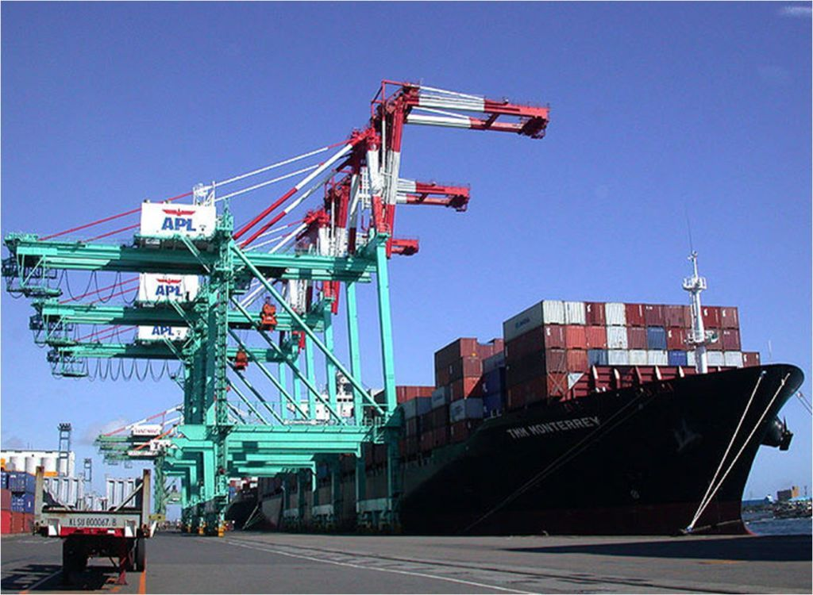
Notes:
In mod simplistic realitate domain-ului de Shipping reprezinta ceva asemanator cu imaginea aceasta:
Avem un port cu incarcaturi care se incarca in nave. Clar ca nu se incarca in oricare nava
dar in acea nava a carei grafic va permite de a transporta in locul si timp cerut de stapinul incarcaturii.

Slide 31
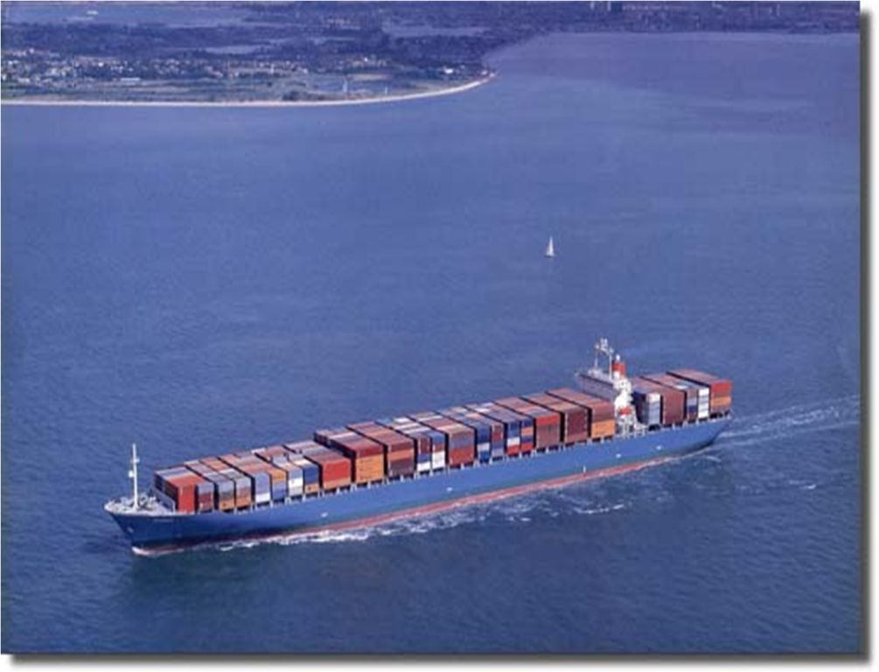
Notes:
Dupa ce se incarca, nava se deplaseaza dupa grafic prin diferite port-uri.

Slide 32
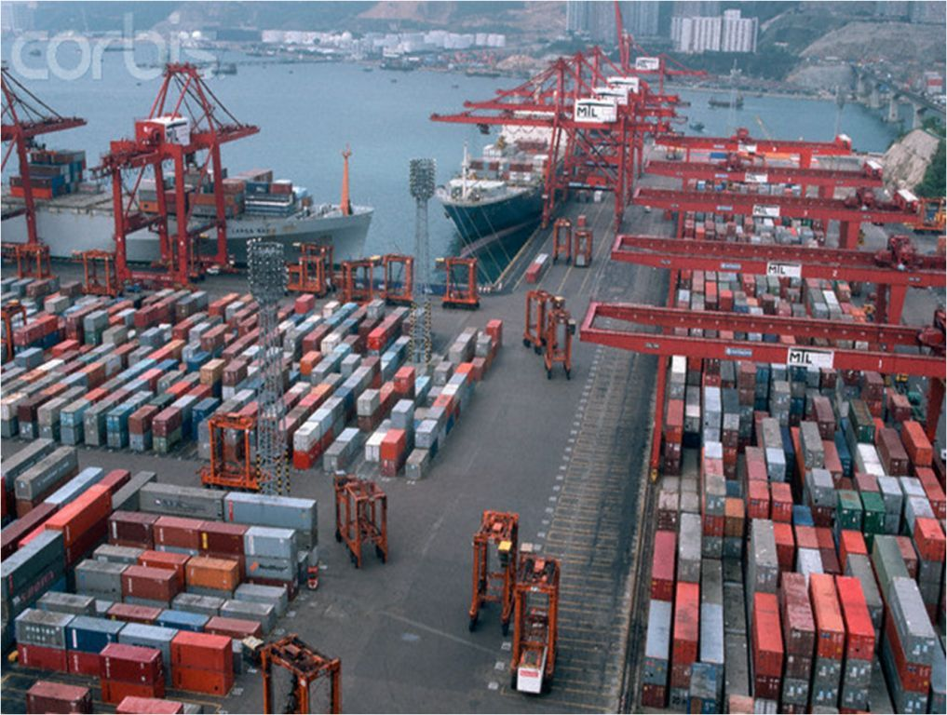
Notes:
Dupa ce incarcatura ajunge la destinatie incarcatura se descarca.
In realitate, nu intodeauna graficul porturilor nevei coincide originea si destinatia incarcaturei
deci incarcatura poate fi transportata la destinatie de mai multe nave, descarcind si incarcind incarcatura
in alte nave.

Slide 33
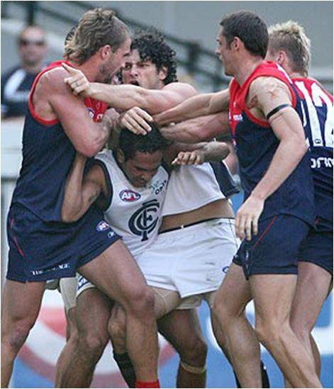
Collaboration: gathering requirements
1. As a Customer I would like to Book Cargo in advance in order to transport it to Destination
2. As a Cargo owner I would like to Track Cargo handling using a key, in order to
see Handling History
Find, Filter and Highlight the “Core”
Notes:
Dupa ce avem o imagine high-level despre business domain pentru care v-om face
aplicatia de management a incarcaturilor trecem la requirements.
Deci pentru inceput avem doua requirements:
Ca client as vrea sa inregistrez incarcatura care mai apoi urmeaza sa fie transportata la destinatie.
Ca stapinul incarcaturii as vrea sa am posibilitatea de a urmari incarcatura utilizind o keie,
pentru a vedea toata istoria transportarii incarcaturii.
Noi ca developeri prin colaborare cu Domain Experti trebuie sa analizam torentul de informatie care vine de la experti, sa-l filtram si
sa evedentiem nucleul domeniului.

Slide 34
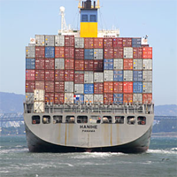

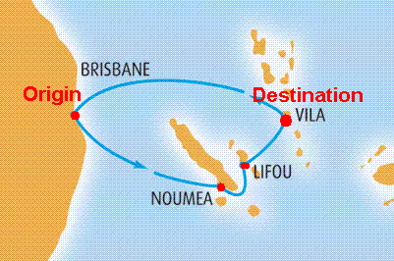
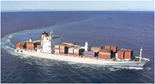
Model Evolution: Step 1
Voyage2
Cargo
Tracking Id
Route Specification
Origin Location
Destin Location
Itineraries
*
Leg
Load Location
Un-Load Location
Leg3
Leg1
Leg2
Voyage
Voyage Number
Schedule
Voyage1
Notes:
Prin discutii cu expertii evaluam un scenariu,
Vine un client care are de dus o incarcatura (Cargo), in cazul nostru un Sarcofag,
Asa apare primu obiect in domain model.
CLICK1
Acestei incarcaturi I se asigneaza imideat de sistem un ID, Tracking Id care in mode unic
identifica acest cargo mai tirziu si poate fi folosit pentru a face tracking.
CLICK2
Dupa aceasta clientul specifica ruta prin locatia, originea si destinatia incarcaturei.
Noi putem sa atasam originea si specificatia de cargo direct, dar mai bine
sa fie un obiect separat ca conceptul de ruta sa fie mai explicit.
CLICK3
In realiatate rar se intimpla cind un careva Cargo se transporta direct din locatia origine in
Locatia destinatie intr-un singur pas, deseori incarcatura se incarca si de descarca in diferite port-uri
in mai multi pasi, de la port la port. Asa apare obiectul Leg cu 2 proprietati, locatia de incarcare
Si locatia de descarcare a incarcaturii.
Leg se asociaza de Cargo ca o lista de Legs, numita Itineraries.
Itinerary este defapt un plan de a ajunge de la origine la destinatie prin un set de pasi.
Desigur ca Itinerary trebuie sa satisfaca Route Specification.
CLICK4
Acum fiecare Leg poate fi transportat de deferite corabii, fiecare corabie are
o ruta care are un Numar unic si un grafic de locatii prin care trece aceasta corabie.
Ruta corabiei si graficul corabiei este independent de existenta si necesitatea a unui cargo anumit, in cazult dat a Sarcofagului.
CLICK5
Putem obtine ca primiele 2 Leg-uri de transporatere va fi efectuata de un Voyage.
Dar utlimul Leg, de la LIFOU la VILA poate fi transportat de un alt Voyage.

Slide 35
Model Evolution: Step 2
Cargo
Tracking Id
Route Specification
Arrival Deadline Time
Origin
Destination
Location
UnLocode
*
Leg
Load Time
Unload Time
Itinerary
Load
Un-Load
Voyage
Voyage Number
Schedule
Make Itinerary and Location explicit
Discover that Location is identified by United Nations Code for
Trade and Transport Locations
Add Arrival Deadline to Route Specification
Add Load/Unload Time to Leg
Notes:
In continuare prin discutii cu experti ajungem la urmatoarele concluzii ca:
Locatia ii ceva mai complex, si se identifica dupa un cod stanard.
Itenarary apare ca un obiect separat ceea ce ne permite sa-l evedentiem in model.
Domain Expertii au mentionat ca orice client care vine nu numai specifica originea si destinatia
a incarcaturii dar si timpul de deadline in care aceasta incarcatura trebuie sa ajunga.
Asta ne inpune ca in Rout Specification sa adaugam un attribut nou: Arrival Deadline
plus la asta sa adaugam la Leg timpul cind incarcatura a fost incarcata intr-un port
si timpul cind ar sa fie descarcata incarcatura.

Slide 36
Handling History
*
Handling Event
Handling Type
Completion Time
Event Location
Cargo
Tracking Id
Route Specification
Arrival Deadline Time
Origin
Destination
Location
UnLocode
0..1
*
Leg
Load Time
Unload Time
Itinerary
Load
Un-Load
Discover that Itinerary could be assigned later
Add Handling Event: Handling Type{Load, Unload}
Add Handling History: to track handling events for a Cargo
Voyage
Voyage Number
Schedule
Notes:
In iteratia aceasta a dezvoltarii modelului dupa discutia cu experti se descopera ca
Itinarary care reprezinta planul de transportare, poate fi asignat mai tirziu.
CLICK1
Posibili chiar clientul sa aleaga singur calea care ii convine, mai eftena sau mai rapida.
CLICK2
Cind incarcatura ajunge intr-un port sau altu acest eveniment se inregistreaza
de operatori din acest port. Handling Event reprezinta un semenea eveniment,
Care are locatia unde s-a intimlpat, timpul si pentru care cargo acest eveniment s-a intimplat.
CLICK3
Si in sfirsit pentru ca modelul nostru sa suporte ultimul requirement, adica
de a da posiblitate de a duce tracking pentru o incarcatura dupa ID, am adaugat
obiectul Handling History, care de fapt reprezinta o lista de evenimente pentru un careva
Cargo.

Slide 37
VO
Handling History
AR
STOP : Select Repositories!
Entity
*
Handling Event
Handling Type
Completion Time
Event Location
AR
Entity
VO
Cargo
Tracking Id
Route Specification
Arrival Deadline Time
Origin
Destination
AR
Location
UnLocode
Entity
0..1
VO
VO
*
Leg
Load Time
Unload Time
Itinerary
Load
Un-Load
AR
VO- Value Object
Voyage
Voyage Number
Schedule
Entity
Entity
AR-Aggregate Root
Notes:
Dupa ce avem un Domain Model, trebuie sa identificam care obiecte sunt Entitati si care is Value Objects.
Incepem cu Cargo.
CLICK1
Cargo – chiar daca avem de transportat 2 sarcofaguri, trebuie sa fie posibilitate de a
le destinge unu de altu. Deci ele is Entitati, in practica toate companiile de transport
asigneaza un ID pentru orice Cargo.
CLICK2
Route Specification – sunt niste proprietati a unui Cargo, care noi le-am scos intr-un obiect aparte
pentru al face mai explicit deci este Value Object, alte argument pentru Value Object este ca
la moment Route Specification este foarte specific pentru un cargo si noi nu avem nevoie sa-l facem
comun pentru mai multe Cargo.
CLICK3 – CLICK4
Itinerary si Legs – reprezinta planul de transport care este foarte dependente de Route Specification
de aceea ele tot is Value Objects, si daca Route Specification se schimba ii mai usor pur si simplu de
a arunca Itinerary vechi si de a crea unu nou care va satisface noua Specificatie a Rutei.
CLICK5 – CLICK6
Voyage si Location – reprezinta obiecte reale ca si Cargo, care deobicei nu sunt interschimbabile,
Voyage are un numar care il identifica in mod unic dar location are un cod care deasemenea
il identifica in mod unic, deci ele sunt Entitati.
CLICK7
Handling Event – reflecta evenimente reale care tot trebuie sa se poate distinge unu de altu
pentru a ne da posibilitatea de a vedea ce se intimpla, deci ele sunt Entitati.
CLICK8
Delivery History – noi nu avem nevoie de un history Id, noi suntem mai mult interesati in
lista de evenimente din acest History care creste in timp.
Dupa ce am identificat ce reprezinta fiecare obiect,
urmatorul pas este de a identifica Aggregate Roots si Buondary a fiecarui Root.
In realitate acest proces, deseori, este unul din cele mai grele.
Sa incepem sa indentificam Aggregate Roots si hotarele, boundary a fiecarui Aggregate Root, ce
va reprezenta unitate de consistentsa, validare ect..
CLICK9
Deci Voyage si Location au identitati independente si aceste entitati pot fi comune pentru
mai multe alte obiecte, deci ele sunt Aggregate Root, si au au urmatorul boundary.
CLICK10
Cargo - deasemenea are o identitate independenta si poate fi comun pentru mai multe obiecte.
Cargo este un aggregate mai mare, route specification nu prea are sens fara Cargo caci cum si am mentionat mai inainte ca reprezinta niste proprietati a cargo.
Itenarary si Leg la moment is dependente de un route specification
ceea ce ne spune ca ele nu au sens fara Cargo si is dependente de acest cargo,
deci deasemenea intra in acelasi boundary.
CLICK11
Handling Events – deobicei vor fi create de operatori in porturi,
prin introducerea a Handling Type – de exemplu ca incarcatura a ajuns,
Timpului, Cargo tarcking Id si codul locatiei port-ului.
Aceste evenimente se creaza independent si se scot din baza prin un DB query pentru a construi History, deci el tot reprezinta un Aggregate Root.
Si este o unitate de consistenta independenta deci are boundary de sine insusi.
CLICK12
Urmatorul pas este de a alege Repositories, deobicei pentru fiecare Aggregate Root avem cite
un repository, asta nu este o regula ca pot fi si exceptii dar in majoritatea cazurilor ii asa.
---------------------------------------------------------------------
Cargo
Two identical crates must be distinguishable, so Cargo objects are ENTITIES. In practice, all
shipping companies assign tracking IDs to each piece of cargo.
Location
Two places with the same name are not the same.
Handling Event
We care about such individual incidents because they allow us to keep track of what is going on.
They reflect real-world events, which are not usually interchangeable, so they are ENTITIES.
Delivery History
We don’t need an id for the history that will identify the history, we are more interested in its event list which is growing in time.
Route Specification
A route is very tight coupled to a specific cargo that is why we are not interested to share it with other Cargoes.
Itinerary and Legs
Are plans that are also very tightly coupled to a Route Specification and customer needs (time vs cost, ect..)
That is why they are also Value Objects, so if Rout Specification is changed then is easily to drop Itinerary and set another.
Voyage
Represent a real object that is not interchangeable and similar to Cargo also has an Number that identify it, so it’s Entity.
AGGREGATE Boundaries
Voyage, Location have their own identities and are shared by many Cargoes, so they must be the roots of their own AGGREGATES.
The Handling Event is another matter. Previously we have considered possible database
query that would search for these: one, to find the Handling Events for a Delivery History.

Slide 38
Cargo’s Ubiquitous Language
Cargo
Handling Event
Route Specification
Cargo Tracking
Handling History
Tracking Id
Itinerary
Location
Voyage
Cargo Booking
Leg
Shipping Module
Voyage Number
Notes:
Cam acestea pot fi termenii folositi ca Ubiquitous Language.

Slide 39
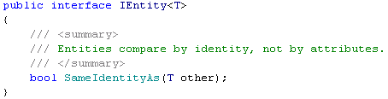
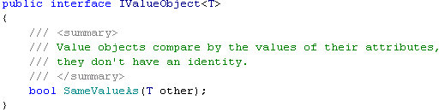
Domain Model Isolation
Presentation
Handling History
Handling Event
Handling Type
Completion Time
Application
Cargo
Tracking Id
Route Specification
Arrival Deadline Time
Domain
Location
UnLocode
Itinerary
Leg
Load Time
Unload Time
Infrastructure
Voyage
Voyage Number
Schedule
Notes:
Domain Model-ul se afla in Domain Layer. Deobicei in proiecte DDD se face o clasa de baza sau interfata pentru Entitati si Value Object
pentru a reflecta mai bine modelul, se poate de facut si o interfata pentru a marka aggregate root-uri pentru a face un mecanizm de validare,
sau repository care va lucra anume cu root-uri.
De ce poate fi nevoie de clasa de baza pentru Entitati sau VO? de exemplu in clasa de baza a Entitatii poate fi implementata
strategia de comparare a doua entitati sau implementarea generica a hashcode.
-------------------------------------------------------------------------------------------------
Minimum Infrastructure References in the domain model, only that is needed to support the domain model.
Layer Supertype is a simple idea that leads to a very short pattern. All you need is a superclass for all the objects in a layer—for example, a Domain Object superclass for all the domain objects in a Domain Model, to have common comparation logic, or hash calculation.

Slide 40
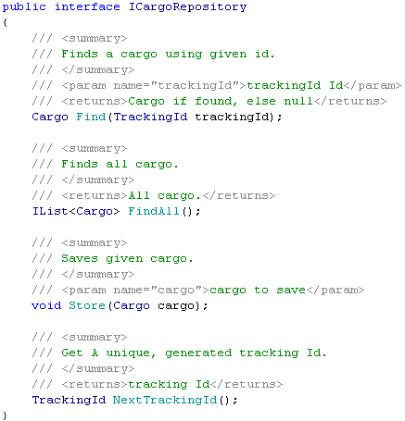
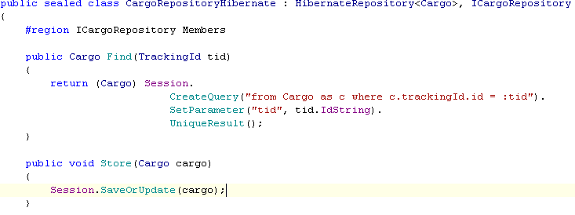
Separated Interface Pattern
Presentation
Application
Domain
Infrastructure Persistence
Infrastructure
Notes:
Pentru a implementa un persistenta prin repository pattern se aplica Separated Interface pattern.
CLICK1
Care desparte implementarea de interfaca in diferite packages sau assemblies.
CLICK2
Aceasta ne permite iarasi sa izolam domain layer de infrastructura, in cazul data persistenta.
CLICK3
------------------------------------------------------------------------------------
Separated Interface
Defines an interface in a separate package from its implementation.

Slide 41
How about design principles & patterns within Domain Layer?
Single Responsability
Open Closed
Liskov Substitution
Interface Segregation
Dependency Inversion
Design Principles
Strategy, Composite, Specification,… Design Patterns
Notes:
Poate sa apara intrebarea cum DDD se impaca cu principiile de design sau design patterne
in domain layer.
CLICK1
Ce tine de principii de design ele desigur ca trebuie sa se eie in consideratie cind facem design sau development
pentru a avea un cod mai clar, flexibil, si mai usor de mentinut.
CLICK2
Cu design paterne situatia este asemanatoare ca si cu principii, numai ca, se considera
ca patternele se relateaza mai mult la partea tehnica de aceea aplicarea paternilor in domain layer trebuie sa contina un contex de domain sau uneori patterne trebuie adaptate pentru a le da un context de domain.

Slide 42
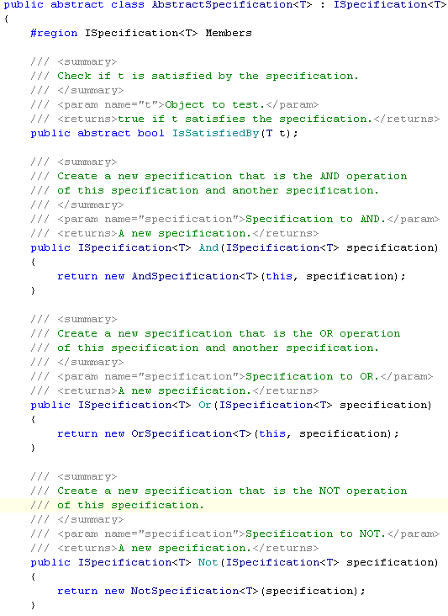
Specification
- Makes the model more explicit
- Allow to Compose
- Could be used with:
1. Repositories - to specify Queries
2. Factories – to specify Object Creation requirements
3. Validation
Notes:
You need to describe what an object might do, without explaining the details of how the object does it, but in such a way that a candidate might be built to fulfill the requirement.
Compose a complex specification but still pass as ISpecification.
Most development teams make an enormous effort to specify what data they want to use in their applications on paper, but as soon as coding starts, these specifications become a less important part of the code. Architects and developers are more interested in the how than in the what of application design. Therefore, specifications are often converted into parameters to methods instead of true first class citizens of the application.
The specification pattern wants to break this habit as it embodies an abstraction of the conditions used to match an object against. In other words, a specification is a class that says what an object should look like in order to be used, instead of how it should be used. This allows the specification to be used in a number of scenarios while being defined only once in the application. The specification can than be used as parameter to a service, to filter a set of objects or it can be used as a business rule before the object is persisted in the datastore.

Slide 43
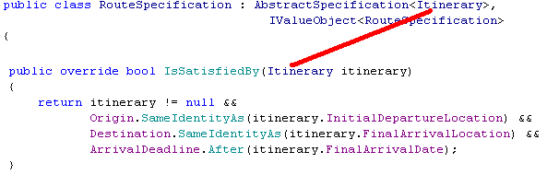
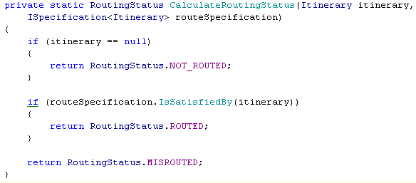
Real Sample
Cargo
Tracking Id
Route Specification
Arrival Deadline Time
Origin
Location
UnLocode
Destination
0..1
Itinerary
Usage:

Slide 44
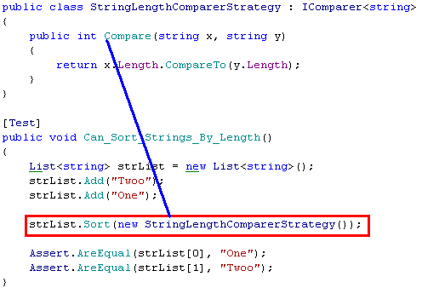
Strategy (a.k.a Policy)
Define a family of algorithms, encapsulate each one, and make them interchangeable. Strategy lets the algorithm vary independently from clients that use it.
Context
+ContextInterface()
Strategy
+AlgoritmInterface()
ConcreateStrategyA
+AlgoritmInterface()
ConcreateStrategyB
+AlgoritmInterface()
ConcreateStrategyB
+AlgoritmInterface()
Notes:
Ca exemplu am luat Strategy pattern care este foarte des folosit.
Deci daca avem o familie de algoritmi interschimbabili
CLICK1
prin o interfata
CLICK2
atunci strategy pattern iti permite de a varia acest algoritm
CLICK3
independent de clasa care il foloseshte.
CLICK4
Iata cel mai trivial exemplu a unei strategii, cind la metoda Sort ii transmitem
o strategii customizata de comparare.

Slide 45
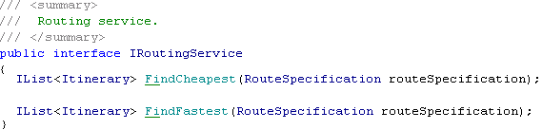


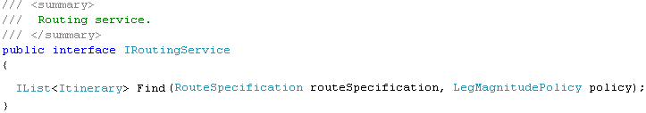
Refactoring to Policy
LegMagnitudePolicy
+Length(Leg leg): double
LegTimeMagnitude
+Length(Leg leg)
LegMoneyMagnitude
+Length(Leg leg)
Notes:
Acum ar sa explic un exemplu mai real aplicat in domain layer.
Deci fie ca avem cerinte de a implementa cautarea rutei optime in termeni de cost si in termeni de timp
care satisfac o ruta.
Ca o rezolvare in mod direct obtinem doua methode FindCheapest si find Fastest.
Dar pe parcurs pot aparea mai multe criterii de cautare a rutei, nu ar fi corect sa adaugam
pentru fiecare o methoda noua.
Deci solutia este desigur aplicarea a strategy pattern, dar in ce mod?
CLICK1
Defenim o intefata comuna de calculare.
CLICK2
Implementam acesta interfata in doua moduri, o data dupa timp alta dupa cost.
CLICK3
Si in final obtinem o metoda Find care primeste strategia de cautare ca un parametru aditional.

Slide 46
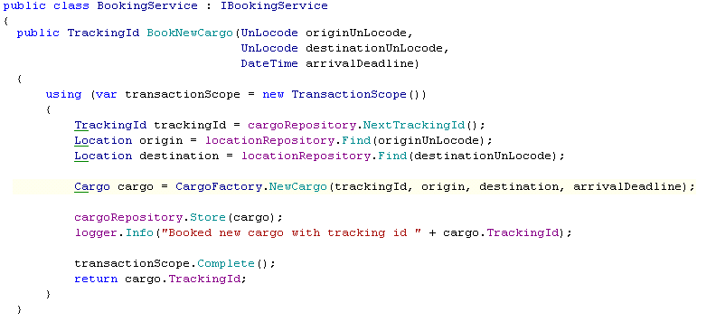
Requirement: 1. Book cargo in advance
Service\Façade Pattern
Application Services
Presentation
Application
Vote in transaction
Manipulate model
Domain
Log Info
Infrastructure
Notes:
Daca revenim la requirementul care ne cere posibilitatea de a inregistrez incarcatura.
Atunci application layer poate expune un serviciu care va fi responsabil de a:
CLICK1
Initia o transactie
CLICK2
Manipula modelul, in cazul dat de a crea un cargo si de al persista.
CLICK3
A loga informatie utilizind infrastructura de logare.
Ca o sumarizare acest layer poate implementa careva Use Case-uri prin delegare la diferite layer:
Ifrastructura sau Domain Layer, de aceea acest layer in marea parte consta din Application Service-uri si Façade.
CLICK4

Slide 47
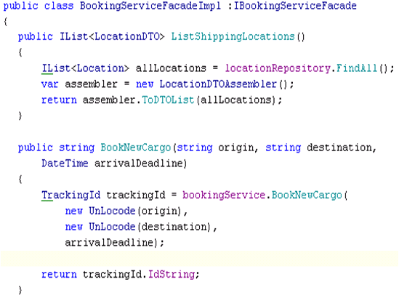
Expose to External World
DTO\Remote Façade\Transfer Assembler Patterns
RMI or WCF Services
Presentation
Application
Domain
Infrastructure
Notes:
Presentation Layer cum si am mai spus poate fi web, RMI, RPC, WCF servicii sau a prezenta informatia la utilizator.
In cazul cind is web servicii de exemplu, este important ca sa nu expunem modelul direct.
Doarece domain modelul nu este optim si gindit pentru a transmite date, pentru aceasta se folosesc
Data Transport Objects
CLICK1
care sunt expuse prin Remote Façade.
CLICK2
Si pentru a transla din un Domain Model in DTO model. Se foloseste o clasa assembler.
CLICK3
Toate aceste lucruri se fac pentru a optimiza transportarea datelor si a izola Domain Modelu de
Influenta lumii exterioare.

Slide 48
MVC & Remote Facade
DTO Model
View
Leg.aspx
or leg.jsp
LegDTO
4. Display
LegDTO
Booking Service
Controller
1. Request
3. And pass the
DTO to View
LegDTO
2.Reply
LegDTO
Notes:
Ce se intimpla mai departe, dupa ce se expun web serviciile.
In cazul litera M, adica Model din MVC reprezinta DTO-uri.
CLICK1
Controleru face un request, de un Itinerary.
CLICK2
care se transforma in o lista de LegDTO.
CLICK3
Dupa aceasta controleru transmite aceste DTO-uri la View
pentru Display.
CLICK4
CLICK5

Slide 49
MVC & Domain Model Isolation
Domain Model View Adapters
View
Cargo.aspx
or cargo.jsp
Domain Model
Cargo ViewAdapter
3.Display
Cargo ViewAdapter
Cargo
Controller
2. And pass the
Adapter to View
Adapter\Model Presenter,… Pattern
1. Create
Cargo ViewAdapter
based on
Cargo
Notes:
In cazul cind comunicare cu Domain Layer nu se face in acelasi process.
Atunci daca avem nevoie sa facem display la Cargo de exemplu din Domain Layer.
CLICK1
Atunci este important sa nu expunem Cargo din domain layer direct la View.
Dar prin niste adaptere,
CLICK2
care vor adapta domain modelu la modelu care este mai comod
pentru prezentare.
CLICK3
Cum asta se face?
CLICK4
Se creaza un Cargo View Adapter pe baza unui Cargo.
CLICK5
dupa aceasta se transmite anume acest adapter la prezentare.
in asa mode noi isolam domain model-ul care este anume de a rezolva probleme
Legate strict de domain, si il adaptam, expunem in diferite moduri care is comode pentru
diferite reprezentari, manipulari, ect…

Slide 50
DDD benefits?
Reduced complexity
Continuous collaboration and feedback
Translations are reduced to minimum
Higher maintainability
Etc…
Notes:
Deci care sunt beneficiile la aplicarea DDD?
Complexitatea proiectului se reduce si este mai controlabila, cel mai important
este ca toti membrii implicati au o imagine clara a supra domainului, ceea ce
permite de a avea un feedback si o colaborare mai productiva fara translari de termeni.
Toate aceste lucrururi duc la o mentenanta si dezvoltare a softului cit mai fructuoasa.

Slide 51
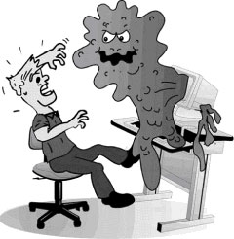
DDD Anti-patterns
Anemic Domain Model
Big Design Up-Front (BDUF)
Smart UI
Represent Model Classes as Record Sets,…
try to keep Model classes to POCO/POJO
Notes:
Exista un set de antipaterne care trebuie sa fie evitate in special cind facem un proiect bazat pe DDD.
Anemic Domain Model – este cind domain model este un set de gettere si settere fara logica.
Big Design Up-Front – este cind un proiect trece in etape de la stringera requirements pina la analiza
Architectura si low level design asa cum se intimpla in waterfall. In asa proiecte feedback-ul se reduce la minimum.
Si in rezultat, sau developeru intelegind problema mai bine o rezolva in felul lui ingorind efortul etapelor anterioare,
sau implementeaza asa cum I s-a dat in design fara a introduce un careva improvement.
Smart UI – este cind toata logica domain, infrastructura,…. este plasata in presentation layer.
Inca unca un fapt care se considera antipatern, este de a implementa domain model prin data seturi, recordset-uri,
sau alte technologii sau frameworkuri.. Domain model trebuie sa fie niste classe simple, independente care reflecta
doar logica de domain.

Slide 52
Agile Practices
Iterative Development
Developers and domain experts have close relationship
TDD
Continuous Refactoring
Notes:
DDD foarte bine se aplica cu diferite metodologii si practici Agile.
Prin iteratii si retrospective se descopera modele mai bune si avansate mai bine reflectind domainul in software.
Dupe cite am vazut colaborarea cu expertii de domain este importanta si trebuie sa fie continua.
Domain Model Logic este usor testabila caci are dependente minime de infrastructura.
Test First Design – este aplicabil pe larg in DDD.
Un effort mic de Rafctoring poate aduce un mare beneficiu si permite ca Modelul sa nu se transforme in unul legacy.
-------------------------------------------------------------
Iterative Development – focus to core, then add additional requirements incrementally discovering deeper models. Iteration retrospectives are also very important, that allows is a good chance to judge and revise the model implementation and its value for the iteration.
The returns from refactoring are not linear. Usually there is a marginal return for a small effort,
and the small improvements add up. They fight entropy, and they are the frontline protection
against a fossilized legacy. But some of the most important insights come abruptly and send a
shock through the project.
A set of tests that are written and maintained by developers to
reduce the cost of finding and fixing bugs—thereby improving
code quality—and to enable the change of the design as
requirements are addressed incrementally. Disciplined writing of
tests encourages loosely coupled designs.
Because Domain Model Layer is Persistence & Infrastructure Ignorant, the model could be easily tested, producing very fast and clean tests.
Continuous Integration reduces time to market and increasing quality
to market by finding Integration bugs often and early, thus eliminating
“hardening Iterations” and the rework that goes along with it.
Continuous Integration also increases visibility of the progress of the
project by making it explicit to the development team and
stakeholders.

Slide 53
Tools and Frameworks
IoC & DI containers
AOP frameworks
ORMs
Mocking Frameworks
Notes:
Rolul tool-urilor si frameworkurilor nu este obligator in proeicte DDD dar pot aduce un benificiu mare.
IoC & DI containers – permit de a decupla in mod mai simplificat diferite aspecte.
AOP – permite de a scrie un cod mai modular si de a “injecta logica” in moment de compilare, sau runtime
fara a polua codul client. De exemplu de a injecta logica de logare in domain layer.
ORM-ca hibernate au un support bun pentru POCO\POJO inclusiv pentru Entityes si Value Objects, plus
este un instrument bun de a abstractica DB schema de domain model.
Mocking Frameworks – este un tool important pentru TDD care permite de a scrie unit teste in isolare.
-------------------------------------------------------------------------------------
IoC & DI containers – allows to decouple various parts of code, increasing cohesion and substitutability leading to maintanable code.
AOP – allows to increase code modularity by providing “logic injection” like logging without polluting client code.
ORMs – like Hibernate have a great support for POCO\POJO including Entity and Value Objects and provide a good abstraction over DB schema,
allowing to concentrate more on the Model.
Mocking Frameworks – is very important tool for TDD practice, that allows to simulated objects that mimic the behavior of real objects in controlled ways. The technique is very important for decoupling.

Slide 54
Domain Specific Language(DSL)
-Make programs more expressive
-Strongest connection to Ubiquitous Language
BUT
Model refinement can become a problem:
-Developer needs to modify the
DSL(grammar declarations, interpretation,…)
-Difficulties to refactor
SO
Could be used for mature Models where client code
is written by a different team
Notes:
La unii le poate aparea intrebarea care tangenta intre DDD si DSL.
DSL, este un limbaj adresat unui domeniu foarte specific, ex: Reg Express, SQL.
Java, C# nu-s DSL-uri ele se considera limbaje cu un scop mai general.
Ex: cu 1 C
----------------------------------------------------
a language, programs can be extremely expressive, and make the strongest connection
with the UBIQUITOUS LANGUAGE. This is an exciting concept, but domain-specific languages also
have their drawbacks in the approaches I've seen based on object-oriented technology.
To refine the model, a developer needs to be able to modify the language. This may involve
modifying grammar declarations and other language-interpreting features, as well as modifying
underlying class libraries. I'm all in favor of learning advanced technology and design concepts, but
we have to soberly assess the skills of a particular team, as well as the likely skills of future
maintenance teams.
Another drawback is that it can be difficult to refactor client
code to conform to a revised model and its associated domain-specific language. Of course,
someone may come up with a technical fix for the refactoring problems.
This technique might be most useful for very mature models, perhaps where client code is being
written by a different team. Generally, such setups lead to the poisonous distinction between
highly technical framework builders and technically unskilled application builders, but it doesn't
have to be that way.

Slide 55
References
Domain-Driven Design: Tackling Complexity in the Heart of Software
Domain Driven Design Quickly
Applying Domain-Driven Design and Patterns: With Examples in C# and .NET
Patterns of Enterprise Application Architecture
.NET Domain-Driven Design with C#: Problem - Design – Solution
Cargo DDD Application Sample – C# implementation/ Java implementation
My Blog Post - Domain Driven Design: Learning
My e-mail artur.trosin@gmail.com ☺

Slide 56
Finally{}
Thank you
Questions?

