Slide 1
Data analysis
I used this data to complete this task:
Articles.csv
transactions-2p-42.csv

Slide 2
Main indicators
Number of customers – 230,688
Number of transactions – 336,078
Average spending per customer per year - 0.036 $
Min price - 0.000186 $
Max price – 0.5 $
Median price – 0.025 $

Slide 3
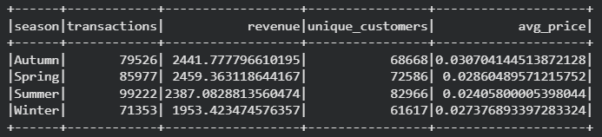
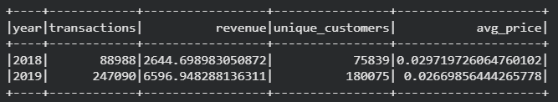
Product trend changes through seasons of the year
Product trend changes through the years

Slide 4
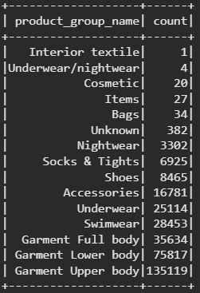
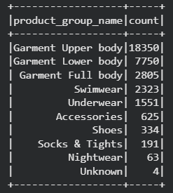
Product groups with the highest customer loyalty
Product group name and count

Slide 5
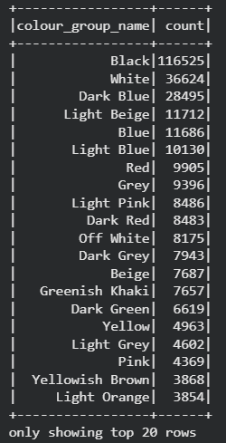
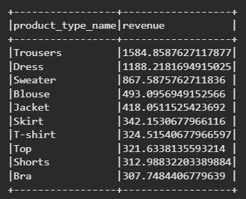
Most popular color category
Top 10 revenue-generating product types

