Slide 1
Java / Frontend Projects
Rafał Borowiec

Slide 2
Aviobook
Multiplatform, Electronic Flight Bag software solution with backend offices support

Slide 3
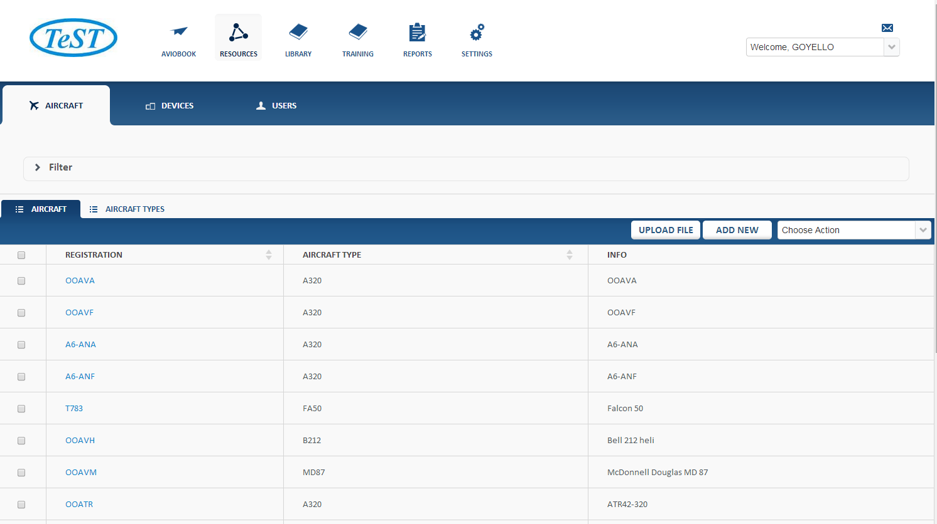

Slide 4
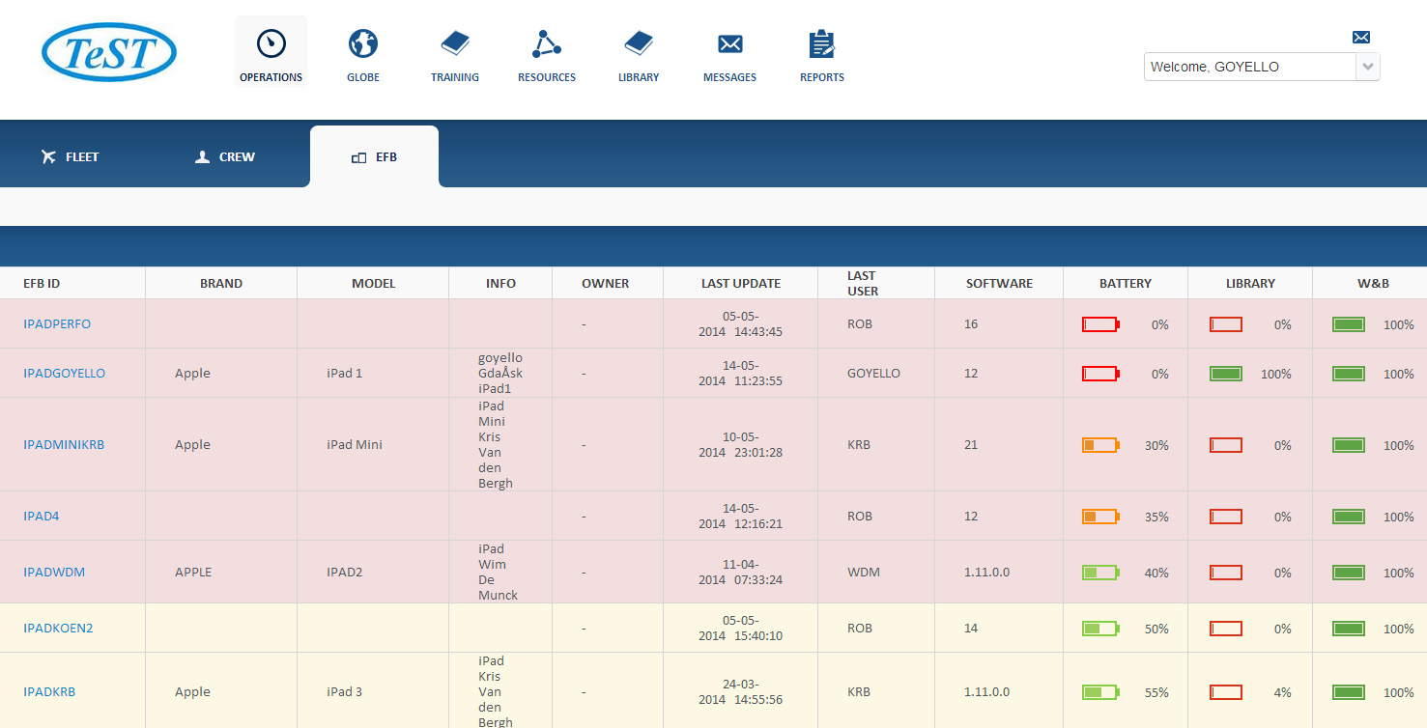

Slide 5
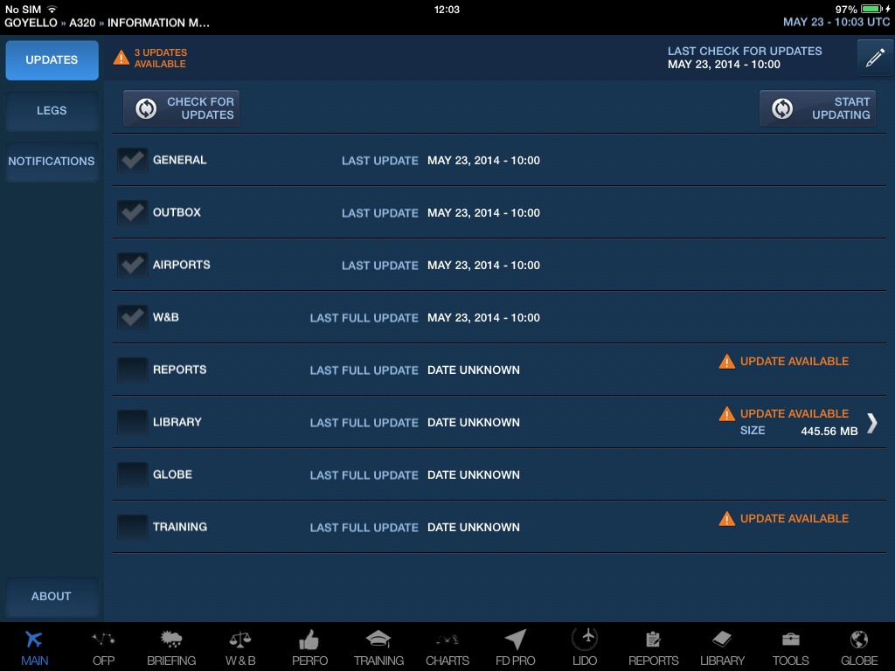

Slide 6
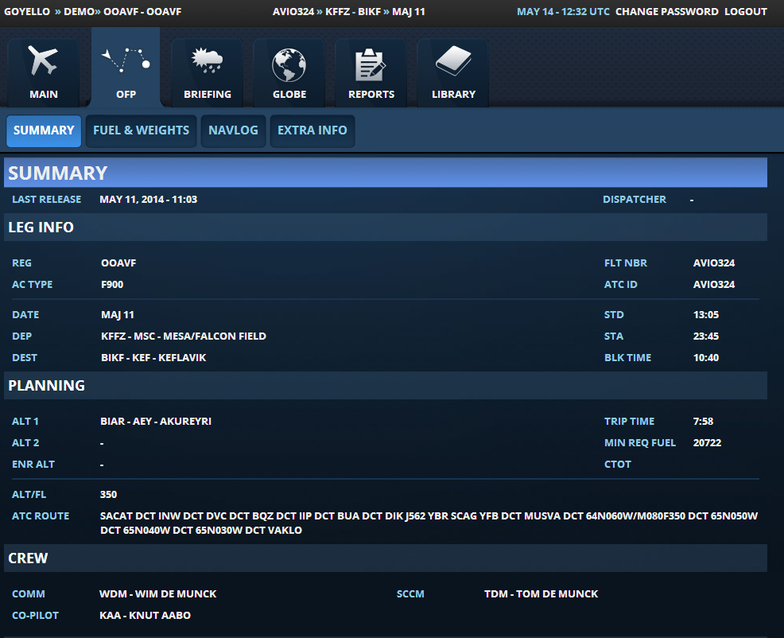

Slide 7
Cycling Service
Managing the information flow between different parties in a cycling organization with a very attractive user interface

Slide 8
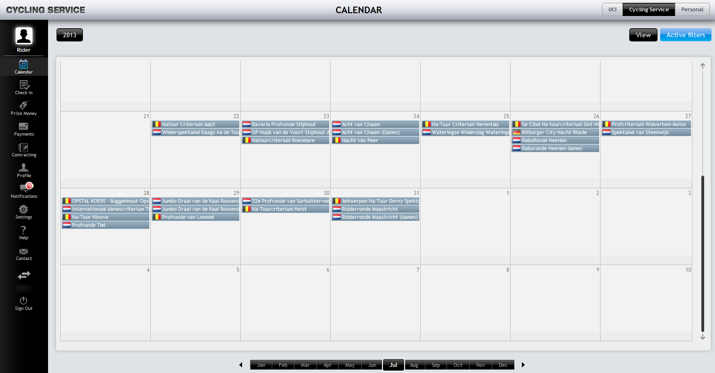

Slide 9
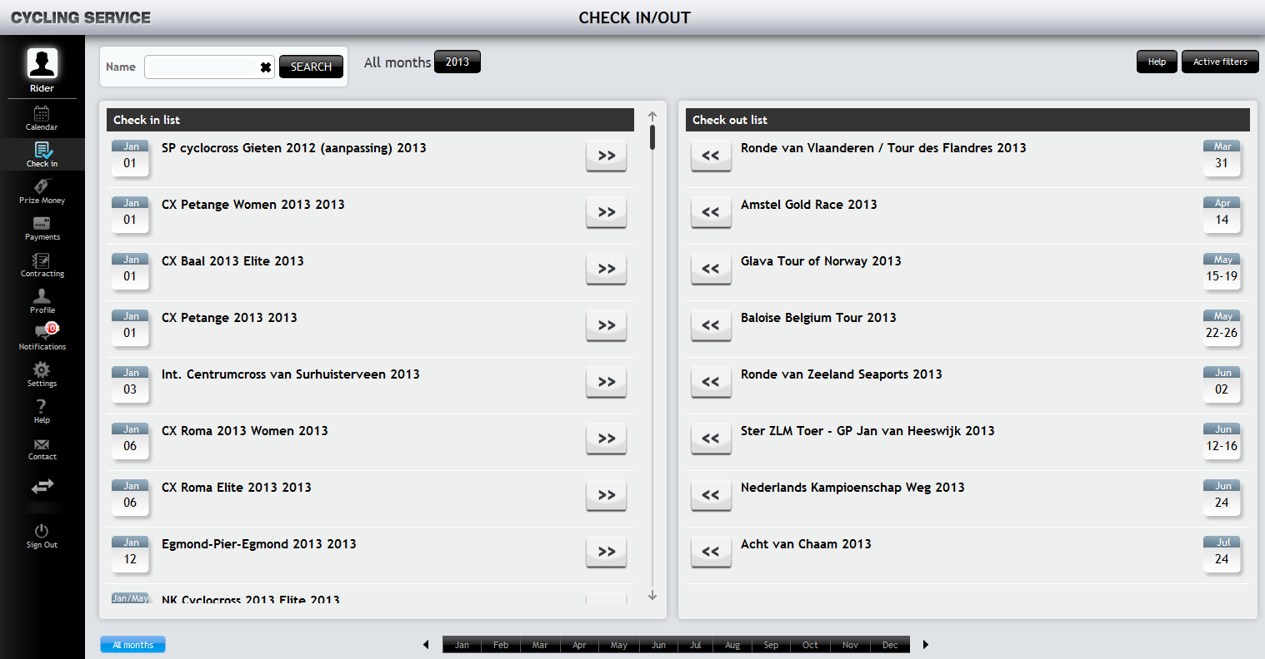

Slide 10
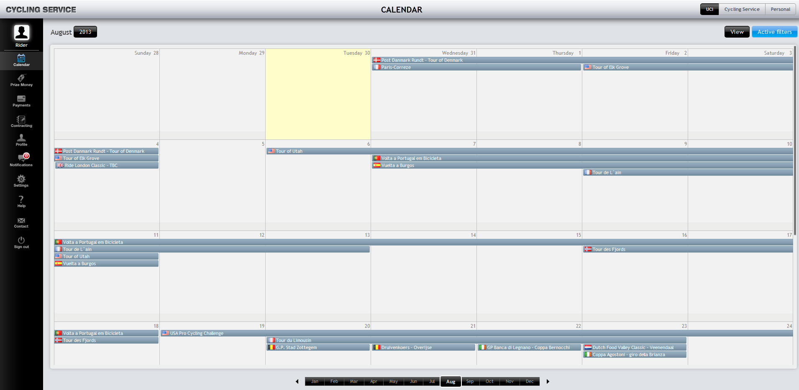

Slide 11
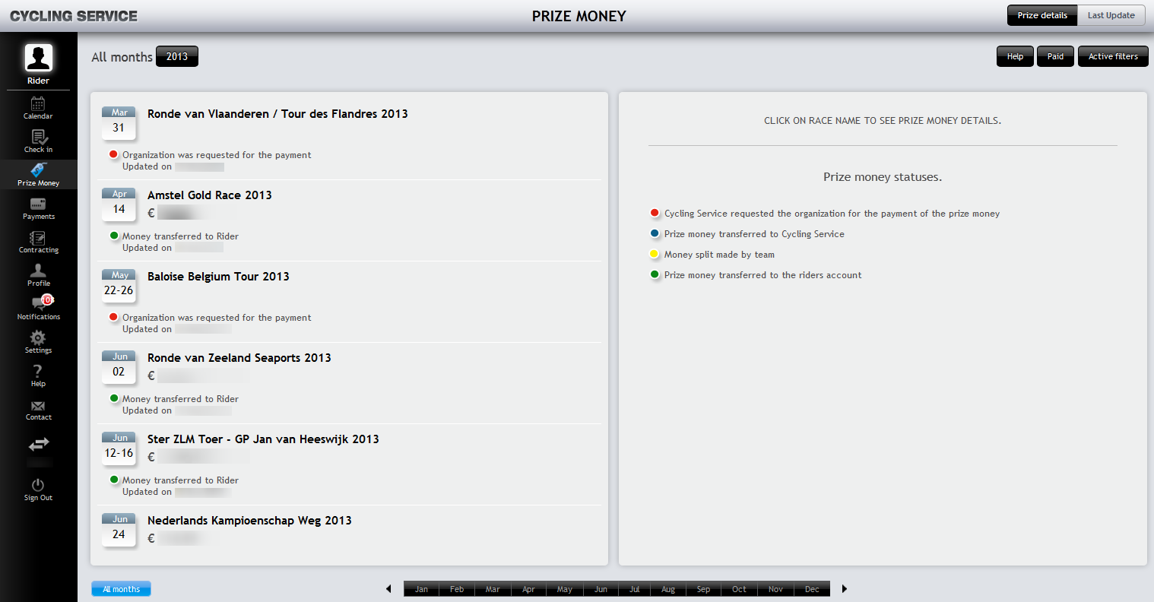

Slide 12
E-Scan
Entrepreneur Platform helps users to further develop their entrepreneurial skills

Slide 13
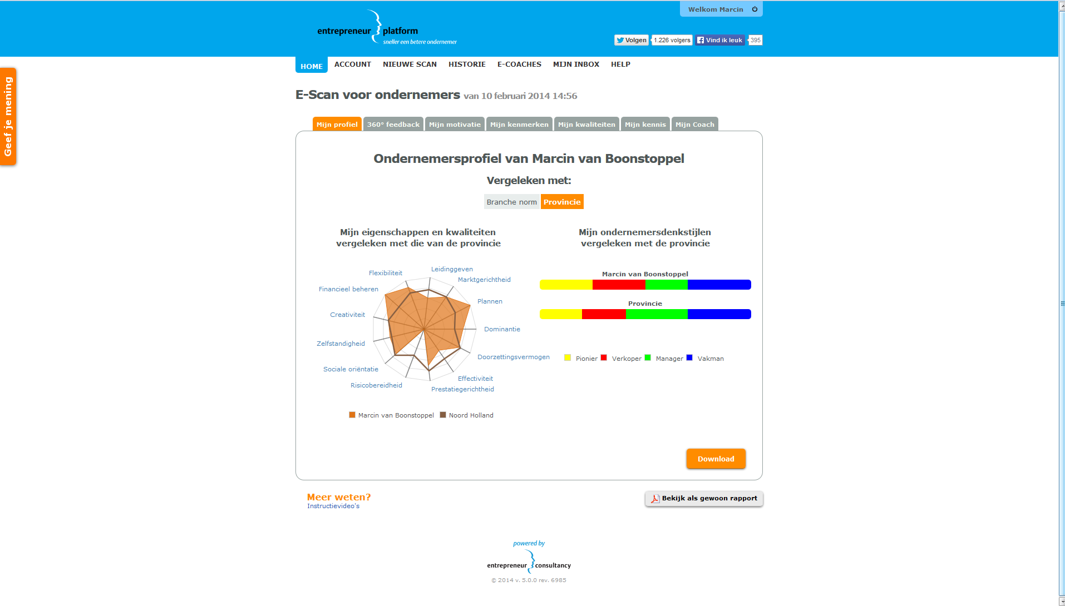

Slide 14
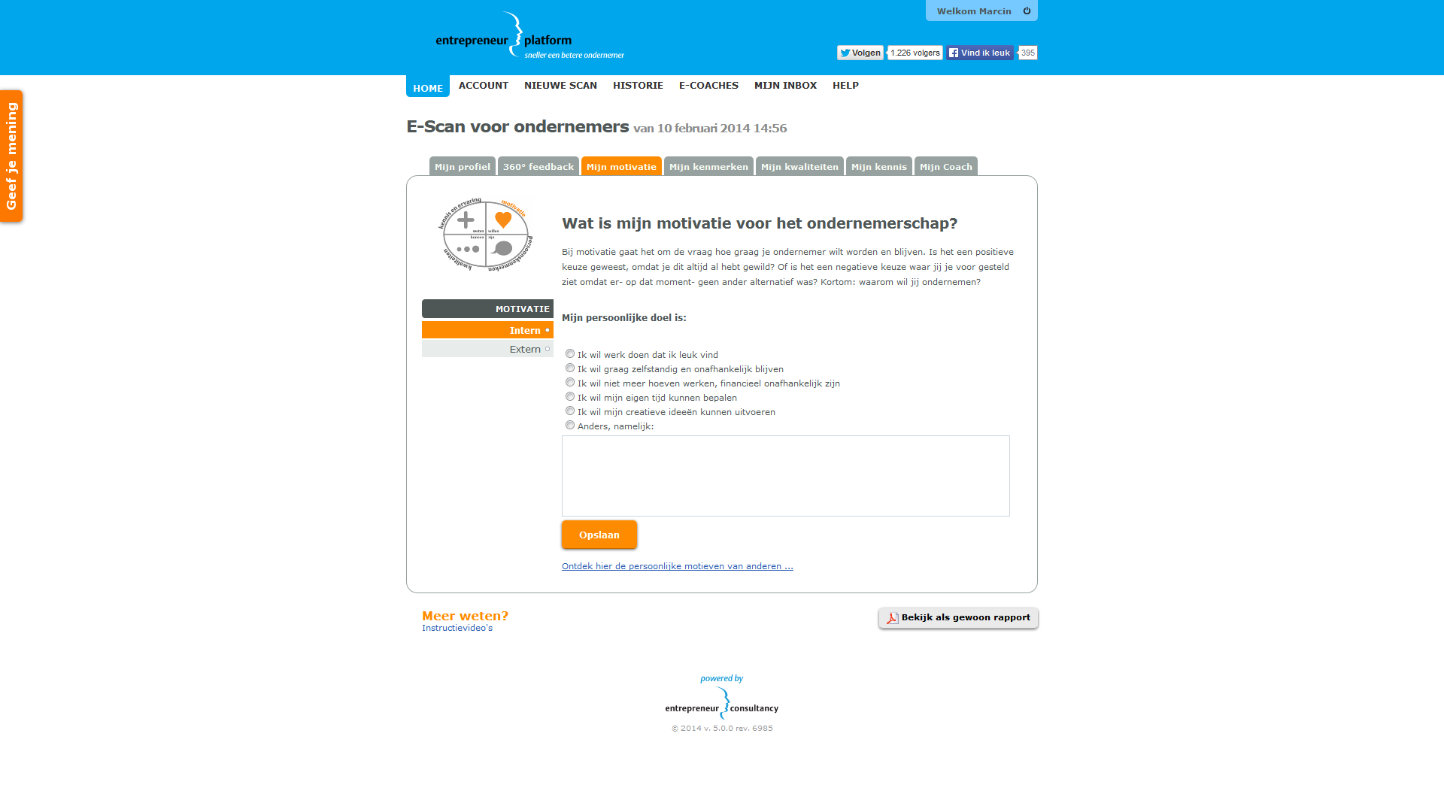

Slide 15
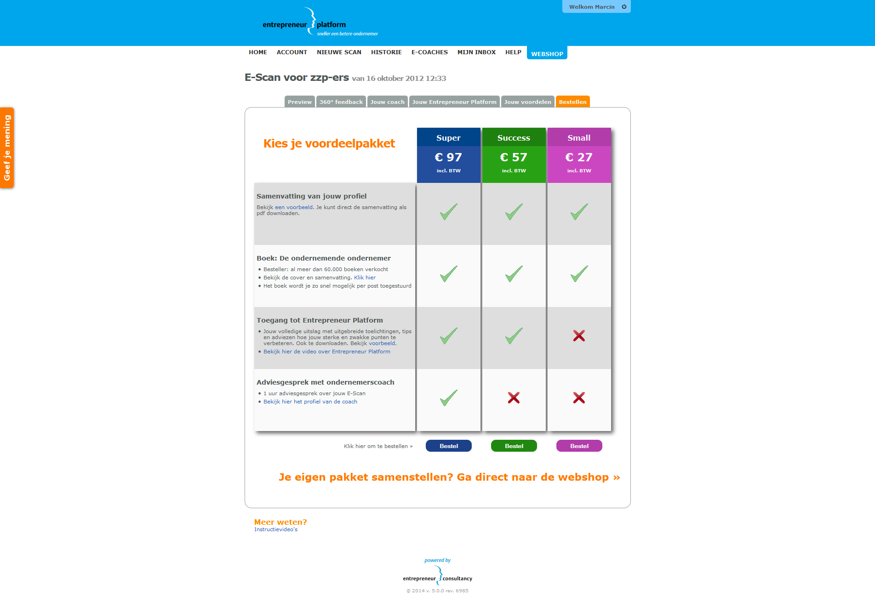

Slide 16
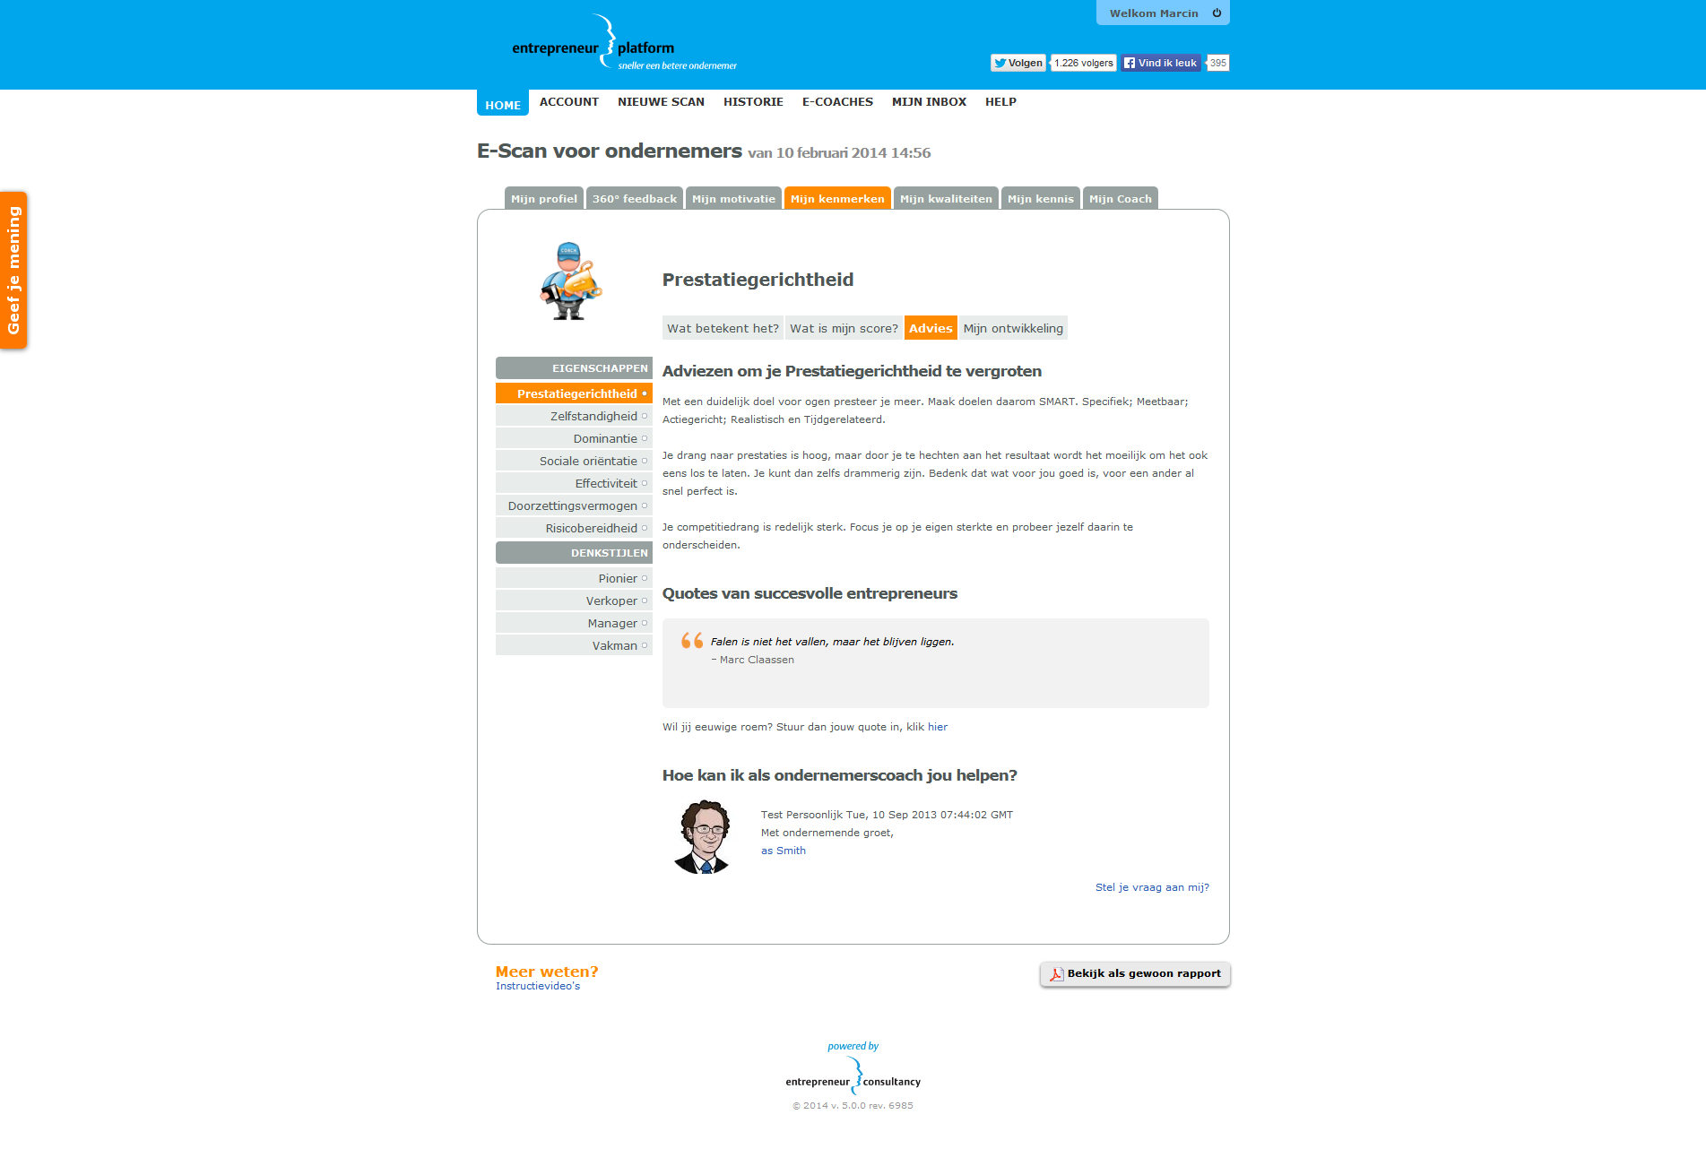

Slide 17
FanTuner
Social media (currently Facebook) analytics tool

Slide 18
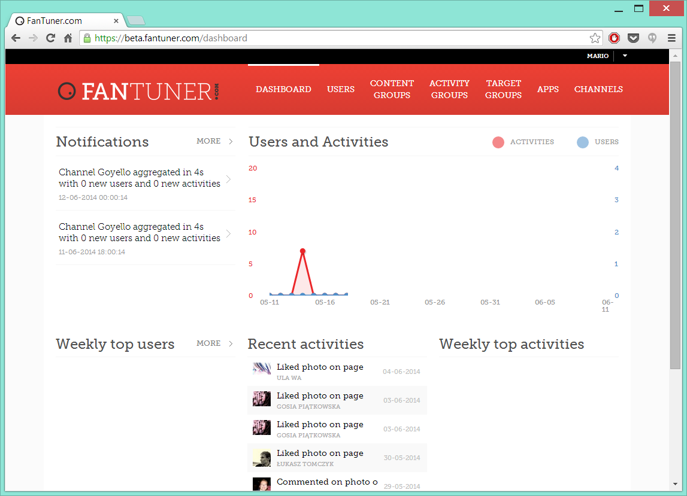

Slide 19
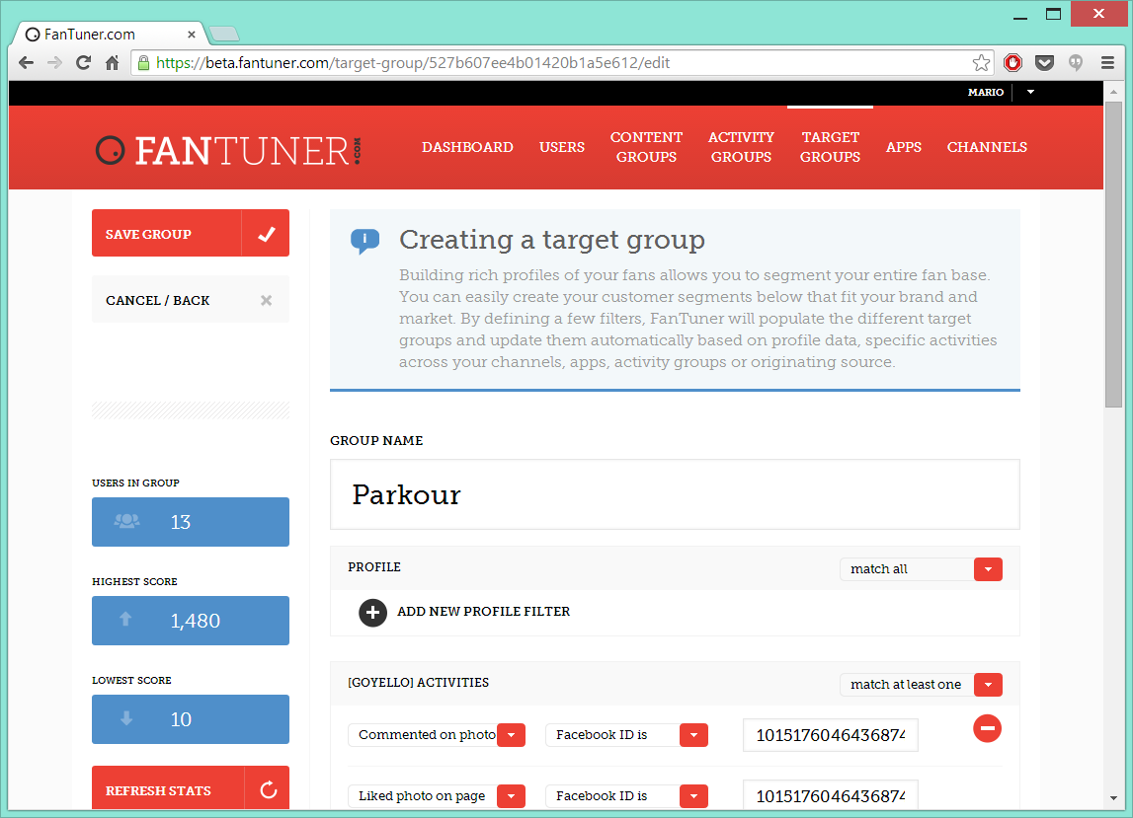

Slide 20
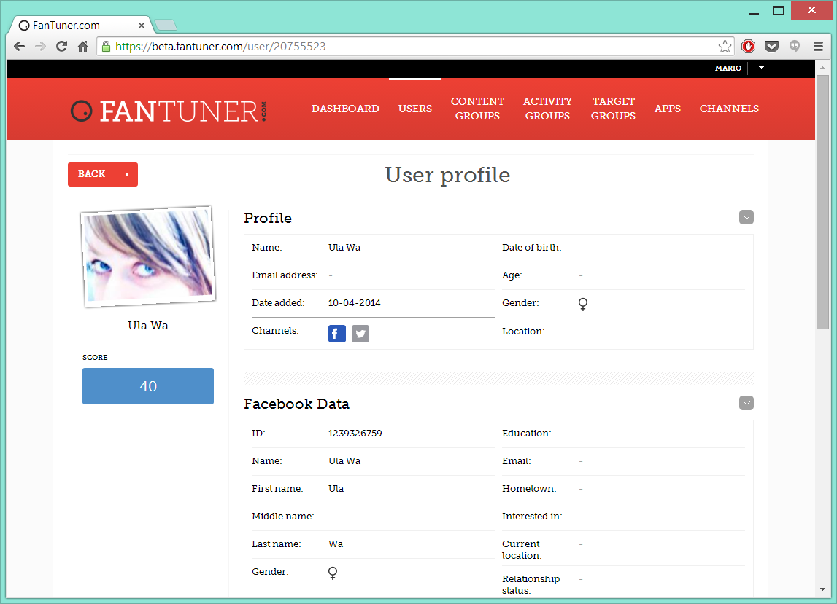

Slide 21
RedBox
Communication solutions in Credit Management
Ensures communication via SMS, Email, letter, automated outgoing voice message and the web.

Slide 22
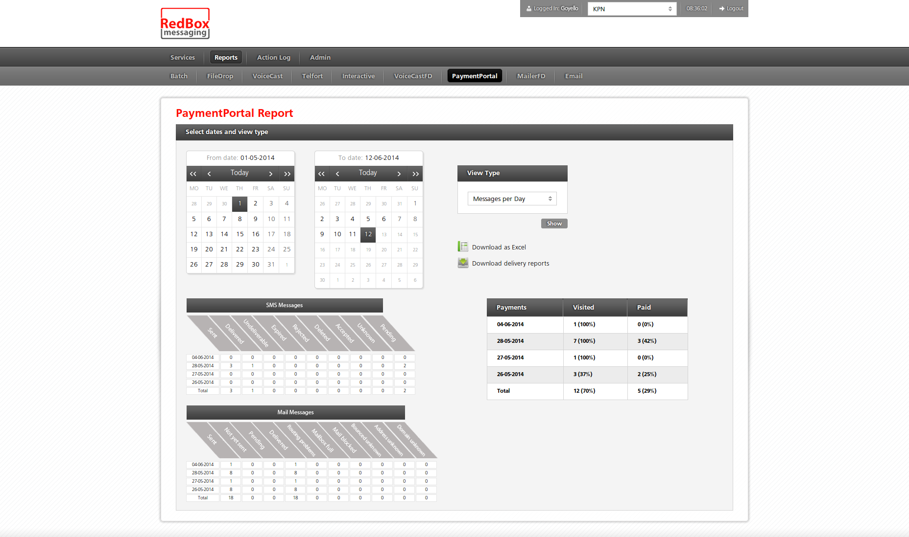

Slide 23
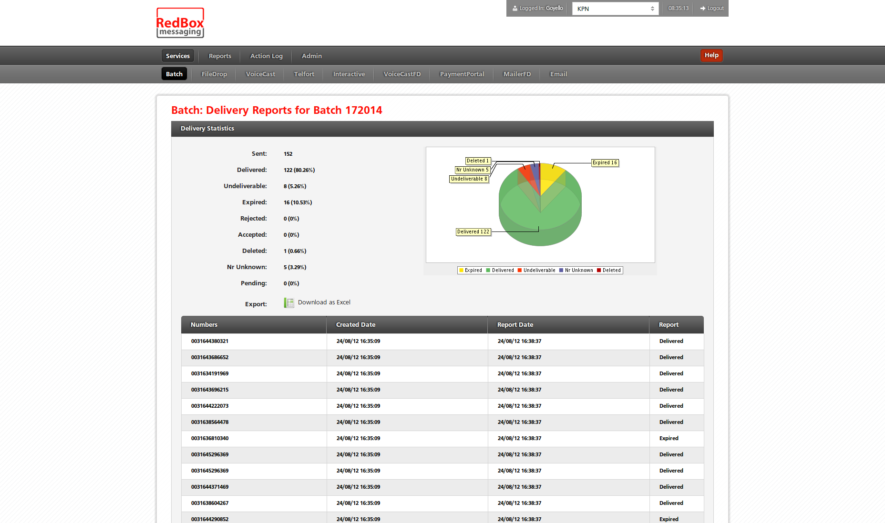

Slide 24
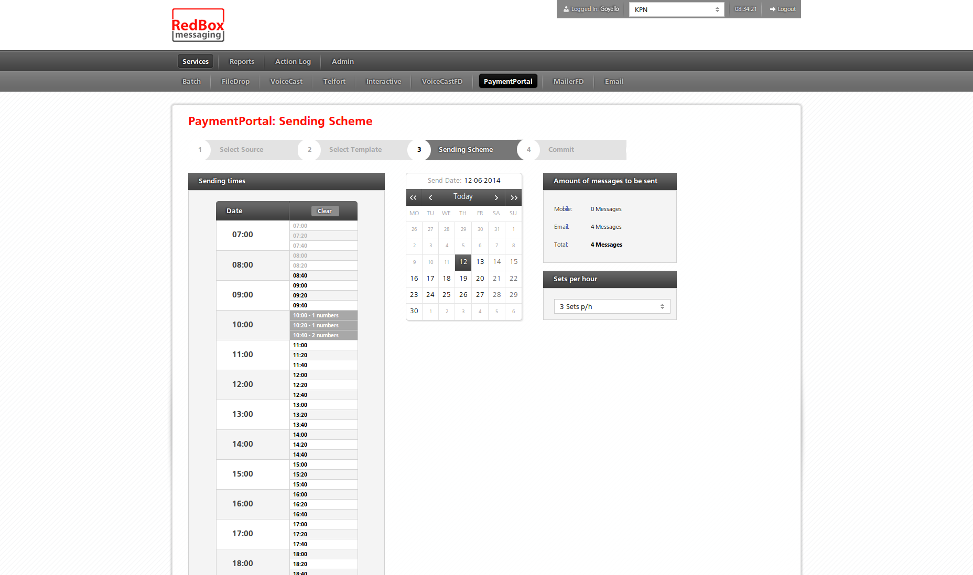

Slide 25
Competences
Certified Java Engineers
Certified Testers
Agile techniques:
Quality of code
Automatic Testing (Unit and Functional)
Continuous Integration
Static code analysis
Knowledge of Spring framework
Knowledge of Java EE technologies
Knowledge of variety of Frontend frameworks
Continuous improvement
Adjusting to customer needs

