Slide 1
Front-End Development
Artur Stępień

Slide 2
Agenda
Metronic Theme
JavaScript
Tools
Overall architecture

Slide 3
Metronic
Metronic is a responsive and multipurpose admin and frontend theme powered with Twitter Bootstrap 3.2.0 Framework. Metronic can be used for any type of web applications: custom admin panels, admin dashboards, eCommerce backends, CMS, CRM, SAAS and websites: business, eCommerce. corporate, portfolio, blog.

Slide 4
Front-End frameworks
Pre-build CSS and JS to make 80% of use-cases
Built-in grid systems
Many ready to use defaults, buttons, forms, etc.
Commonly-used elements like dropdowns, alers, panels, etc.
JavaScript to power interactivity

Slide 5
Maintaining JavaScript components
How do you get jQuery ?
Visit the website, click download the package, open the zip, navigate and find the file that you want, copy it into the project ?
The answer is No!

Slide 6
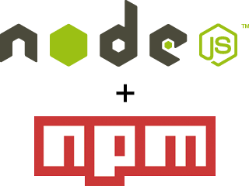
Node.js and npm
Node.js
Node.js is a platform built on Chrome's JavaScript runtime for easily building fast, scalable network applications. Node.js uses an event-driven, non-blocking I/O model that makes it lightweight and efficient, perfect for data-intensive real-time applications that run across distributed devices.
Nuget Packaged Module manager
Any package can be installed by using npm install.

Slide 7

Bower
This tool helps to manage packages for the we. Bower works by fetching and installing packages from all over, taking care of hunting, finding, downloading, and saving the stuff you’re looking for. Bower keeps track of these packages in a manifest file, bower.json. How you use packages is up to you. Bower provides hooks to facilitate using packages in your tools and workflows.
npm install -g bower

Slide 8


Too many things to do
Compiling SASS/LESS stylesheets to one script
Using jsHint to catch the problems in JavaScript files
Concating, minifying files
Running tests

Slide 9
Grunt
The JavaScript task runner
In one word: automation. The less work you have to do when performing repetitive tasks like minification, compilation, unit testing, linting, etc, the easier your job becomes. After you've configured it, a task runner can do most of that mundane work for you—and your team—with basically zero effort.

Slide 10
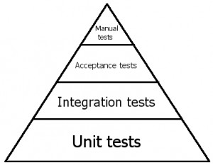
Unit testing
Jasmine
Karma

