Slide 1
Front-End Development
Artur Stępień

Slide 2
Agenda
Metronic Theme
Front-End Utilities
Maintaining JavaScript components
Node.js & npm
Bower
Grunt
AngularJS
Unit testing
JavaScript – coding standards
IDE for Front-End development
Overall architecture

Slide 3
Metronic
Metronic is a responsive and multipurpose admin and frontend theme powered with Twitter Bootstrap 3.2.0 Framework. Metronic can be used for any type of web applications: custom admin panels, admin dashboards, eCommerce backends, CMS, CRM, SAAS and websites: business, eCommerce. corporate, portfolio, blog.

Slide 4
Front-End Utilities
Pre-build CSS and JS to make 80% of use-cases
Built-in grid systems (e.g. BootstrapTwitter, 960 Grid System)
Many ready to use defaults, buttons, forms, etc.
Commonly-used elements like dropdowns, alerts, panels, etc.
JavaScript to power interactivity

Slide 5
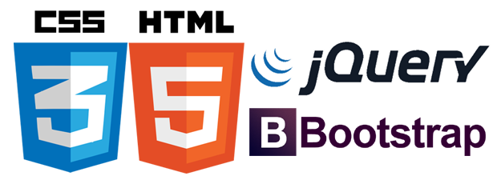
Bootstrap Twitter
It’s the most popular HTML, CSS, and JS framework for developing responsive, mobile first projects on the web.
jQuery
It’s a fast, small, and feature-rich JavaScript library. It makes things like HTML document traversal and manipulation, event handling, animation, and Ajax much simpler with an easy-to-use API that works across a multitude of browsers. With a combination of versatility and extensibility, jQuery has changed the way that millions of people write JavaScript.

Slide 6
Maintaining JavaScript components
How do you get e.g. jQuery ?
Visit the website, click download the package, open the zip, navigate and find the file that you want, copy it into the project ?
Can I do it faster ? Yes!
bower install jquery –save

Slide 7
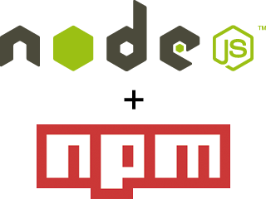
Node.js and npm
Node.js
Node.js is a platform built on Chrome's JavaScript runtime for easily building fast, scalable network applications. Node.js uses an event-driven, non-blocking I/O model that makes it lightweight and efficient, perfect for data-intensive real-time applications that run across distributed devices.
Nuget Packaged Module manager
Any package can be installed by using npm install.

Slide 8

Bower
This tool helps to manage packages for the we. Bower works by fetching and installing packages from all over, taking care of hunting, finding, downloading, and saving the stuff you’re looking for. Bower keeps track of these packages in a manifest file, bower.json. How you use packages is up to you. Bower provides hooks to facilitate using packages in your tools and workflows.

Slide 9


Too many things to do
Compiling SASS/LESS stylesheets to one script
Using jsHint to catch the problems in JavaScript files
Concating, minifying files
Running tests (Jasmine, Karma)

Slide 10

Grunt
The JavaScript task runner
In one word: automation. The less work you have to do when performing repetitive tasks like minification, compilation, unit testing, linting, etc, the easier your job becomes. After you've configured it, a task runner can do most of that mundane work for you—and your team—with basically zero effort.

Slide 11

AngularJS
It’s an open-source web application framework, maintained by Google and community, that assists with creating single-page applications, one-page web applications that only require HTML, CSS, and JavaScript on the client side. Its goal is to augment web applications with model–view–controller (MVC) capability, in an effort to make both development and testing easier.

Slide 12
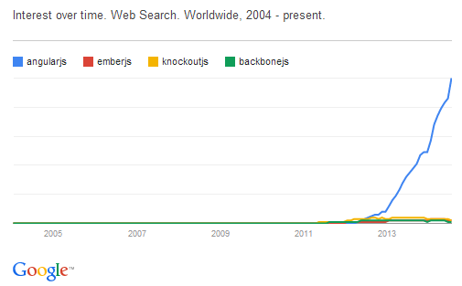
AngularJS - statistics
Google Search Trends - Link

Slide 13


Unit testing
Jasmine Jasmine is a behavior-driven development framework for testing JavaScript code. It does not depend on any other JavaScript frameworks. It does not require a DOM. And it has a clean, obvious syntax so that you can easily write tests. This guide is running against Jasmine version 2.0.0.
Karma The main goal for Karma is to bring a productive testing environment to developers. The environment being one where they don't have to set up loads of configurations, but rather a place where developers can just write the code and get instant feedback from their tests. Because getting quick feedback is what makes you productive and creative.

Slide 14
JavaScript – coding standards
JavaScript Design Patterns
Constructor Pattern
Module Pattern
Revealing Module Pattern
Singleton Pattern
Observer Pattern
Mediator Pattern
Prototype Pattern
Command Pattern
Facade Pattern
Factory Pattern
Mixin Pattern
Decorator Pattern
Flyweight Pattern

Slide 15
IDE for Front-End development
WebStorm
Brackets
Sublime Text
Aptana Studio

Slide 16
Overall architecture
DEMO

Slide 17
Thank you

