Slide 1
Theory Review 1st Session December 2021

Slide 2
Second lesson
First lesson – THIS ONE!
Class components vs Functional Components
Higher Order Components
Hooks
3rd party libraries: Router, redux, sagas, thunks…
Good practices about architecture, performance and Memo(detectChanges/markForChanges in angular).

Slide 3

Class components vs Functional Components
Functional Components are relatively new but growing fast in popularity
99% of all React development could be done and should be done with Functional Components
However you will see lots of Class Components from when working in real world environments because not long ago, that was the only way to work
1 – Code challenge introduction
Buddy has to present the code challenge.
1 session of 30 minutes
Francisco Azcarate
John Paul Moran
Fernando Ramos
Alberto Martín
Buddies for the first groups:
Buddies for next groups:
Advantages Class Components
Access to lifecycle methods
Slightly faster bundle load time
It is the original ‘proper’ javascript way
Advantages Functional Components
Less code
It’s the modern ‘cool’ way
Encourages hooks and custom hooks to create clean looking components

Slide 4
Class components vs Functional Components
Disadvantages Class Components Disadvantages Function Components
1 – Code challenge introduction
Buddy has to present the code challenge.
1 session of 30 minutes
Francisco Azcarate
John Paul Moran
Fernando Ramos
Alberto Martín
Buddies for the first groups:
Buddies for next groups:
More code to write
Will have to use the ‘this’ in binding
Will have to use LifeCycles
Will have to understand constructor and super etc
Will have to use the Render() function
Could be difficult for class component developers to change their way of thinking towards function components, hooks etc.

Slide 5
Higher Order Components
What is that?
A component that takes in another component as an argument.
Just like higher order functions take in other functions as an argument.
Syntax:
const NewComponent = higherOrderComponent(WrappedComponent);
Why?
You can pass another component inside as argument to re-use functions or render something again, without having to recreate another component
Encourages reusability
1 – Code challenge introduction
Buddy has to present the code challenge.
1 session of 30 minutes
Francisco Azcarate
John Paul Moran
Fernando Ramos
Alberto Martín
Buddies for the first groups:
Buddies for next groups:

Slide 6
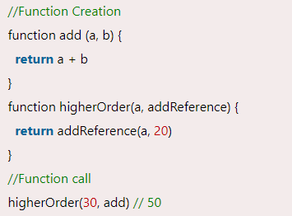
Understand Higher Order Functions First
1 – Code challenge introduction
Buddy has to present the code challenge.
The function you are passing (add), is called a callback function, and the function where you are passing the callback function(higherOrder) is called a higher-order(HOCs) function.
Francisco Azcarate
John Paul Moran
Fernando Ramo
Alberto Martín
Buddies for the first groups:
Buddies for next groups:

Slide 7
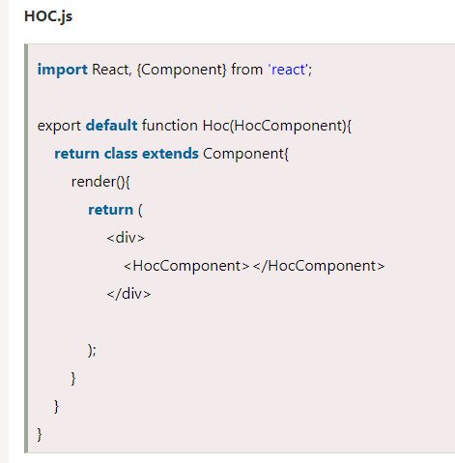
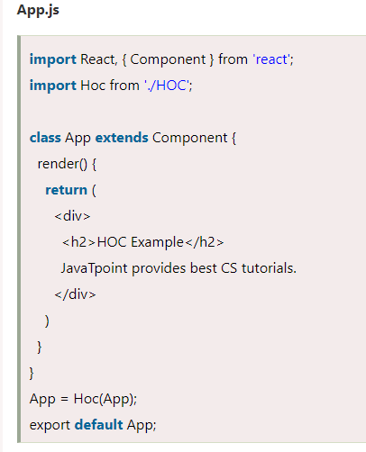
Higher Order Component example
1 – Code challenge introduction
Buddy has to present the code challenge.
Francisco Azcarate
John Paul Moran
Fernando Ramo
Alberto Martín
Buddies for the first groups:
Buddies for next groups:

Slide 8
Hooks
Hooks are essential when working with Functional Components
Most frequentely used hooks: useState, useEffect.
1 – Code challenge introduction
Buddy has to present the code challenge.
Fernando Ramo
Alberto Martín
Buddies for the first groups:
Buddies for next groups:
useEffect(() => {
//do stuff
}, [dependacyArray])
Most commonly used with a dependacyArray
Replaces the need to use LifeCycle hooks
It is designed to fire effects, what are effects? Some kind of event that will change your state, API calls, click events
useState:
const [name, setName] = useState(‘Tom’)
Is used to as a hook to state, this state will be tracked and your page re-render whenever the state is changed.

Slide 9
Hooks - useEffect dependacy array rules:
useEffect(() => {}, [dependencyArray])
An empty dependency array will execute the code inside the useEffect on the FIRST render of the component, so only once!
No dependency array will execute the code whenever ANY state is changed – this will likely cause problems and most likely lead to INFINITE LOOPS 💀💀, at least in my experience this has happened
A dependency array with a dependency inside will fire useEffect ONLY AFTER THAT DEPENDENCY HAS BEEN CHANGED, this is the most common use case for useEffect. Eg, something has changed and we need to re-render the component to show that change ✓✓✓✓.
1 – Code challenge introduction
Buddy has to present the code challenge.
Fernando Ramo
Alberto Martín
Buddies for the first groups:
Buddies for next groups:

Slide 10
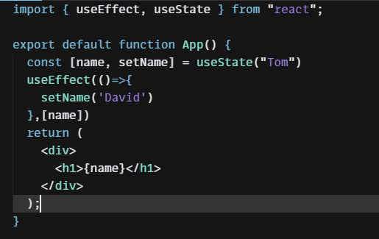
Hooks useState and useEffect simple example
1 – Code challenge introduction
Buddy has to present the code challenge.
Fernando Ramo
Alberto Martín
Buddies for the first groups:
Buddies for next groups:

Slide 11
Custom hooks
Custom hooks are essential to organise your components in a cleaner way
A custom hook should start with useXXXX, like useFetchList or useFormatDate
They are design to do something like fetching data or returning a value that has been manipulated
It is a function that returns variables
They will likely use useEffect() and useState() inside
Buddies for next groups:

Slide 12
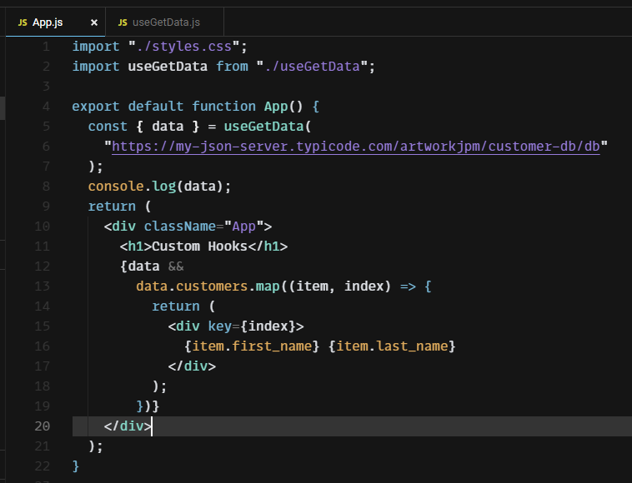
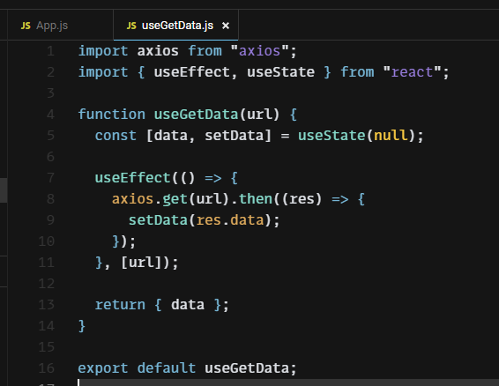
Custom hooks example: call an API
https://codesandbox.io/s/custom-hooks-9xfuw?file=/src/App.js
Buddies for next groups:

Slide 13
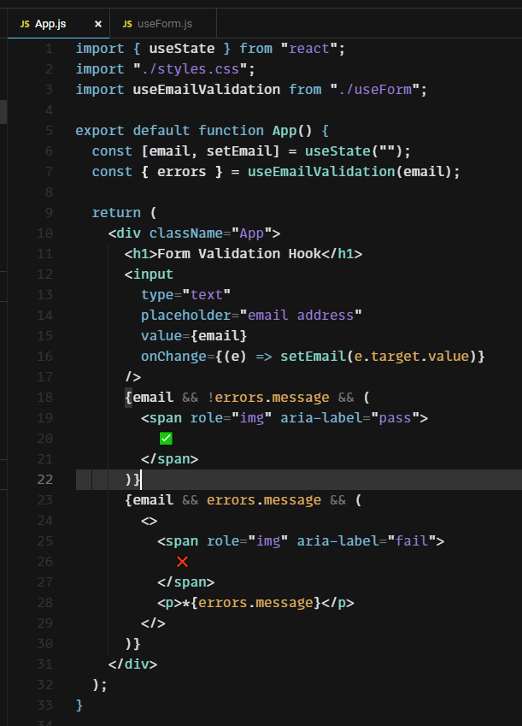
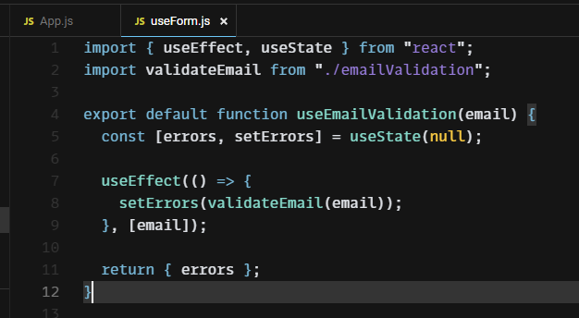
Custom hooks example: validate email
https://codesandbox.io/s/custom-hook-form-validation-3iywb?file=/src/App.js
Buddies for next groups:

Slide 14


Thank you

