Slide 1
Theory Review 2nd Session December 2021

Slide 2
Second lesson – THIS ONE!
First lesson
Class components vs Functional Components
Higher Order Components
Hooks
3rd party libraries: Router, redux, sagas, thunks…
Good practices about architecture, performance and Memo(detectChanges/markForChanges in angular).

Slide 3
3rd party libraries: Router, redux, sagas, thunks…
React-Router v6: uses a different syntax eg:
Instead of Switch, use Routes
Instead of Redirect use Navigate to
Instead of Component use Element
Redux, Sagas, Thunks are all part of State Managements
Redux relies GETTING the global state and SETTING the global state
The modern way of doing this are through built in Redux hooks:
useSelector (TO GET)
useDispatch (TO SET) ….in more detail….

Slide 4
REDUX WITH REACT

Slide 5
Redux
Redux is the industry standard and recommended way of managing state but only when prop-drilling because a problem
You must wrap your app inside a <Provider> which must have a propery of store <Provider store={store}>
The value of store will be a reference to the createStore() that will then reference your reducers
Reducers are functions that take the current state and action as arguments

Slide 6
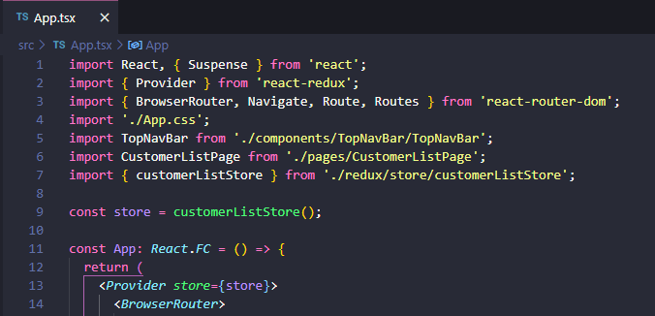
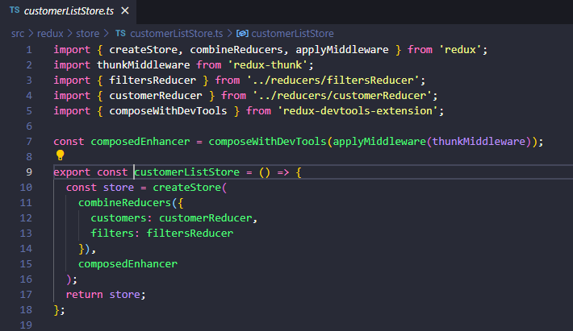
Redux code:

Slide 7
Connect the Redux state to your component:
There are several ways to connect your Redux state to your component, I will cover two ways.
connect(mapStateToProps)(yourComponent); - old way but still ok
useSelector( state => state.yourStateName) – modern up to date way

Slide 8
Redux connect(mapStateToProps)(yourComponent); You can use the connect() higher order component method, it accepts two arguments: mapStateToProps and the component you want to connect it with. After this, your state are accessed via props from the component you passed in

Slide 9
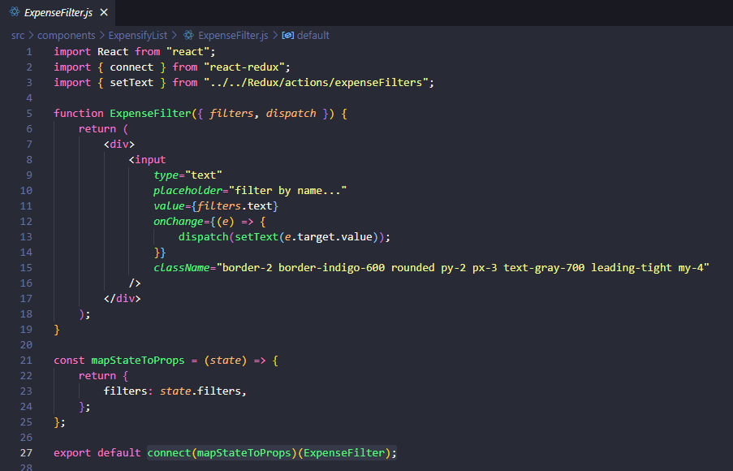
connect(mapStateToProps)(yourComponent);

Slide 10
Redux useSelector() hook Another way is to use the useSelector hook from ‘react-redux’, it Works like a callback and returns your state as an object which you return by accessing its key name. import { useSelector } from "react-redux"; const myState = useSelector((state) => state.yourReducer name);

Slide 11
Redux dispatching actions Actions are the way that the State is updated, it is the glue that makes redux work. We need to dispatch() actions using the dispatch() function that Redux provides us with. How do we get the dispatch method? 1) If using the connect() method, dispatch() Will be a prop of your components you passed in. 2) If using useSelector hook, you can use the useDispatch hook to get the all import dispatch method: import { useDispatch} from "react-redux"; const dispatch = useDispatch();

Slide 12
Redux Thunk What is a thunk? Redux is a strict design pattern in which Actions must return an object with a type export const removeExpense = (id) => { return { type: "REMOVE_EXPENSE", id, }; };

Slide 13
Redux Thunk Simply put, a thunk is the possibility of returning a function instead of an object with a type. It’s a simple as that. Why? Say you want to do an asynchronous call to get some data then dispatch() that data into your state (reducer)

Slide 14
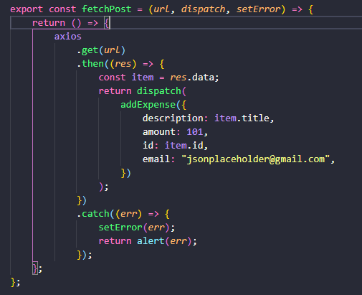
Redux Thunk So now instead of returning an object, we can return a function that calls an API and passes that payload into the dispatch

Slide 15
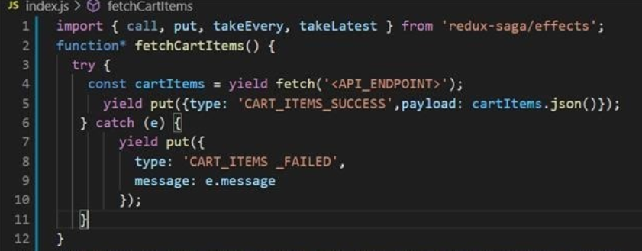
Redux Sagas redux-sagas give lets you dispatch() actions in an asynchronous way using the yield put, yield call, yield takeLatest methods, INSTEAD of using thunks callback methods. Yield put replaces the dispatch()

Slide 16
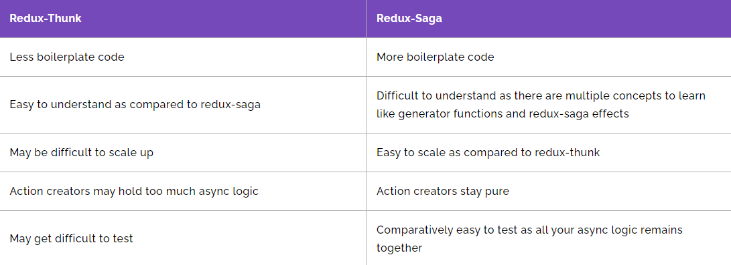
Redux Sagas vs Redux Thunks It is difficult to explain all the benefits of both here and to explain all the tools of Redux-sagas without getting heavy in syntax. In short for smaller apps use Redux-Thunks, for larger apps use Redux-Sagas

Slide 17
NEWS FLASH!!!!
USE REACT-TOOLKIT!!!!

Slide 18
What is Redux-toolkit?
React and Redux are constantly improving and something that you might have just learned maybe out of date, Redux-toolkit is now preferred over React-Redux.
Redux-toolkit makes it easier for Devs to create actions and reducers in one place, instead of making them in separate files.
Using a concept called SLICES, we declare the initialState and Reducers and the toolkit automatically creates Actions.
Quick setup
https://redux-toolkit.js.org/tutorials/quick-start

Slide 19
Redux-toolkit main differences
Uses a different method to set up configureStore ()
With typescript we need to export the types `RootState` and `AppDispatch` types from the store itself
Creates Actions automatically but you need to export them from the slice
export const { increment, decrement, incrementByAmount } = counterSlice.actions

Slide 20
Redux Selectors
Selectors are another important element of Redux, they are often used to select certain parts of the global state and return values without actually changing the state. For example, you want to filter out a list:
const expenses = useSelector((state) => state.expenses.filter(item => item.name.includes('Tom')));

Slide 21
BEST PRACTICES

Slide 22
Best Practices Guidelines: Use this as a guide: https://github.com/DX-and-EE-South-Europe/javascript-style-guide/blob/feat/react-proposal/frameworks/react/index.md Main areas I will cover: 1) Architecture 2) Unit Tests 3) Responsive Web Design 4) Performance

Slide 23
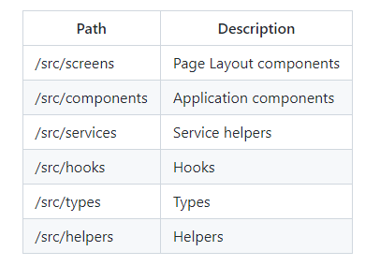
Good practices – Architecture:
Composition instead of Inheritance (Use functions not classes)
Folder structure:
Screens ( e.g. routed pages)
Components(e.g. TopNavBar.js)
Services(API call exported functions)
Hooks(Custom hooks form validations)
Types (Typescript interfaces)
Helpers(Any re-useable functions that does
something useful)

Slide 24
FILE NAMING CONVENTIONS

Slide 25
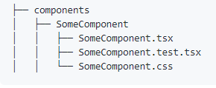
Component or Page related files, e.g anything that returns jsx (html), should use PascalCase
All other files should use camelCase, this has become an industry standard un- written rule
Don’t use camelCase in Routes, use xxx-xxx-

Slide 26
ATOMIC DESIGN PATTERN

Slide 27
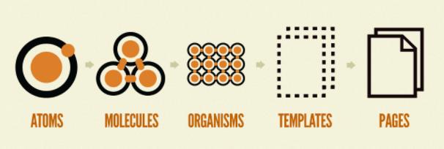
Anyone used Atomic Design?

Slide 28
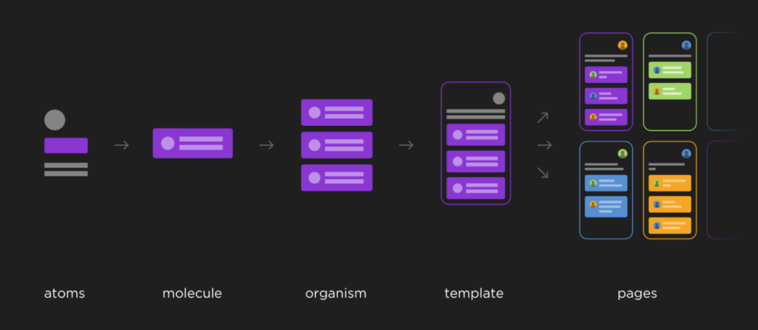
Atomic Design

Slide 29
Atomic Design Atoms The most basic building blocks: BUTTONS, FONTS, INPUT FIELDS Should be re-useable anywhere Make style changes at Atom level, colors, font size etc Molecules ( Group of Atoms) Are components HEROS, ALERT DIALOGS, SEARCH NAVIGATIONS, TABLE LIST Should be simple, portable, re-usable that can be dropped in anywhere Organisms (Group of Molecules) Sections of a webpage eg: TOPNAVBAR HEADERS, FOOTERS, LOGIN FORM Templates (Group of Organisms) A home to place organisms: HOME PAGE TEMPLATE, CONTACT US PAGE Pages Pages show us the interface with real content (therefore a folder called pages may not actually exist in your architecture). It is what the end user sees

Slide 30
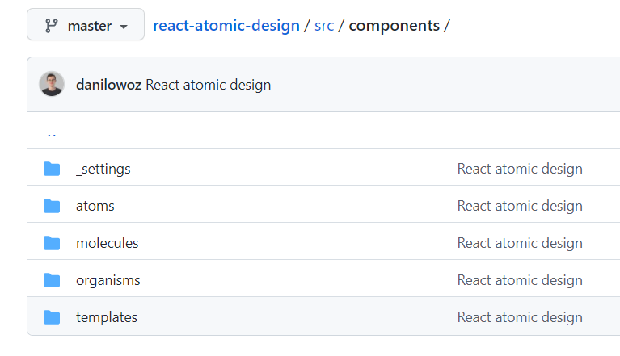
Atomic Design

Slide 31
UNIT TESTS

Slide 32
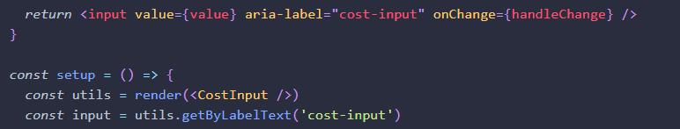
Good practices – Unit tests
Unit Tests
Use Jest and React Testing Library (RTL)
Enzyme is being dropped by React
RTL encourages finding form elements by their label text eg aria-label
https://testing-library.com/docs/example-input-event/

Slide 33
Unit tests React-Testing-Library
Find links and buttons from their text (like a user would).
Finding elements by a data-testid is an escape hatch for elements where the text content and label do not make sense or is not practical.
Avoid using css classNames to find DOM elements
End to End tests
Use Cypress or Playwright

Slide 34
RESPONSIVE WEB DESIGN

Slide 35
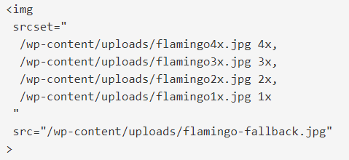
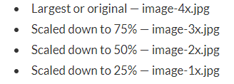
Responsive Web Design
Define standard breakpoints (320px -480px: Mobile devices etc..)
Use the viewport meta tag to control layout on mobile browsers inside the index.html > <meta name="viewport" content="width=500, initial-scale=1">
Use scalable units (ems, rem, instead of px)
Consider image optimization using srcset (to avoid using high-quality images on low-resolution screens) - browser technology continues to improve the client (browser) gets to make the decision what to use
Specify Image density (2x) or image Width, Height:
<img srcset=" /wp-content/uploads/flamingo4x.jpg 4025w, /wp-content/uploads/flamingo3x.jpg 1006w”>

Slide 36
Responsive Web Design
Consider Fluid Grid Systems Fluid grids allow to create responsive designs which suit dynamic screen sizes.
The complexity of developing a fluid grid can be minimized by using an existing CSS framework. – Tailwind, fluidable.com, MaterialUI, bootstrap-react or even better to make your own
Adjust the fluid grid when necessary according to your design and try to provide the best browsing experience for the user.

Slide 37
Performance: memo, useCallback, useMemo

Slide 38
Performance: memo, useCallback, useMemo – only use if neccesary, eg your app is running slow and you will a noticeable difference in load times
We will be talking about memo, useCallback, useMemo
One important note to say is that you only should start using these tools if your app is lagging or having some performance issue
Memo (higher order component)
useCallback (hook)
useMemo (hook)

Slide 39
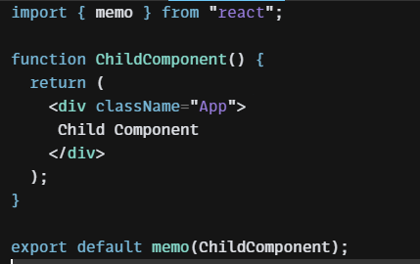
Performance Best Practices - memo(componentName)
Memo Higher Order Component can be used to stop re-rendering child components after the parent has been updated.
By default, all child components will render again if the parent has been updated

Slide 40
useCallback( () => {}, [dependencies] )
The useCallback is a react hook that returns a memoized callback when passed a function and a list of dependencies as parameters.
It’s very useful to avoid Re-Rendering of child components because by default, React will render all child components after any state change inside the parent
It only changes the callback when one of its dependencies gets changed.
Is useful for to improve performance of an app, you will only re-render components that need re-rendering

Slide 41
useCallback vs useMemo
useCallback is used for function or componts
useMemo is used for a function that returns a value, lets say a function that does a lot of work then returns a value, like calculations, API call, formatting json code
https://codesandbox.io/s/usecallback-3xh1d?file=/src/App.js

Slide 42
useMemo
Is used to handle values rather than functions
The useMemo is similar to useCallback hook as it accepts a function and a list of dependencies but it returns the memoized value returned by the passed function.
It recalculates the value only when one of its dependencies has change. It is useful to avoid expensive calculations on every render when the returned value is not going to change.
Eg a large functions that edit json data returned from an API call.

Slide 43
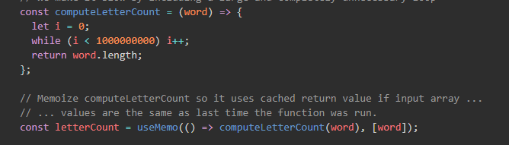
useMemo
useMemo allows you to memoize expensive functions so that you can avoid calling them on every render.
memo() is a higher order function
useMemo() is a hook to memoize expensive functions so they don’t run again on re-render

Slide 44

Code Challenge review
1 – Code challenge introduction
Buddy has to present the code challenge.
Boilerplate:
https://github.com/DX-and-EE-South-Europe/react-for-angular-devs
2 – Implement the challenge
Complete Availability:
1 week of self coding
Partial Availability:
2 weeks of self coding
TODO list
Forms (validations)
API calls example
Performance example
3 – Code challenge Resolution
Buddy shows our implementation and resolve the last questions

Slide 45


Thank you

