Slide 1
Mandala Drawer
Lab Training : Embedded Systems
(07/14/2016)
<Ali Ahmad Butt, Artem Yaroshchuk, Gauravsingh Pundir>

Slide 2
Contents
Introduction(Aim)
Components and Schematic diagram
Implementation
Demo

Slide 3
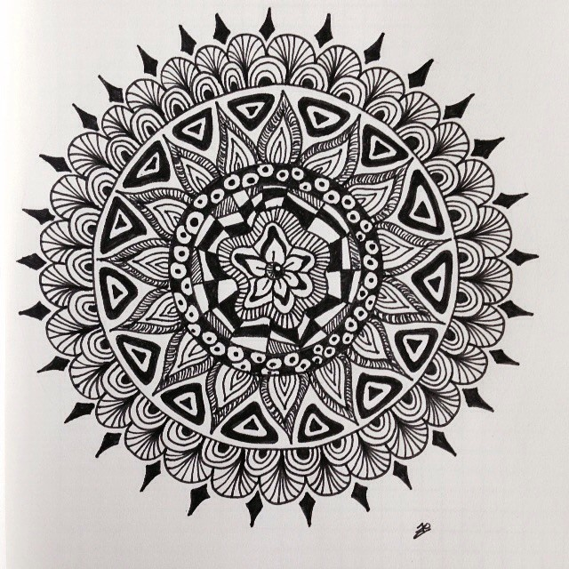
Introduction
What is Mandala drawer ???
Fig. 1 : Typical mandala drawing [1]

Slide 4
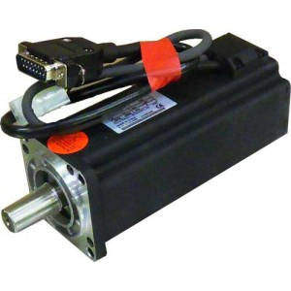
Components
Components required
Two servo motors
Arduino UNO
Bread Board
Jumper wires
Pen
Keypad
Small spring (from any old ballpoint)
A tube of diameter larger than the pen
Fig. 2 : Servo motor [2]

Slide 5
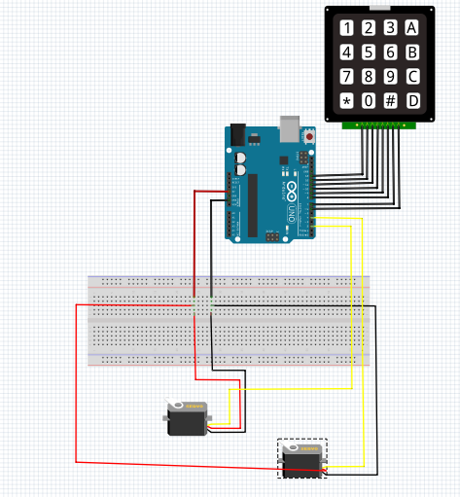
Schematic Diagram
Fig. 3 : Schematic Diagram [3]

Slide 6

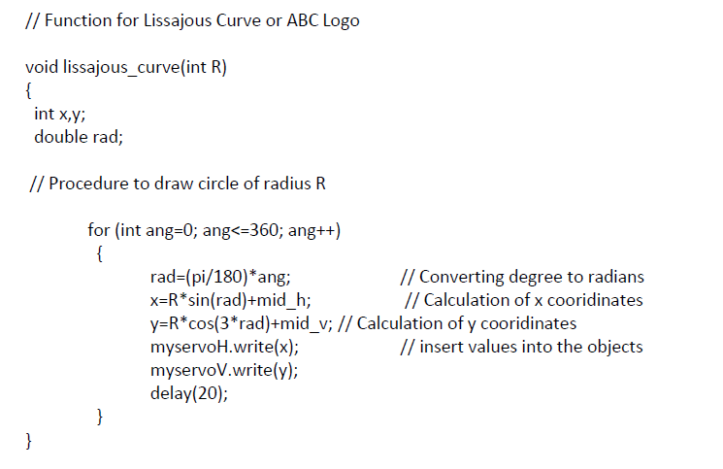
Implementation
Include libraries for servo and keypad
Create two servo objects
.
Fig. 4 : ABC logo[4]

Slide 7
Implementation (2)
Keypad buttons functions:
Square
Vertical movement from down to top
Rhombus
Horizontal movement from right to left
Center position
Horizontal movement from left to right
Circle
Vertical movement from top to down
Lissajous Figure (ABC Logo)
Polar rose

Slide 8
References
For more information on source code and for README file, kindly visit : https://github.com/artyar-tui/mandala-drawer
https://scontent.cdninstagram.com/hphotos-xaf1/t51.2885-15/e15/11380275_1424571094537628_629906584_n.jpg
https://usamaomar.files.wordpress.com/2013/02/sme60s-0040-30aak-3lkl-400w-ac-servo-motor.jpg
https://raw.githubusercontent.com/artyar-tui/mandala-drawer/master/Schematic/Schematic.PNG
https://thumbor.abcopen.net.au/oogTPjyDTN_25byxCxbZ3CZ56PA=/970x545/smart/http://farm8.staticflickr.com/7243/7361351680_0f7ae01aa8_b.jpg

