Slide 1
Процессы и потоки.
Пользователи, группы и права доступа.

Slide 2
Процесс vs. Поток
ПРОЦЕСС
Машинный код, данные, файловые дескрипторы
ПРОЦЕСС
Машинный код, данные, файловые дескрипторы
ПОТОК
Регистры
+
стек
ПОТОК
Регистры
+
стек
ПОТОК
Регистры
+
стек

Slide 3
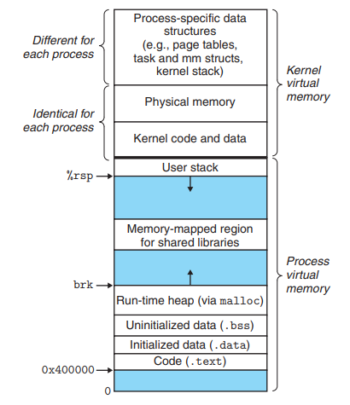
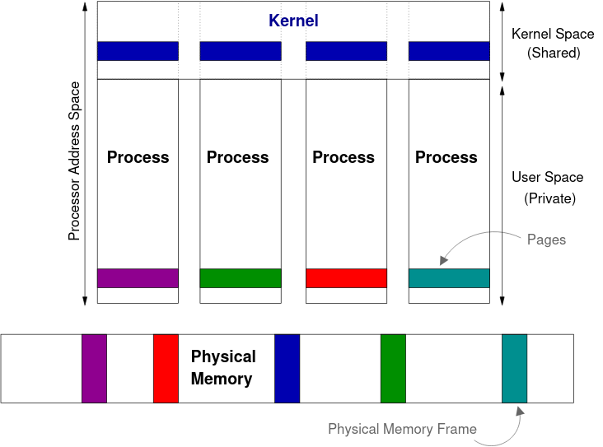
Процесс

Slide 4
procfs
$ ls /proc
1 11 124 142 155 170 1828 195 294 37 490 52 69 83 98 ioports slabinfo
10 110 1242 143 156 171 183 196 3 372 491 53 7 84 99 irq softirqs
100 111 1244 144 157 172 1839 2 30 373 492 54 70 843 994 kallsyms stat
1008 112 125 1442 158 1720 184 20 301 378 493 540 71 848 acpi kcore swaps
1009 1125 126 145 1584 1724 1841 200 304 38 494 541 72 85 asound keys sys
101 113 127 146 159 173 1844 204 31 39 495 55 73 854 bootconfig key-users sysrq-trigger
1014 1139 128 1465 16 1738 185 208 32 4 496 550 74 86 buddyinfo kmsg sysvipc
1018 114 129 147 160 174 1850 21 328 40 497 56 743 87 bus kpagecgroup thread-self
102 1145 13 148 161 1741 186 212 33 41 498 57 75 88 cgroups kpagecount timer_list
103 1147 130 149 162 1742 187 213 333 42 499 58 76 89 cmdline kpageflags tty
104 115 131 1493 163 175 1873 214 334 43 5 59 768 9 config.gz latency_stats uptime
1045 116 132 15 1635 176 1874 215 336 44 50 6 77 90 consoles loadavg version
1049 117 133 150 1636 1769 1879 22 338 45 500 60 78 91 cpuinfo locks vmallocinfo
105 1172 1333 1501 164 177 188 226 34 46 501 61 785 910 crypto mdstat vmstat
1050 118 134 1504 1646 1774 1881 23 340 47 502 62 79 911 devices meminfo zoneinfo
1052 119 135 1505 165 1777 1889 236 35 48 503 629 793 913 diskstats misc
1056 1193 136 1506 166 1779 189 24 356 482 504 63 797 915 dma modules
1057 12 1368 151 1668 1783 1892 25 357 483 505 630 8 92 driver mounts
106 120 137 1510 167 179 19 256 358 484 507 64 80 921 dynamic_debug mtrr
1061 121 1373 1512 168 1799 190 26 359 485 509 65 802 922 execdomains net
107 1211 138 1514 169 18 191 260 36 486 51 66 804 93 fb pagetypeinfo
1070 1217 139 152 1697 180 192 27 360 487 510 67 809 94 filesystems partitions
108 122 14 153 1698 1802 1927 276 361 488 511 68 81 95 fs schedstat
1083 123 140 154 1699 181 193 28 366 489 512 687 82 96 interrupts scsi
109 1238 141 1540 17 182 194 29 369 49 518 688 820 97 iomem self
$ ls /proc/1
arch_status environ maps personality status
attr exe mem projid_map syscall
autogroup fd mountinfo root task
auxv fdinfo mounts sched timens_offsets
cgroup gid_map mountstats schedstat timers
clear_refs io net sessionid timerslack_ns
cmdline ksm_merging_pages ns setgroups uid_map
comm ksm_stat numa_maps smaps wchan
coredump_filter latency oom_adj smaps_rollup
cpu_resctrl_groups limits oom_score stack
cpuset loginuid oom_score_adj stat
cwd map_files pagemap statm
$ cat /proc/1/cmdline
/sbin/initsplash

Slide 5
procfs self
$ cat /proc/self/environ
SHELL=/bin/bashSESSION_MANAGER=local/elephant:[...]
$ ls /proc/self
arch_status environ maps patch_state statm
attr exe mem personality status
autogroup fd mountinfo projid_map syscall
auxv fdinfo mounts root task
cgroup gid_map mountstats sched timens_offsets
clear_refs io net schedstat timers
cmdline ksm_merging_pages ns sessionid timerslack_ns
comm ksm_stat numa_maps setgroups uid_map
coredump_filter latency oom_adj smaps wchan
cpu_resctrl_groups limits oom_score smaps_rollup
cpuset loginuid oom_score_adj stack
cwd map_files pagemap stat
$ ls -l /proc/self/fd
total 0
lrwx------ 1 avp avp 64 окт 1 09:40 0 -> /dev/pts/2
lrwx------ 1 avp avp 64 окт 1 09:40 1 -> /dev/pts/2
lrwx------ 1 avp avp 64 окт 1 09:40 2 -> /dev/pts/2
lr-x------ 1 avp avp 64 окт 1 09:40 3 -> /proc/60521/fd
$ cat /proc/self/status | head -7
Name: cat
Umask: 0002
State: R (running)
Tgid: 61248
Ngid: 0
Pid: 61248
PPid: 59741

Slide 6
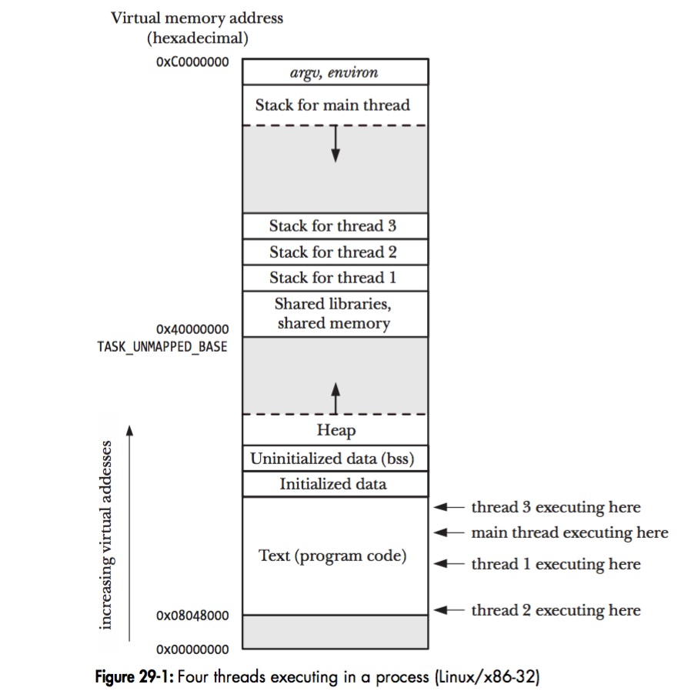
Поток
Единица исполнения
Общие в рамках процесса файловые дескрипторы, код и память.
Содержит: стек, регистры, состояние
$ pstree -t 25602
oosplash─┬─soffice.bin─┬─{PipeIPC}
│ ├─{dconf worker}
│ ├─{gdbus}
│ ├─{gmain}
│ ├─{pool-spawner}
│ ├─{soffice.bin}
│ └─{threaded-ml}
└─{osl_executeProc}

Slide 7
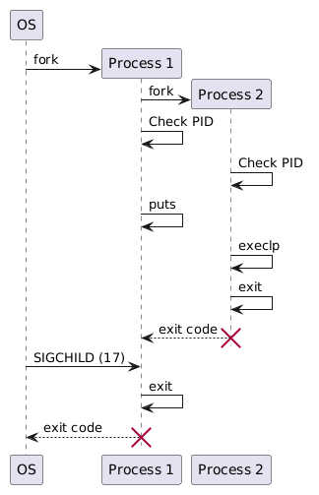
Создание новых процессов
#include <stdio.h>
#include <unistd.h>
int main() {
int pid = fork();
if (pid == 0) {
execlp("/usr/bin/ls", "/usr/bin/ls", NULL);
puts("Hello from child!");
} else if (pid > 0) {
puts("Hello from parent!");
} else {
return 1; /* ERROR! */
}
return 0;
}
Notes:
@startuml
participant "OS" as P0
participant "Process 1" as P1
participant "Process 2" as P2
create P1
P0 -> P1: fork
create P2
P1 -> P2: fork
P1 -> P1: Check PID
P2 -> P2: Check PID
P1 -> P1: puts
P2 -> P2: execlp
P2 -> P2: exit
P1 <-- P2: exit code
destroy P2
P0 -> P1: SIGCHILD (17)
P1 -> P1: exit
P0 <-- P1: exit code
destroy P1
@enduml

Slide 8
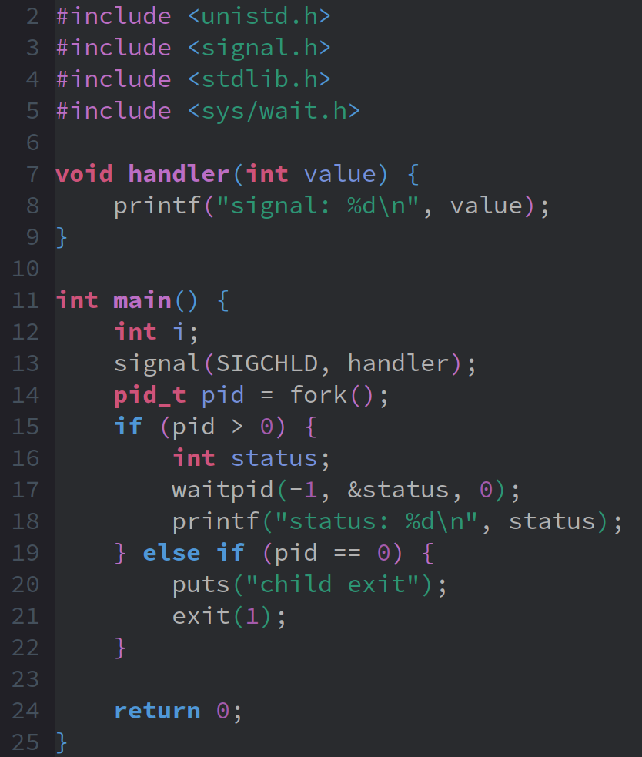
Статус завершения процесса
$ gcc main.c
$ ./a.out
child exit
signal: 17
status: 256

Slide 9
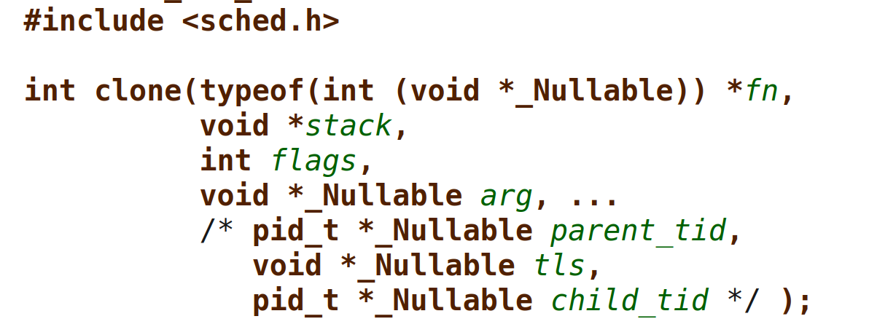
Системный вызов «clone»
#include <unistd.h>
#include <sched.h>
#include <sys/types.h>
#include <stdlib.h>
#include <string.h>
#include <stdio.h>
#include <fcntl.h>
int variable, fd;
int do_something() {
variable = 42;
close(fd);
_exit(0);
}
int main(int argc, char *argv[]) {
void **child_stack;
char tempch;
variable = 9;
fd = open("test.file", O_RDONLY);
child_stack = (void **) malloc(16384);
printf("The variable was %d\n", variable);
clone(do_something, child_stack, CLONE_VM|CLONE_FILES, NULL);
sleep(1);
printf("The variable is now %d\n", variable);
if (read(fd, &tempch, 1) < 1) {
perror("File Read Error");
exit(1);
}
printf("We could read from the file\n");
return 0;
}
Флаги «clone»:
- CLONE_VM – Share the same virtual address space
- CLONE_FS – Share filesystem information
- CLONE_FILES – Share file descriptor table
- CLONE_SIGHAND – Share signal handlers
- CLONE_THREAD – Place the task in the same thread group
- CLONE_SETTLS – Initialize thread-local storage
Аналог «pthread»:
clone(CLONE_VM | CLONE_FS | CLONE_FILES | CLONE_SIGHAND, 0);
Аналог «fork»:
clone(SIGCHLD, 0);
Joey Bernard, «Using the Clone() System Call»:
https://www.linuxjournal.com/article/5211

Slide 10
Вход в систему
Графическая сессия
Терминальная сессия
init (PID 1)
init
(PID 1)
init
(PID 1)
fork
fork
init
Session
init
init
exec
exec
getty
getty
SystemD
Greeter
«login:»
«login:»
fork
...
fork
SystemD
Display Server
(X11, Wayland)
getty
exec
exec
exec
fork
Display Manager
(GDM, LightDM, ...)
User shell
e.g. «/bin/bash»
login
login
«Password:»

Slide 11
Пользователи: /etc/passwd
$ cat /etc/passwd | head
root:x:0:0:root:/root:/bin/bash
daemon:x:1:1:daemon:/usr/sbin:/usr/sbin/nologin
bin:x:2:2:bin:/bin:/usr/sbin/nologin
sys:x:3:3:sys:/dev:/usr/sbin/nologin
sync:x:4:65534:sync:/bin:/bin/sync
games:x:5:60:games:/usr/games:/usr/sbin/nologin
man:x:6:12:man:/var/cache/man:/usr/sbin/nologin
lp:x:7:7:lp:/var/spool/lpd:/usr/sbin/nologin
mail:x:8:8:mail:/var/mail:/usr/sbin/nologin
news:x:9:9:news:/var/spool/news:/usr/sbin/nologin
General Electric Comprehensive Operating System (GECOS)
- User's full name (or application name, if the account is for a program)
- Building and room number or contact person
- Office telephone number
- Home telephone number
- Any other contact information (pager number, fax, external e-mail address, etc.)
https://en.wikipedia.org/wiki/Gecos_field
GID
UID
Password
Username
GECOS
Home directory
Login shell

Slide 12
Утилита «finger»
$ sudo apt-get install finger
$ grep ^user: /etc/passwd
user:x:1000:1000:Vasiliy Pupkin:/home/user:/bin/bash
$ finger user
Login: user Name: Vasiliy Pupkin
Directory: /home/user Shell: /bin/bash
Last login Fri Oct 2 09:46 (MSK) on pts/0 from 192.168.122.1
No Mail.
No Plan.

Slide 13
Пользователи: /etc/shadow
$ cat /etc/shadow | head -2
avp:$6$.n.:17736:0:99999:7:::
root:!:19089:0:99999:7: : :
Unused
Last password change
Maximum password age
Expiration date
Password
Minimum password age
Warning period
Inactivity period
Username

Slide 14
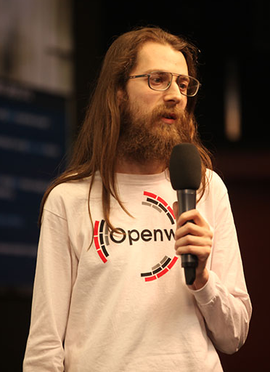
The Trusted Computing Base (TCB)
$ cat /etc/tcb/root/shadow
root:$y$j9T$YRhJAi4kQLvOF1Y1kVMV90$khdQrVH8NkNIh54Y8A28dpWAedKTJXBVK72FefBEvS/:20512::::::
Encrypted password hash
Parameters
Salt
$1$ is MD5
$2a$ is Blowfish
$2y$ is Blowfish
$5$ is SHA-256
$6$ is SHA-512
$y$ is yescrypt
Scheme ID
(y = yescrypt)
Modular Crypt Format:
$<id>[$<param>=<value>(,<param>=<value>)*][$<salt>[$<hash>]]
https://en.wikipedia.org/wiki/Crypt_(C)
Alexander Peslyak a.k.a. Solar Designer — автор «yescrypt» @ PHDays 2012

Slide 15
Права доступа
$ ls -lha main.c
-rwxrwxr-x 1 avp avp 16K сен 30 16:27 a.out
-rw-rw-r-- 1 avp avp 327 сен 30 16:27 main.c
owner group other r = read, w = write, x = execute
r w x r w x r - x
binary: 1 1 1 1 1 1 1 0 1
octal: 7 7 5

Slide 16
Группы
$ cat /etc/group | head
root:x:0:
bin:x:1:root
daemon:x:2:root
sys:x:3:root,bin,adm
adm:x:4:root
tty:x:5:
disk:x:6:root
lp:x:7:
mem:x:8:
kmem:x:9:
$ cat /etc/group | grep ^user:
user:x:1000:
$ cat /etc/passwd | grep ^user:
user:x:1000:1000::/home/user:/bin/bash
$ ls -lha /home/user/.bashrc
-rw------- 1 user user 188 июл 26 2021 /home/user/.bashrc

Slide 17
Управление правами
Смена владельца:
$ chown user:user script.sh
Задание прав:
$ chmod +x script.sh
$ chmod 700 script.sh
$ chmod u+rwx script.sh

Slide 18
Управление процессами в терминале
$ emacs &
$ jobs
[1]+ Running emacs &
$ fg %1
emacs
^Z
[1]+ Stopped emacs
$ bg %1
[1]+ emacs &
$ kill %1
Запуск процесса в фоне.
Вывод процесса на передний план.
Процесс остановлен комбинацией клавиш Ctrl+Z
Возобновление работы процесса в фоне.

Slide 19
Сигналы
$ kill -L
1) SIGHUP 2) SIGINT 3) SIGQUIT 4) SIGILL 5) SIGTRAP
6) SIGABRT 7) SIGBUS 8) SIGFPE 9) SIGKILL 10) SIGUSR1
11) SIGSEGV 12) SIGUSR2 13) SIGPIPE 14) SIGALRM 15) SIGTERM
16) SIGSTKFLT 17) SIGCHLD 18) SIGCONT 19) SIGSTOP 20) SIGTSTP
21) SIGTTIN 22) SIGTTOU 23) SIGURG 24) SIGXCPU 25) SIGXFSZ
26) SIGVTALRM 27) SIGPROF 28) SIGWINCH 29) SIGIO 30) SIGPWR
31) SIGSYS 34) SIGRTMIN 35) SIGRTMIN+1 36) SIGRTMIN+2 37) SIGRTMIN+3
38) SIGRTMIN+4 39) SIGRTMIN+5 40) SIGRTMIN+6 41) SIGRTMIN+7 42) SIGRTMIN+8
43) SIGRTMIN+9 44) SIGRTMIN+10 45) SIGRTMIN+11 46) SIGRTMIN+12 47) SIGRTMIN+13
48) SIGRTMIN+14 49) SIGRTMIN+15 50) SIGRTMAX-14 51) SIGRTMAX-13 52) SIGRTMAX-12
53) SIGRTMAX-11 54) SIGRTMAX-10 55) SIGRTMAX-9 56) SIGRTMAX-8 57) SIGRTMAX-7
58) SIGRTMAX-6 59) SIGRTMAX-5 60) SIGRTMAX-4 61) SIGRTMAX-3 62) SIGRTMAX-2
63) SIGRTMAX-1 64) SIGRTMAX
$ pgrep firefox
12345
$ kill 12345

Slide 20
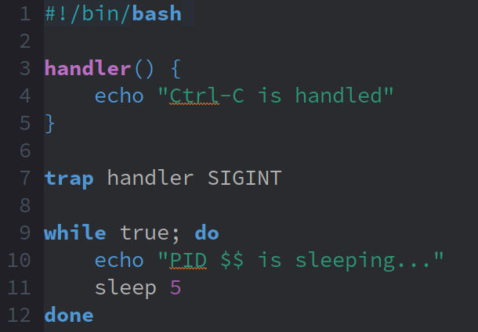
Обработка сигналов в Bash
Terminal 1
$ bash main.sh
PID 144978 is sleeping...
PID 144978 is sleeping...
Terminated
Terminal 2
$ kill 144978

Slide 21
Источники изображений
Linux address-space layout © Ian Wienand — CC BY-SA 3.0: https://bottomupcs.com/ch06s09.html
Linux process virtual-memory layout (a derivative work) © Randal E. Bryant and David R. O'Hallaron: https://csapp.cs.cmu.edu/3e/ics3/vm/linuxrtimage.pdf
Multiple threads in a process: virtual address-space figure © Michael Kerrisk: https://michaelkerrisk.com/tlpi/index.html
Alexander Peslyak / Solar Designer at PHDays 2012 © Ptsecurity — CC BY-SA 4.0: https://commons.wikimedia.org/wiki/File:Solar_designer.jpg

