Slide 1
Exploiting and Defense
Dobin Rutishauser
February 2017

Slide 2
Intro
Notes:
Who knew about this module?

Slide 3
About Me
Dobin Rutishauser
Working as Security Analyst @ Compass Security
Penetration Tests
Webapp Checks
Architecture Reviews
& lots more
Interested in Hacking Security since I was little (1999+)

Slide 4
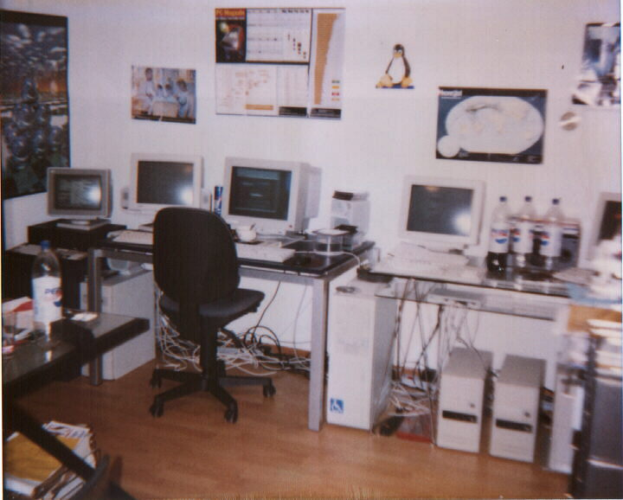
I got a bit overboard when I was little

Slide 5
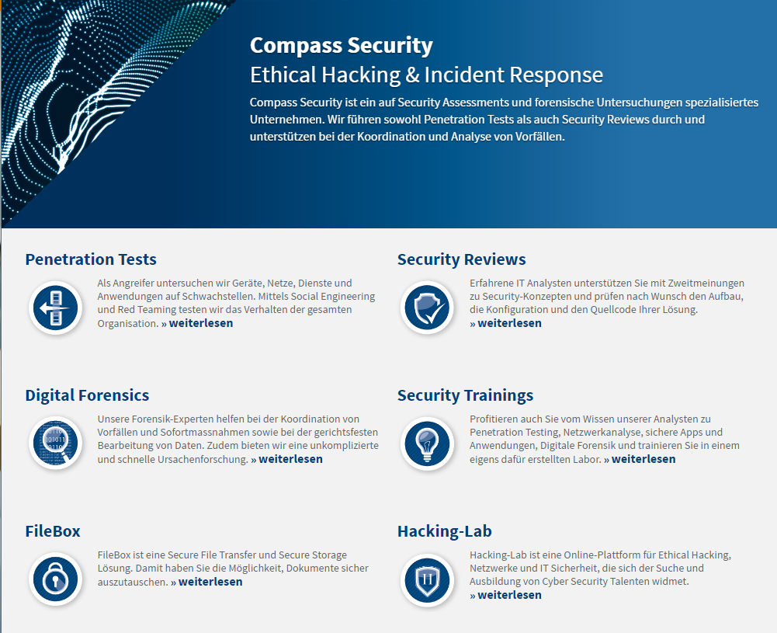
Compass

Slide 6
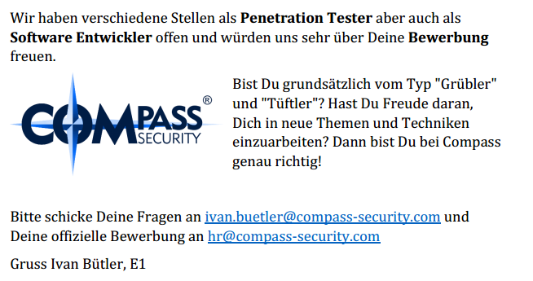
Compass is hiring (always)

Slide 7
Vorlesung

Slide 8
Vorlesung
Websites:
https://exploit.courses
Online exploit development website
JavaScript Based
Uses Hacking-Lab accounts
Solve challenges online (or local on your box)
Write exploits
Debug stuff
https://www.hacking-lab.com
Half-online challenges website
Uses HLCD (Kali-based Linux Distribution)
VPN-Based

Slide 9
Vorlesung
Slack (optional)
Chat++
https://bfhed2017.slack.com/shared_invite/MTQzNzkxODMyOTE2LTE0ODc1ODEyMzMtYTJmNDUzZmNmNQ
Und Quizlet (optional):
Quizes
https://quizlet.com/join/AnKsUcWHC

Slide 10

Vorlesung
Siiiiii abr ähhhhh
EBP isch doch 32 bit?
Notes:
Fragen erwünscht
Aufstrecken / schnippen / Reinreden
Interkation (wie kurs)

Slide 11
Motivation
Motivation for Exploiting & Defense

Slide 12

Content
Looking behind the curtain

Slide 13
Motivation
For the hacker:
Develop exploits
Debugging of C/C++ code
Being 31337
For the computer enthusiast:
How do functions work?
How does the memory allocator work?
Whats the difference between userspace and kernelspace?
How does computer work?
Notes:
Ask people what they want

Slide 14
Motivation
For the Sysadmin
Judge security level of operating systems
And applications
Harden/protect servers
And clients
For the future CISO:
Assess CVSS score for vulnerabilities
Assess security mitigations
Better risk analysis
Notes:
Ask people what they want

Slide 15
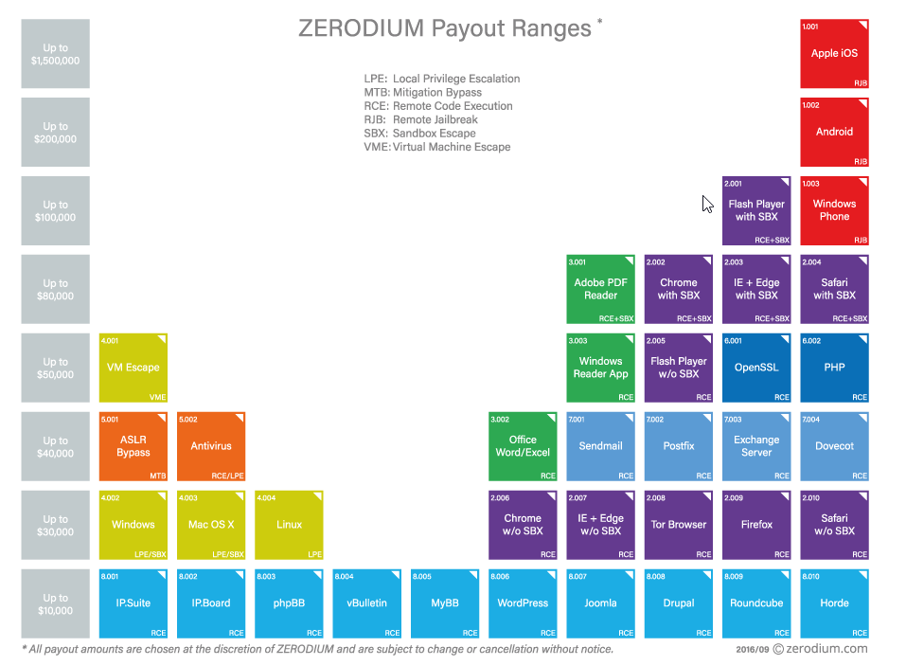
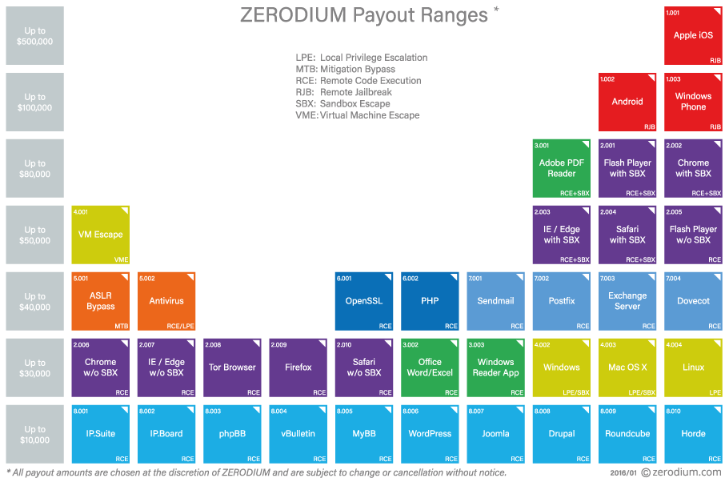
Motivation

Slide 16
Content of the next 7 Friday afternoons

Slide 17
Content
You want to learn:
What memory corruptions are
What buffer overflows are
What exploits are
How exploits are being created
To exploit a local application
To exploit a remote application
Learn about anti-exploiting technologies
To circumvent all common anti-exploiting technologies for Linux
And some for Windows
Use After Free
Hack browsers
Hack facebook “for a friend”

Slide 18
Content
You will actually learn:
Intel x86
Architecture
CPU
Registers
Linux
Userspace memory layout, stacks, heap
Syscalls
Sockets
Networking
Programming Languages
Assembler
C
Python
Bash
(Ruby)

Slide 19
Plan

Slide 20
Plan
24.02.2017
Theory:
0x01 Intro (this)
0x02 Intro Technical
0x10 Intel Architecture
0x11 Memory Layout
Challenges:
0 Introduction to memory layout – basic
1 Introduction to memory layout - advanced

Slide 21
Plan
03.03.2017
Theory:
0x12 C Array and Pointers
0x30 ASM Intro
0x31 Shellcode
0x32 Function Call Convention
0x33 Debugging
Challenges:
Challenge 8
Challenge 9
Challenge 3
Challenge 7
Challenge 50

Slide 22
Plan
10.04.2017
Theory:
0x41 Buffer Overflow
0x42 Exploit
0x44 Remote Exploit
Challenges:
Challenge11
Challenge12

Slide 23
Plan
17.04.2017
Theory:
0x51 Exploit Mitigation
0x52 Defeat Exploit Mitigation
0x53 Exploit Mitigation – PIE
0x54 Defeat Exploit Mitigation ROP
Challenges:
Challenge14
Challenge15

Slide 24
Plan
24.04.2017
Theory:
0x72 Linux Hardening
Defeat Exploit Mitigation – Heap Intro
Defeat Exploit Mitigation – Heap Attacks
Challenges:
Challenge31

Slide 25
Plan
31.04.2017
Theory:
Windows Exploiting
Secure Coding
Fuzzing
Challenges:

Slide 26
Plan
07.05.2017
Theory:
Puffer
Case Studies
Questions
Challenges:

Slide 27
Content
Intel Architecture
Buffer Overflow
Memory Layout
C Arrays
BoF Exploit
Assembler
Remote Exploit
Shellcode
Exploit Mitigations
Function Calls
Defeat Exploit Mitigations
Debugging

Slide 28
ASCII Armor
Arbitrary Write
Overflow Local Vars
Stack Canary
Heap Overflows
Brute Force
Exploit
Mitigations
Partial RIP Overwrite
ASLR
NOP Slide
PIE
Info Disclosure
DEP
Ret 2 PLT
ROP

Slide 29
And:
Windows Exploiting
Secure Coding
Fuzzing
Linux Hardening
Browser Security
Case Studies

Slide 30
Exam Oral
What is (mainly) relevant for the oral exam?
How does memory corruption work?
How does an exploit work?
What exploit mitigations exist?
How can these exploit mitigations be circumvented?

Slide 31
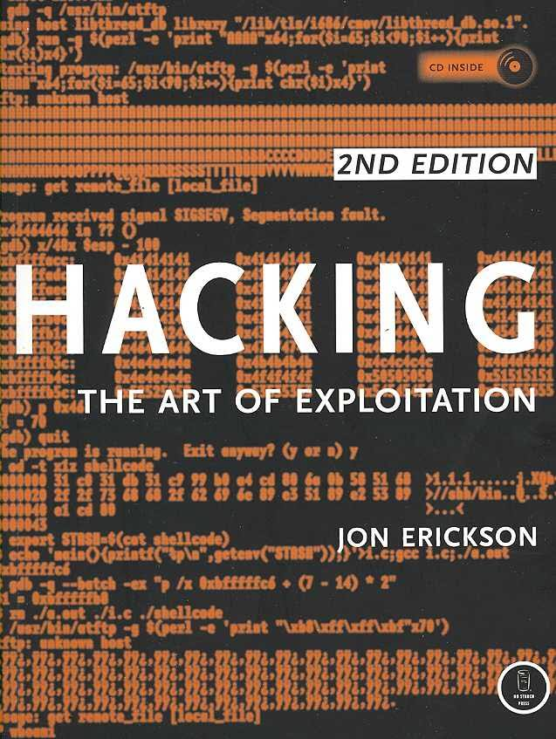
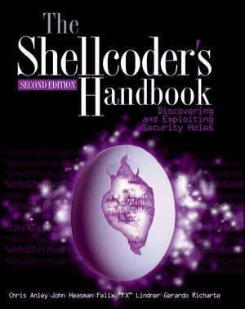
Books

