Slide 1
Exploiting and Defense Technical Intro
Dobin Rutishauser
December 2016

Slide 2
Intro - Technical

Slide 3
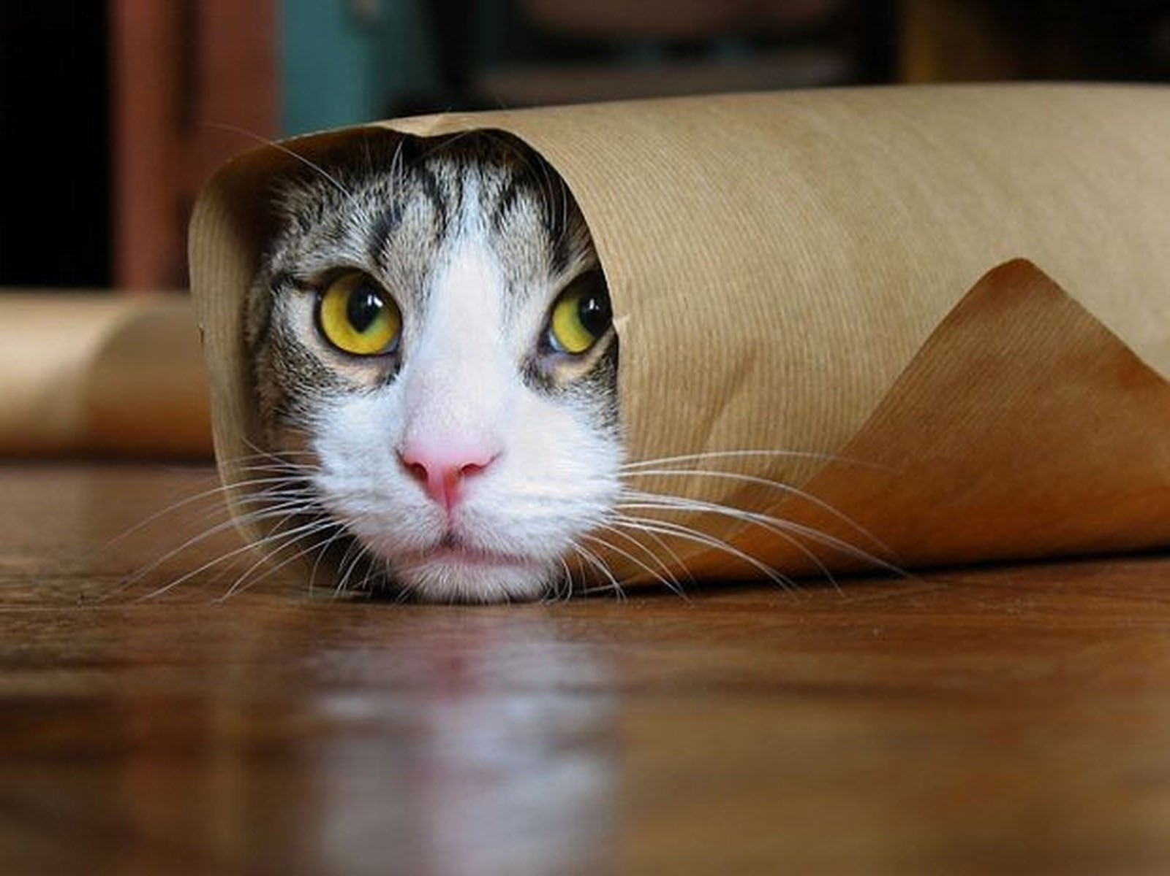
What is a picture?

Slide 4
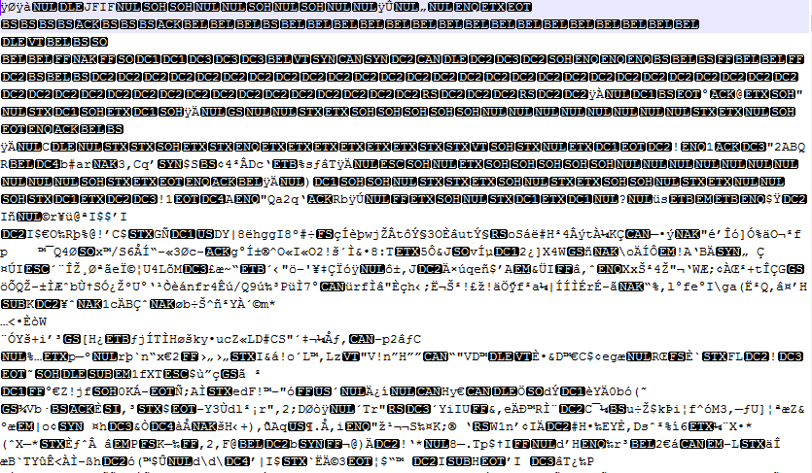
What is a picture? In an text editor

Slide 5
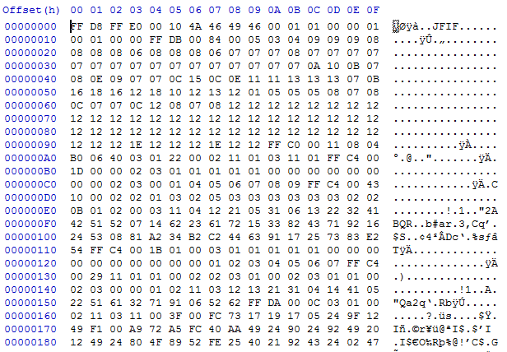
What is a picture? In an hex editor

Slide 6
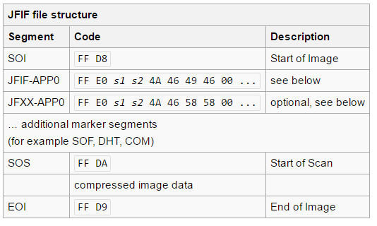
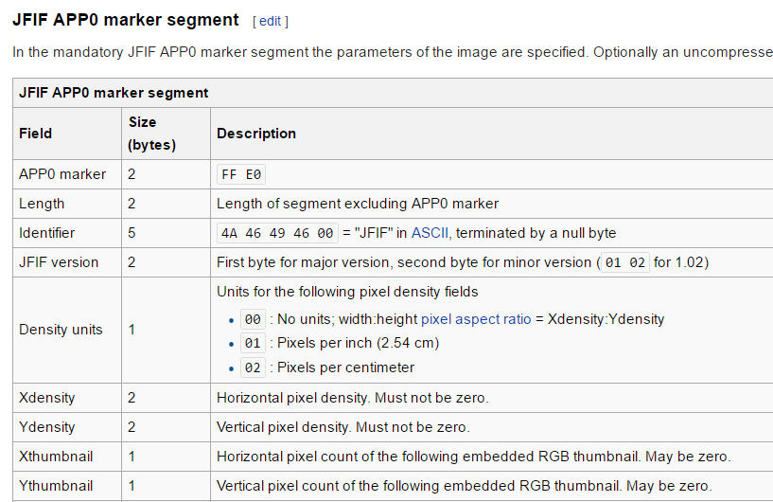
What is a picture?

Slide 7
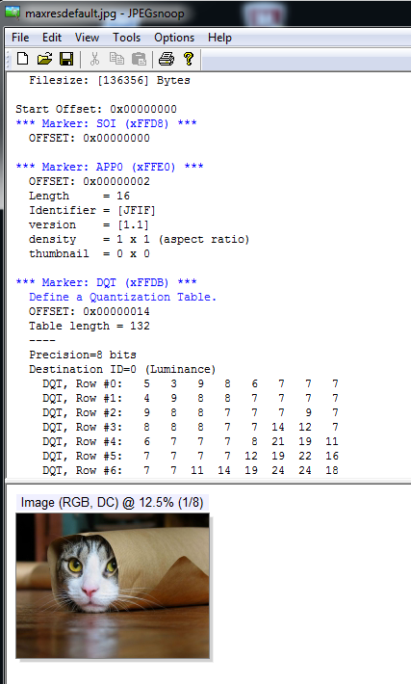

Slide 8
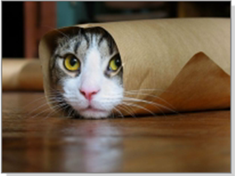
What is a picture?
Data for the computer
When interpreted correctly, displays a cat (via GPU)
When interpreted wrongly, displays garbage / crashes
When interpreted wrongly in the right way, lets us hack a computer
File
Application
<Instructions>

Slide 9
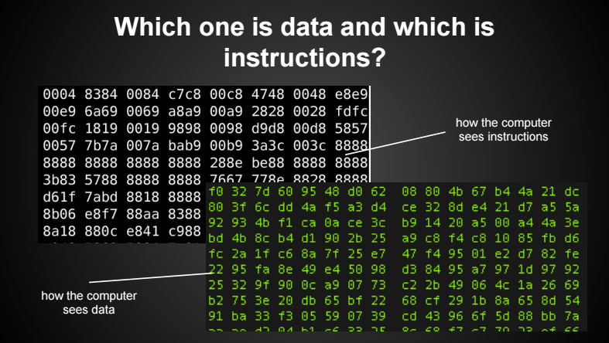
What is a picture?

Slide 10
What is a picture?
Is it possible to create an image which executes code?
Yes
If this is intentional, it’s a feature
If this is not intentional, the picture is an exploit

Slide 11
What is an exploit?

Slide 12
What is an exploit?
Simple Definition of exploit
to get value or use from (something)
to use (someone or something) in a way that helps you unfairly
Full Definition of exploit
to make productive use of : utilize <exploiting your talents> <exploit your opponent's weakness>
to make use of meanly or unfairly for one's own advantage <exploiting migrant farm workers>
http://www.merriam-webster.com/dictionary/exploit

Slide 13
What is an exploit?
Exploit (v): To take advantage of a vulnerability so that the target system reacts in a manner other than which the designer intended.
Exploit (n): The tool, set of instructions, or code that is used to take advantage of a vulnerability.
(The Shellcoders Handbook, 2nd Edition, p4)

Slide 14
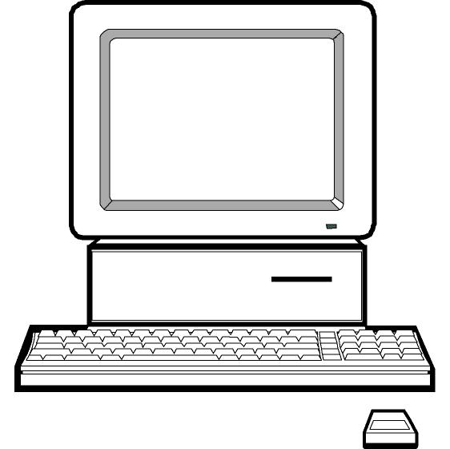
What is an exploit?
App (Word)
Only trusted apps (code) running
Computer fully secure
App (Firefox)
App (Apache)

Slide 15
What is an exploit?
App
Virus / Backdoor / Trojan / Malware
Is NOT
Exploit
App
Evil App

Slide 16
What is an exploit?
App
Introduce new code into running software
App
App
Evil

Slide 17
Types of exploits
Local
Server-side
Client-side

Slide 18
Types of exploits - Local exploit
High Privileged App
Evil
Evil
Low Privileged App

Slide 19
Types of exploits - local
Local Exploit:
Attacker is already on a host
Wants to execute his code with higher privileges
“Privilege Escalation”
Linux:
SUID Programs
www-data -> root
Windows:
User -> Local Admin (->System)

Slide 20
Types of exploits - Server-side exploit
Server Software
Exploit
Evil
Evil

Slide 21
Types of exploits - Remote
Remote Exploit:
Attacker can directly talk with a server software on a host
Wants to execute his code on the remote host
Server Examples
FTP Server (proftp, wuftp)
DNS Server (bind)
Web Server (IIS, Apache)

Slide 22
Types of exploits - Client-side exploit
Exploit
Evil
Evil
Client Software

Slide 23
Types of exploits - Client
Client Exploit:
Attacker can influence data which a client receives
Wants to execute his code on the client host
Examples:
Browser
Flash
Java
Image Viewer
Word
Putty
Git

Slide 24
Is exploit writing hacking?

Slide 25
Is exploit writing hacking?
Hack
1.to cut, notch, slice, chop, or sever (something) with or as with heavy, irregular blows (often followed by up or down): to hack meat; to hack down trees.

Slide 26
Is exploit writing hacking?
An aspect of hack value is performing feats for the sake of showing that they can be done, even if others think it is difficult. Using things in a unique way outside their intended purpose is often perceived as having hack value.
Examples:
using a dot matrix impact printer to produce musical notes
using an optical mouse as barcode reader.
making soup with your coffee machine
https://en.wikipedia.org/wiki/Hacker_culture

Slide 27
Is exploit writing hacking?
hack: Computers.
to modify (a computer program or electronic device) or write (a program) in a skillful or clever way: Developers have hacked the app. I hacked my tablet to do some very cool things.
to circumvent security and break into (a network, computer, file, etc.), usually with malicious intent: Criminals hacked the bank's servers yesterday. Our team systematically hacks our network to find vulnerabilities.
http://www.dictionary.com/browse/hacking

Slide 28
Is exploit writing hacking?
Hackerethik:
Freier Zugriff auf Computer
Freier Zugriff auf Wissen
Misstrauen gegenüber Autoritäten und Bevorzugung von Dezentralisierung.
Hacker sollten nur nach ihrer Fähigkeit beurteilt werden.
Du kannst Kunst und Schönheit mittels Computer erzeugen
Verbesserung der Welt durch das Verbreiten von Technologien
https://de.wikipedia.org/wiki/Hackerethik

Slide 29
Vulnerability types

Slide 30
Vulnerability types
Vulnerability types
Memory corruption
Authentication
Authorization
Configuration error
Input validation
Logic error
Sensitive data protection
Session management
Encoding Error
Cryptographic Errors
Permission Problems
…

Slide 31
Vulnerability Types
Memory corruption occurs in a computer program when the contents of a memory location are unintentionally modified due to programming errors; this is termed violating memory safety. When the corrupted memory contents are used later in that program, it leads either to program crash or to strange and bizarre program behavior
Modern programming languages like C and C++ have powerful features of explicit memory management and pointer arithmetic. These features are designed for developing efficient applications and system software.
https://en.wikipedia.org/wiki/Memory_corruption

Slide 32
What is vulnerable against memory corruption?

Slide 33
What is vulnerable?
What software is affected?
Software developed in unsafe programming languages
(ASM)
C
C++
Fortran (lol)

Slide 34
What is vulnerable?
What software is affected?
Software developed in unsafe programming languages
(ASM)
C
C++
Fortran (lol)
Who writes software in C/C++, anyway?
IE, Chrome, Firefox
Apache / IIS
Postfix, Sendmail
BIND
MS Office / LibreOffice
Antivirus
Other “Security” Software

Slide 35
What is vulnerable?
Not affected:
Software written in interpreted languages
PHP
Perl
Ruby
Bash
Python
JavaScript
Software with strict bound checking
Rust
C#
Java
Exception: Native calls

Slide 36
What is vulnerable?
Special case: Interpreter itself
What language is PHP, Java, JavaScript, … written-in?
C / C++

Slide 37
Some memory corruption vuln’s
From 2015

Slide 38
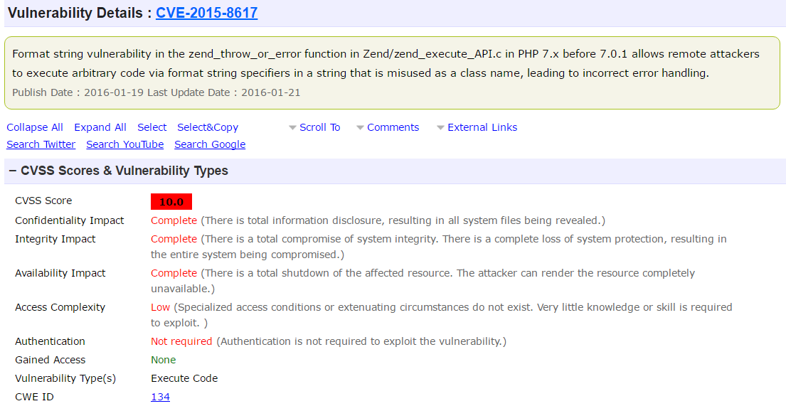
What is vulnerable?

Slide 39
Some memory corruption bugs
CVE-2015-6094
Microsoft Office is prone to a remote memory-corruption vulnerability because it fails to properly handle objects in memory.
Excel 2010, 2013, 2016
CVE-2015-6068
Microsoft Internet Explorer is prone to a remote memory-corruption vulnerability. Attackers can exploit this issue by enticing an unsuspecting user to view a specially crafted webpage.
IE11
CVE-2015-5122
Use-after-free vulnerability in the DisplayObject class in the ActionScript 3 (AS3) implementation in Adobe Flash Player 13.x through 13.0.0.302 on Windows and OS X, 14.x through 18.0.0.203 on Windows and OS X, 11.x through 11.2.202.481 on Linux, and 12.x through 18.0.0.204 on Linux Chrome installations allows remote attackers to execute arbitrary code
Flash 11, 12, 13, 14

Slide 40
Some memory corruption bugs
CVE-2015-0287
ASN.1 structure reuse memory corruption. Reusing a structure in ASN.1 parsing may allow an attacker to cause memory corruption via an invalid write.
OpenSSL 0.9.8-1.0.2
CVE-2015-7852
A potential off by one vulnerability exists in the cookedprint functionality of ntpq. A specially crafted buffer could cause a buffer overflow potentially resulting in null byte being written out of bounds.
NTP 4.2.8p2
CVE-2015-1538 (Stagefright)
Integer overflow in the SampleTable::setSampleToChunkParams function in SampleTable.cpp in libstagefright in Android before 5.1.1 LMY48I allows remote attackers to execute arbitrary code via crafted atoms in MP4 data that trigger an unchecked multiplication
Android 1.5 - 5.1

Slide 41
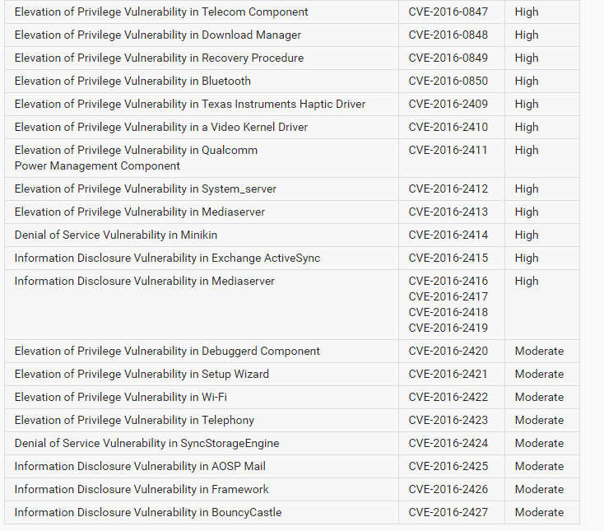
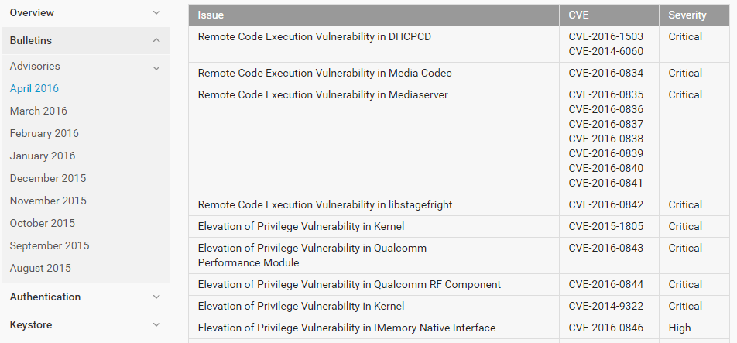
Some memory corruption bugs
Android:

Slide 42
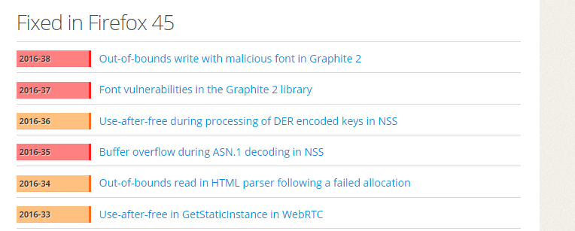
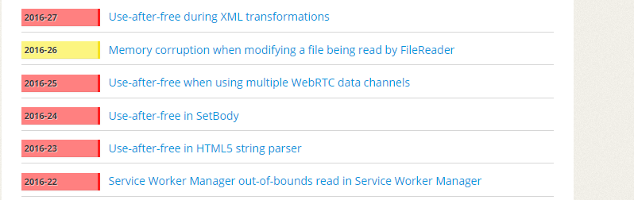
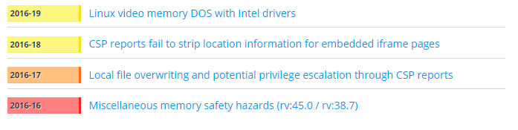
Some memory corruption bugs
Firefox:

Slide 43
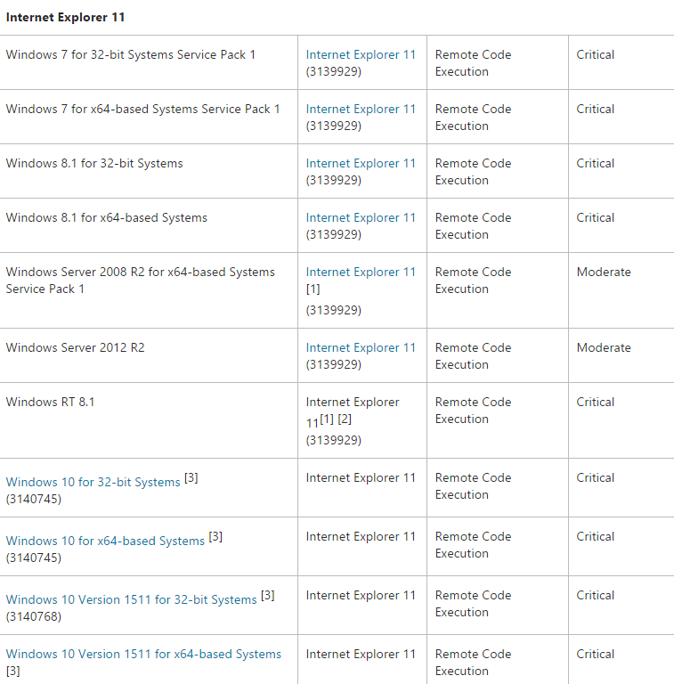
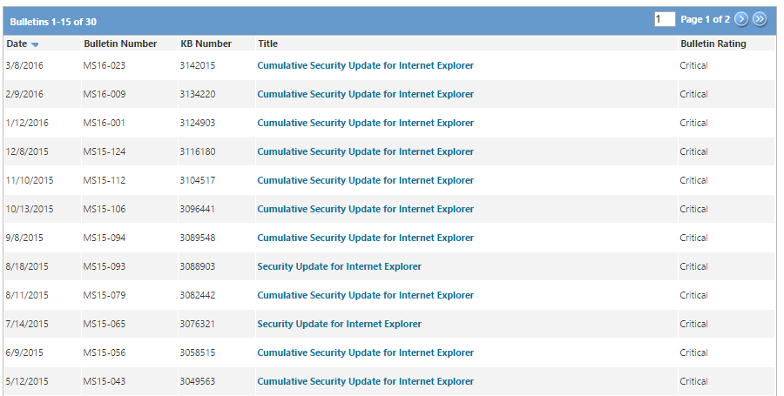
Some memory corruption bugs
IE11

Slide 44
Some memory corruption bugs
Conclusion:
Important software is written in C/C++
Memory corruption bugs are very prelevant

Slide 45
Intro
Recap:
We are concerned with memory corruption vulnerabilities
A program which misuses a memory corruption vulnerability is called an exploit
There can be local-, server- and client exploits
A exploit injects additional code into a trusted app and executes it

Slide 46
Programs and Data

Slide 47
Programs and Data
Definition of a “program”:
“A program is a set of instructions which modify data”

Slide 48
Programs and Data
Definition of a “program”:
“A program is a set of instructions which modify data”
which is controlled by data”

Slide 49
Programs and Data
Definition of a “program”:
“A program is a set of instructions which modify data”
which is controlled by data”
Or in other words:
Data is manipulating the instruction flow of a program,
not the other way round

Slide 50
Weird machines
Weird machines:
In computer security, the weird machine is a computational artifact where additional code execution can happen outside the original specification of the program.
It is closely related to the concept of weird instructions, which are the building blocks of an exploit based on crafted input data.

Slide 51
Weird machines
Programming of “Weird Machines”
Gain very detailed understanding of:
Program logic
Implementation of “hidden mechanics”
Stack, Heap etc.
Error conditions
Leads from from:
“This bugs randomly crashes my program!”
To:
“This bugs lets me reliably execute arbitrary code”

Slide 52
Obligatory history lesson…

Slide 53
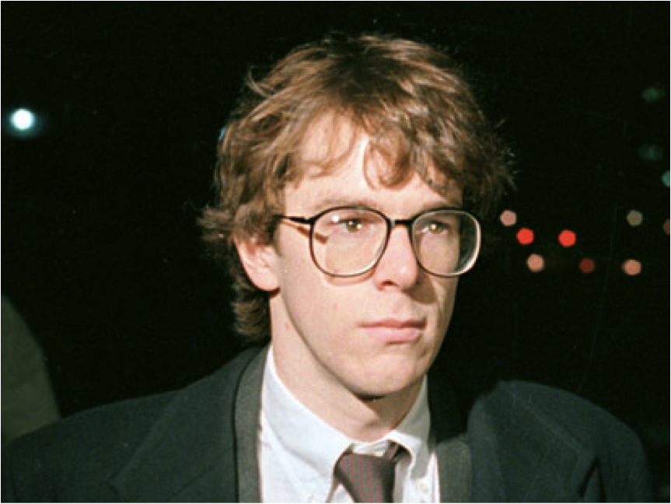
Morris worm
Morris worm
02.11.1988
Written by graduate student Robert Morris, MIT
He wanted to count the number of computers on the internet
Worm had a bug, re-infected already infected computers, killed the Internet
Attacked fingerd and sendmail (and some more things)

Slide 54
Morris worm
fingerd bug in BSD4 on VAX machines:
The bug exploited to break fingerd involved overrunning the buffer the daemon used for input. The standard C library has a few routines that read input without checking for bounds on the buffer involved. In particular, the gets call takes input to a buffer without doing any bounds checking; this was the call exploited by the Worm.
The Internet Worm Program: An Analysis (2004)
http://spaf.cerias.purdue.edu/tech-reps/823.pdf

Slide 55
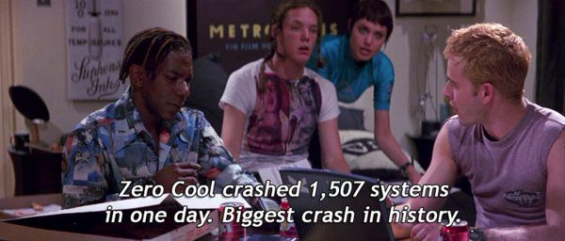
Morris worm

