Slide 1
Hacking Lab Challenges

Slide 2
Hacking Lab
A laboratory to try hacking techniques
Accessible via VPN
LiveCD: Bootable Hacking Linux Distribution
Based on Kali Linux
Also as virtualbox image

Slide 3
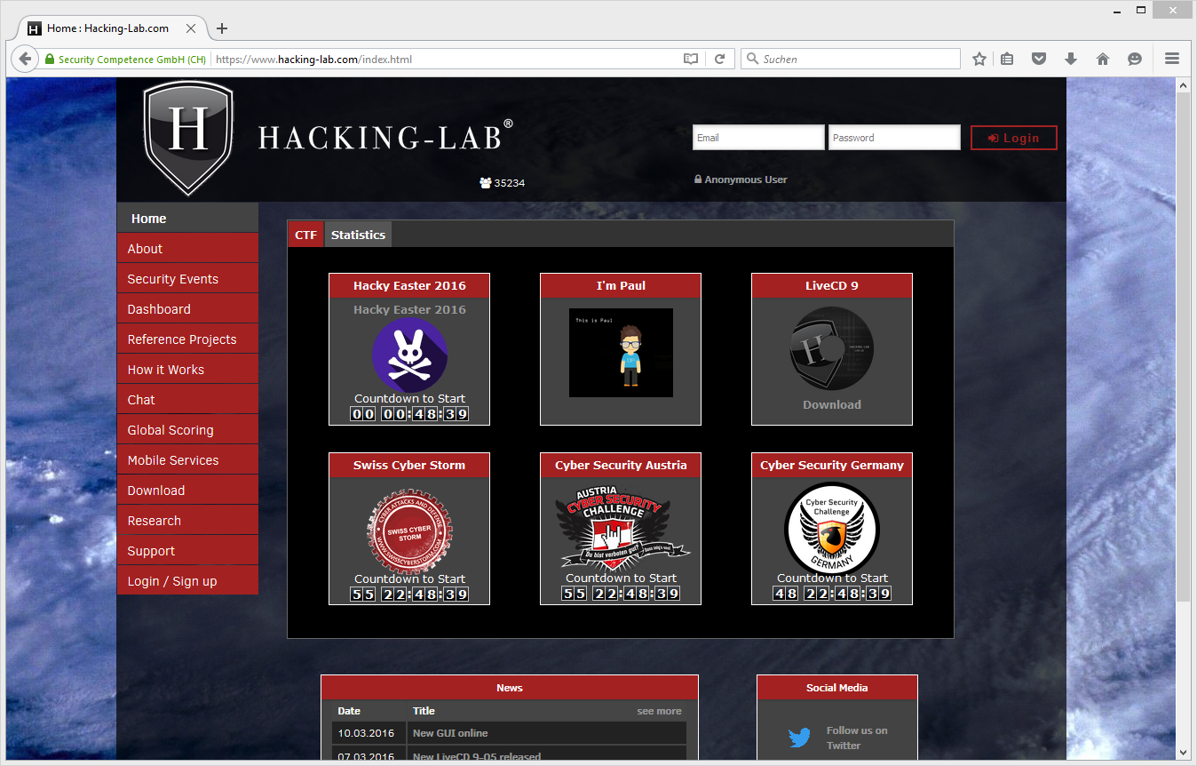
Hacking-Lab Online Security Lab

Slide 4
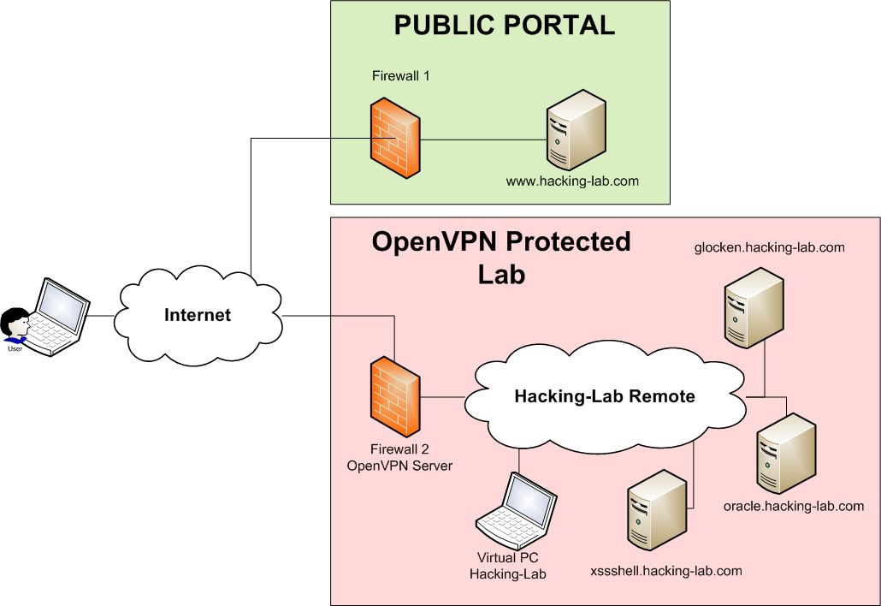

Hacking-Lab Architecture
PUBLIC
OpenVPN
Free LiveCD

Slide 5


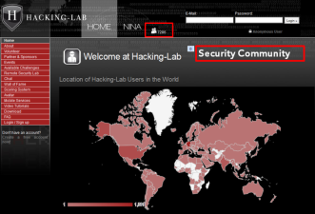
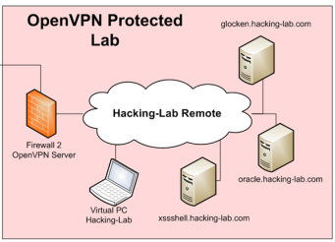


Working with Hacking-Lab
Challenge Details
Hands-On
Send Solution
Solution Grading

Slide 6
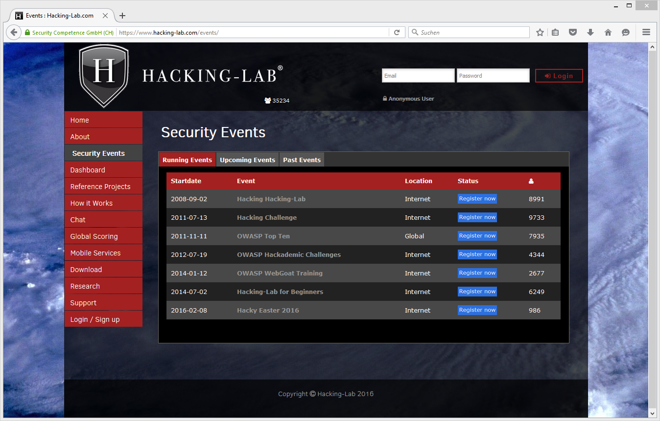
Running Events (Classrooms)

Slide 7
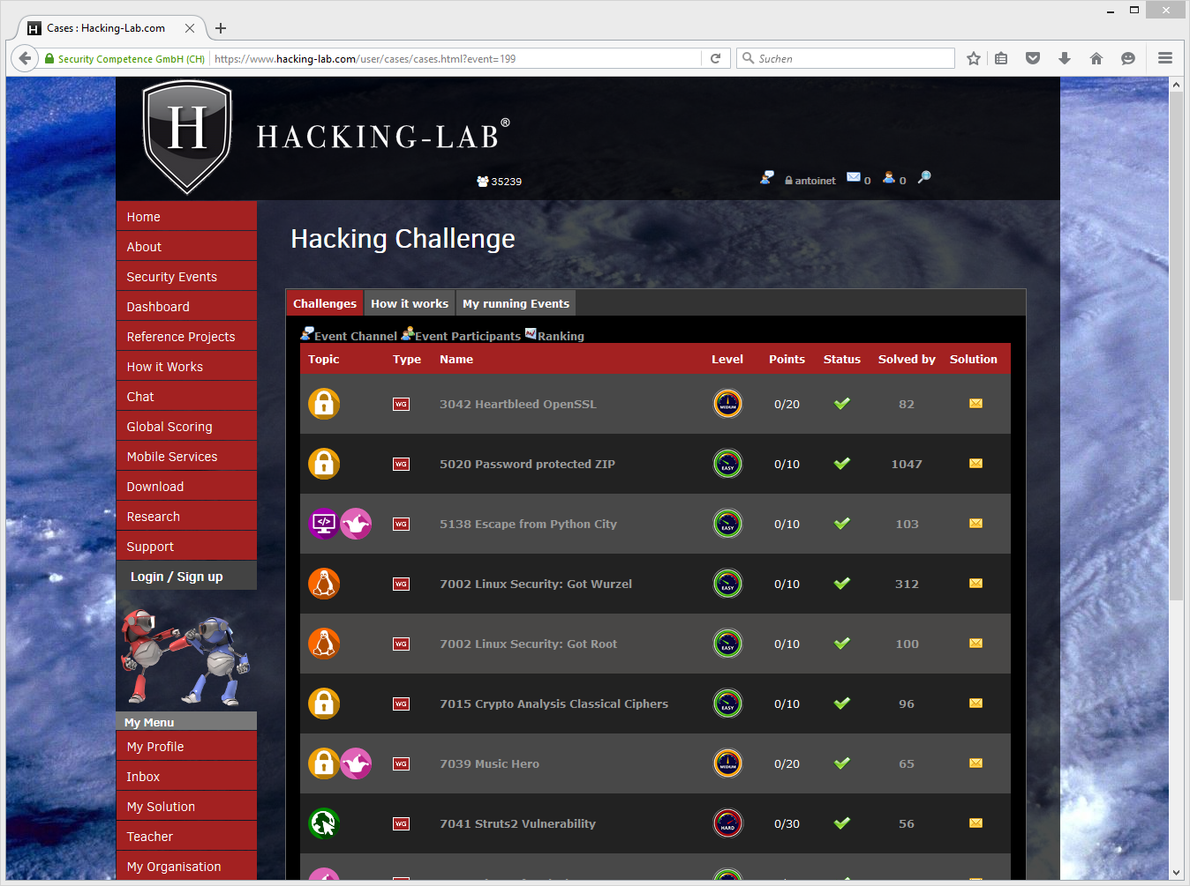
Challenge Types
Challenge Type:
Web Security
Crypto
Pentesting
Fun

Slide 8
Challenge Description
Challenge Description:
Your mission
Your job

Slide 9
Challenge Levels
Levels:
Easy
Intermediate
Advanced

Slide 10
Challenge Scoring
Max points for winning team:

Slide 11
Solution Submission
Icon used to submit your solution

Slide 12
Hacking-Lab LiveCD
A tool that will help you doing the hands-on labs

Slide 13
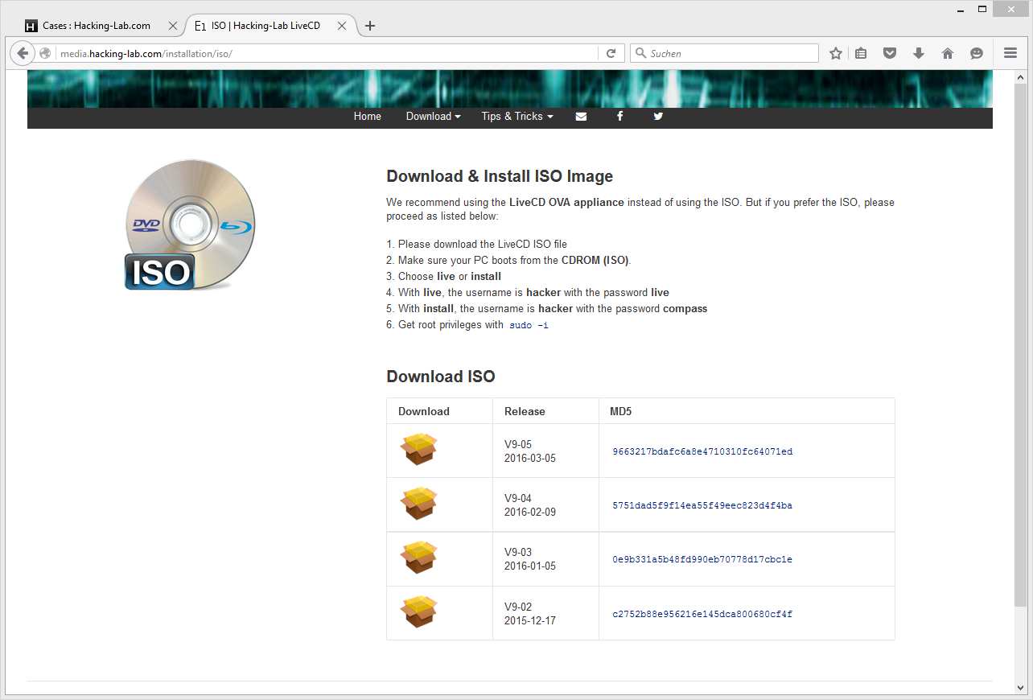
media.hacking-lab.com

