Slide 1
Intel Architecture

Slide 2
Content
Intel Architecture
Buffer Overflow
Memory Layout
C Arrays
BoF Exploit
Assembler
Remote Exploit
Shellcode
Exploit Mitigations
Function Calls
Defeat Exploit Mitigations
Debugging

Slide 3
Intel Architecture Intel CPU

Slide 4
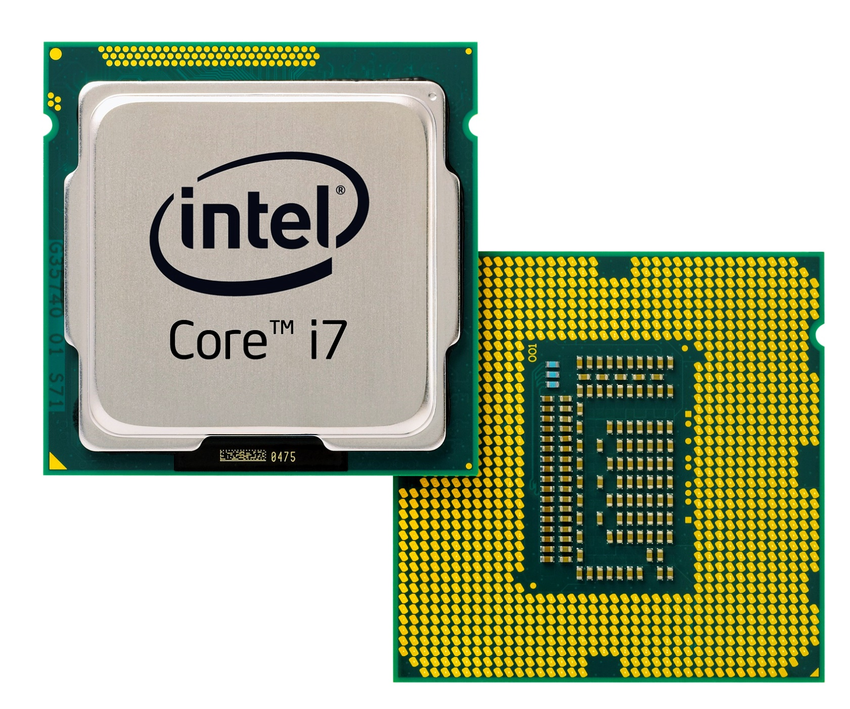
Intel CPU

Slide 5
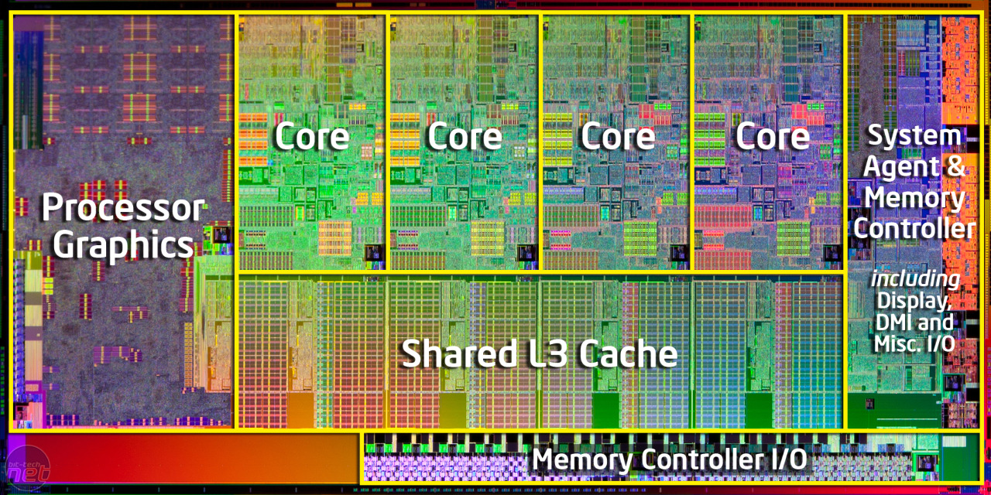
Intel CPU

Slide 6
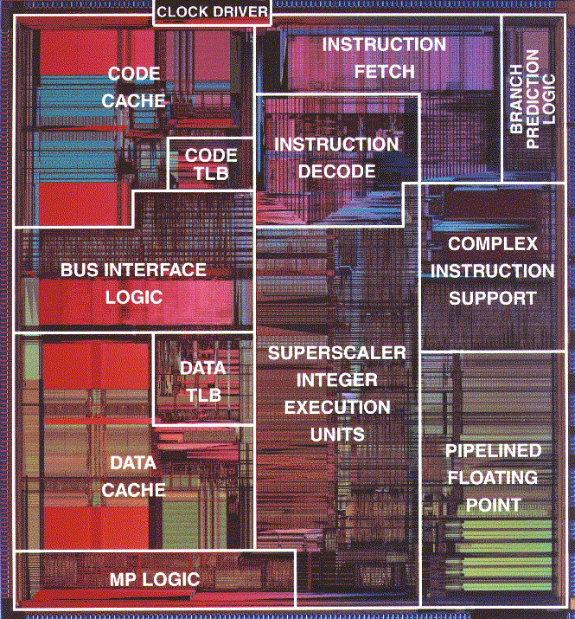
Intel CPU
Pentium Die

Slide 7
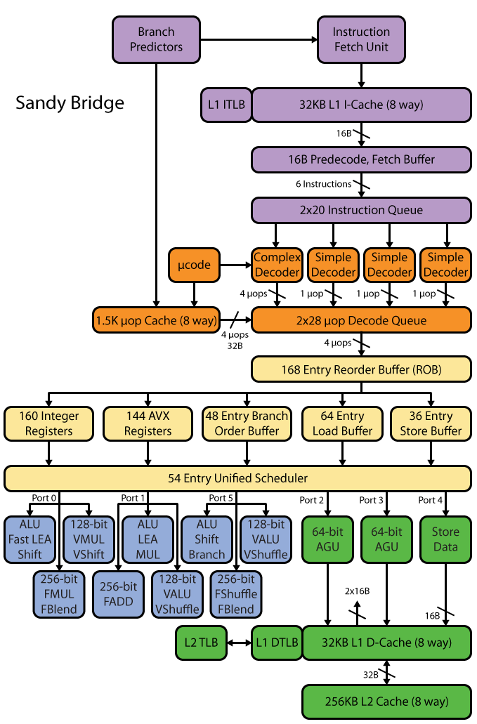

Slide 8
Overview: Computerz
RAM
CPU
<magic>
Read:
Data
Instructions
Write:
Data

Slide 9
Overview: Computerz
von Neumann Architecture
RAM
CPU
<magic>
Read:
Data
Instructions
Write:
Data
Instructions
Notes:
Other: Harvard architecture

Slide 10
Overview: Computerz
RAM
CPU
<magic>
Register
Read:
Data
Instructions
Write:
Data
Instructions

Slide 11
Overview: CPU Registers
Register are the “variables” on the CPU
Immediate access for the CPU
Cannot write Memory -> Memory
Always: Memory -> Register -> Memory
Register: <1 cycle
L1: ~3
L2: ~14
RAM: ~240

Slide 12
Overview: CPU Registers
Register can hold:
Data (numbers)
Addresses (also numbers, but with a different meaning)
Registers can be used to:
Perform computations
Read / Write memory
Execute instructions

Slide 13
Overview: CPU Registers
32 | 64 | Acronym
EAX | RAX | Accumulator | Adding stuff
EBX | RBX | Base | Referencing stuff
ECX | RCX | Count | Counting stuff
EDX | RDX | Data | Stuff
ESI | RSI | Source Index | Points to a source
EDI | RDI | Destination Index | Points to a destination
 | R8-R15 |  | General Purpose

Slide 14
Overview: CPU Registers
32 | 64 | Acronym | Points to?
EIP | RIP | Instruction Pointer | Next instruction to be executed
ESP | RSP | Stack Pointer | Top of Stack
EBP | RBP | Base Pointer | Current Stack Frame (Bottom)
Print this slide
and stick it on your bathroom mirror
Notes:
Wichtig!

Slide 15
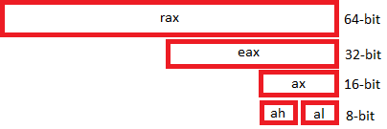
Overview: CPU Registers
88 77 66 55 44 33 22 11

Slide 16
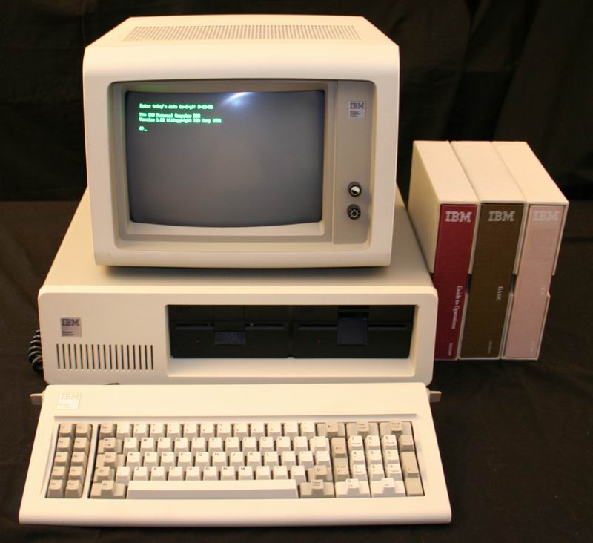
Overview: CPU Registers
Fun Fact: Current Intel CPU’s are compatible to the 8086
8086:
From 1978
5-10mhz

Slide 17
Overview: CPU Registers
Recap:
CPU work with registers
Registers can hold data
Registers can also hold addresses of memory locations (to write data to)
They can be 32 bit (EAX) or 64 bit (RAX)
Some registers are multi-purpose
Some registers are special (RIP, RBP, RSP)

Slide 18
Hex Numbers, and Little Endian
A guide to understand the rest of my slides

Slide 19
Hex Numbers, and Little Endian
Intel CPU’s
1 Byte = 8 Bit
Little endian

Slide 20
Hex Numbers, and Little Endian
Intel CPU’s
1 Byte = 8 Bit
Little endian
Others:
CDC 6000: 18, 24 and 60 bit
PDP1/9/15: 18 bit words
ARM and other RISC: Big Endian

Slide 21
Hex Numbers
Hex: 0 1 2 3 4 5 6 7 8 9 A B C D E F
1 hex digit: 16 values (4 bit)
2 hex digits: 256 values (8 bit)
16 * 16 = 256
1 Byte = 8 Bit = 256 values!

Slide 22
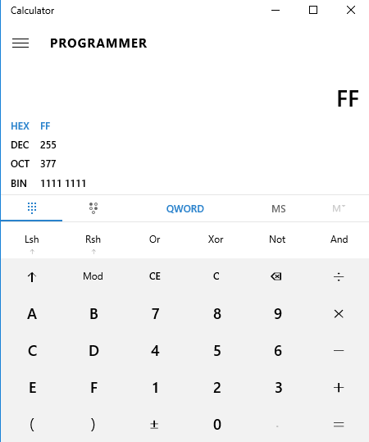
Hex numbers
0x00 = 0
0x01 = 1
0x0f = 15
0xf0 = 240
0xff = 255
Notes:
Count with hands in binary

Slide 23
Hex Numbers
Base 10
6975
Base 16
0x1B3F
Nibbles
0001 1011 0011 1111

Slide 24
Hex Numbers
Base 10
6975
Base 16
0x1B3F
Nibbles
0001 1011 0011 1111
Bytes
0x1B
0x3F

Slide 25
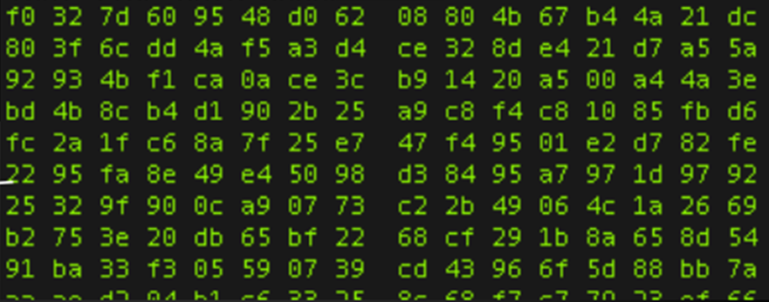
Endianness
Number:
Big Endian:
Little Endian:
0x1B3F
0x1B 0x3F 0x1B3F
0x3F 0x1B 0x3F1B

Slide 26
Endianness: Big Endian (ARM)
32 bit = 4 bytes
2864434397
Number in Decimal (10)
0xAABBCCDD
Number in Hex (16)
AA BB CC DD
Big Endian Storage
1
2
3
0
4

Slide 27
Endianness: Little Endian (Intel)
32 bit = 4 bytes
2864434397
Number in Decimal (10)
0xAABBCCDD
Number in Hex (16)
DD CC BB AA
Little Endian Storage
1
2
3
0
4

Slide 28
Endianness: Little Endian (Intel)
DD CC BB AA
Four 8 bit numbers:
DD
CC
BB
AA
Two 16 bit numbers:
0xCCDD
0xAABB
A 32 bit number:
0xAABBCCDD
??

Slide 29
Endianness: Little endian
Number:
0x1122334455667788
Little Endian:
88 77 66 55 44 33 22 11
0
1
2
3
4
5
6
7

Slide 30
Numbers in memory
0
0x11223344
32 bit = 4 bytes
4
0x55556666
32 bit = 4 bytes
8
0x77778888
32 bit = 4 bytes

Slide 31
Numbers in memory
0
0x11223344
32 bit = 4 bytes
4
0x55556666
32 bit = 4 bytes
8
0x77778888
32 bit = 4 bytes
0
4
8
0x11223344
0x55556666
0x77778888
32 bit
32 bit
32 bit

Slide 32
Numbers in memory
0
4
8
0x44 0x33 0x22 0x11
0x66 0x66 0x55 0x55
0x88 0x88 0x77 0x77
0
4
8
0x11223344
0x55556666
0x77778888
32 bit
32 bit
32 bit

Slide 33
Numbers in memory
Recap:
Numbers can be displayed in decimal, or hex (0-9, a-f)
Numbers are stored as 16, 32 or 64 bit value as little endian
If we look at little endian numbers as bytes, they are inverted
If we look at numbers in memory, we can’t know if they are 8, 16, 32 or 64 bit

Slide 34
Operating System Basics

Slide 35
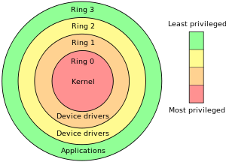
OS Basics: Rings
Ring 0: Kernel (Kernelspace)
Not covered here
Can be interacted with by using “syscalls”
Ring 3: Userspace
Where all programs run
ls, Bash, Vim, Apache, Xorg, Firefox, …
How to transit from userspace to kernelspace?
System Calls (syscall)
Notes:
Ring 1, 2, -1, -2

Slide 36
OS Basics: Rings
Process
Process
Process
Please do things for me
Kernel

Slide 37
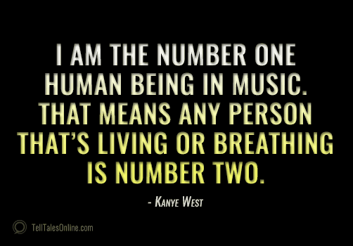
OS Basics: Processes
A Process:
Is a running program
Program lives on disk (static)
Process lives on memory (alive)
Process thinks he “owns” the hardware
RAM
CPU
Multiple processes can run simultaneously
Everyone thinks he is the only one
Like Kanye West

Slide 38
OS Basics: Process and Memory
Processes can address:
4 GB of memory in 32bit OS
(2-3 GB actually)
Independent on how much memory there really is
What if we have:
Only 2 GB RAM?
OOM (Out Of Memory) when too much memory is used
8 GB RAM?
2 Processes can use all their 4GB!

Slide 39
OS Basics: Process and Memory
Why 4 GB?
32 bit register
Register are used to address memory
2^32 = 4 billion = 4 gigabyte
A process has therefore access to 4 billion one-byte memory locations

Slide 40
OS Basics: Process and Memory
1 byte
2^32
EAX:
0xaabbccdd
0
RAM

Slide 41
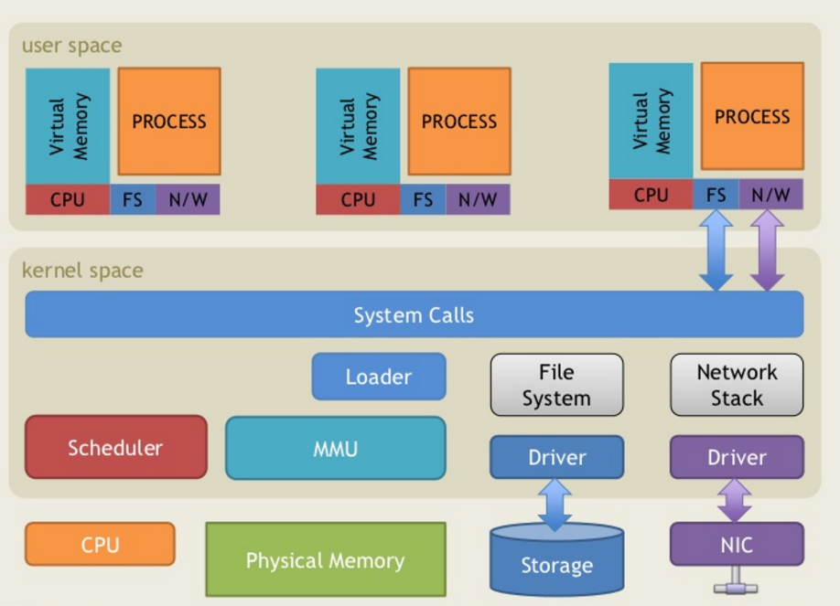
OS Overview
http://www.slideshare.net/saumilshah/operating-systems-a-primer

Slide 42
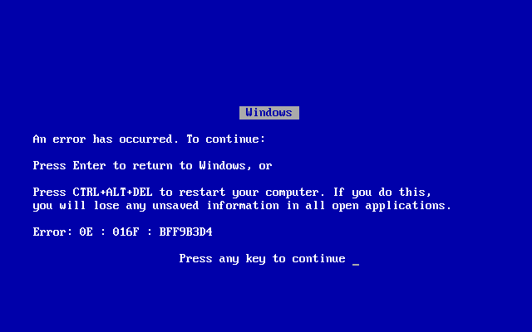
OS Overview
History lesson: “The good old times”
Windows did not have true protected memory until windows NT/2000
Including all of DOS, Windows 3.1, Windows 95, 98, ME
Every process could write into all all other processes, or even the OS
“Blue screen of death”

Slide 43
OS Overview
There’s only one CPU, how can:
Multiple programs run at the same time?
The OS and the programs run at the same time?
Solution: Interrupts
Timer interrupts
Interrupts are handled by the kernel
Time / clock
Network interface
USB devices
Kernel schedules the different processes

Slide 44
OS Overview
Recap:
Processes are programs which are alive in the RAM
Every process thinks he owns the computer (including all the RAM)
Evey process has access to 2^32 (~4 billion) memory locations of 1 byte size

Slide 45
32 bit vs 64 bit

Slide 46
32bit vs 64bit
From 32 to 64 bit
You all are probably too young for this
But it was kinda big thing
AMD invented the current 64 bit architecture
Intel wanted a new one: Itanium. Failed hard.
(AMD was better than Intel in most respects. Sigh).
x86 to x64 / amd64
8086, 80286, 80386, 80486, 80586 aka Pentium
“Is windows 64 bit twice as good/fast than windows 32 bit?”
Width of the CPU registers define the amount of addressable memory

Slide 47
32bit vs 64bit
64 bit pros:
Can address more than 4 gb of memory per computer
64 bit calculations are maybe a bit faster
64 bit cons:
Programs use more space
Because pointers and data-types (integer) are twice as big
On disk, memory and cache

Slide 48
32bit vs 64bit
64 bit registers are prefixed with “R” (RAX, RIP, …)
New registers: R8-R15
Pointers are 64 bit
Push/Pop are 64 bit

Slide 49
32bit vs 64bit
For 64 bit:
64 bit are 18 exabytes
Only 47 bit are used (=140 terabytes)
< 0x00007fffffffffff

Slide 50
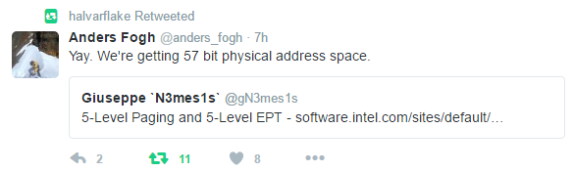
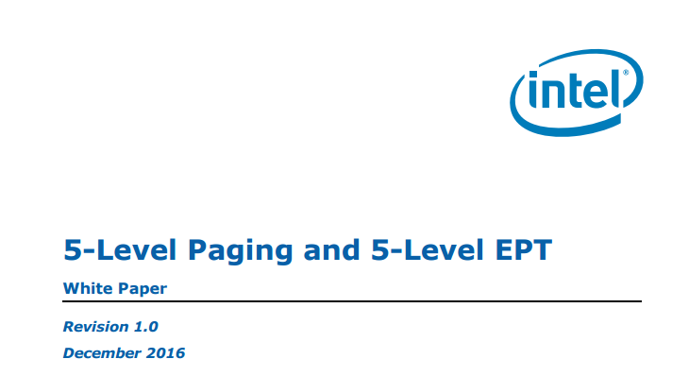
32bit vs 64bit
For 64 bit:
64 bit are 18 exabytes
Only 47 bit are used (=140 terabytes)
< 0x00007fffffffffff

Slide 51
32bit vs 64bit
Linux (and Windows) can execute 32 bit processes on a 64 bit OS
C:\Program Files
C:\Program Files (x86)
/lib/lib
/lib/lib64
The 32 bit process does not realize he’s on a 64 bit system
But needs a 32 bit runtime

Slide 52
32bit vs 64 bit
For this presentation:
32 bit is “old” and “dead”
But its much easier to create and explain exploits in it
Old plan was: “Lets be modern, 64 bit only”
Current plan: “Lets be modern, but still use 32 bit to exploit stuff”
Sorry…

Slide 53
32bit vs 64bit
Recap
There are some differences between 32 and 64 bit
A 32 bit process can run on a 64 bit system as 32 bit

