Slide 1

Thyroid Disease Detection and Prediction
IS597 Final Project Presentation
Group 7: Danni Wu, Pranav Rajesh Charakondala, Arundhati Raj

Slide 2
Project Overview
Objective: Predict thyroid disease using machine learning.
Type: Binary Classification (Thyroid Disease vs No Thyroid Disease)
Tools: AWS SageMaker, Amazon S3, Jupyter Notebooks
Key Focus: Early diagnosis, reproducibility, model scalability

Slide 3
Dataset Summary
Total Records: 2,800+ patients
Features: Hormone levels (TSH, T3, TT4, T4U, FTI), demographic info
Target Variable: Thyroid condition (yes/no)
Challenges: Missing values, slight class imbalance

Slide 4
Methodology
Models Implemented:
Decision Tree Classifier
Random Forest Classifier
Logistic Regression (Baseline Model)
Data Handling:
Missing Value Imputation (Mean/Mode)
Stratified Train/Test Split (80/20)
Feature Engineering:
One-Hot Encoding for categorical variables
Principal Component Analysis (PCA) for dimensionality reduction

Slide 5
SageMaker Workflow
Data upload and storage on Amazon S3
Notebook-based Data Preprocessing
Model Training using SageMaker built-in algorithms
Evaluation Metrics Calculation
Model Export: Models saved as Joblib files to S3

Slide 6
Model Performance Metrics
Random Forest achieved the best AUC-ROC score and recall, indicating strong capability in correctly identifying thyroid disease patients.
Decision Tree performed comparably but was slightly more prone to overfitting.
Logistic Regression struggled with recall, suggesting limited ability to capture complex, non-linear relationships.

Slide 7
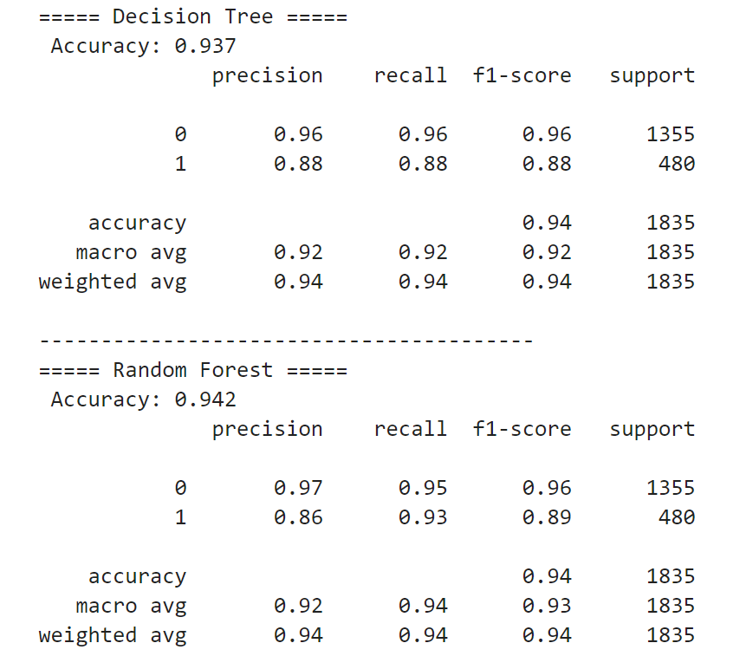
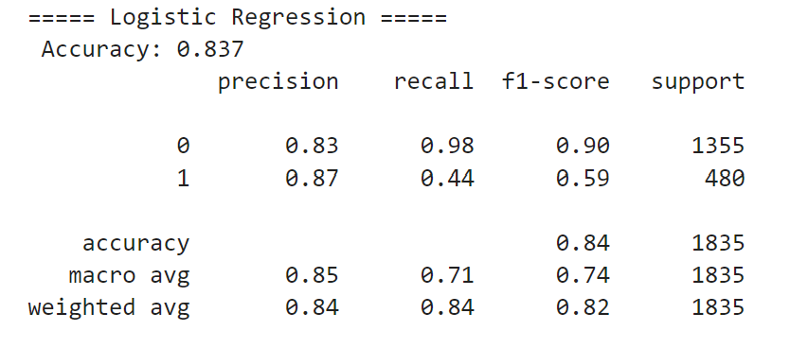
Comparative Results of Different Models

Slide 8
Visual Insights
ROC Curves:
Random Forest curve closest to ideal top-left
Logistic Regression underperforms
Confusion Matrix:
Random Forest minimized false negatives, critical in healthcare

Slide 9
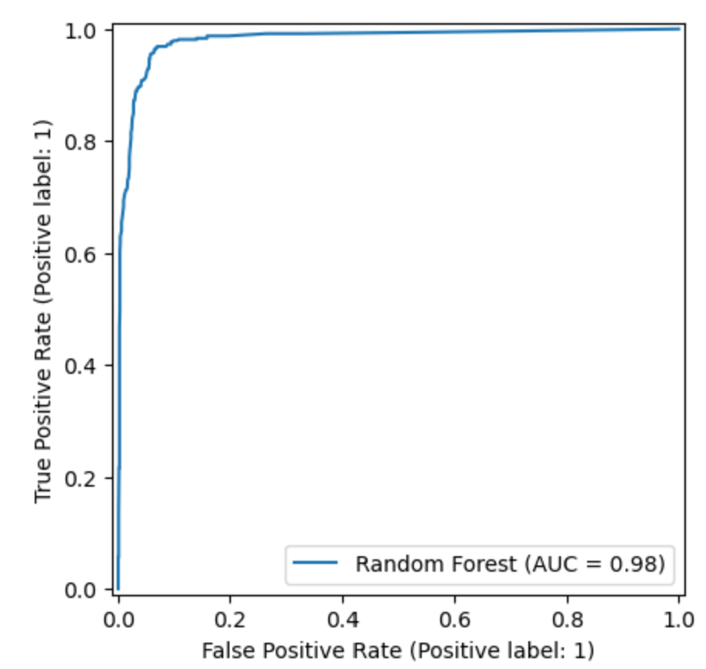
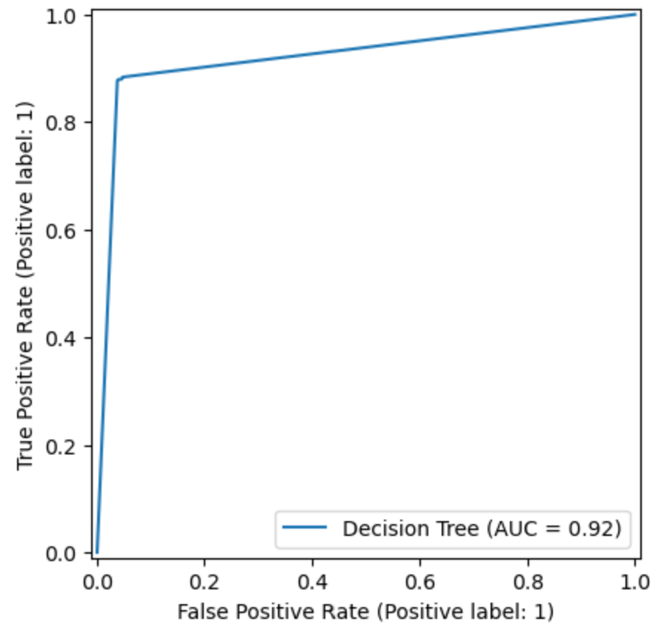
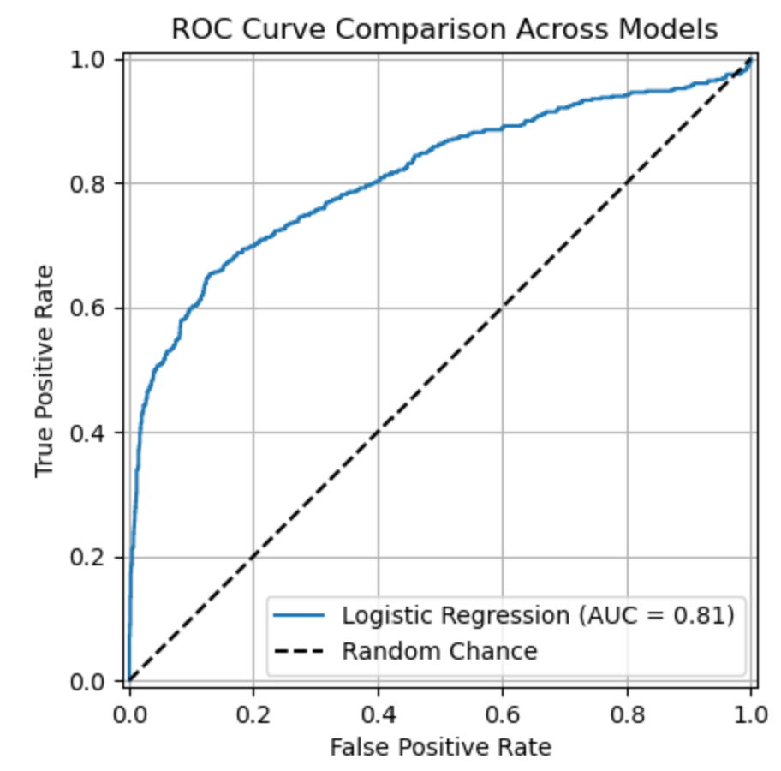
ROC Curve Comparison
Random Forest achieved the best performance with an AUC of 0.98, demonstrating high sensitivity and low false positive rates.
Decision Tree showed strong performance with an AUC of 0.92, balancing accuracy and model interpretability.
Logistic Regression had a lower AUC of 0.81, struggling to detect positive thyroid cases

Slide 10
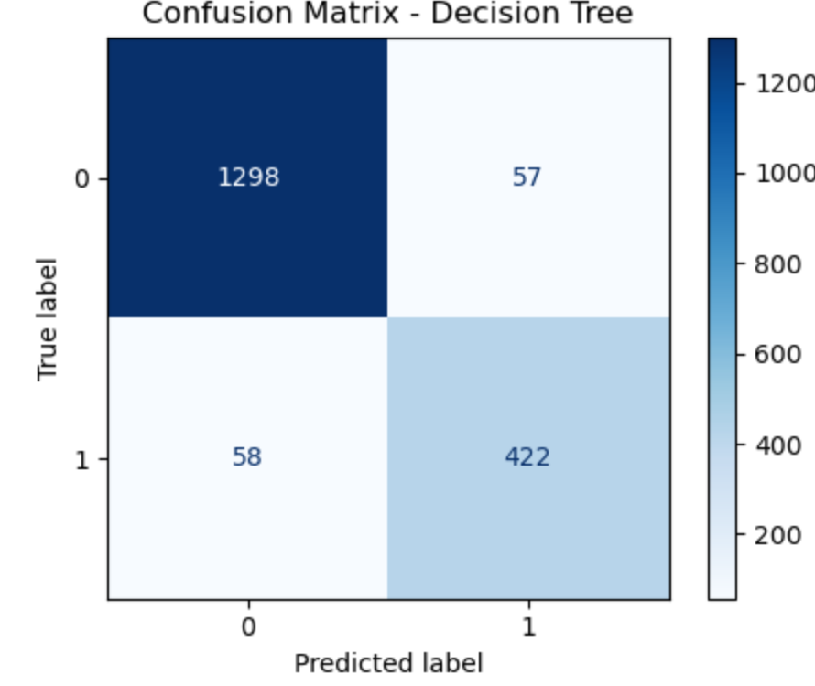
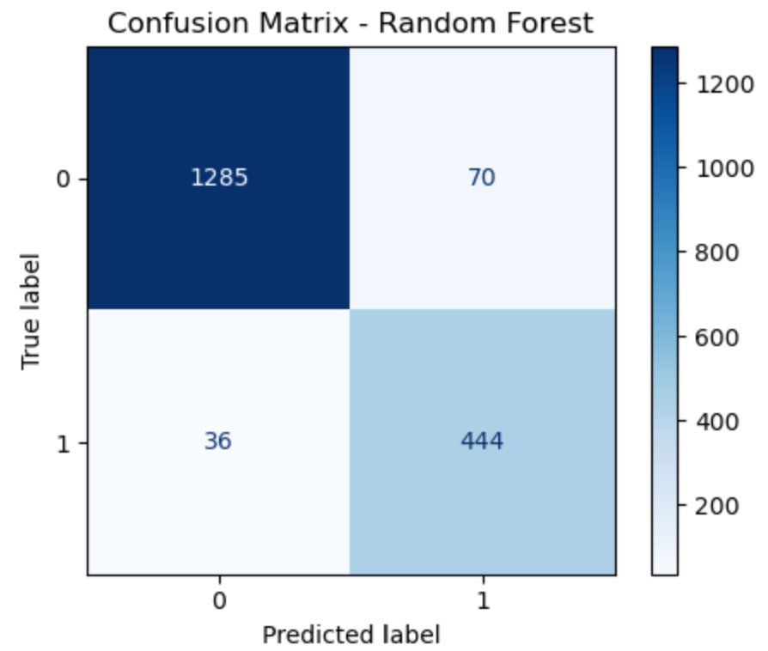
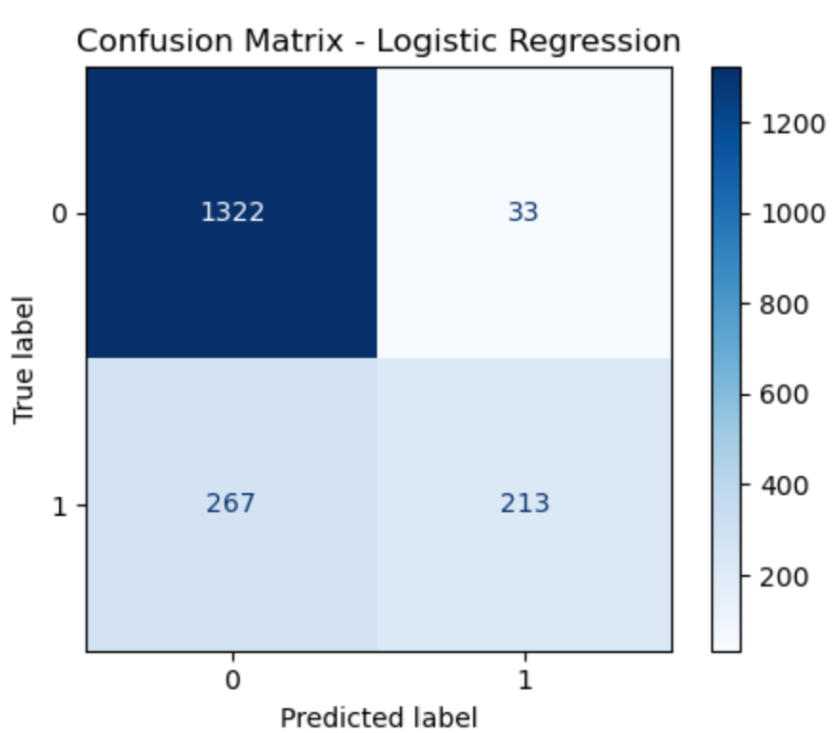
Confusion Matrix Visualization
Decision Tree Classifier
Balanced performance; moderate false negatives (58).
Random Forest Classifier
Best recall with only 36 false negatives.
Stronger at detecting thyroid disease, minor trade-off in false positives.
Logistic Regression
High true negatives, but 267 false negatives.
Poor recall; misses many thyroid cases.

Slide 11
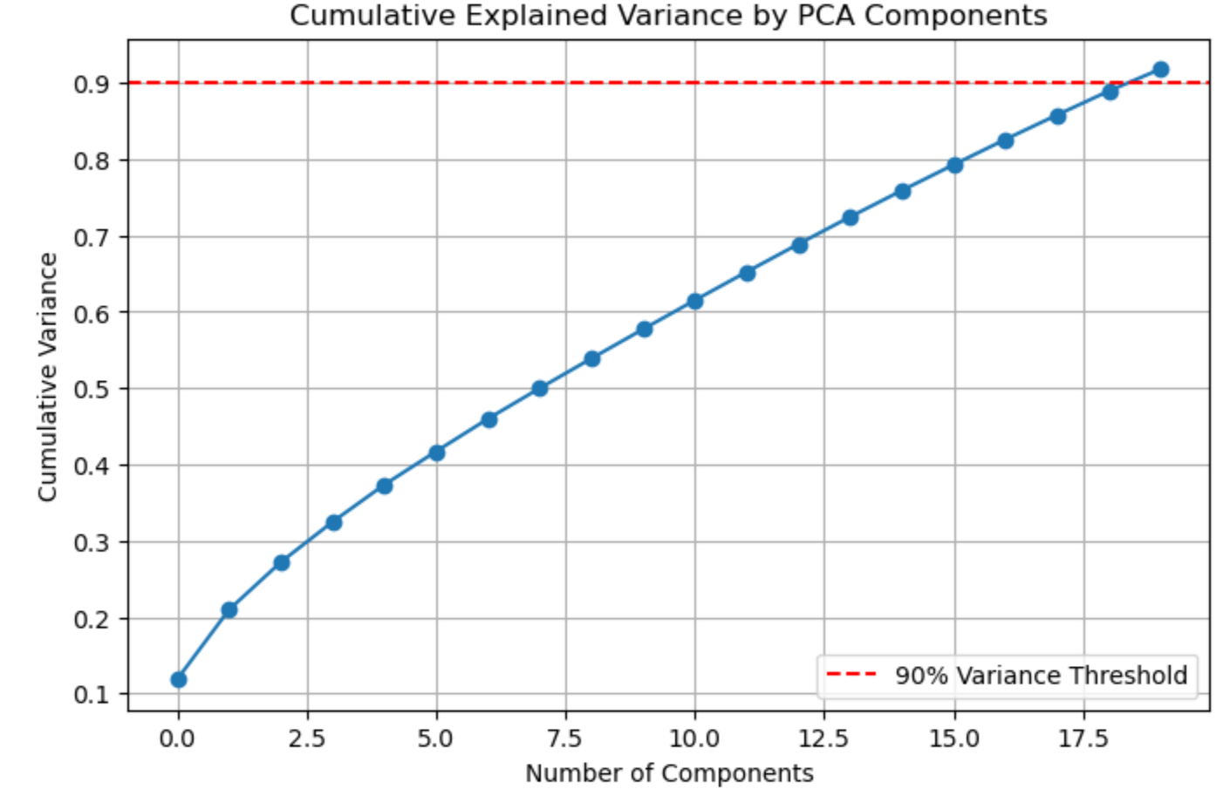
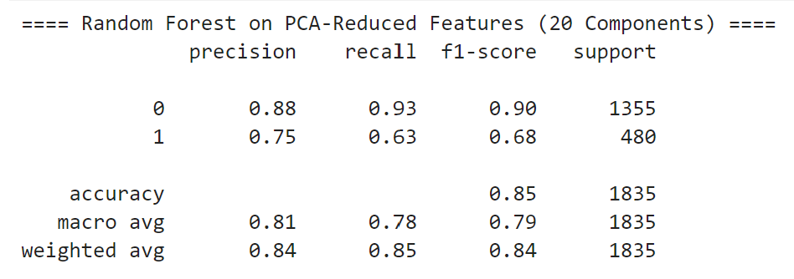
Impact of PCA
Accuracy: 85% on the test set (compared to ~94% without PCA).
Recall (for class 1 - thyroid cases): Dropped to 0.63, indicating reduced sensitivity.
F1-score (for class 1): Reduced to 0.68.

Slide 12

Strengths & Challenges
Strengths:
Cloud-native and scalable pipeline
Effective preprocessing for noisy healthcare data
Strong model generalization
Challenges:
Manual hyperparameter tuning (Time-intensive)
Dataset demographic bias (Mostly adult patients)
Minor class imbalance affected logistic regression performance

Slide 13
Future Enhancements
Automate full SageMaker pipeline using AWS Step Functions
Integrate XGBoost and LightGBM for potentially higher accuracy
Deploy REST API for real-time thyroid prediction
Utilize SHAP or LIME for model explainability in healthcare compliance

Slide 14
Conclusion
Achieved 94.2% accuracy using Random Forest
Demonstrated feasibility of ML-assisted thyroid diagnosis
Ready for scaling with more diverse datasets and real-world integration

Slide 15
Team Contributions
Pranav Rajesh Charakondala:
Model Training using SageMaker built-in algorithms
Evaluation Metrics Calculation
Danni Wu and Arundhati Raj:
Choosing final dataset and uploading it on S3
Notebook-based Data Preprocessing

Slide 16

Thank You!

