Slide 1
Styling React Components
Antonio Ruberto
https://github.com/aruberto
https://www.linkedin.com/in/antonioruberto

Slide 2
Introduction
There are many different views and opinions on what is best approach to styling React components.
Review each approach to help you make an informed choice when developing your own components.
Concepts can be directly applied developing components in other libraries/frameworks.

Slide 3



Introduction
Demo each approach by building a simple Button:
Source for all examples can be found at https://github.com/aruberto/styling-react-components

Slide 4
1. Old School Styling

Slide 5
Old School Styling
Add some classes in your components
Set up CSS rules

Slide 6
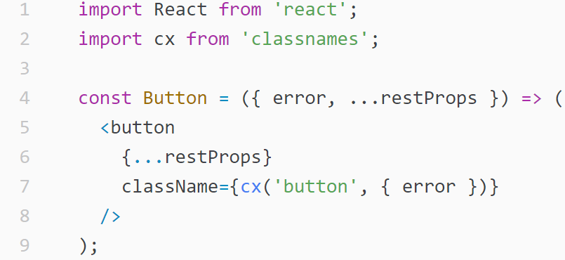
Old School Styling
button.js
    { error } is ES2015 shorthand for { error: error }
    Using https://github.com/JedWatson/classnames to conditionally join CSS class names.
      cx(‘button’, { error }) returns ‘button’ when error is false, ‘button error’ when error is true.

Slide 7
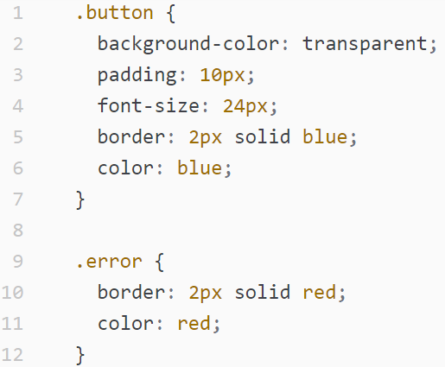
Old School Styling
button.css

Slide 8
Old School Styling

Slide 9

Old School Styling - Pros

Slide 10
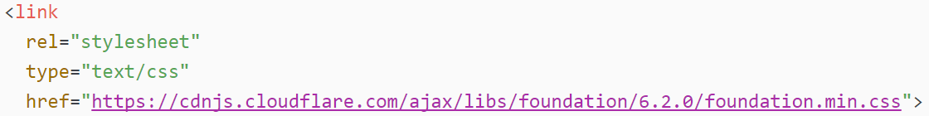


Old School Styling - Cons
What if in future someone adds some more style sheets to your site ...
Our Button component no longer looks right ...

Slide 11

Old School Styling - Cons
In CSS everything is global.
Button isn’t a truly isolated component since the button and error CSS classes are essentially global mutable variables.
As your application grows, it makes things hard to reason about.

Slide 12
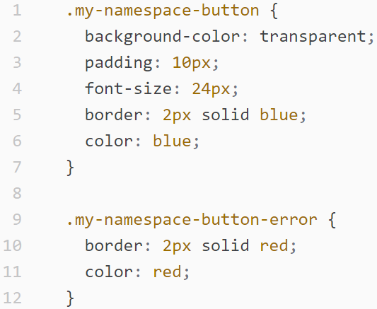
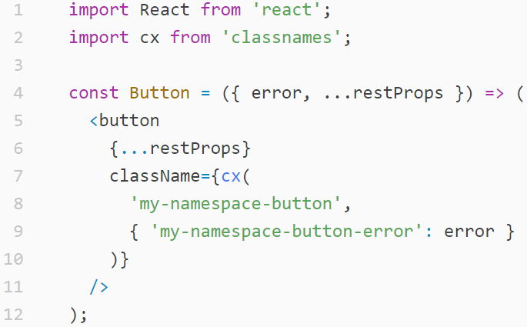
Old School Styling - Cons
Can partially solve this issue by name-spacing our class names (BEM, OOCSS, etc.) at cost of making our code more verbose.
button.css
button.js

Slide 13
Old School Styling
What if CSS wasn’t global be default ...

Slide 14
2. CSS Modules

Slide 15
CSS Modules
A CSS Module is a CSS file in which all class names are scoped locally by default.
Component imports/requires CSS Module (just like you would a JavaScript dependency) and uses imported class names.

Slide 16
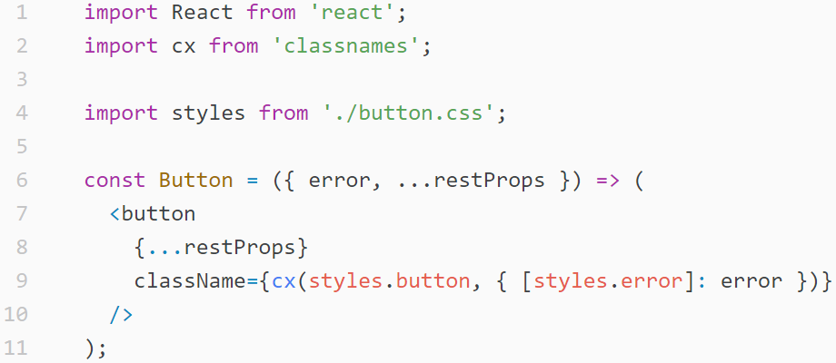
Old School Styling
// styles = {
// button: <unique id>,
// error: <unique id>,
// }

Slide 17
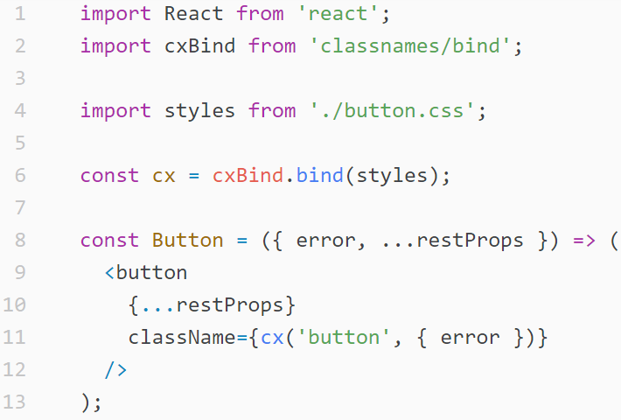
CSS Modules
Can make it even simpler using special “bind” version of classnames module designed for use with CSS Modules.
// cx() performs
// lookup into styles
// object, ‘button’
// becomes styles.button

Slide 18
CSS Modules - Pros
We can continue to use same CSS we know without having to worry about global conflicts.

Slide 19

CSS Modules - Cons
Importing/requiring CSS isn’t out of the box JavaScript
Users can only use your component
css-loader

