Slide 1

Distilled Human Judgment for Public Goods Funding (DHJ)
Aligning LLM Voters to Human Juror Values
Warsaw, 2026
IT - Intelligent Systems and Data Science
Author:
Arsen Rundytskyi
Supervisor:
dr hab. Andrzej Wodecki, prof. PJATK

Slide 2

Problem of democratic structures
Avoid concentration of power
Low participation and low-effort voting in practice
Power recentralizes in a few trusted people and popular voices

Slide 3
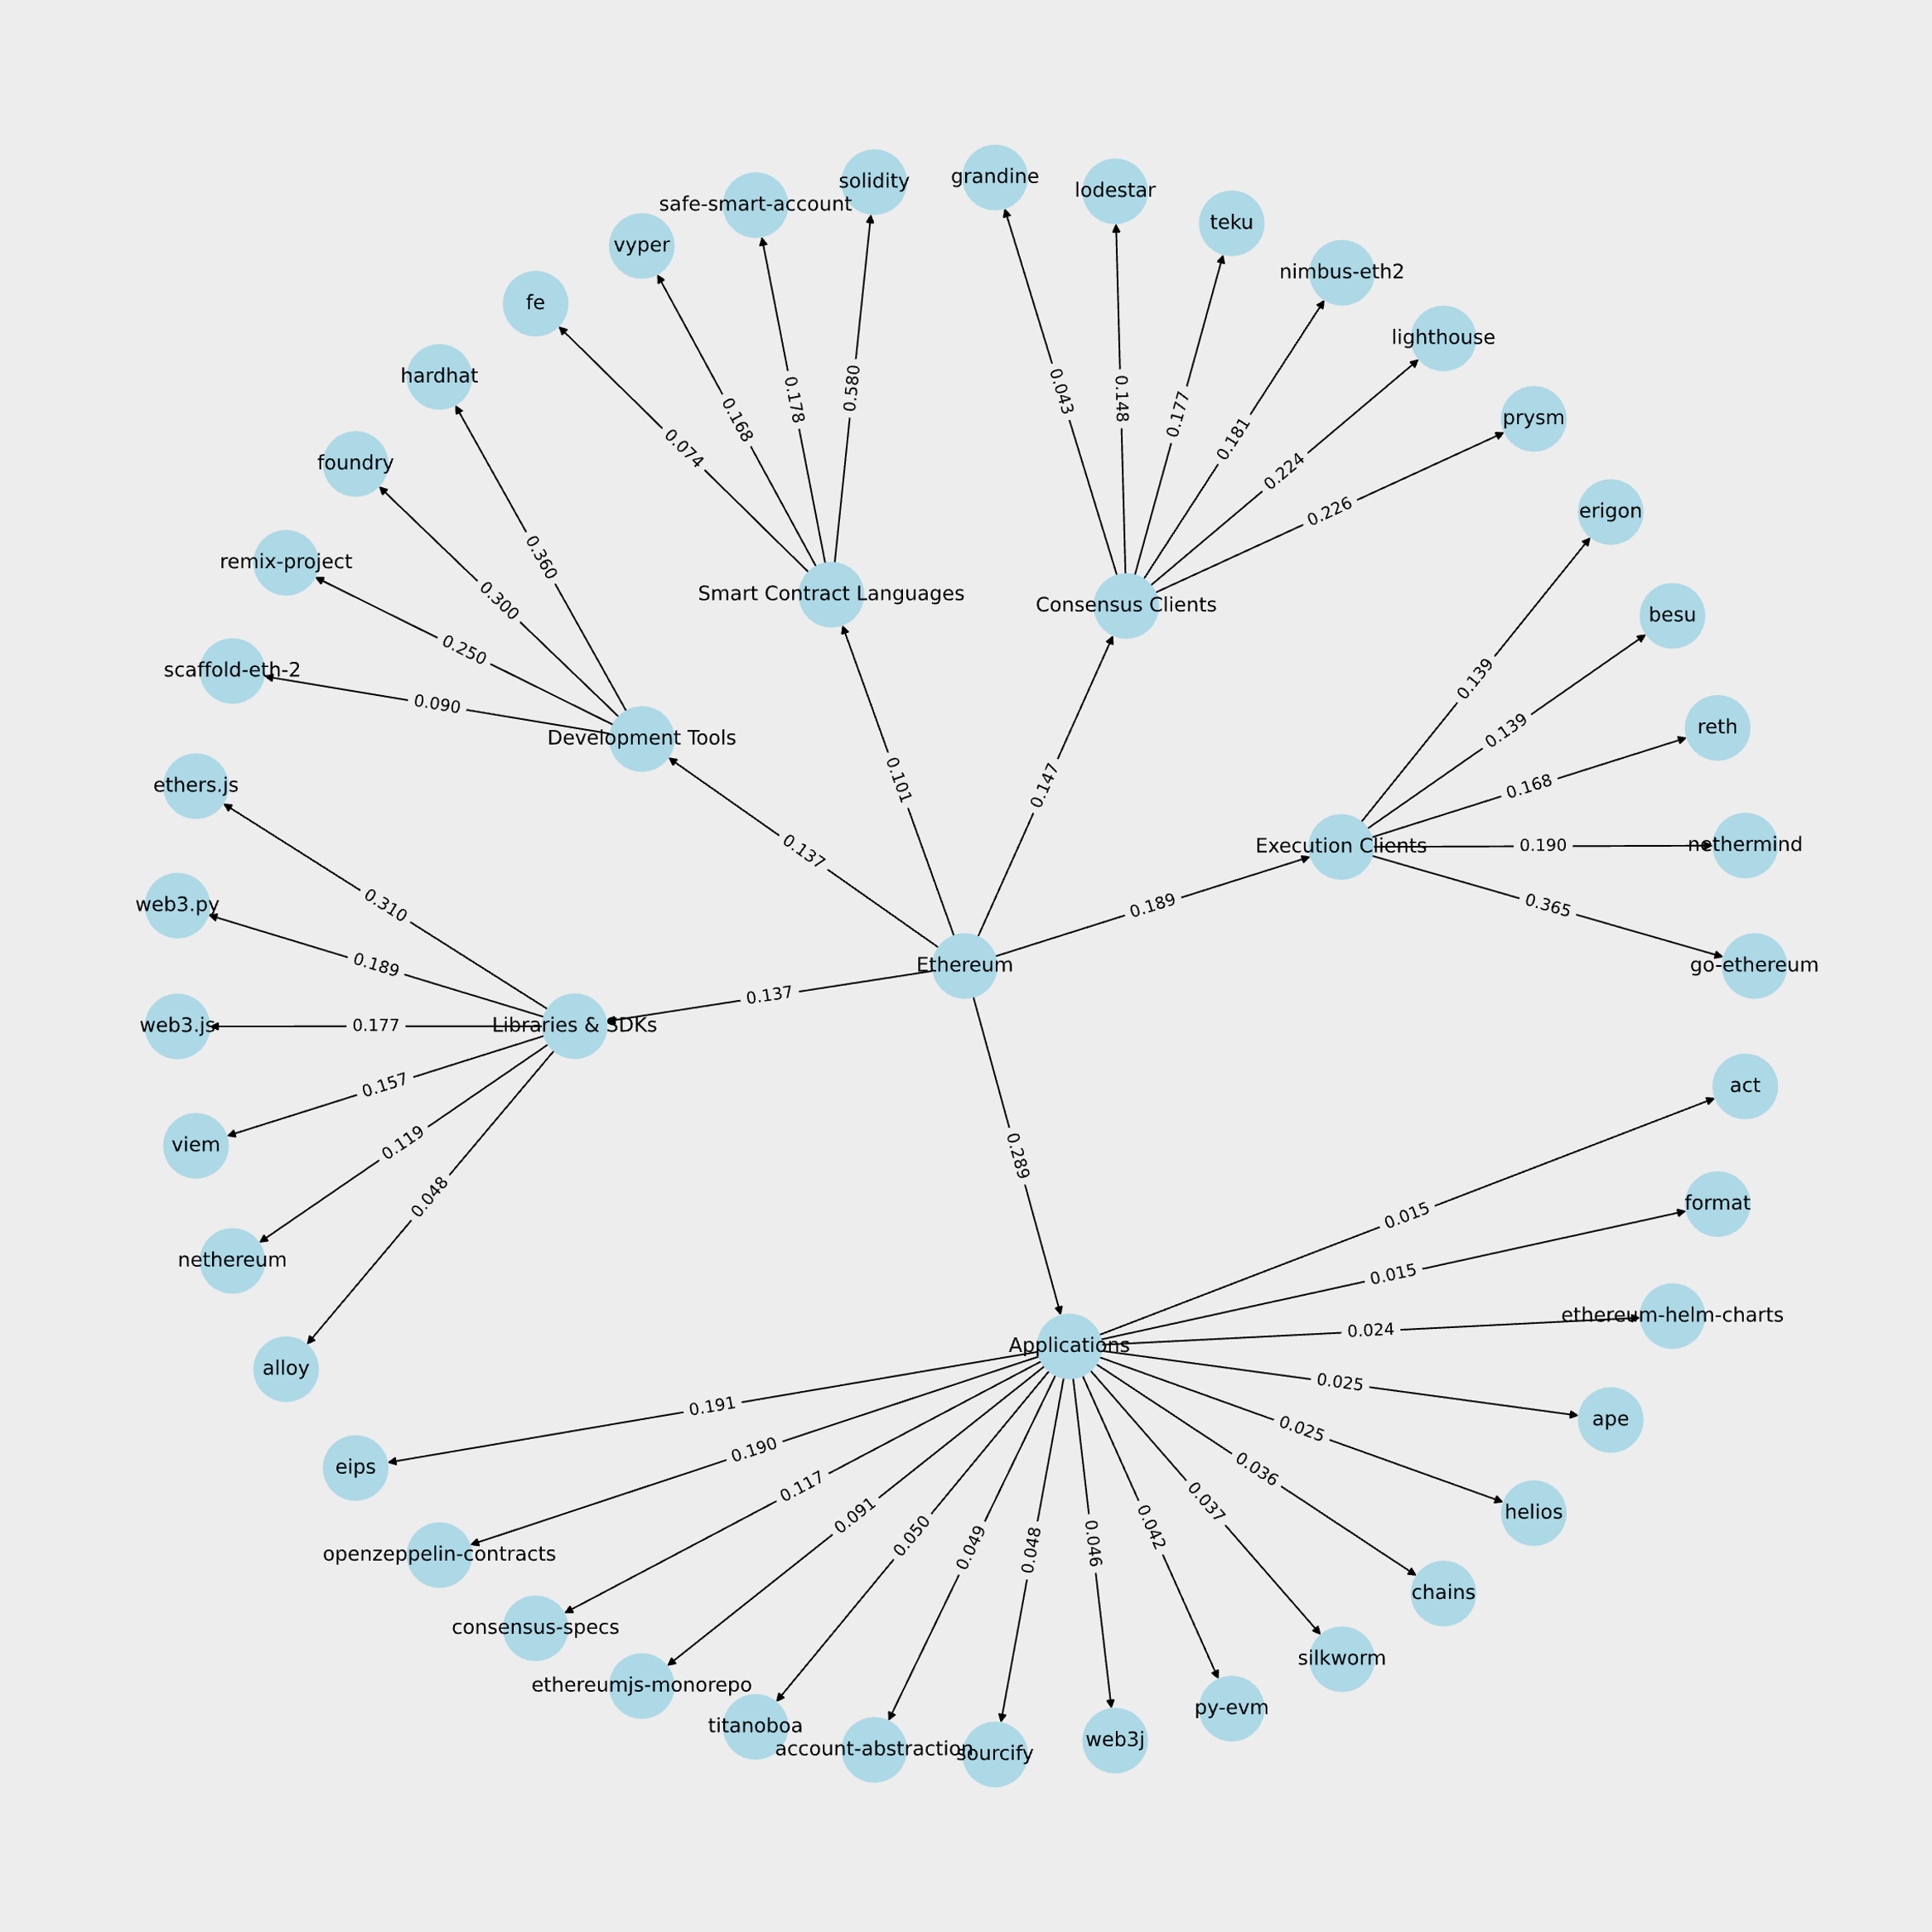
Example of such problem

Slide 4
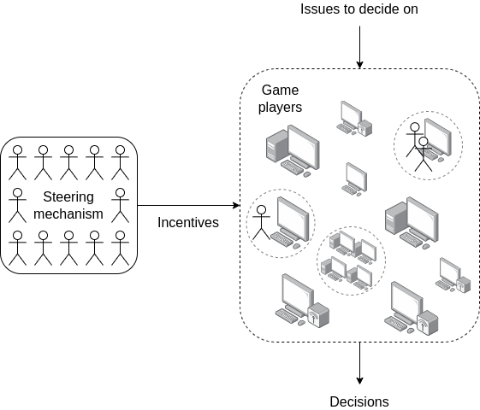




Solution overview:
Distilled Human Judgment
Small jury labels a subset of decisions
(high-quality human signal)
Many AI models score everything
(scale)
Learn an ensemble that best matches
human judgments
(alignment step)

Slide 5


How judgments are represented
Plain text
Math equations
Humans provide pairwise, multiplicative judgments (e.g., “B is 10× A”)
M - multiplier
Encode judgments in log-space so ratios become additive
indexes: i models, j repositories, k human-labeled comparisons (a, b)

Slide 6

How LLM scores are represented
Plain text
Math equations
Each LLM outputs positive scores for every repository
s - scores
Convert scores into logits
L - logit
indexes: i models, j repositories, k human-labeled comparisons (a, b)

Slide 7




How final scores are produced
Plain text
Math equations
Build a combined logit vector over repositories
Ł(w) - logit vector
For each human-labeled comparison between repositories (A, B), the ensemble predicts
p(w) - prediction
Human labels are signed log-multipliers c​. Fit weights by minimizing squared disagreement
w* - final weights
Combine logit per repository, then exponentiate to get the final score
indexes: i models, j repositories, k human-labeled comparisons (a, b)

Slide 8




Results
Primary metric: Agreement rate
Percent of pairwise comparisons where LLMs and the jury choose the same repo
72.92%
60.42%
vs.
Test set: 96 comparisons
Unique repositories: 47
Jurors: 37
DHJ
(Ensemble of 14 LLMs)
AI-only least-weighted (Grok 3)

Slide 9
Performance Comparison
Benchmarking DHJ versus AI-only least-weighted (Grok3) on test-set
DHJ
AI-only least-weighted (Grok 3)
72.92%
Agreement rate
60.42%
0.5481
Correlation
0.4704
2.3768
RMSE (ln)
2.6101
1.7509
MAE (ln)
2.0173

Slide 10
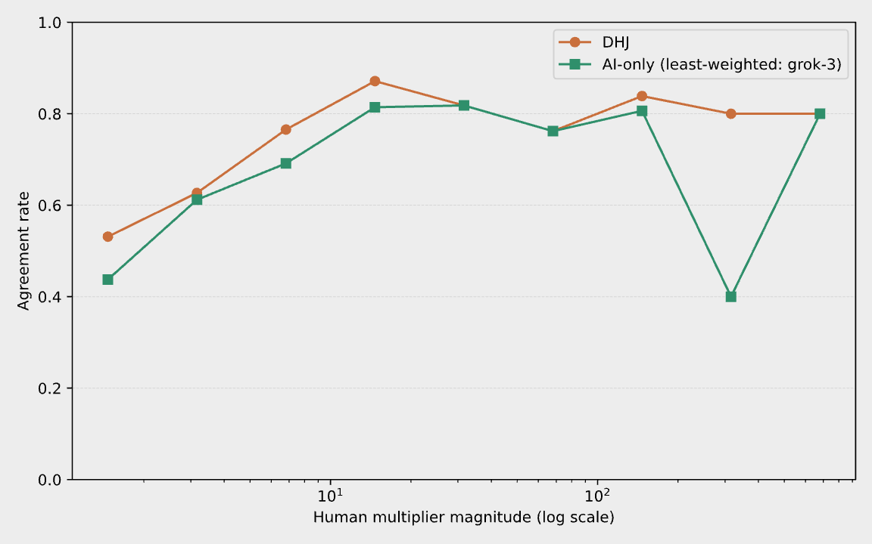
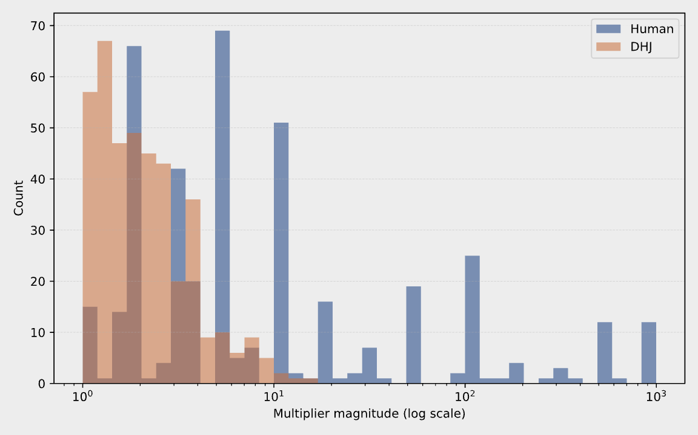
Conclusion
Where DHJ succeeds and fails

Slide 11
Thank you!
Warsaw, 2026

