Slide 1
Capstone Project - The Battle of Neighborhoods (Week 2)
Elena Aruffo

Slide 2
Background
Housing market increasing in Toronto
Buy new house as investment
Rent a house to students: very profitable
Important: since young students house close to grocery stores, bookstores, fast food and entertainments

Slide 3
Project
Help buyer in identifying best location
Use information via Foursquare
Help in finding location close to : university, stores and entertainment

Slide 4
Data
Toronto postal codes
Foursquare amenities data (rank)

Slide 5
Methodology
focus only on Toronto Downtown
Access Foursquare to look at amenities within 1000 meters in each neighbourhood
Look at common amenities, but focus on food stores, bookstores and subway stations
Cluster sub neighborhoods

Slide 6
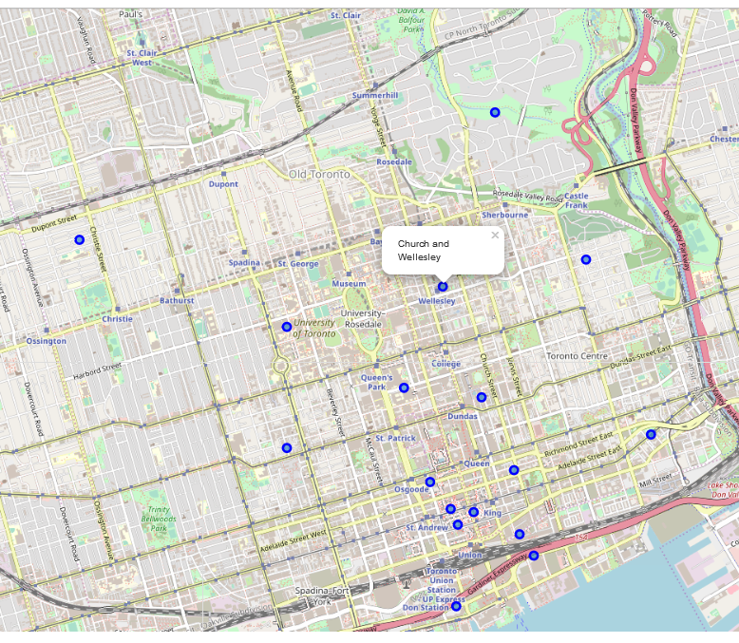
Toronto Downtown sub-neighborouds

Slide 7
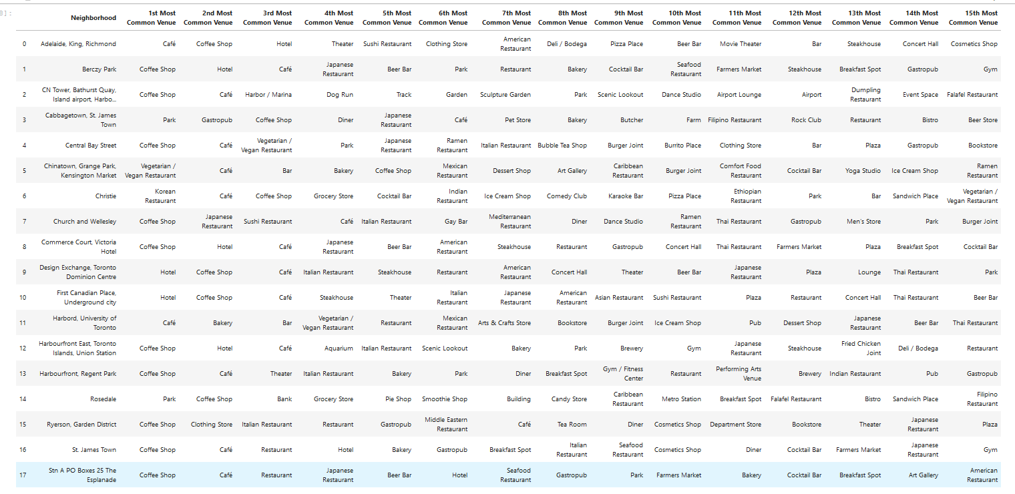
Common amenities

Slide 8
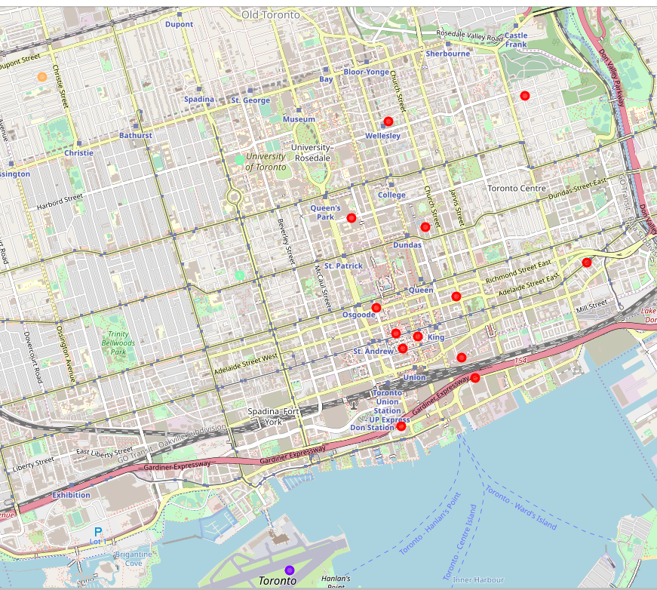
Clusters

Slide 9
Results
All neighbourhoods have restaurants, bars, fast foods stores;
Harbord presents bookstores and art stores as well
Rosedale presents subway station
Hence: first choice Harbord
second choice Rosedale

