Slide 1
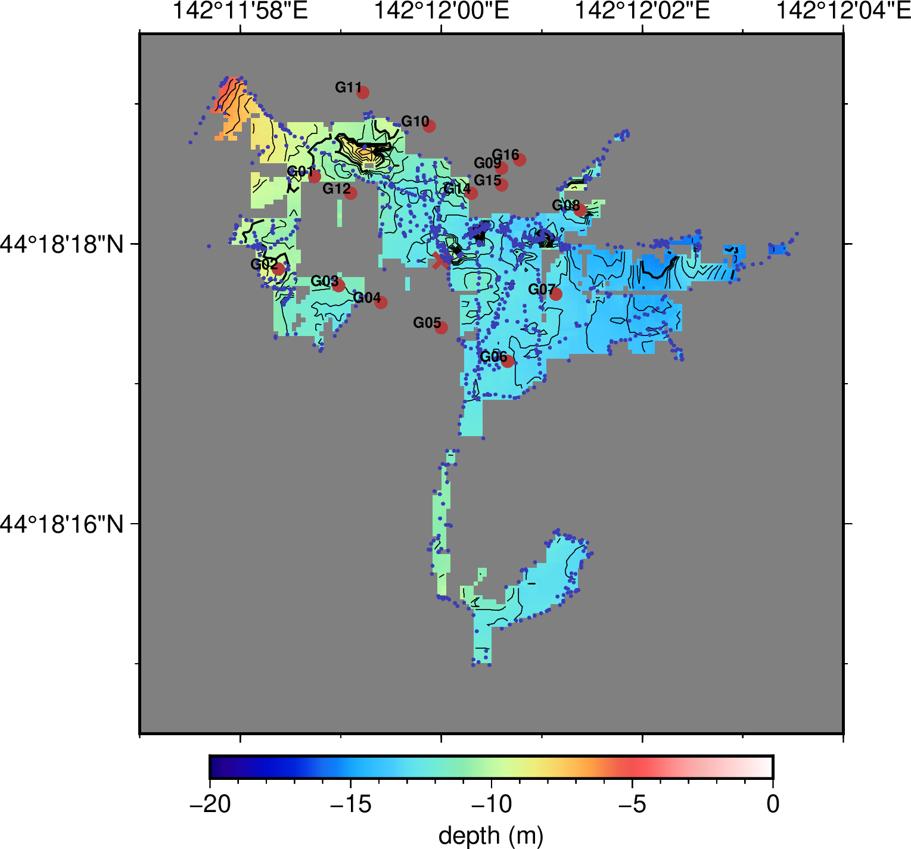
南極ブルー試験：北海道朱鞠内湖 2022年2月
水深（南極ブルー）が水深（実測）より深くなる傾向
データ処理
探索半径： 10 m
解像度：1 m
PointName | MesureDepth | Lon | Lat | BlueDepth
G01 | -9.60 | 142:11.979 | 44:18.308 | -10.10019
G02 | -8.70 | 142:11.973 | 44:18.297 | -9.46425
G03 | -10.90 | 142:11.983 | 44:18.295 | NaN
G04 | -11.50 | 142:11.99 | 44:18.293 | NaN
G05 | -12.25 | 142:12 | 44:18.29 | NaN
G06 | -12.95 | 142:12.011 | 44:18.286 | -12.6557
G07 | -13.20 | 142:12.019 | 44:18.294 | -13.17239
G08 | -13.80 | 142:12.023 | 44:18.304 | -12.14619
G09 | -7.50 | 142:12.01 | 44:18.309 | NaN
G10 | -10.80 | 142:11.998 | 44:18.314 | NaN
G11 | -9.45 | 142:11.987 | 44:18.318 | NaN
G12 | -10.50 | 142:11.985 | 44:18.306 | NaN
G14 | -13.20 | 142:12.005 | 44:18.306 | NaN
G15 | -9.95 | 142:12.01 | 44:18.307 | NaN
G16 | -6.70 | 142:12.013 | 44:18.31 | NaN
：拠点
：測深箇所
：南極ブルーによる観測箇所

