Slide 1
Java to NodeJS

Slide 2

JavaScript?

Slide 3
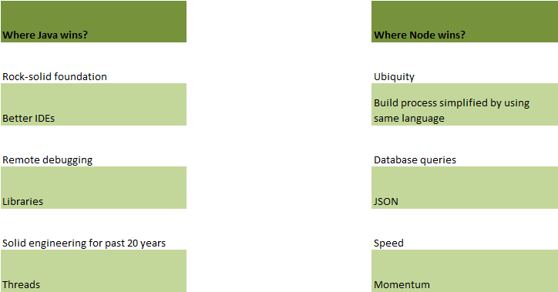
Win-Win situation.,

Slide 4
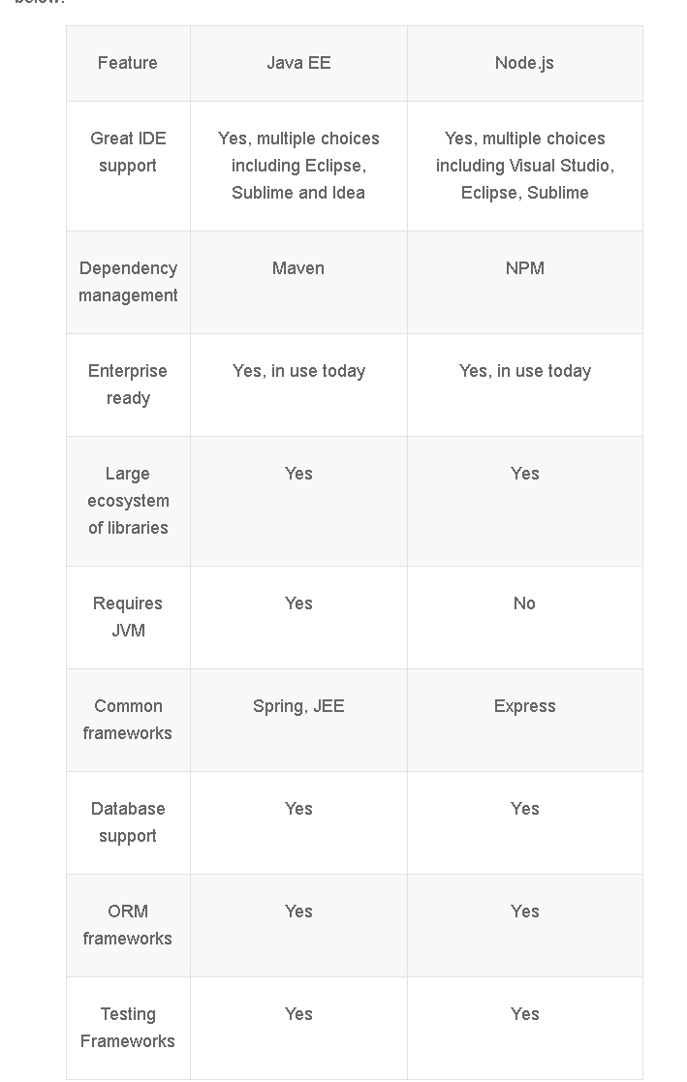
Features Comparison

Slide 5
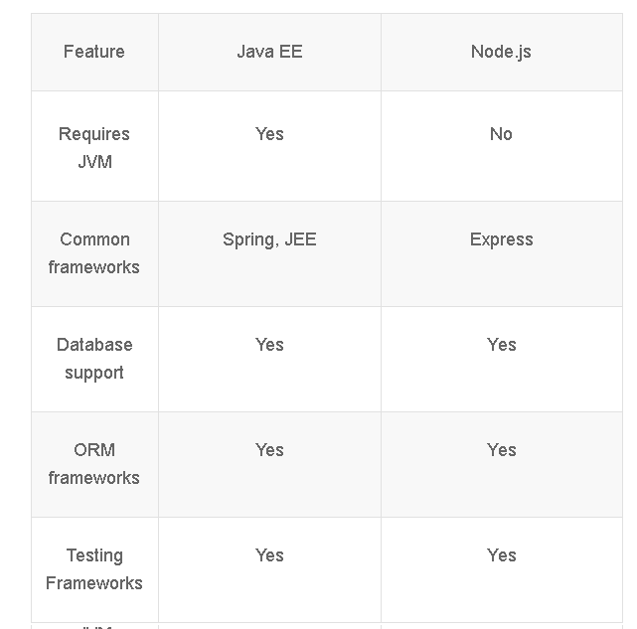
Features Comparison – contd.,

Slide 6
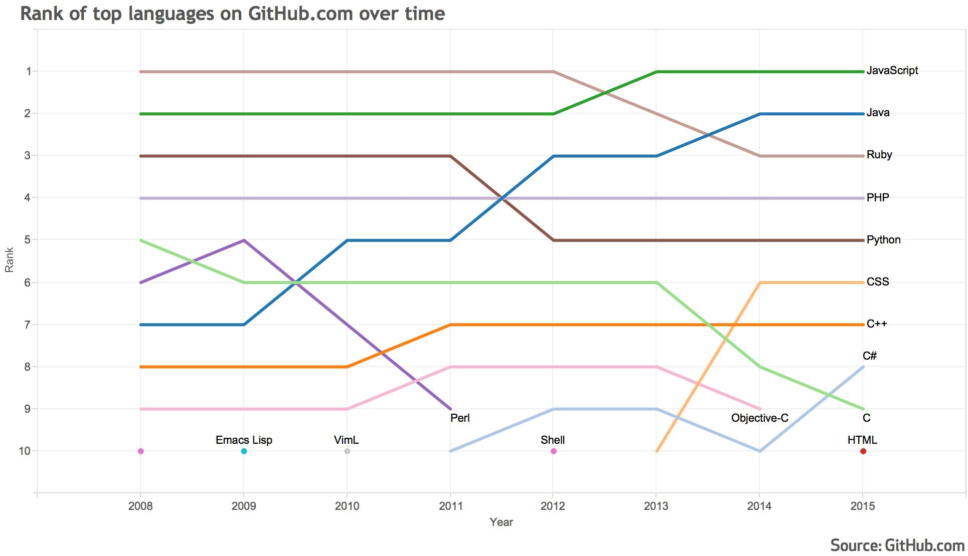
Notes:
If we try and correlate the architecture of Chrome with respect to V8, we will learn a lot about Nodejs. Chrome has many things but our purpose the four important areas are V8, Web API, callback queue and Eventloop.

Slide 7
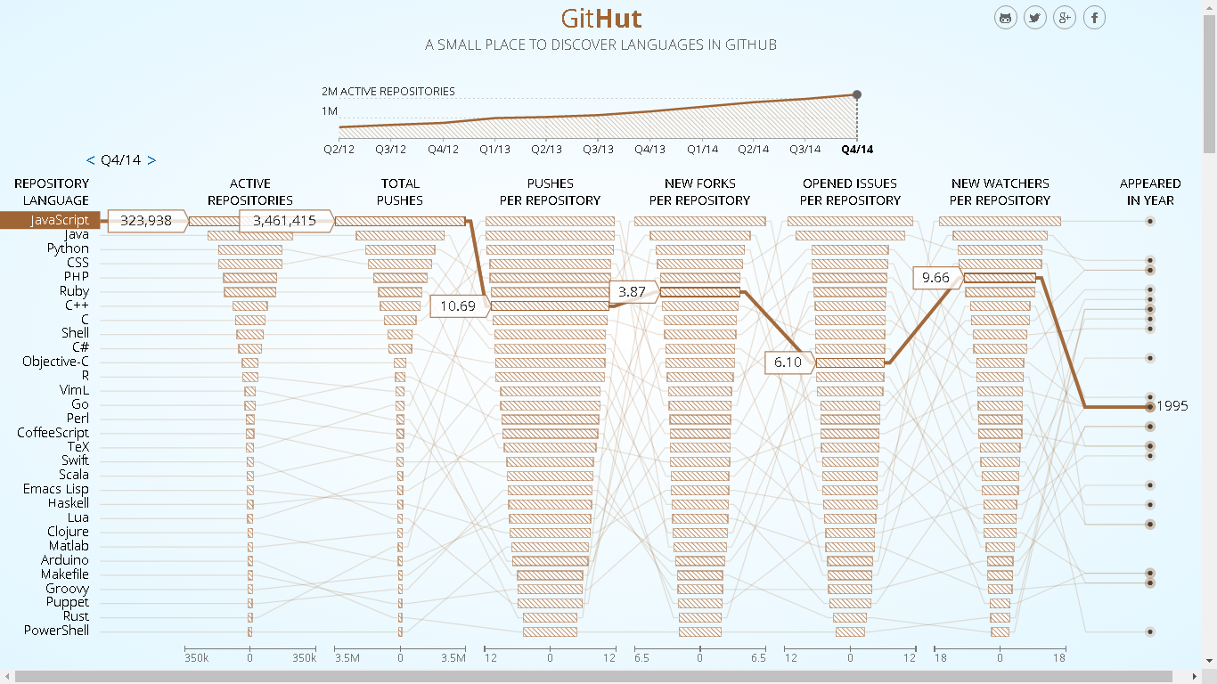
GitHub Adoption : JavaScript

Slide 8
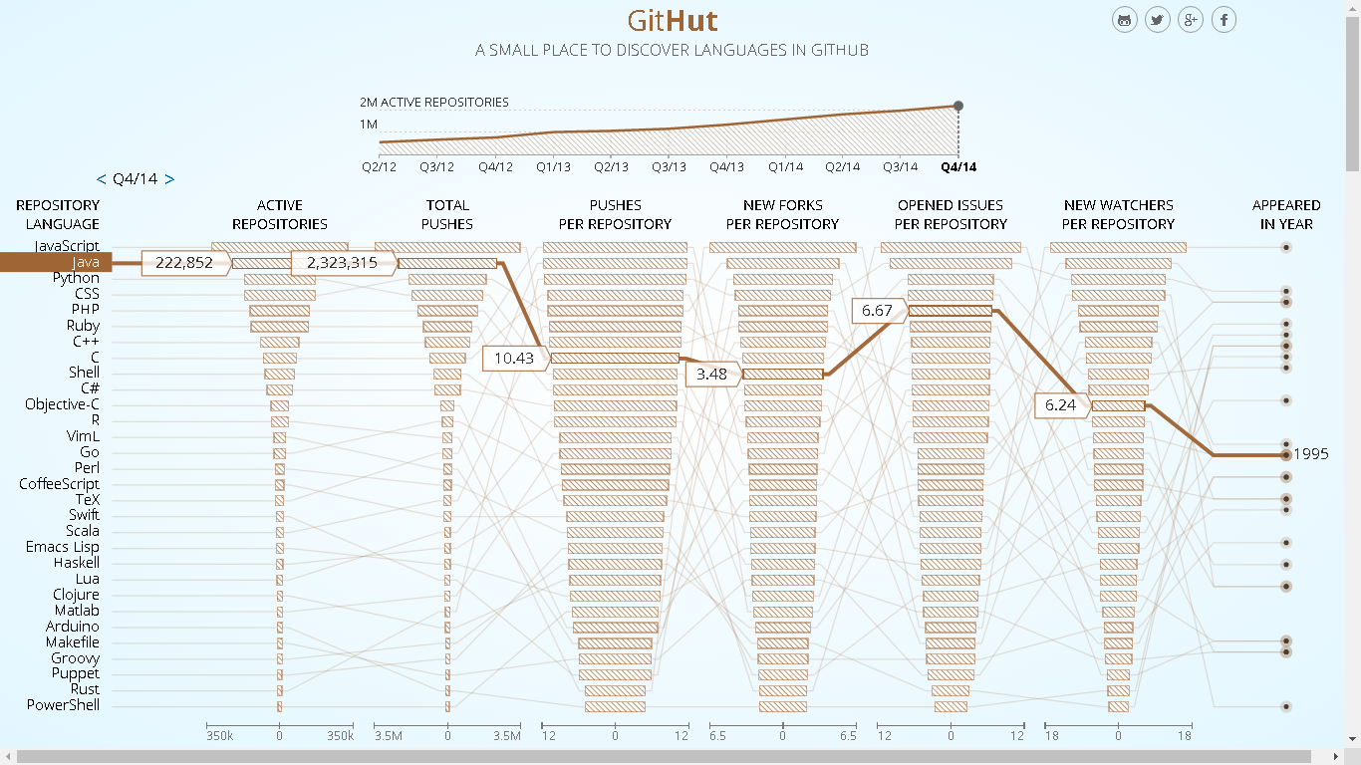
GitHub Adoption : Java
Notes:
Copy the code to test.js
Run node test.js

Slide 9
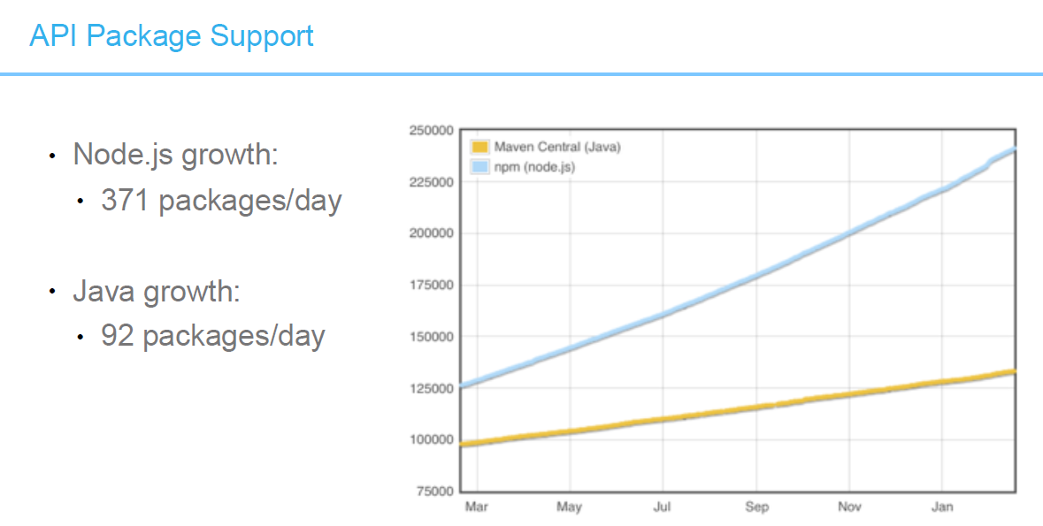
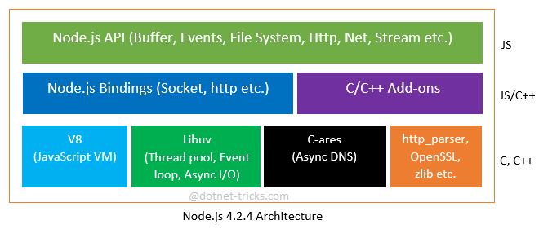
NodeJS Architecture

Slide 10
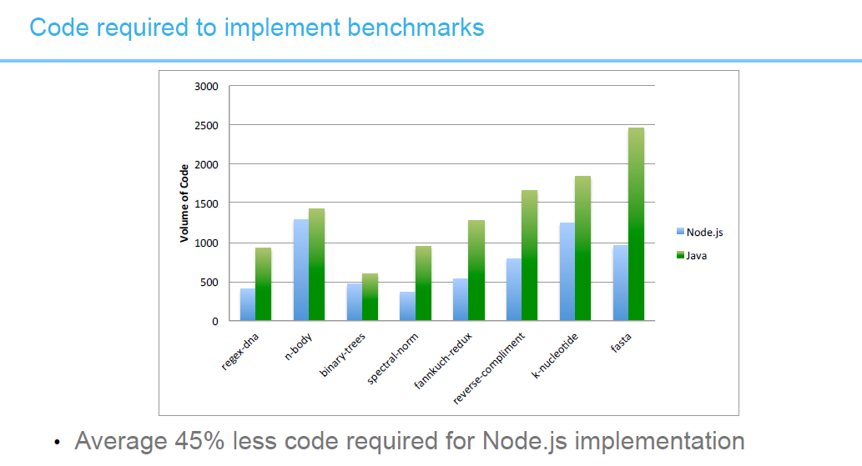
Understanding callbacks
Notes:
Copy the code to test.js
Run node test.js

Slide 11
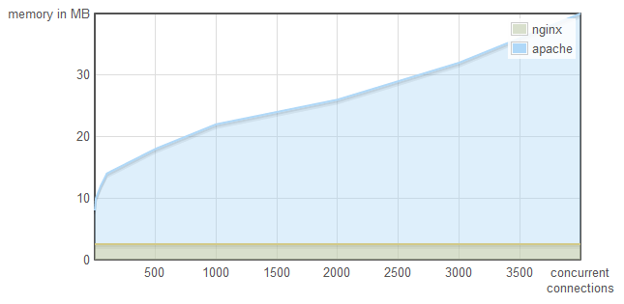
Memory Consumption – thread vs event driven

Slide 12
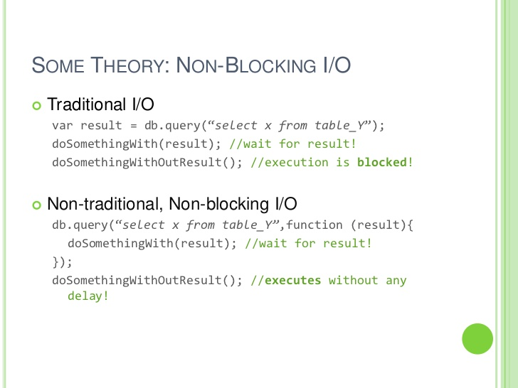
Notes:
If we try and correlate the architecture of Chrome with respect to V8, we will learn a lot about Nodejs. Chrome has many things but our purpose the four important areas are V8, Web API, callback queue and Eventloop. All JavaScript events are

Slide 13
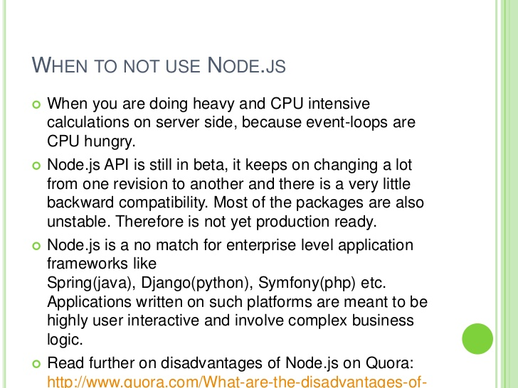
Notes:
If we try and correlate the architecture of Chrome with respect to V8, we will learn a lot about Nodejs. Chrome has many things but our purpose the four important areas are V8, Web API, callback queue and Eventloop. All JavaScript events are

