Slide 1
Node Architecture and Patterns
Puttaiah Arugunta
Arugunta Soft Solutions Ltd.,

Slide 2
What is Node?

Slide 3
Basics of Node
Node is a wrapper around high performance V8 JavaScript runtime from google and Libuv library.
JavaScript is a event driven language, and node uses this mechanism to produce highly scalable servers. This Architecture is called event loop.
To support a event driven approach node supplies a set of “non blocking” libraries. Theses are basically interfaces to file system or database which operate in a non blocking way.
Only one thing will happen at a time. i.e only event is handled at a time.
Concurrency is a problem in nodejs. A node program can’t use all of its CPU’s.
As everything is non blocking, the time between an event is emitted and an event is handled is very short.
Rule of thumb: All actions should be event driven.
Notes:
V8 is for browser, but how it is working in server side. It may be mostly due to enhanced API’s.
Use case: explain a scenario how the call back is handled to achieve non blocking. Ex a web request for a data.

Slide 4
Node.js
Node.js Core Library (JavaScript)
Node.js Bindings (C++)
Google V8 (C++)
Libuv (C)
Notes:
Node at the high level

Slide 5
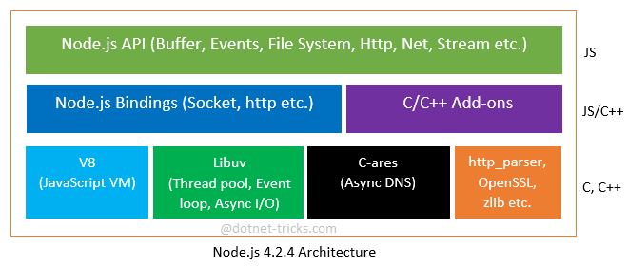
Node Js Architecture

Slide 6
Working of Node
Simple Server program in Node
var http = require("http");
var server = http.createServer(function(request,response){
response.end("Requeset Received...")
}).listen(3000);
console.log("Server started on 3000...")
In the set up phase node js registers all the events. And then waits for the events to occur.

Slide 7
Node Patterns
Single threaded
Non blocking
Above two lead to asynchronous
Synchronous event de multiplexer or Event loop thread will be used to synchronously collect all events from a set of watchable resources. And these events will be queued for further processing. And event loop will wait for next set of events which are going to generated from watched resources.
Pattern (reactor): handles I/O by blocking until new events are
available from a set of observed resources, and then reacting by
dispatching each event to an associated handler.
Notes:
Started with one process -> multi thread ->single thread and polling -> single thread event loop

Slide 8
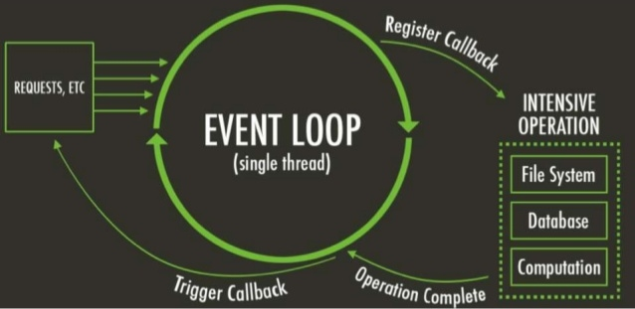
Single Thread Model

Slide 9
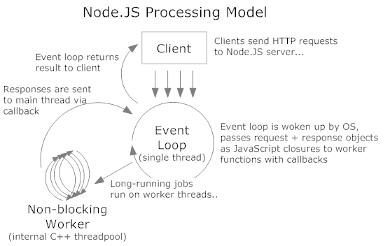

Slide 10
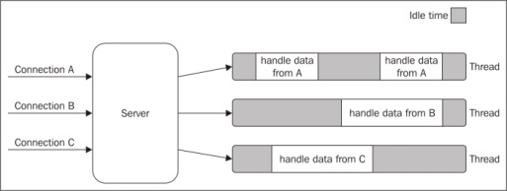
Blocking IO Model
Notes:
Where each thread is idle for some time to complete the execution

Slide 11
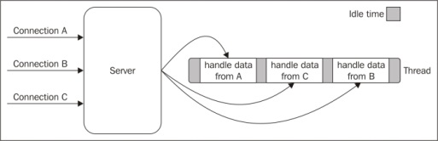
Non Blocking IO Model

Slide 12
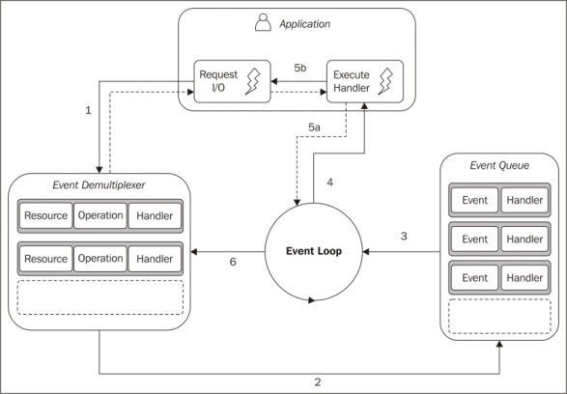
Reactor Pattern
Notes:
1. The application generates a new I/O operation by submitting a request to
the Event Demultiplexer. The application also specifies a handler, which will
be invoked when the operation completes. Submitting a new request to the
Event Demultiplexer is a non-blocking call and it immediately returns the
control back to the application.
2. When a set of I/O operations completes, the Event Demultiplexer pushes the
new events into the Event Queue.
3. At this point, the Event Loop iterates over the items of the Event Queue.
4. For each event, the associated handler is invoked.
5. The handler, which is part of the application code, will give back the
control to the Event Loop when its execution completes (5a). However,
new asynchronous operations might be requested during the execution
of the handler (5b), causing new operations to be inserted in the Event
Demultiplexer (1), before the control is given back to the Event Loop.
6. When all the items in the Event Queue are processed, the loop will block
again on the Event Demultiplexer which will then trigger another cycle.

Slide 13
EventEmitter Vs Callbacks
A common dilemma when defining an asynchronous API is to check whether
to use an EventEmitter or simply accept a callback. The general differentiating
rule is semantic: callbacks should be used when a result must be returned in
an asynchronous way; events should instead be used when there is a need to
communicate that something has just happened.

Slide 14
Node Principles
Simple and light core functionalities should be part of node, rest of the functionalities added by modules.
Simple and small modules, which we can use directly instead of extending and re implementing. Share and re use even a smallest piece of code (DRY).
Expose only a minimum set of functionalities in a module.
“Do the simplest think that could possibly work” instead of implementing a complete software package .
Keep it Simple and Stupid(KISS).

Slide 15
Questions?

