Slide 1

Swagger Make your API accessible
Notes:
Hello, my name is Puttaiah and I am going to catch you up with my excitement about the nodejs framework.

Slide 2
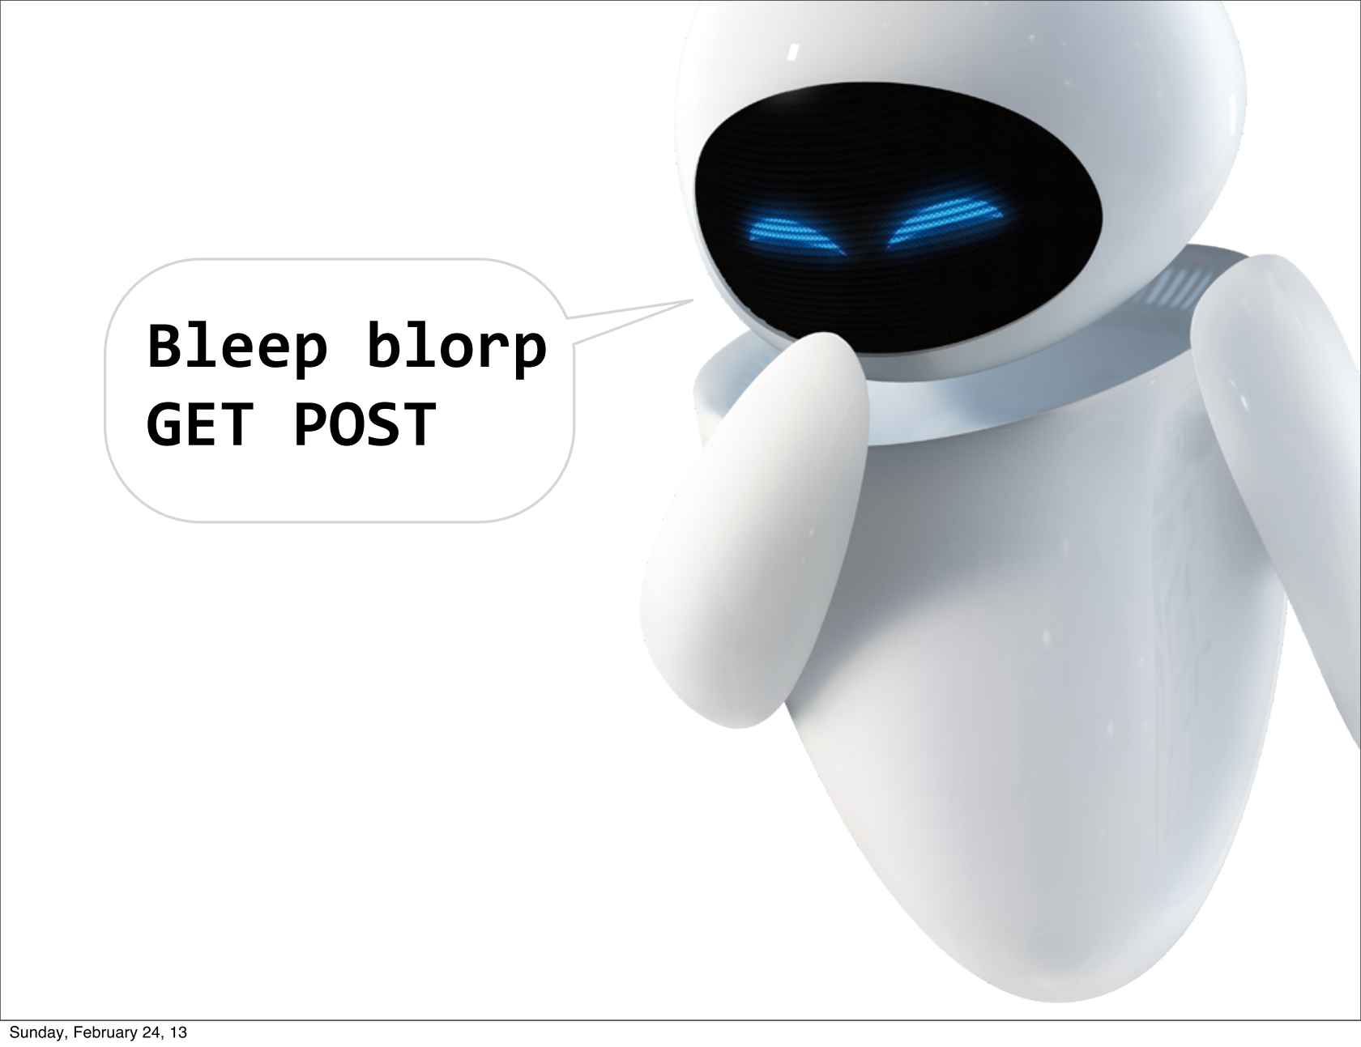
Architecture
APIs are for humans
Why?
http://www.infoq.com/resource/presentations/API-Humans/en/slides/sl23.jpg
Notes:
I also understood that although APIs are consumed by machines, the real API users are human – developers. The successful API is the one that it is easy to implement a client application. And the crucial part of this is the documentation.

Slide 3
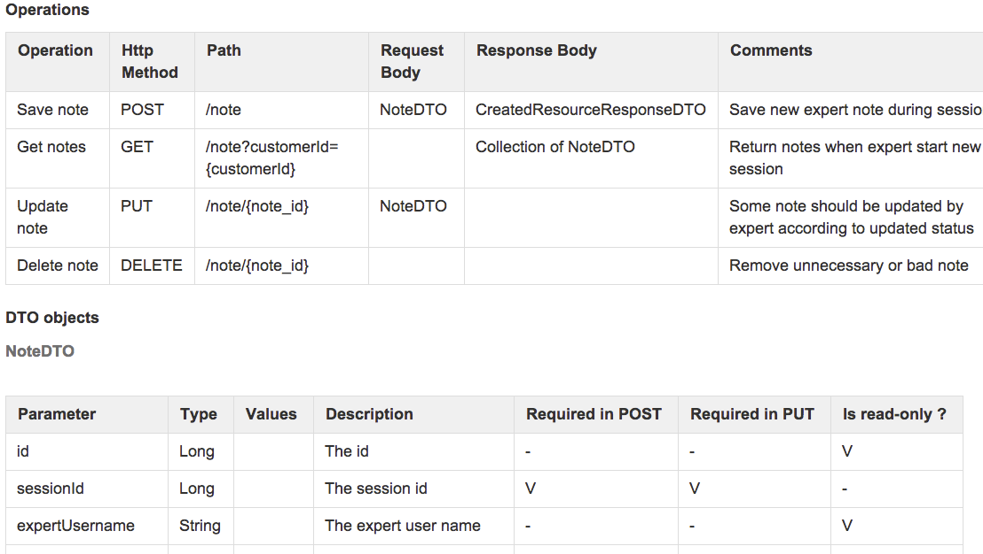
Documentation
Notes:
So with these insights we’ve started our journey and defined our own proprietary documentation format. We are using confluence, so we defined a page for each and every API. There are API description, HTTP method, API parameters, return types etc. I believe you had similar pages in your organization as well.

Slide 4

Documentation
No standard
Ad-hoc attributes
Managed manually
Not up to date
Not testable
…..
http://www.imagineyourreality.com/business-coaching/documentation.html
Notes:
The problem was that there was no standard to these pages. I mean, we tried to achieve one, but more and more attributed were added that were required in one API, but not needed in others. We managed the documentation manually. Every time the API signature was changed we needed to open the confluence page and update the doc. Guess what: we did not do it enough: fast the documentation became not synchronized with the actual live API: a nightmare.

Slide 5

APIs are for humans
But, How?
Notes:
I also understood that although APIs are consumed by machines, the real API users are human – developers. The successful API is the one that it is easy to implement a client application. And the crucial part of this is the documentation.

Slide 6
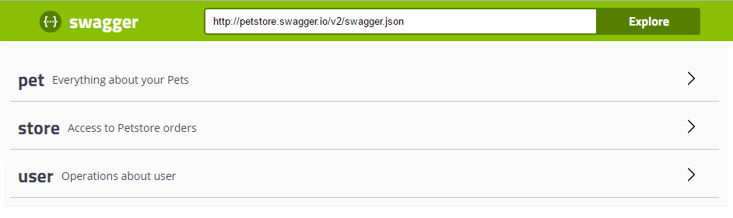
API Listing
Notes:
So I started to look for a better solution. I wish I had a UI in which I could see the list of my APIs and a description about each and every one of them.

Slide 7
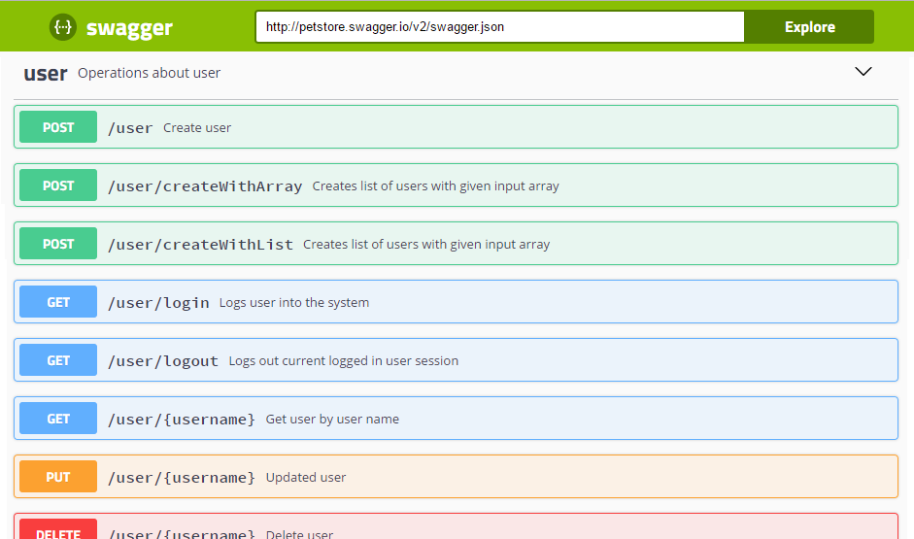
API Operations
Notes:
I wish I could drill down to a specific API and see the list of the operations and their descriptions.

Slide 8
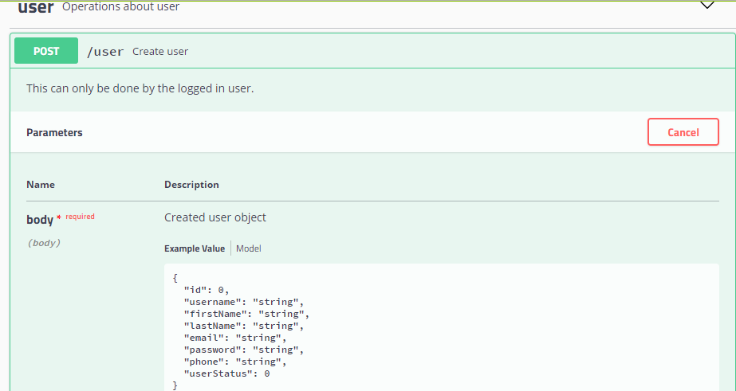
API parameters and return types
Notes:
When I drill further I will see the details of the parameters and return types. I also wish that the documentation will be synchronized with my application code.

Slide 9
Swagger is…
Technology
Methodology
A framework
for
A specification
for
producing
consuming
visualizing
RESTful APIs
describing
documenting
RESTful APIs
Notes:
And then I found swagger! Swagger is a technology. It is a framework that helps implementing APIs both server side and client side. But from the other side, and this side I find much more important it is a specification for describing and eventually documenting the APIs and I believe it allows to build a methodology for API development.

Slide 10
The Swagger Specification
It’s a spec!
JSON to specify metadata
JSON to specify API structure
JSON schema for the model specification
Machine readable
Language agnostic
Notes:
In the center of swagger there is a JSON. You can use JSON to specify the API version, API base URL and other Meta attributes. You can build another JSON that will specify the API structure: what are the API operations and their attributes. Swagger adopts another emerging standard called JSON schema. JSON schema is a standard for specification entities. It is similar to XSD in the XML world. You write a JSON in which you specify the field type, name, whether it is required etc. And swagger uses this standard for specification of the API model: the parameters and return types of a certain operation. The fact that it is all about JSON allows swagger specification to be machine-readable a language agnostic: there is no language these days that is not capable to deal with JSON.

Slide 11
Agenda
Introduction
The Technology
Swagger is not…
Alternatives
Approach
Demo
References
Notes:
This was an introduction. The rest of the talk I will dive deeper into swagger, will briefly describe the technology, will describe what swagger was not meant to be and what are the alternatives. I believe that the more interesting part of this talk is a discussion about the methodology: both development and deployment.

Slide 12
The Technology

Slide 13
The Technology
Swagger-editor
swagger-codegen
swagger-ui
Notes:
From the technical perspective swagger is implemented with scala language. There three main building blocks: swagger-core is the actual implementation of the framework; swager-codegen deals with all the client generations and swagger-ui is the same default UI that come out of the box.

Slide 14
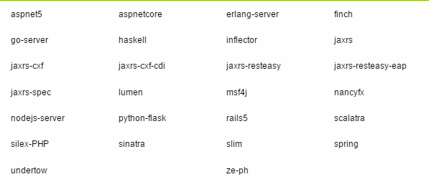
Server side integrations
Notes:
Swagger is integrated with a bunch of server side frameworks on many programming languages. You have python django, Node.js, many JVM based frameworks: JAX_RS, Grails, Scala and many more.

Slide 15
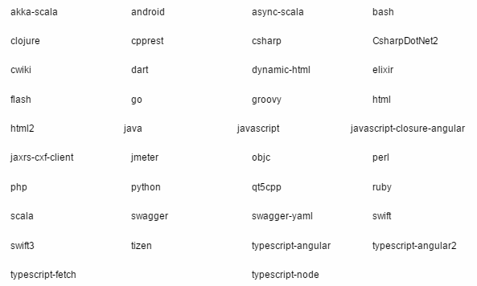
Client code generation
Notes:
For the client code generation swagger uses mustache templates. There are already template for generating Java, Scala, C#, ruby code. You can implement your own. Recently I’ve contributed templates for generating a groovy code based on a wonderful groovy HttpBuilder.

Slide 16
Swagger is not

Slide 17
Does not support multiple API versions
Does not tell how to write the API
Delete an object by HTTP DELETE or via HTTP GET with query param
Is not trying to solve all problems for all APIs
Notes:
The are API development aspects that swagger does not deal with. For example swagger does not support multiple API versions. I believe it can be extended for this purpose, however. There are many debates in the industry about what are REST APIs and what is a right way of doing them. There is a ‘REST by the book’ and a ‘Pragmatic REST’. Swagger will work any way you will choose to implement your API. Swagger philosophy is not try to solve all the problems for all the APIs.

Slide 18
Alternatives

Slide 19
SOAP/WSDL
http://www.w3.org/TR/wsdl
WADL
http://en.wikipedia.org/wiki/Web_Application_Description_Language
Mashery IO-Docs
http://www.mashery.com/product/io-docs
https://github.com/mashery/iodocs
http://apiary.io/
Homegrown
Notes:
In the traditional web services world there is SOAP and a WSDL. Actually it is quite similar to swagger, but more complicated. WADL is an attempt to build a standard for the REST APIs similar to WSDL. As it tries to solve too many problems it is not adopted that well today. Mashery IO-Docs is a commercial product that does similar job: provides a UI for that describes the APIs. There is an open source license as well. The product looks interesting but could not find much documentation about it. Yes, you do need documentation about the tool that generates the documentation. Apiary is another commercial tool. And you always can build it by yourself.

Slide 20
Approach
Notes:
The rest of this talk are suggestions for the development and deployment processes. I actually invite for a discussion and would be glad what do you think is the right way to go.

Slide 21
API development approaches
API specification first
Write the JSON spec
Generate the API stubs
Implement the APIs
Publish
pertarget
……
percflow
public aspect MyPertargetAspect (myPointcut()){
private int counter = 0;
pointcut myPointcut() : call (* myMethod ());
after() returning() : myPointcut() {
counter++;
System.out.println("after pertarget “+counter+" “+this);
}
}
Notes:
As for the development phase there the two approaches make sense. You can start with the API specification. You can write the JSON specs first. Then you may have two teams progressing in parallel. The client side team will use the specs and generate the client code. Then it will use this code in the client application. The server side team, that responsible for the actual API implementation may use the specs to generate the API stubs and then implements the API. Then this API will be published and become available together with its documentation.

Slide 22
API development approaches
API implementation first
Implement the API
Publish
Share with client for consumption
More waterfall model
pertarget
……
percflow
public aspect MyPertargetAspect (myPointcut()){
private int counter = 0;
pointcut myPointcut() : call (* myMethod ());
after() returning() : myPointcut() {
counter++;
System.out.println("after pertarget “+counter+" “+this);
}
}
Notes:
A second approach is to start with the API implementation. The annotations can be placed on top of the API and the documentation will be generated.
The ideas are not new, similar approaches are relevant for the traditional SOAP based web services.

Slide 23
Demo
Notes:
The rest of this talk are suggestions for the development and deployment processes. I actually invite for a discussion and would be glad what do you think is the right way to go.

Slide 24
References
Swagger home:
https://swagger.io/
Swagger specification
http://swagger.io/specification/
Swagger Demo
http://petstore.swagger.io/
Swagger Editor
http://editor.swagger.io/

Slide 25
Make your API accessible
Use Swagger!

