Slide 1
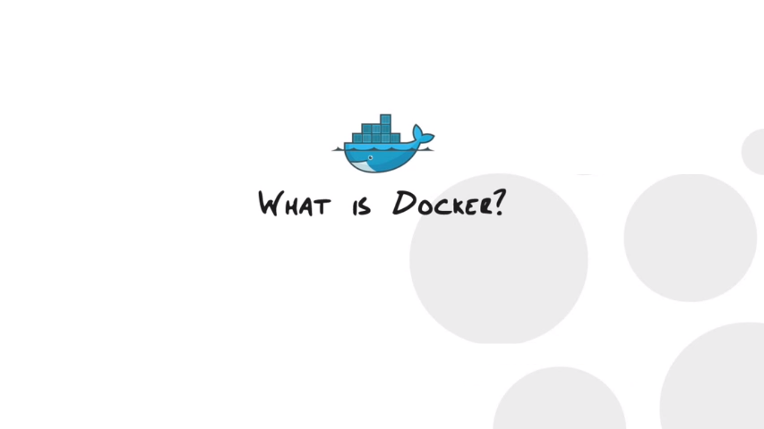
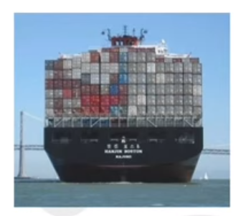
IDEAL – unified architecture
By: Puttaiah Arugunta

Slide 2
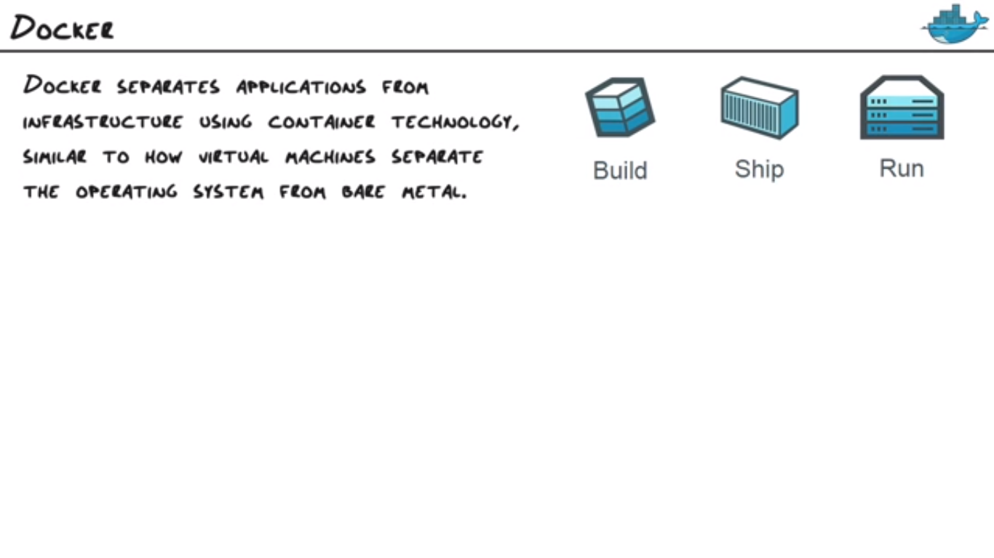
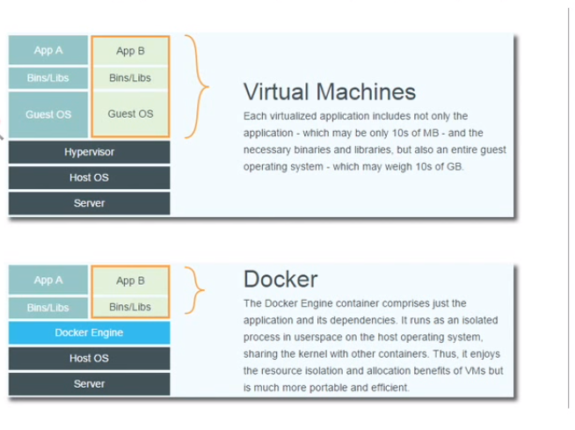
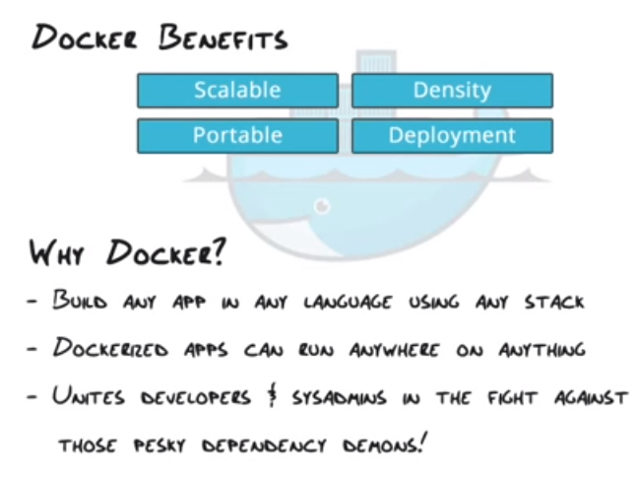
IDEAL – unified architecture

Slide 3
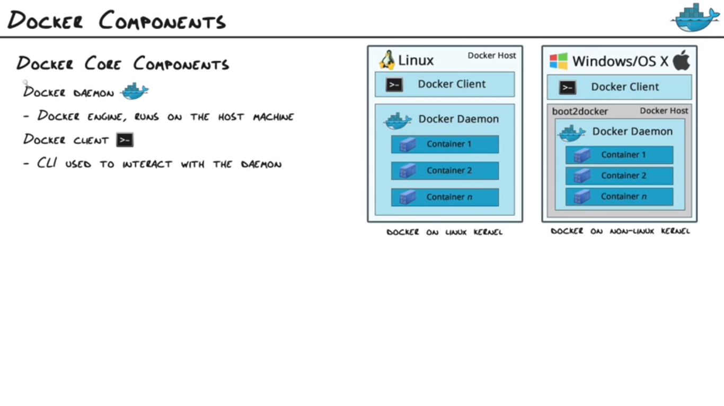
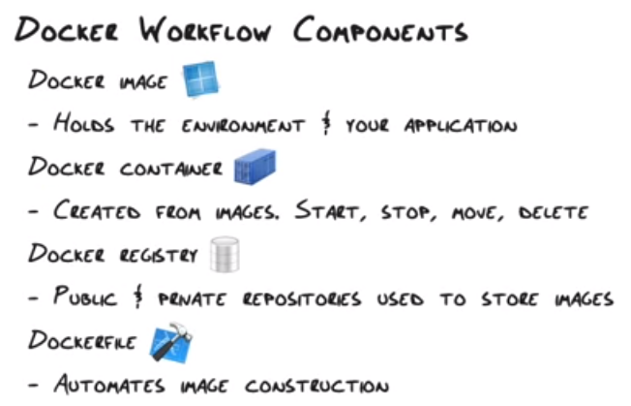
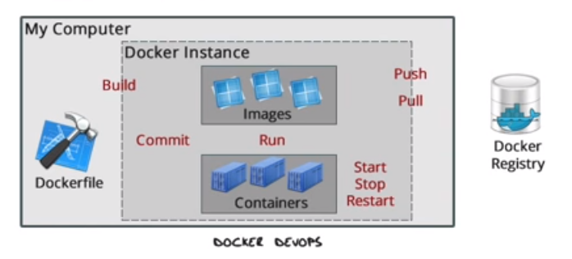
IDEAL – unified architecture

Slide 4
https://nodejs.org/en/docs/guides/nodejs-docker-webapp/
https://blog.risingstack.com/node-hero-deploy-node-js-heroku-docker/
https://github.com/phusion/passenger-docker#why_use
https://www.youtube.com/watch?v=aLipr7tTuA4
https://devops.profitbricks.com/tutorials/configure-a-docker-container-to-automatically-pull-from-github-using-oauth/
Credits to : CBT Nuggets (Garth Schulte)

Slide 5
Thank You

