Slide 1





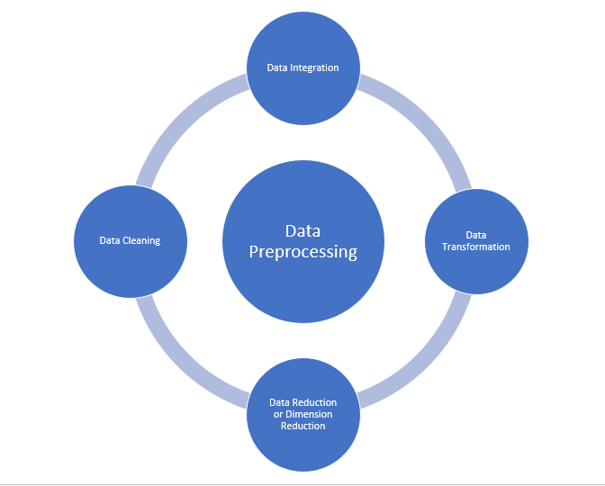
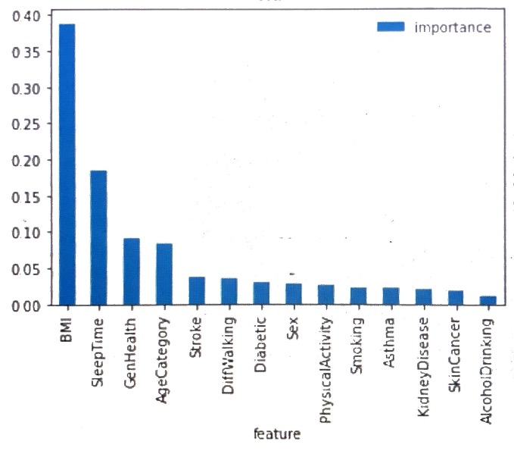
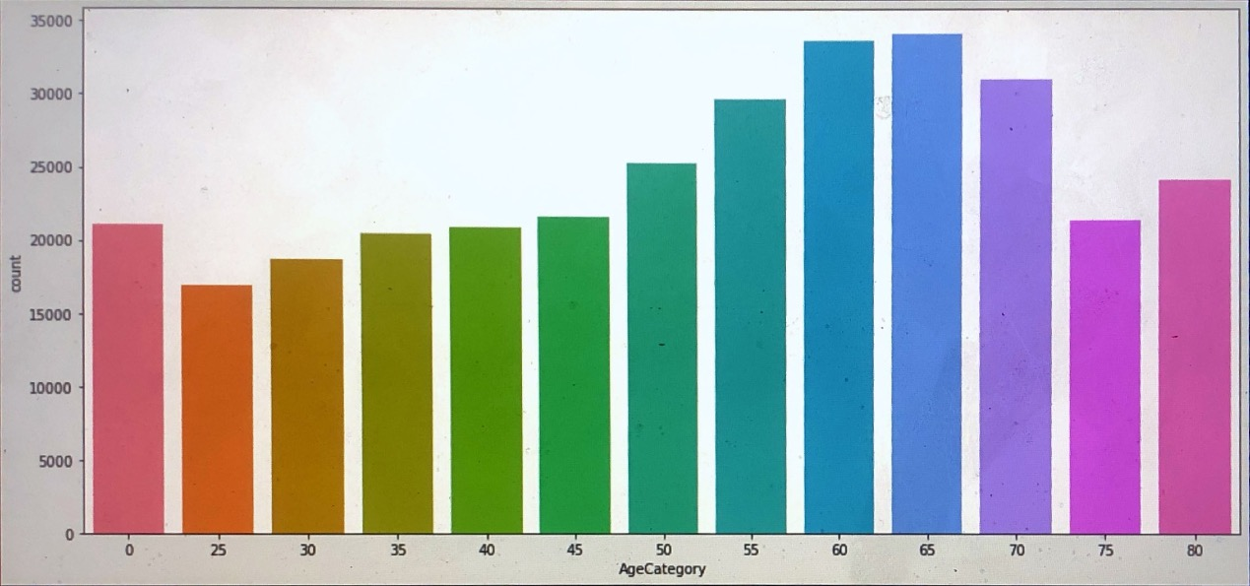
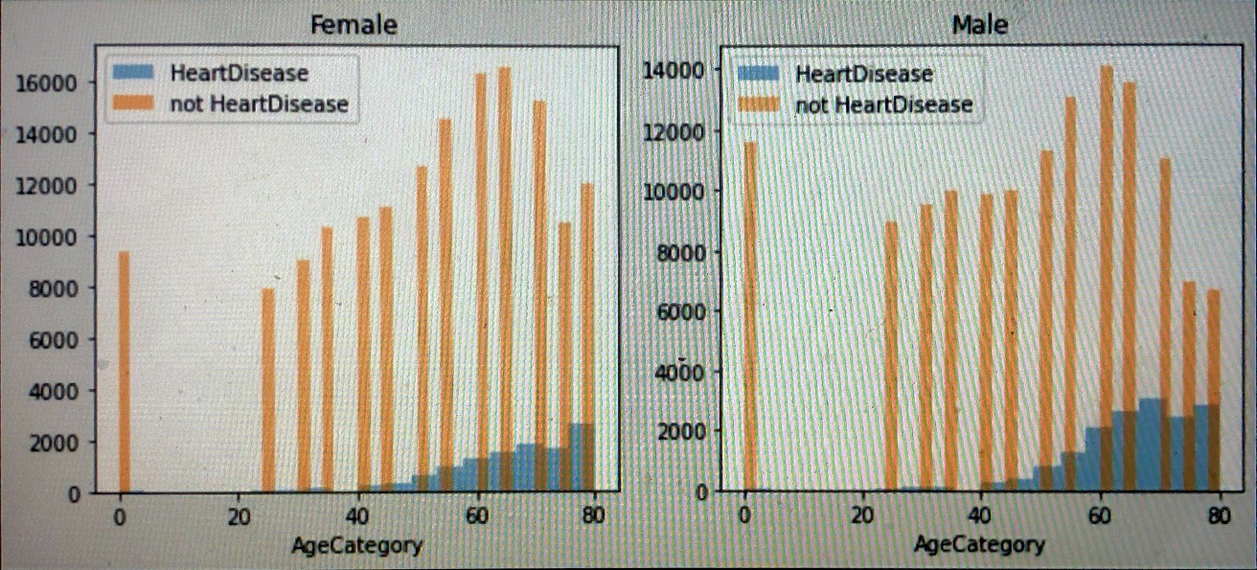
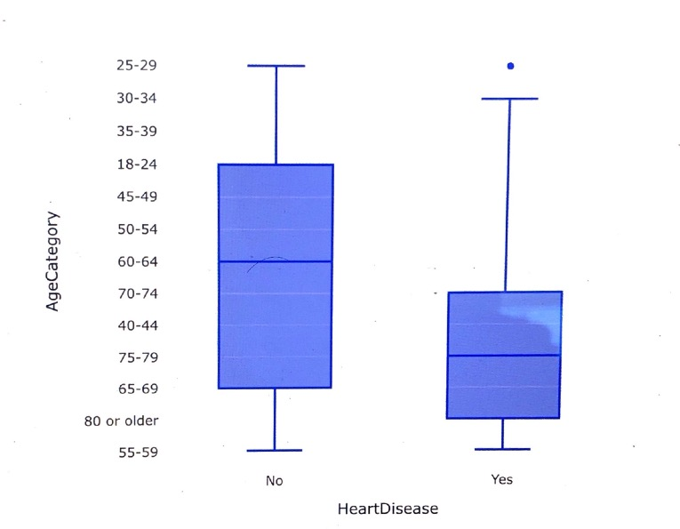
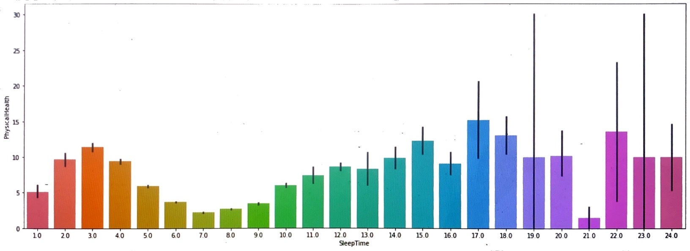
Heart Disease Prediction
SUNY College at
Old Westbury
Anibal Ruiz
Old Westbury
aruiz23@oldwestbury.edu
Introduction
Evaluation
According to the CDC, heart disease is one
of the leading According to the CDC, heart
disease is one of the leading causes of death
for people of most races in the US r people o
f most races in the US.. About half of all Americans
(47%) have at least 1 of 3 key risk factors for heart
disease: high blood pressure, high cholesterol, and smoking.
The main goal of this research is to find the best accuracy
for the prediction of heart disease by using major risk factors
based on different classifier algorithms
● Evaluation
Performance comparison of the different models.
Accuracy:
Random Forest: 96.2
Logistic Regression: 91.62
K Nearest Neighbor: 92.92
Gaussian Naive Bayes: 85.05
Perceptron: 84.51
Linear Support Vector Machine: 91.59
Decision tree: 96.21
RANDOM FOREST?
Random Forest is a supervised learning algorithm. Like you can already see from it’s name, it creates a forest and makes it somehow random. The forest, It builds, is an ensemble of Decision Trees, most of the time trained with the “bagging” method. The general idea of the bagging method is that a combination of learning models increases the overall result. To say it in simple words: Random Forest builds multiple decision trees and merges them together to get a more accurate and stable prediction.
Random Forest and Cross validation
Scores = [0.9014, 0.9032, 0.9015, 0.9022, 0.9020, 0.8998, 0.9019, 0.8981, 0.9025, 0.9036]
Mean = 0.9016510590346509
Standard Deviation = 0.0015397808125594981
Now, our model has an accuracy of 90% and a standard deviation of 0.15%
Data Description
The data has 17 attributes and the predicted class: heart disease:
The data has 17 attributes and the predicted class: heart disease: yes or no.
Heart Disease (binary)
BMI
Smoking (binary)
Alcohol Drinking (binary)
Stroke (binary)
Physical Health
Mental Health
DiffWalking (binary)
Sex (binary)
10. AgeCategory
11. Race
12. Physical Activity (binary)
13. GenHealth
14. SleepTime
15. Asthma (binary)
16. Kidney Disease (binary)
17. Skin Cancer (binary)
18. Diabetic (binary)
Models Comparison
Model | Mean | Standard Deviation
KNN | 0.897564 | 0.001970
Logistic Regression | 0.916196 | 0.000619
Naïve Bayes | 0.850507 | 0.002169
Perceptron | 0.910161 | 0.010409
Linear SVM | 0.915906 | 0.000347
Decision Tree | 0.889326 | 0.001480
Discussion and Conclusion
The best machine learning models are:
Linear SVM: 91.59
Random Forest: 96.2
Decision tree: 96.21
After using the k-fold cross validation, the best models:
Linear SVM: 91%
Random Forest: 90%
Perceptron: 91%
Size of data:
18 columns and 319795 entries.319795 entries.
Visualization
The importance table looks like this:
 | Count | Mean | STD | Min | 25% | 50% | 75% | Max
BMI | 3319795.0 | 28.33 | 6.36 | 12.02 | 24.03 | 27.34 | 31.42 | 94.85
PhysicalHealth | 319795.0 | 3.37 | 7.95 | 0.00 | 0.00 | 0.00 | 2.00 | 30.00
MentalHealth | 319795.0 | 3.898 | 7.96 | 0.00 | 0.00 | 0.00 | 3.00 | 30.00
SleepTime | 319795.0 | 0.097 | 1.44 | 1.00 | 6.00 | 7.00 | 8.00 | 24.00
HeartDisease | 319795.0 | 0.085 | 0.2797 | 0.00 | 0.00 | 0.00 | 0.00 | 1.00
General Description:
The mean of BMI (Body Mass Index) is: 28.33
A BMI of less than 18.5 means a person is underweight. A BMI of between 18.5 and 24.9 is ideal. A BMI of between 25 and 29.9 is overweight. A BMI over 30 indicates obesity.
The Standard deviation of BMI is: 6.36
 | importance
feature
BMI | 0.388
SleepTime | 0.185
GenHealth | 0.091
AgeCategory | 0.084
Stroke | 0.037
Important notes:
-All the participants are adults.
-Good number of participants for each range of ages. (Balance)
The sex is not important for a heart disease.
Either females or males have the same tendency
to have heart problems when they are older.
The most cases are between 60 and 80 years old.
Contributions
https://www.kaggle.com/code/ahmedklabi/heart-disease-pred/notebook
2020 annual CDC survey data of 400k adults related to their health status.
https://www.cdc.gov/heartdisease/index.htm Center for Disease and Control prevention.
https://www.ncbi.nlm.nih.gov/pmc/articles/PMC7521325/
People who sleep between 6 and 10 hours per day have better physical health.

