Slide 1
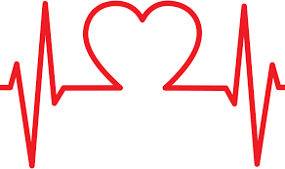
Heart Disease Prediction
By Anibal Ruiz

Slide 2


Introduction
According to the CDC, heart disease is one of the leading According to the CDC, heart disease is one of the leading causes of death for people of most races in the US r people of most races in the US
About half of all Americans (47%) have at least 1 of 3 key risk factors for heart disease: high blood pressure, high cholesterol, About half of all Americans (47%) have at least 1 of 3 key risk factors for heart disease: high blood pressure, high cholesterol, and smoking.
The main goal of this research is to find the best accuracy for the prediction of heart disease by using major risk factors based on different classifier algorithms

Slide 3
Data Description
The data has 17 attributes and the predicted class: heart disease: The data has 17 attributes and the predicted class: heart disease: yes or no.
Heart Disease (binary)
BMI
Smoking (binary)
Alcohol Drinking (binary)
Stroke (binary)
Physical Health
Mental Health
DiffWalking (binary)
Sex (binary)
10. AgeCategory
11. Race
12. Physical Activity (binary)
13. GenHealth
14. SleepTime
15. Asthma (binary)
16. Kidney Disease (binary)
17. Skin Cancer (binary)
18. Diabetic (binary)
Size of data:
18 columns and 319795 entries.319795 entries.

Slide 4
Data Cleaning and Preprocessing
No Null values.
Four attributes (BMI, Physical Health, Mental health and Sleep time) are integers data type.
You need to convert a lot of features into numeric ones. Specially the binary data (yes/no) -> (0/1).
Features have widely different ranges, that you will need to convert into roughly the same scale.
Dropped ID (not important)

Slide 5
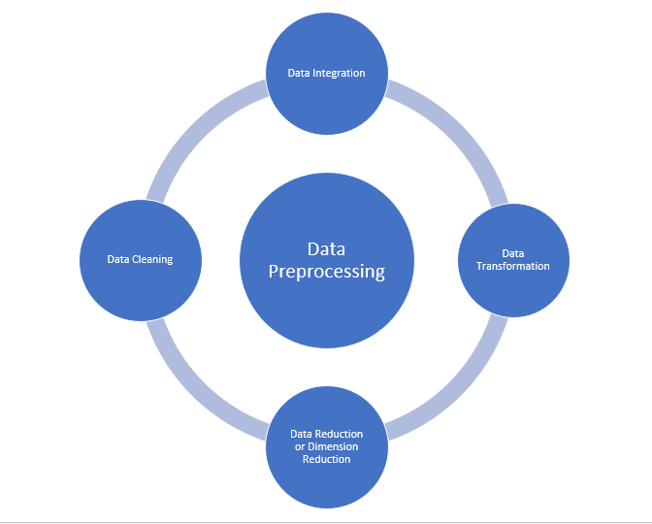
HeartDisease, Smoking, alcoholDrinking, SkinCancer, Asthma,
DiffWalking, KidneyCancer, PhysicalHealth and Stroke:
Converted as follow:
No -> 0
Yes -> 1
Sex:
Converted as follow:
Female -> 0
Male -> 1
AgeCategory:
‘7’ age categories were created to minimize the work.
0 to 11 -> 0
11 to 20 -> 1
21 to 30 -> 2
31 to 40 -> 3
41 to 50 -> 4
51 to 60 -> 5
61 to 70 -> 6
71 or greater -> 7

Slide 6
Data Exploratory and Visualization
General Description:
The mean of BMI (Body Mass Index) is: 28.33
A BMI of less than 18.5 means a person is underweight. A BMI of between 18.5 and 24.9 is ideal. A BMI of between 25 and 29.9 is overweight. A BMI over 30 indicates obesity.
The Standard deviation of BMI is: 6.36
 | Count | Mean | STD | Min | 25% | 50% | 75% | Max
BMI | 3319795.0 | 28.33 | 6.36 | 12.02 | 24.03 | 27.34 | 31.42 | 94.85
PhysicalHealth | 319795.0 | 3.37 | 7.95 | 0.00 | 0.00 | 0.00 | 2.00 | 30.00
MentalHealth | 319795.0 | 3.898 | 7.96 | 0.00 | 0.00 | 0.00 | 3.00 | 30.00
SleepTime | 319795.0 | 0.097 | 1.44 | 1.00 | 6.00 | 7.00 | 8.00 | 24.00
HeartDisease | 319795.0 | 0.085 | 0.2797 | 0.00 | 0.00 | 0.00 | 0.00 | 1.00

Slide 7
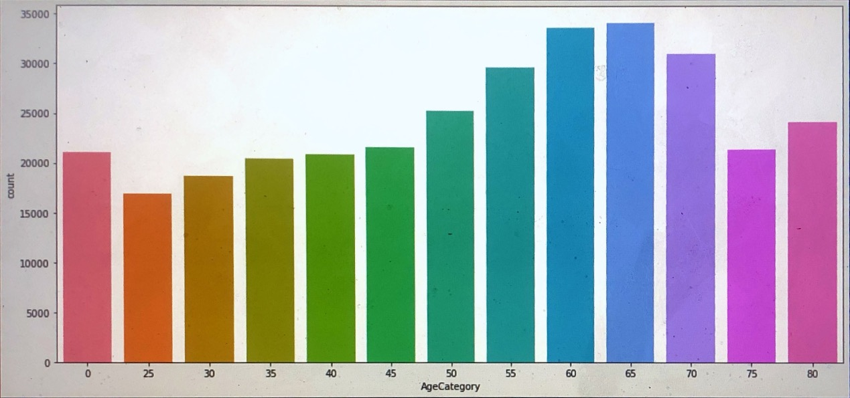
Important notes:
-All the participants are adults.
-Good number of participants for each range of ages. (Balance)
-Most participants are in the range of “50 or older”

Slide 8
 | BMI | Physical Health | Mental Health | Sleep time
BMI | 1.000000 | 0.109788 | 0.064131 | -0.051822
Physical Health | 0.109788 | 1.000000 | 0.287987 | -0.061387
Mental Health | 0.064131 | 0.287987 | 1.000000 | -0.119717
Sleep time | -0.051822 | -0.031387 | -0.119717 | 1.000000
CORRELATION TABLE:

Slide 9
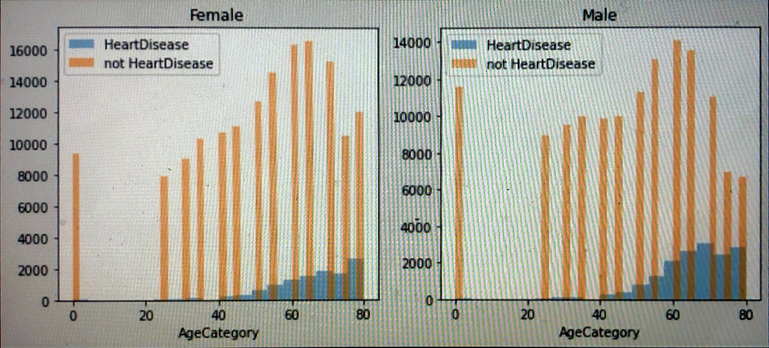
Age and Sex
histograms for male (heartDisease vs not heartDisease) and for female (heartDisease vs not heartDisease)
The sex is not important for a heart disease. Either females or males have the same tendency to have heart problems when they are older. The most cases are between 60 and 80 years old.

Slide 10
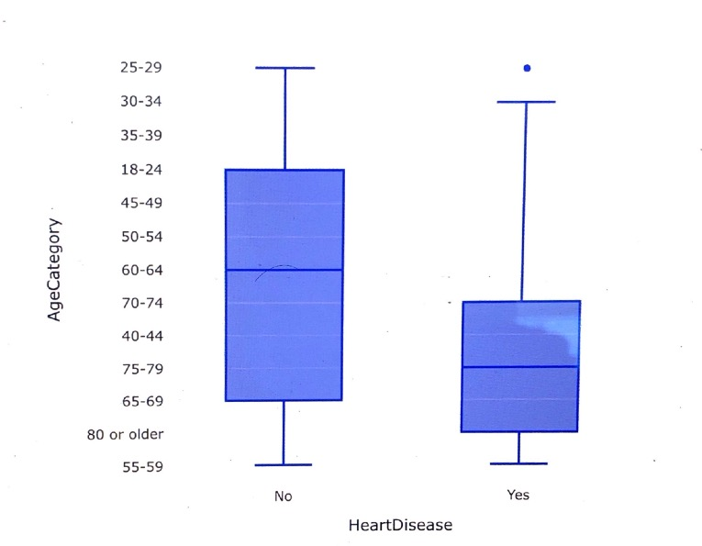
Age and heart Disease

Slide 11
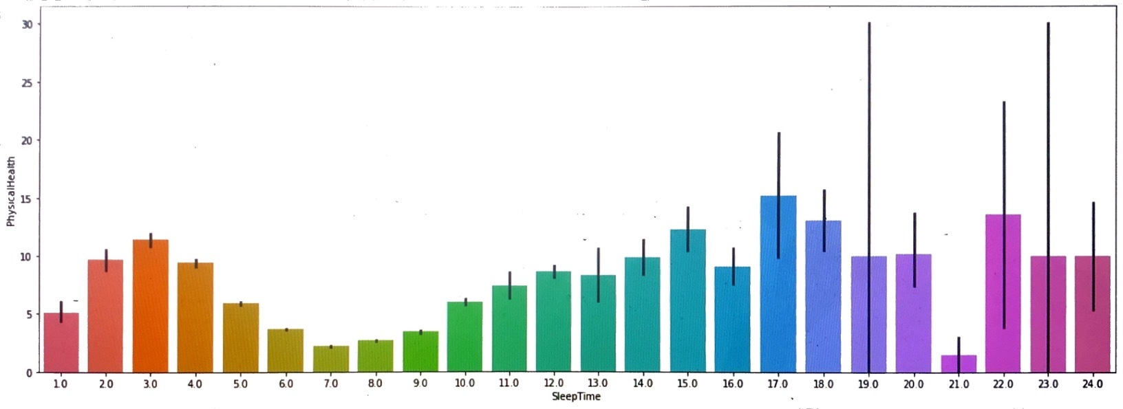
Sleep time and Physical Health

Slide 12
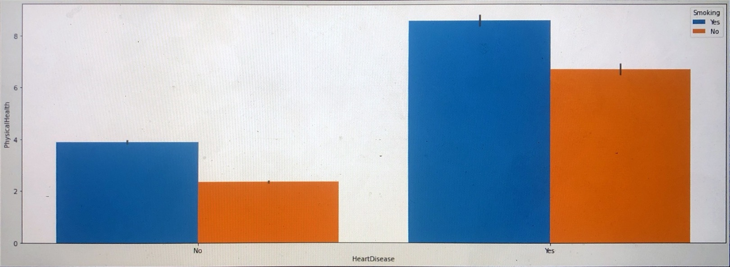
Heart Disease and Physical Health
“Most of patients with a heart disease had a bad physical health”

Slide 13
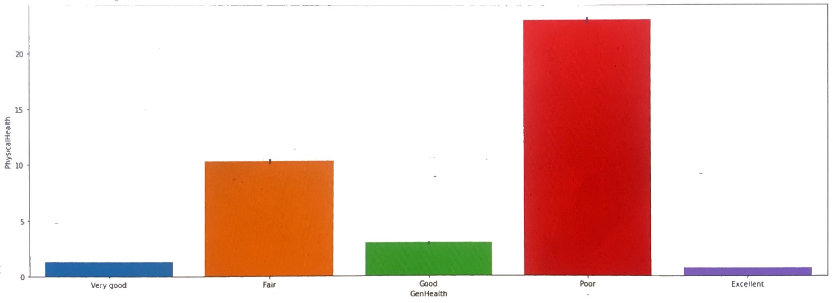
Physical health and Gen Health
“Having a good GenHealth lead to better PhysicalHealth”

Slide 14
Machine Learning Algorithms
● Evaluation
Performance comparison of the different models.
Accuracy:
Random Forest: 96.2
Logistic Regression: 91.62
K Nearest Neighbor: 92.92
Gaussian Naive Bayes: 85.05
Perceptron: 84.51
Linear Support Vector Machine: 91.59
Decision tree: 96.21
Random Forest and Decision tree are the best models.

Slide 15
Random Forest and Cross validation
Scores = [0.9014, 0.9032, 0.9015, 0.9022, 0.9020, 0.8998, 0.9019, 0.8981, 0.9025, 0.9036]
Mean = 0.9016510590346509
Standard Deviation = 0.0015397808125594981
Now, our model has an accuracy of 90% and a standard deviation of 0.15%

Slide 16
Models Comparison
Model | Mean | Standard Deviation
KNN | 0.897564 | 0.001970
Logistic Regression | 0.916196 | 0.000619
Naïve Bayes | 0.850507 | 0.002169
Perceptron | 0.910161 | 0.010409
Linear SVM | 0.915906 | 0.000347
Decision Tree | 0.889326 | 0.001480

Slide 17
Discussion and Conclusion
The best machine learning models are:
Linear SVM: 91.59
Random Forest: 96.2
Decision tree: 96.21
After using the k-fold cross validation, the best models:
Linear SVM: 91%
Random Forest: 90%
Perceptron: 91%

Slide 18
 | importance
feature
BMI | 0.388
SleepTime | 0.185
GenHealth | 0.091
AgeCategory | 0.084
Stroke | 0.037
The importance table looks like this:

Slide 19
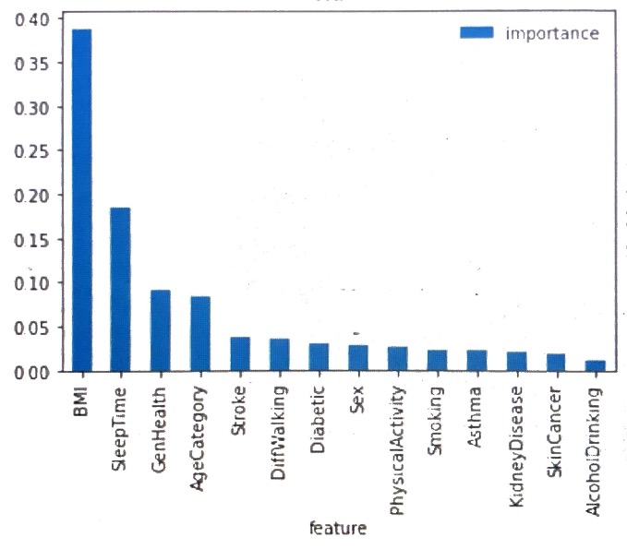

Slide 20


