Slide 1
Regression. London Energy Consumption Forecast Regression
SAPIENZA UNIVERSITY OF ROME
Big Data and Official Statistics
Project is done by:
Aruzhan Kakibay 1996005

Slide 2
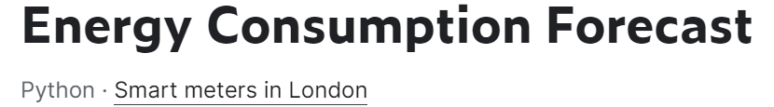
Project discussion
We are looking at a database containing energy consumption in a London household. Database of more than 5 thousand houses on 356k rows with many attributes. For a detailed consideration, we use some of them at the time of preprocessing. Tables containing data on energy, weather and schedules of UK banks were involved.

Slide 3
Python packages we used:
Pandas
Numpy
Pyspark
Matplotlib
Seaborn
Sklearn
Pylab
Statsmodels
Os, intertools, warnings, datatime

Slide 4
Content of work
was divided in the following way
Downloading and loading the Dataset from Google Drive
Pre-processing, consisting of importing the packages, sorting CVS files that we will consider in the work, combining them to the Dataset
Feature analysis in plots and histograms
Data Scaling
Feature Selecting
Splitting Data
ARIMAX
Model training by Decision tree, SVM Regression, Random Forest Regression, MLPN

Slide 5
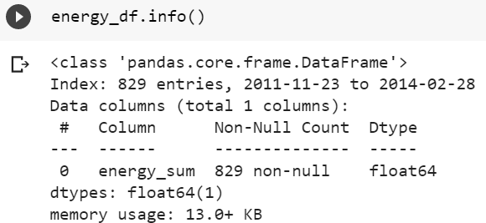
Pre-processing
The data from the three CSV files (energy,csv, weather_daily_darksky.csv and uk_bank_holidays.csv) was collected into new dataset. Instead of considering the energy consumption per household per day, we combine the data and consider the average to show the change of energy consumption over time.
ENERGY.CSV

Slide 6
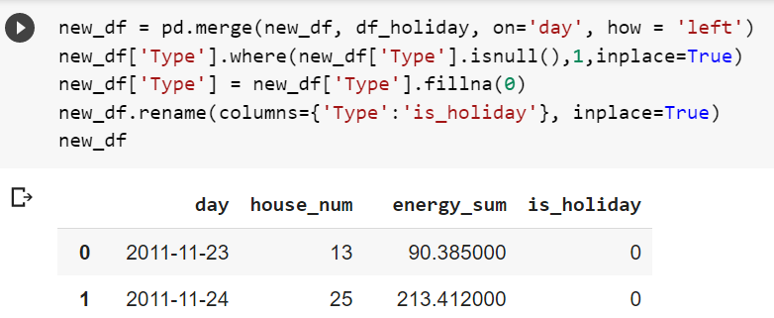
uk_bank_holidays.csv
The data about the bank holidays in UK includes the date of bank holidays in this time period. We assign the bank holiday in the record as 1, otherwise, record it as 0.
WEATHER_DAILY_DARKSKY.CSV
We read the weather data file into the code and combine them, to show daily weather in these 829 days.

Slide 7
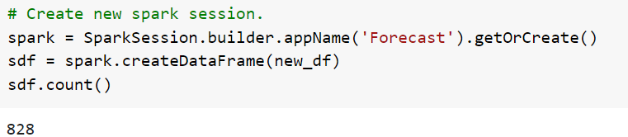
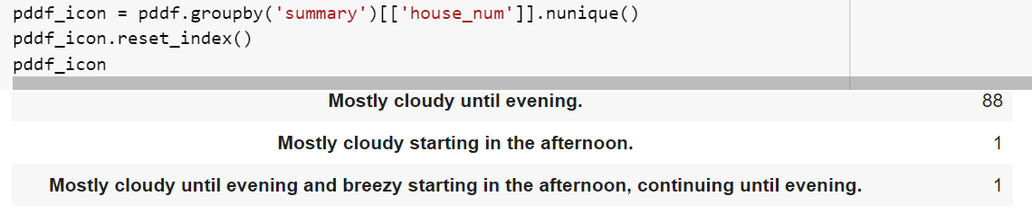

Pyspark implementation
In this phase we change the time data, sort days and clean dataset from too complex weather features, which describe too detailed conditions.

Slide 8
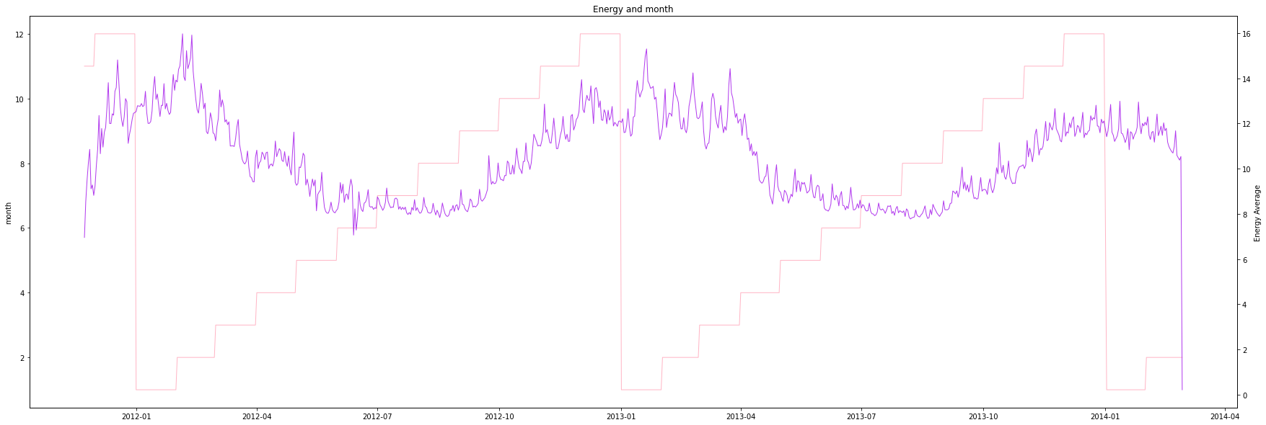
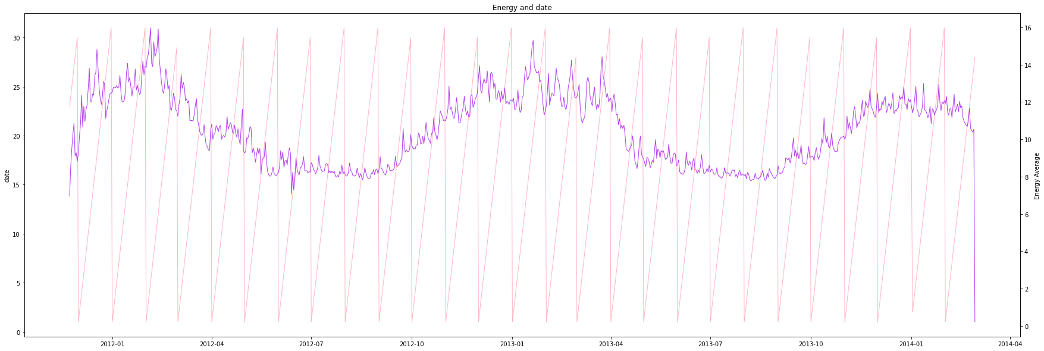
Data in Plot
Plotting graphs at the initial stage of model development helps to consider the amplitude of correlations and prepare a dataset by finding the average value and removing the repeated data.
Energy and month
Energy and date

Slide 9
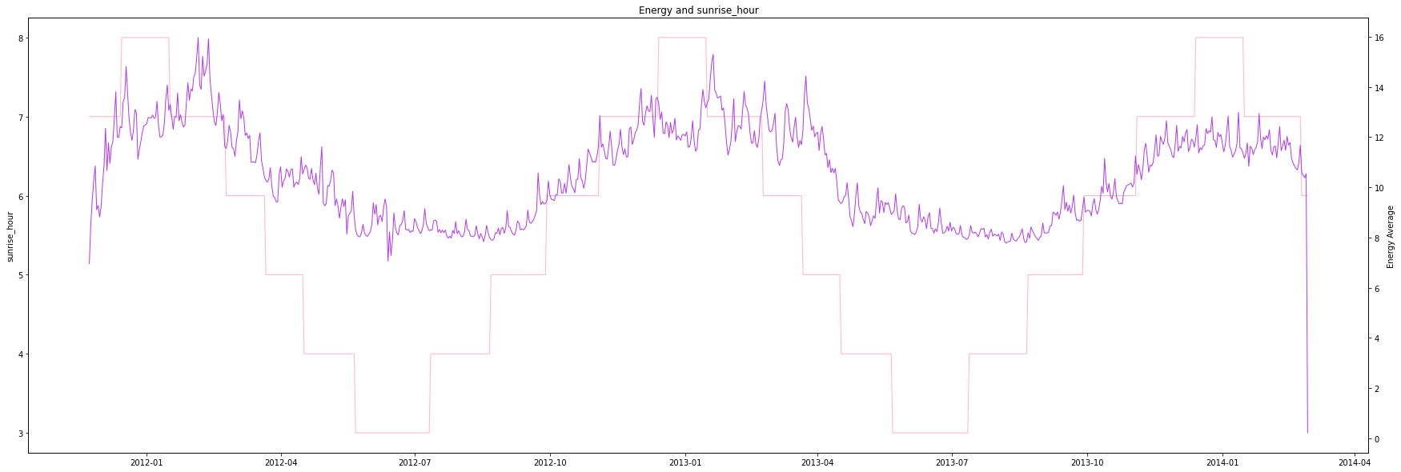
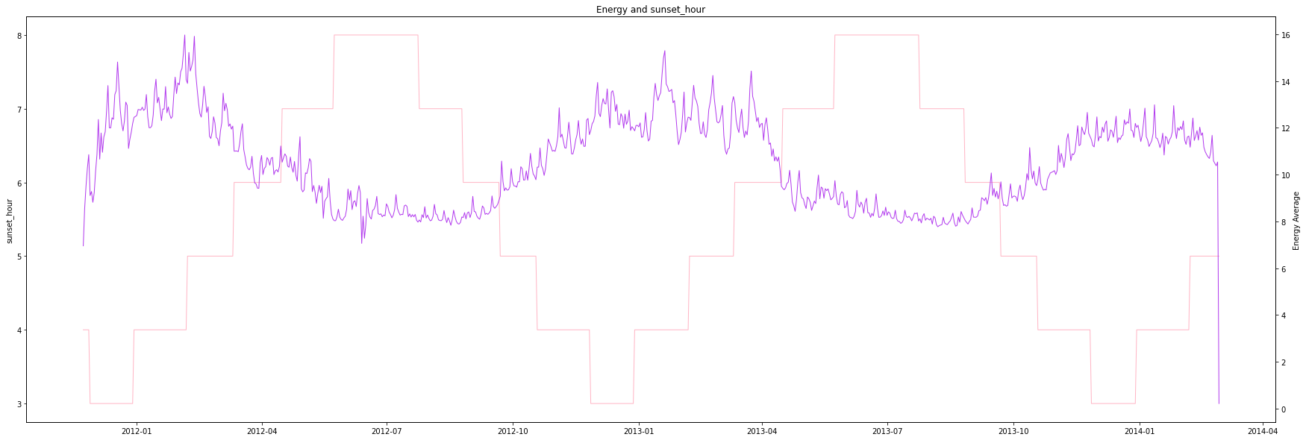
Energy and sunset hours by taking energy average

Slide 10
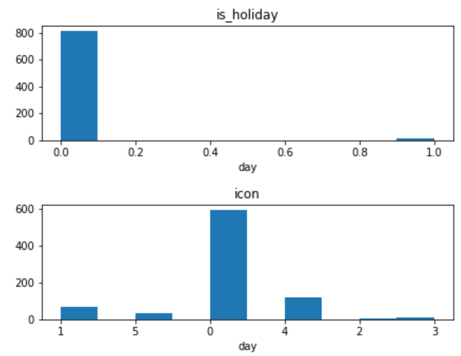
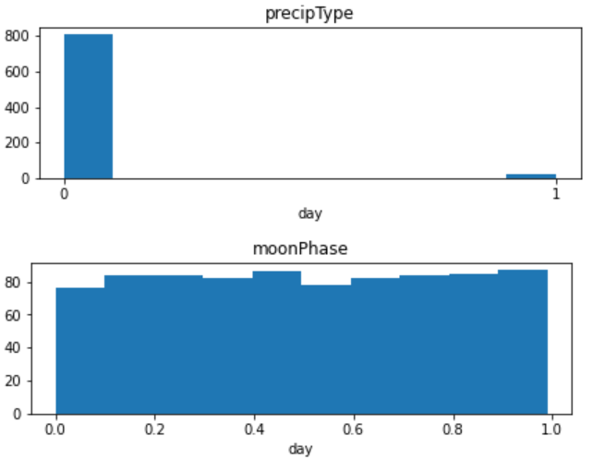
Data in Hist
We put the energy consumption and each feature on a graph to show the relationship between the feature and the energy consumption. We consider the histograms to uk_bank_holidays
We found that some of these features did not correlate well with the average of energy consumption or repeated with other features, so we removed them from training data.

Slide 11
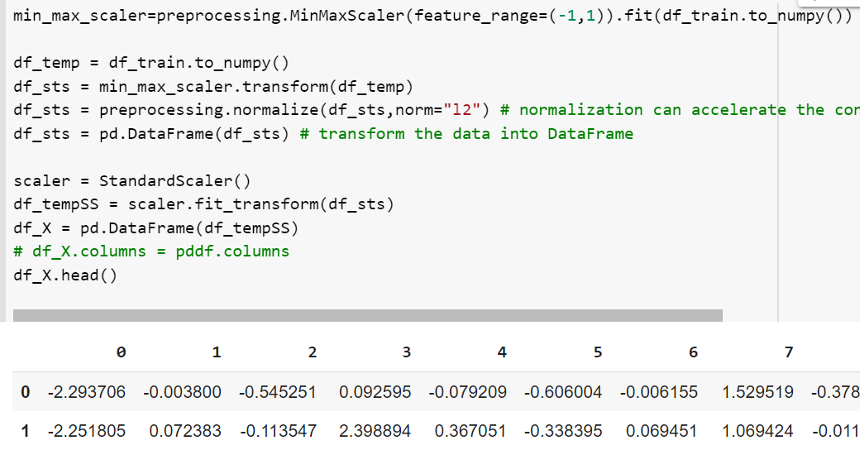
Data Scaling
Scaling and standardizing the data. We implement minimum and maximum scaler, scaling makes the search jumps smoother in the gradient decent.
For the normalization we use preprocessing.normalize, it can accelerate the convergence and makes different features are numerically comparable.

Slide 12
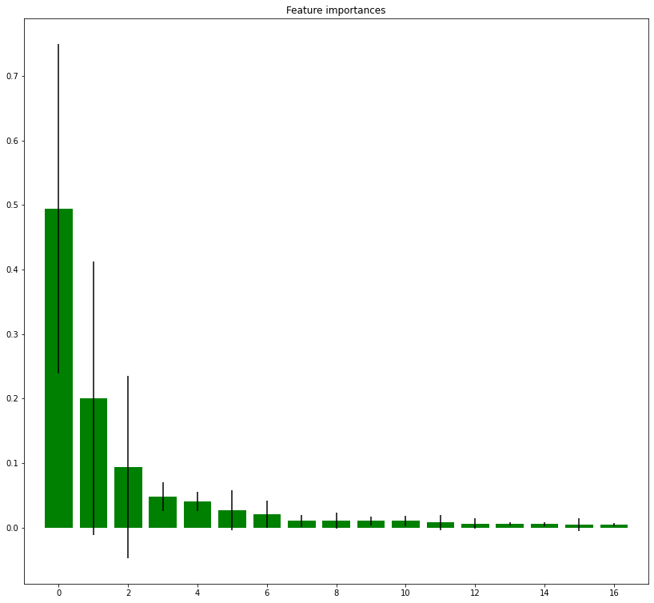
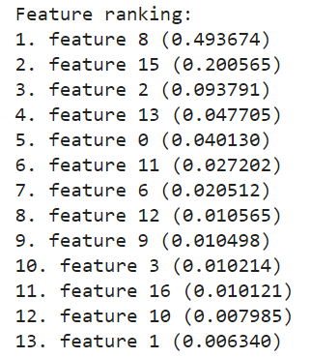
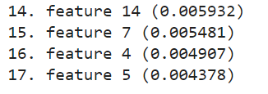
Feature SelectinG
Use random forest on the dataset, analyze the feature importance, and select 10 of these features as the training set.
Impliment sklearn.ensemble or to be more precise we use RandomForestRegressor. Print the feature ranking and plot the feature importances of the forest.

Slide 13
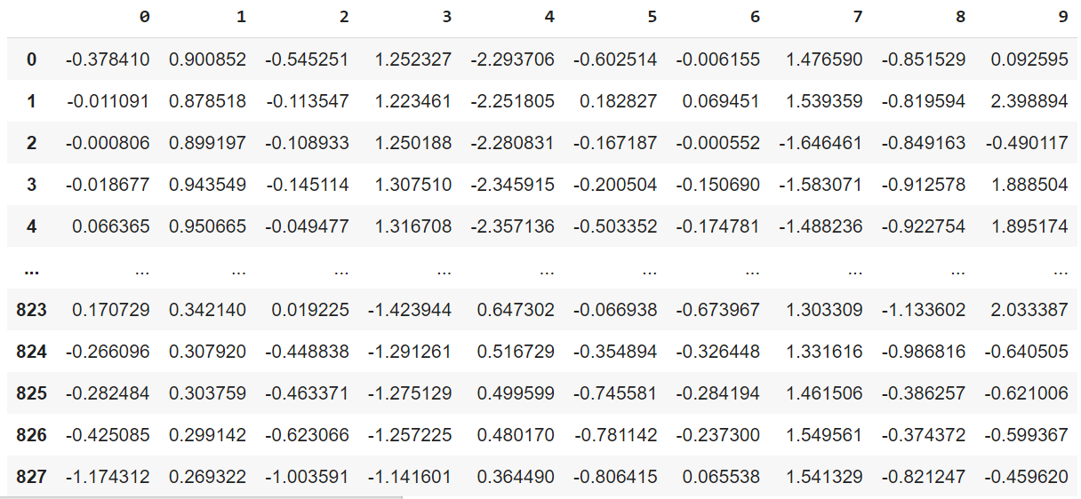
Select the most important 20 features
Data Splitting
X_train,X_test,y_train,y_test = train_test_split(df_X_10, df_y, test_size = 0.3, random_state = 1) # split the dataset

Slide 14
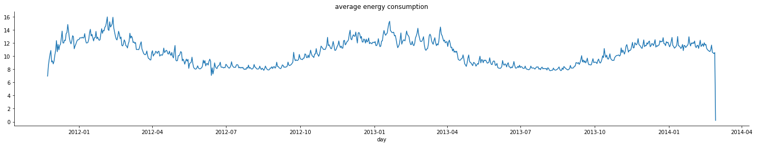
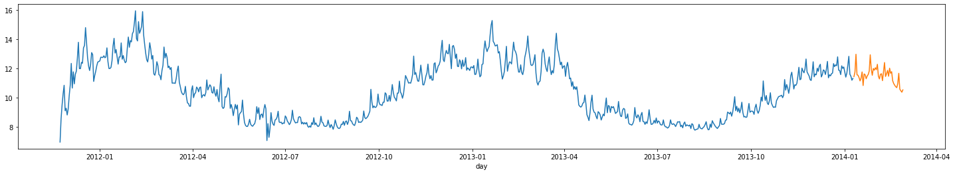
arimax
The standard ARIMA (autoregressive integrated moving average) model allows to make forecasts based only on the past values of the forecast variable.
We create a test DataFrame to practice the ARIMAX model, consider the features as day, energy_avg, temperature_max.
Split data to train and test datasets and display

Slide 15
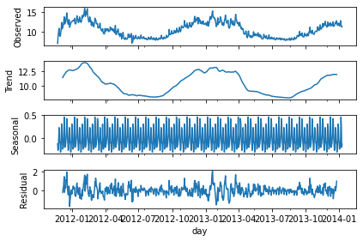
Create function of difference. Seasonal Decomposition
The seasonal component is quite low while the trend is quite strong with obvious dips in electricity consumption during summers i.e. April to September. This may be attributed to longer days during summer.

Slide 16
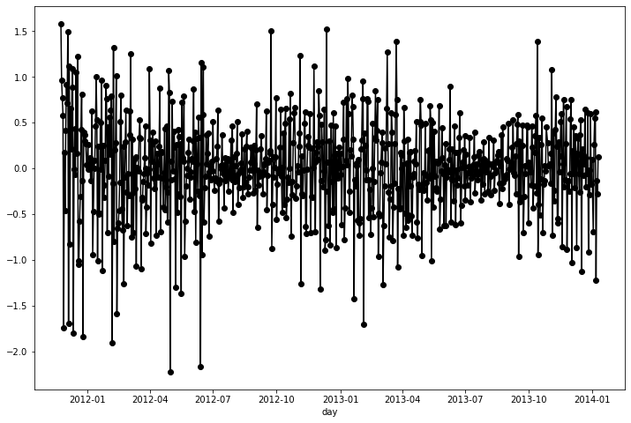
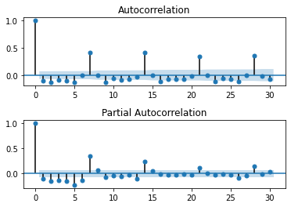
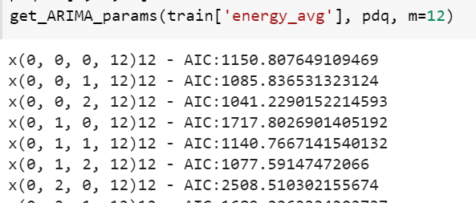
Draw ACF and PACF plots to determine p, q values
Seasonal_order is ordered by grid search, seasonal_order=0,2,0,12 is better specify to ignore warning messages

Slide 17
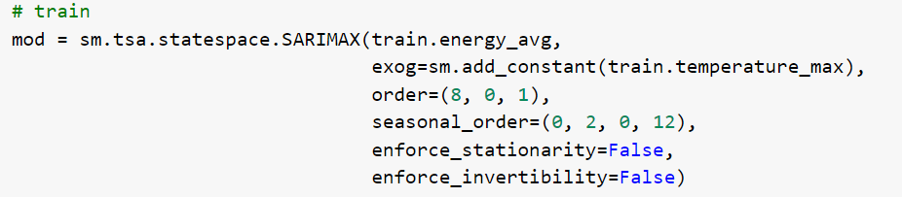
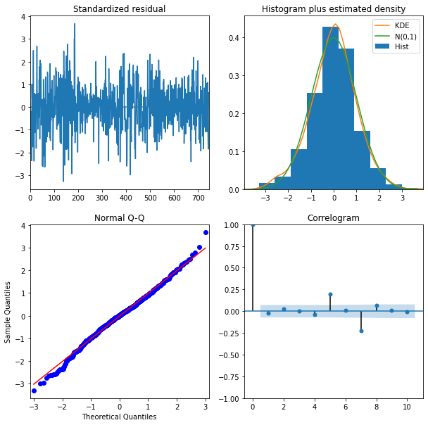

Slide 18
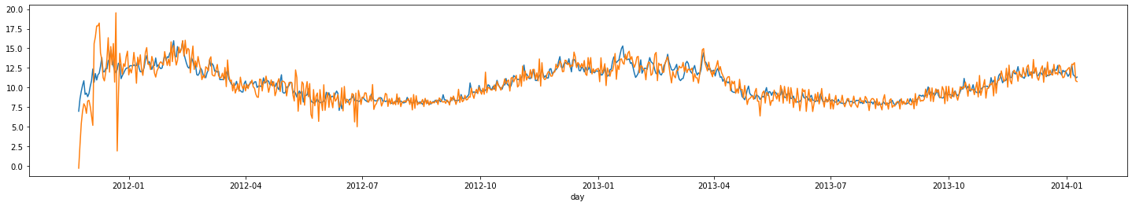
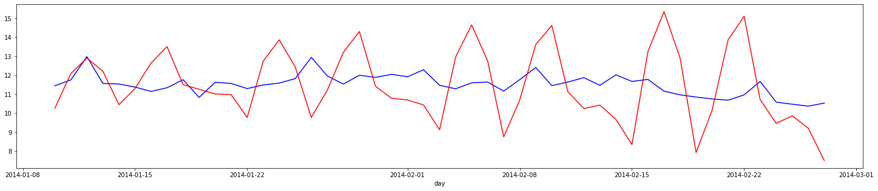
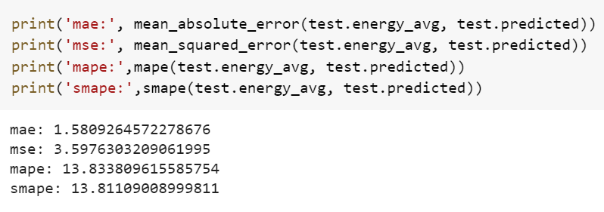
Train energy average
Energy average (blue) and predicted (red)

Slide 19
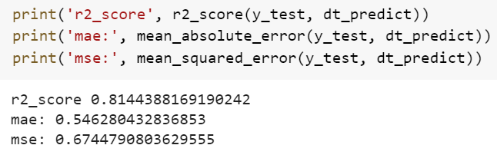
ML. Model Training
Decision Tree
Define a decision tree model and set the scope of grid search parameters, due to the big size of dataset, we choose random parameter to splitter. Using RandomizedSearchCV to do the cross-validation while we can control the amount of the computing.
We train a model and print the Best parameter
the Best parameter is： {'splitter': 'random', 'min_samples_split': 4, 'min_samples_leaf': 4, 'max_features': 9, 'max_depth': 20, 'criterion': 'mae'}
and make a prediction for our future evaluation.
Evaluation

Slide 20
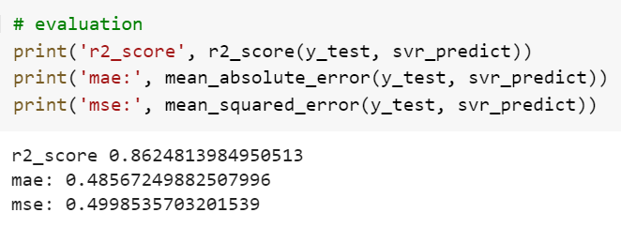
SVM Regression
Support Vector Machine is a class of linear classifier which classifies data according to supervised learning. It creates a margin between two classes which separate the two classes totally. Generally, SVM has good learning ability and require little computer memory.
We do the same work as previously, set a scope of grid search parameters and by using SVM find the best parameter.
Best parameters: {'kernel': 'rbf', 'gamma': 0.001, 'C': 10}
Evaluation

Slide 21
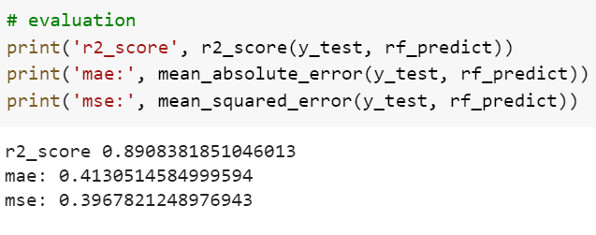
Random forest regression
For the random forest, as long as there are enough trees in the random forest, the model will not overfit.
We use RandomForestRegressor()
Best parameters: {'n_estimators': 30, 'min_samples_split': 5, 'min_samples_leaf': 3, 'max_features': 'sqrt', 'max_depth': 100, 'criterion': 'mse'}
Evaluation

Slide 22
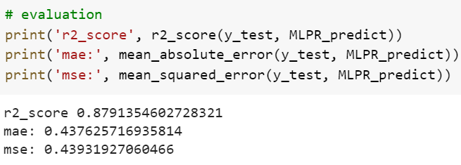
MLPN
MLPN is sensitive to scaling, adding scaling can improve model accuracy and GD convergence speed to a certain extent.
We use MLPRegressor(solver='adam', random_state=1,max_iter=10000)
Solver chose ADAM because ADAM works well on a relatively large data sets, and max_iter must be large enough to converge. So I set it 10000
Best parameters: {'learning_rate': 'constant', 'hidden_layer_sizes': 30, 'alpha': 0.1, 'activation': 'tanh'}
Evaluation

Slide 23
Thank you!

