Slide 1
Big data is like teenage sex:
everyone talks about it,
nobody really knows how to do it, everyone thinks everyone else is doing it, so everyone claims they are doing it...
Prof. Dan Ariely

Slide 2
Advantages of Python in Atmospheric & Oceanic Sciences
Arulalan. T
(Project Scientist - C)
a.k.a TuxCoder
National Centre for Medium Range Weather Forecasting
MoES, Noida, India
PyDelhi Conf 2016
05-Mar-2016

Slide 3
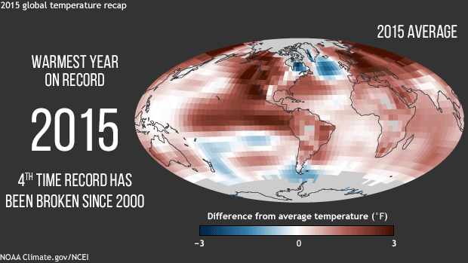
Global Warming
Source : National Oceanic and Atmospheric Administration (NOAA), U.S

Slide 4
Climate
Slow, Steady, Long-Period Process, Feedback
Change

Slide 5
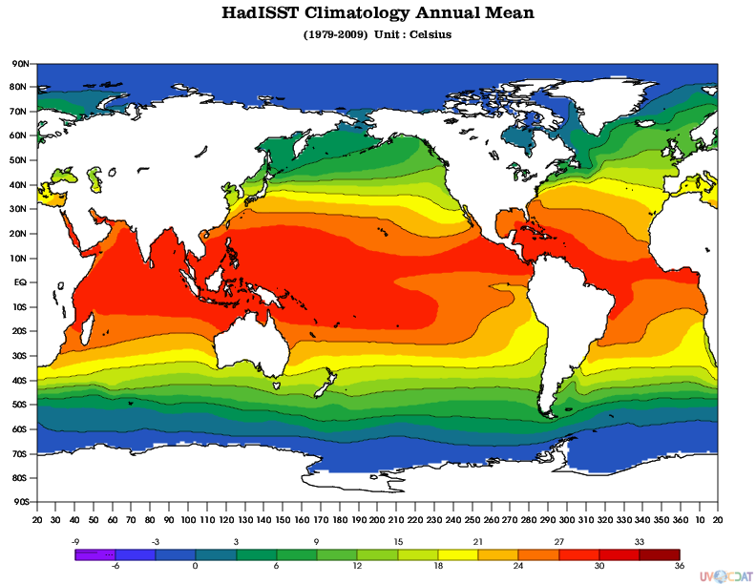
Observed Climatology of Sea Surface Temperature (SST)

Slide 6
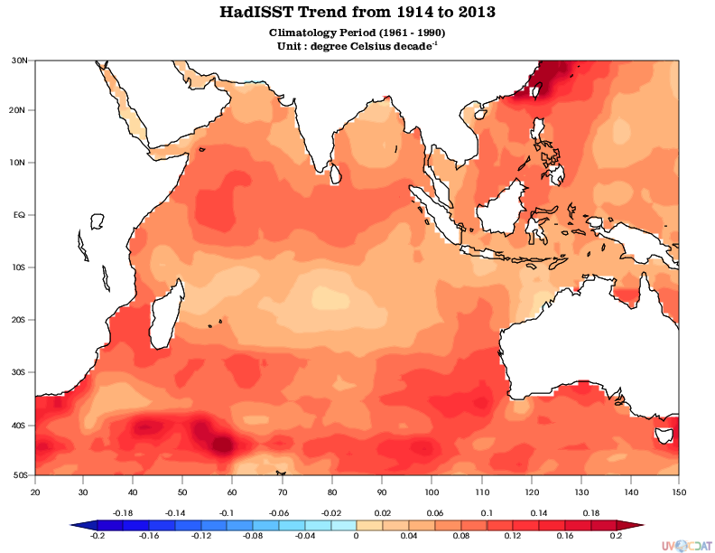
Observed Indian Ocean SST during past 100 years

Slide 7
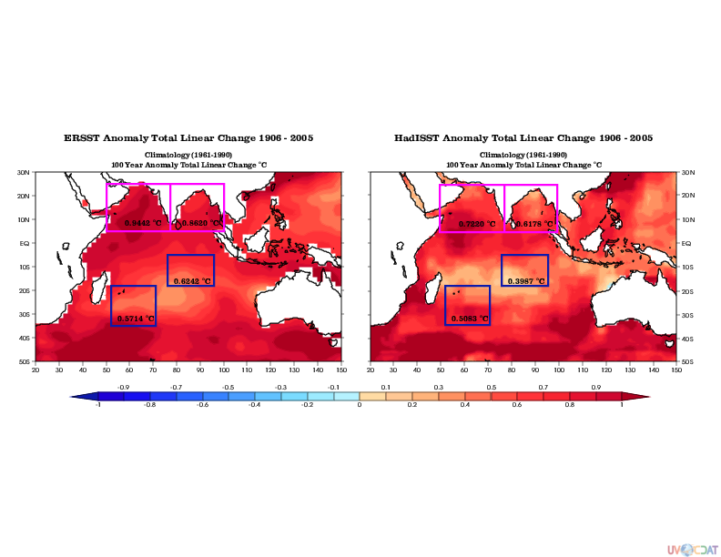
Observed Indian Ocean SST during past 100 years

Slide 8
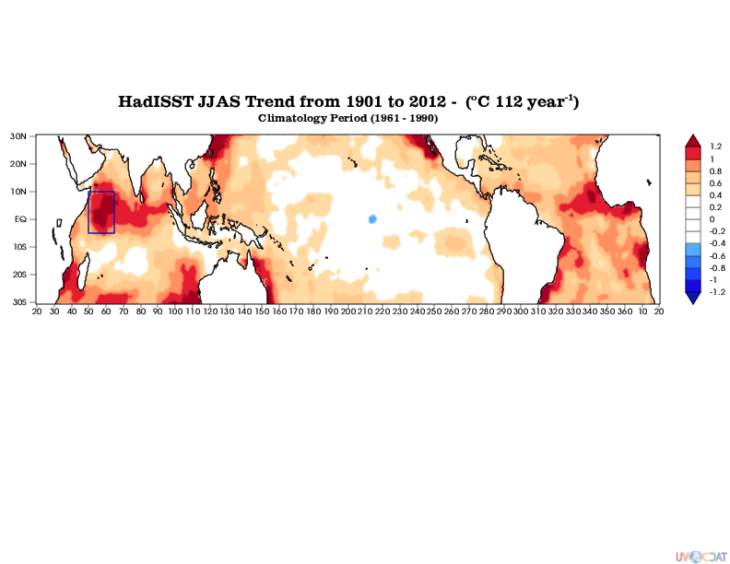
Observed Indian Ocean SST during past 100 years
(Monsoon Season)

Slide 9
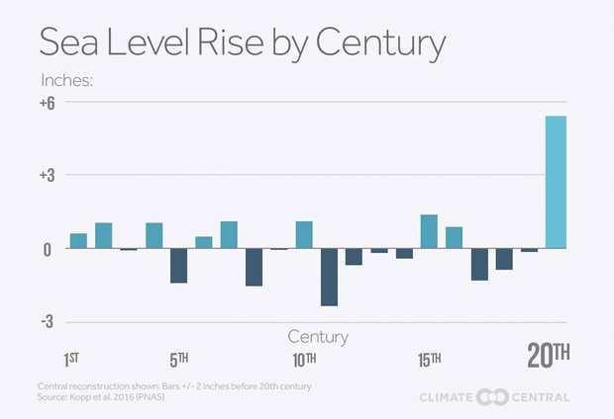
Increased Global Ocean Surface Height from MeanSeaLevel
Centimeters
+15.24
+7.62
-7.62
Source : Kopp et al., 2016 , PNAS

Slide 10
Weather
Fast, Rappid, Short-period Process, Feedback
Change

Slide 11
Weather
Medium Range (3 - 10 days)
Forecast

Slide 12
National Centre for
Medium Range Weather Forecasting (NCMRWF, MoES, India)

Slide 13
Background
NCMRWF located at Noida, UP
NCEP GFS (modified) running at various resolutions
  T254L64, T382L64, T574L64
UK Met Office Unified Model model
Focus on forecasts during the Monsoon Season (JJAS)
How does one track progress?
A diagnostic framework to facilitate this
Funded by MoES
4 years dev (Dec 2010 to Dec 2014) at IITD and hosted at NCMWRF

Slide 14










CMC (Canada)
NCEP (USA)
BoM (Australia)
CMA (China)
CPTEC (Brazil)
NCMRWF (India)
Multi Models Access
Different Resolution in
Grid (x,y), Level (z),
Time (t), Forecast Time
KMA (Korea)
MeteoFrance (France)
ECMWF (Europe)
UKMO (UK)

Slide 15


Observation / Analysis / Truth Data
Forecasts Hours (Next 7 to 10 Days) Dataset
24 48 72 96 120 144 168

Slide 16

How to Handle Multi Model Datasets
(Anl / Obs / Forecasts Hours Data)
Grrrrrr.........

Slide 17


Each Models have multi
Ensembles Datasets too !
Eeveryday each model generates
1 Anl + 'F' hours of forecasts dataset = 1 + F
'E' nos of Ensembles = (1 + F) x E
'M' nos of Models = (1+F) x E x M
'T' nos of Days = (1+F) x E x M x T
Case 1:
(1 Analysis/Observation + 15 Forecasts)
x 5 Ensembles x 15 Models x 100 years
x 365 days = 4,38,00,000 Files
Case 2:
We have 3 hours forecasts datasets too!
So 43800000 x 7 (3 Hour Fcst)
= 30,66,00,000 Files

Slide 18
Each Models have multi
Ensembles Datasets too !
Really
Big
Datasets ..!
Eeveryday each model generates
1 Anl + 'F' hours of forecasts dataset = 1 + F
'E' nos of Ensembles = (1 + F) x E
'M' nos of Models = (1+F) x E x M
'T' nos of Days = (1+F) x E x M x T
Case 1:
(1 Analysis/Observation + 15 Forecasts)
x 5 Ensembles x 15 Models x 100 years
x 365 days = 4,38,00,000 Files
Case 2:
We have 3 hours forecasts datasets too!
So 43800000 x 7 (3 Hour Fcst)
= 30,66,00,000 Files
~ 1.1 PBs
produced every year @ NCMRWF

Slide 19

Additional Issues
Models in development
  Some have not been run long enough
  May not have climatology!
Observational products
  In-situ observations (e.g. rainfall)
Currently all diagnostics & visualization accomplished through hodgepodge of
  Grads / Fortran / CDO / DBNet

Slide 20

Scientists' Reaction !?
How ?
Time Associated Data Access Problem ?
Climate / Weather Diagnostics Plots?
File Formats
more ...
We developed a Python based framework
at IITD and hosted at NCMRWF
A Python Based
Framework for Systematic Weather Model Diagnosis

Slide 21




mmDiagnosis

Slide 22
Purpose of Framework
Handle multiple models seamlessly
Verify forecasts and Diagnose the models in a systematic way
Facilitate easy comparison / benchmarking
Visualization / Plotting
“Recall” to avoid repetition of work
Control everything over GUI & CUI
Systematic auto process

Slide 23

Ultrascale Visualization
Climate Data Analysis Tools
A Python based library which is coupled with
VTK/ParaView, VCS, VisTrails, DV3D, ViSUS, ESMF/ESMP, VisIt & R
Developed at
Lawrence Livermore National Laboratory (LLNL), CA
Sponsors
Department of Energy, U.S.A & NASA

Slide 24
Arrays, Masked Arrays and Masked Variables in UV-CDAT

Slide 25
Arrays, Masked Arrays and Masked Variables in UV-CDAT
>>>b = MV2.masked_greater(a,4)
>>> b.info()
*** Description of Slab variable_3 ***
id: variable_3
shape: (3, 2)
filename:
missing_value: 1e+20
comments:
grid_name: N/A
grid_type: N/A
time_statistic:
long_name:
units:
No grid present.
** Dimension 1 **
id: axis_0
Length: 3
First: 0.0
Last: 2.0
Python id: 0x2729450
** Dimension 2 **
id: axis_1
Length: 2
First: 0.0
Last: 1.0
Python id: 0x27292f0
*** End of description for variable_3 ***
>>> a=numpy.array([[1.,2.],[3,4],[5,6]])
>>> a.shape
(3, 2)
>>> a[0]
array([ 1., 2.])
Additional info such as metadata
and axes
>>> numpy.ma.masked_greater(a,4)
masked_array(data =
[[1.0 2.0]
[3.0 4.0]
[-- --]],
mask =
[[False False]
[False False]
[ True True]],
fill_value = 1e+20)
These values are now MASKED
(average would ignore them)

Slide 26

UV-CDAT can access all the Self Describing Files
NetCdf HDF PP
ASCII
Ctl
Binary Grib Buffer

Slide 27
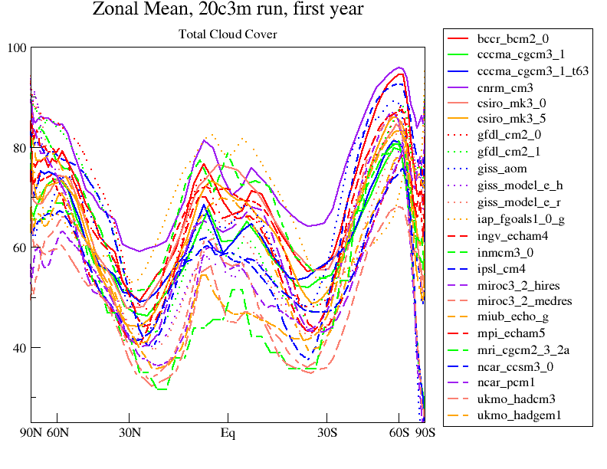
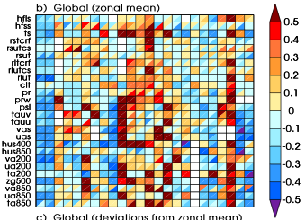
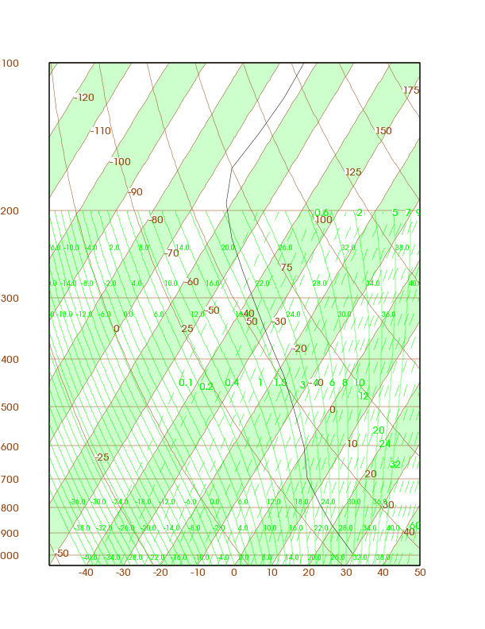
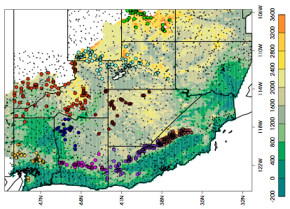
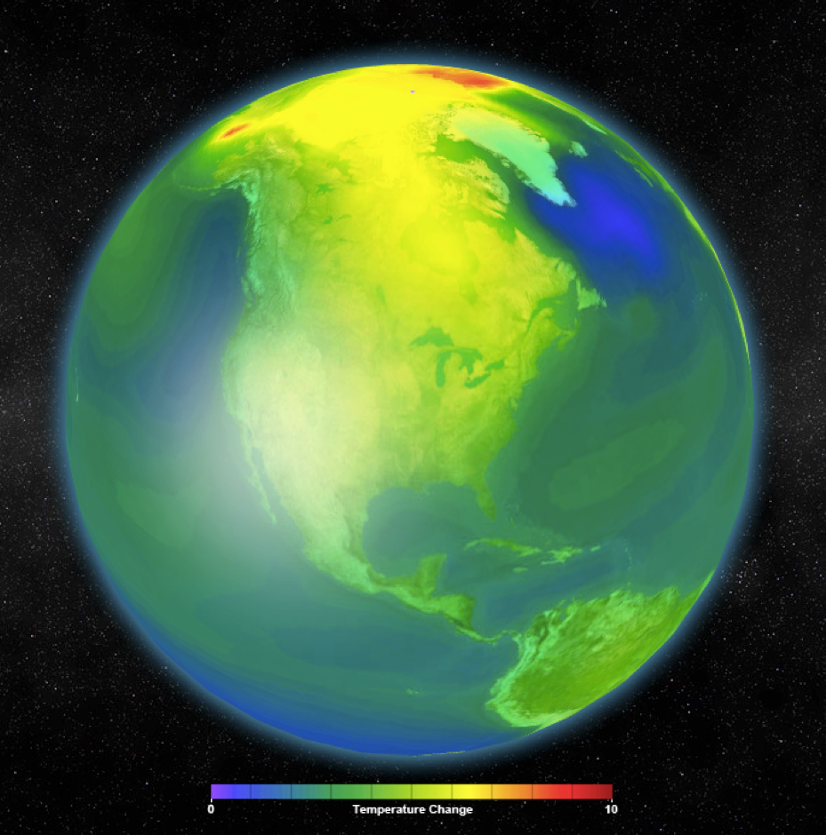
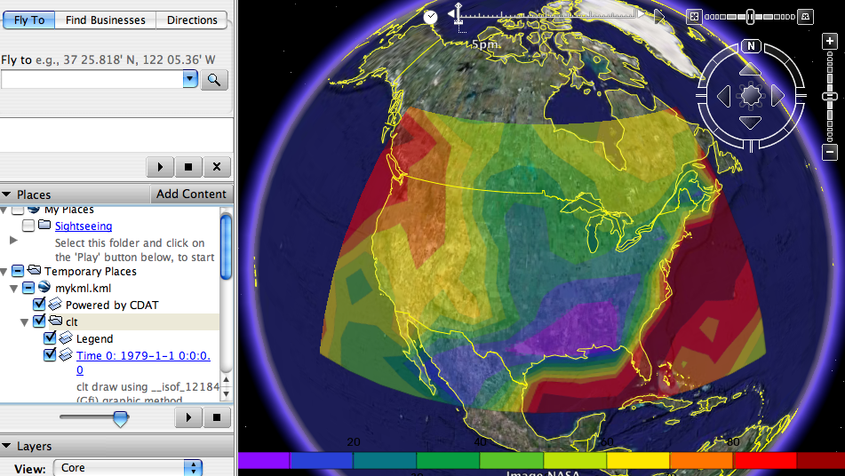
Visualization in UV-CDAT

Slide 28

cdscan
xml

Slide 29
Ideal conditions for a Python Fix!
uvcdat
  grib, pp, hdf, ctl, netCDF data
cdscan
  Scanning the “data sets” into an “xml” file
cdtime
Regridding data
Automation of diagnosis
  Certain operations are scheduled and carried out daily/monthly/seasonally
Plotting Programs
CUI & GUI
“Browsing” the results
Testing
Documentation

Slide 30
xml_data_access.py
Access daily, monthly, seasonal data for multiple years in a customized axis / dimension.
>>> xobj = XmlDataAccess('xml_dir_path')
>>> xobj.getData('uwnd', dtype='fcst', hour=24, time=('2016-2-1', '2016-2-29'), lat=(0, 40), lon=(60, 100), level=850)) # region
Extract uwind data of Fcst 24 hour from 1-Feb-2016 to 29-Feb-2016.

Slide 31
xml_data_access.py
?
Get multi-day forecast dataset along with its corresponding ("partner") analysis/observation/truth data and vice versa.
>>> xobj.getPartnerData(...)
Case1: Today's 24 hour forecast data is partner of tomorrow's truth data.
Case2: Today's truth data is partner of yesterday's 24 hour forecast data.
Both cases extensible up to arbitrary number of hours/days

Slide 32
xml_data_access.py
Find Partners
>>> xobj.findPartners('f', '2016-2-5', hour=24) # 'f' → 'forecast'
2016-02-06 0:0:0.0 # cdtime.comptime type
>>> xobj.findPartners('a', '2016-2-5', returnType='s') # 'a' → 'analysis'
{24: '20160204',
48: '20160203',
72: '20160202',
96: '20160201',
120: '20160131',
144: '20160130',
168: '20160129'}
Depends upon the availability of the forecast and anlalysis files,
it should return partner date

Slide 33
timeutils.py
The timeutils.py modules gives more facilities (using the cdtime module under UVCDAT) to address the following time axis access requirements
>>> import cdms2
>>> import cdtime
>>> f = cdms2.open('uwnd_2015.nc')
>>> taxis = f.getAxis('time')
>>> print taxis
id: time
Designated a time axis.
units: days since 2015-1-1
Length: 365
First: 0
Last: 364
Other axis attributes:
calendar: gregorian
axis: T
Python id: 0x1eb9d90
>>> f = cdms2.open('uwnd_2013.nc')
>>> taxis = f.getAxis('time')
>>> print taxis
id: time
Designated a time axis.
units: days since 2013-1-1
Length: 350
First: 0
Last: 349
Other axis attributes:
calendar: gregorian
axis: T
Python id: 0x1eb4f81

Slide 34
timeutils.py
The timeutils.py modules gives more facilities (using the cdtime module under UVCDAT) to address the following time axis access requirements
>>> import cdms2
>>> import cdtime
>>> f = cdms2.open('uwnd_2015.nc')
>>> taxis = f.getAxis('time')
>>> print taxis
id: time
Designated a time axis.
units: days since 2015-1-1
Length: 365
First: 0
Last: 364
Other axis attributes:
calendar: gregorian
axis: T
Python id: 0x1eb9d90
>>> f = cdms2.open('uwnd_2013.nc')
>>> taxis = f.getAxis('time')
>>> print taxis
id: time
Designated a time axis.
units: days since 2013-1-1
Length: 350
First: 0
Last: 349
Other axis attributes:
calendar: gregorian
axis: T
Python id: 0x1eb4f81

Slide 35
timeutils.py
1) We need a list or generator covering a specified range of time and time step. Returns in string type or comptime (component time object) type. Fuctions : tRange, xtRange
>>> tobj = TimeUtility()
>>> gen = tobj.xtRange(startdate= '2013-12-7 12:0:0.0',
enddate= '2013-12-10 0:0:0.0', stephour= 12)
>>> for i in gen:
... print i
...
2013-12-7 12:0:0.0
2013-12-8 0:0:0.0
2013-12-8 12:0:0.0
2013-12-9 0:0:0.0
2013-12-9 12:0:0.0
2013-12-10 0:0:0.0
Stephour, stepday could be -ve also !

Slide 36
timeutils.py
2) Need to check data availability for specified time range by passing a time axis. Can check for all months or only months with partial/full coverage. Month names with start & end date (in comptime type) returned as a dictionary.
>>> tobj.getTimeAxisMonths(taxis)
{ 'JANUARY': (2013-1-1 0:0:0.0, 2013-1-31 0:0:0.0),
'FEBRUARY': (2013-2-1 0:0:0.0, 2013-2-28 0:0:0.0),
'DECEMBER': (2013-12-1 0:0:0.0, 2013-12-15 0:0:0.0) }
>>> tobj.getTimeAxisPartialMonths(taxis)
{ 'DECEMBER': (2013-12-1 0:0:0.0, 2013-12-15 0:0:0.0) }
>>> tobj.getTimeAxisFullMonths(taxis)
{ 'JANUARY': (2013-1-1 0:0:0.0, 2013-1-31 0:0:0.0),
'FEBRUARY': (2013-2-1 0:0:0.0, 2013-2-28 0:0:0.0) }

Slide 37
timeutils.py
3) Need to identify, is the passed time axis continuous or not ?
(i.e. contains values for each possible time step).
If there are any missing times in data of length N returns boolean & optionally the missing time points.
(For eg : N = 100 years x 365 days x 6 hours = 2,19,000 datapoints)
>>> tobj.has_all(taxis)
>>> tobj.has_missing(taxis)

Slide 38
timeutils.py
4) Need to extract data for customized date range alone for each year of data.
>>> tobj.getSeasonalData('uwnd', 'path.xml', sday=1, smon=12, eday=28, eday=2, lat= (0, 40), lon=(60, 100), level=850) #kwargs
Extract all Dec, Jan, Feb from over some 100 years dataset.
>>> tobj.getSummerData(...)
>>> tobj.getWinterData(...)
>>> tobj.getJJASData(...)

Slide 39
timeutils.py
5) Need to step/move from one time point by an increment or decrement of 'N' hours / days / months / years.
>>> tobj.moveTime(2016, 03, 05, moveday=200)
2016-09-21 0:0:0.0 # comptime object
>>> tobj.moveTime(2016, 03, 05, moveday= -200, returnType='s')
'2015-8-18' # string type
>>> tobj.moveTime(2015, 2, 28, 366)
2016-2-29 0:0:0.0
..note:: 2012 is a leap year. By default it take cdtime.DefaultCalendar.
>>> tobj.moveTime(2015, 2, 28, 366, calendarName=cdtime.NoLeapCalendar)
2016-3-1 0:0:0.0

Slide 40
Setting up
“cdscan” data
  1 xml file for analysis
  Separate xml files for forecast hours such as 24, 48, 72, 96, 120, 144, 168
  Waiting for “forecast dimension”
“Registering” the
  Model & Ensemble
  Climatology of the model
  Reference data / Observation
Defining Custom “Regions”
>>> import cdutil
>>> India = cdutil.region.domain(longitude=(60, 100, 'cc'), latitude=(0, 40, 'cc'))

Slide 41
Plotting Libraries in Python
  Xmgrace
  Matplotlib
  VCS
  VTK/ ParaView
  VisTrails
  DV3D
  ViSUS
  VisIt
  more

Slide 42
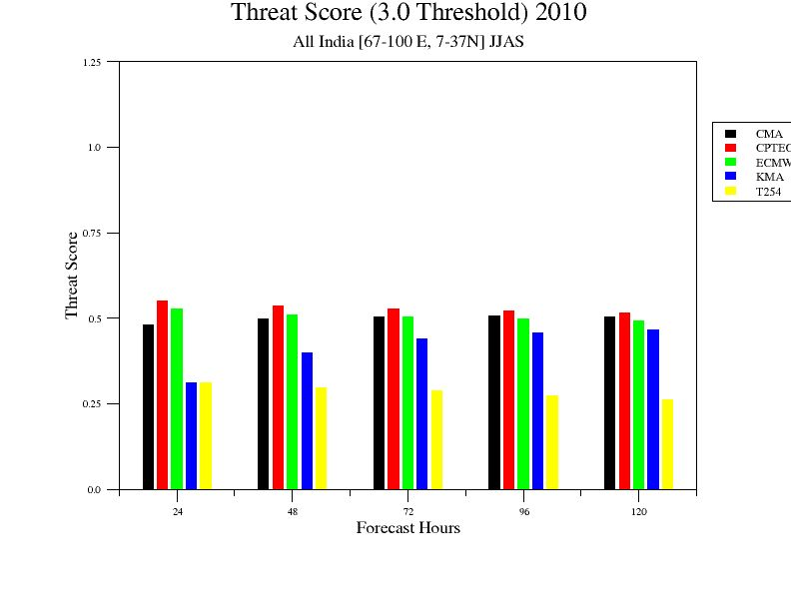
Sample Plots
xmGrace

Slide 43


More Statistical Functions & Plots
- 1
+1
Correlation
Variance, Lanczos Filtered Variance,
EOF, CEOF, EEOF & more

Slide 44
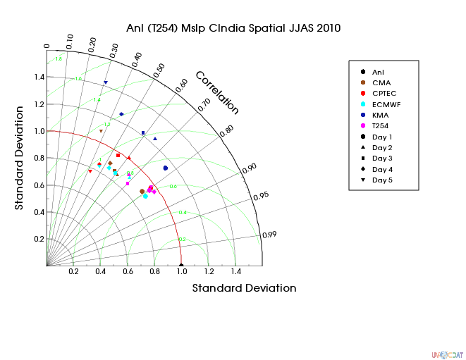
More Statistical Scientific Plots
Multi Model Vs Multi Fcst Hrs Correlation
Taylor Diagram

Slide 45
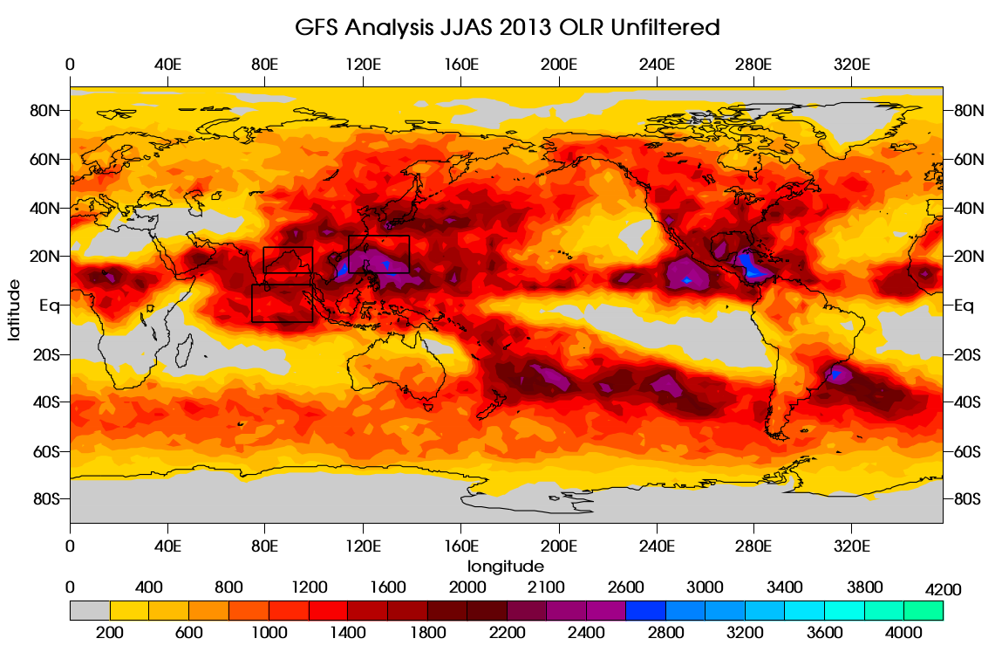
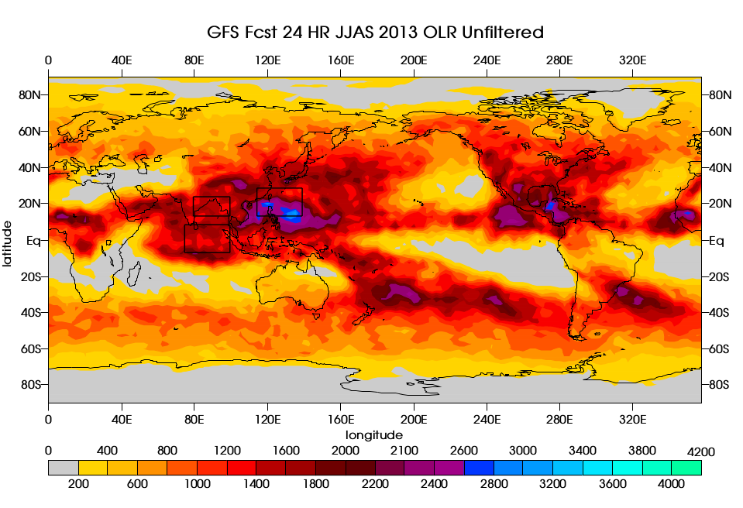
Anomaly Variance

Slide 46
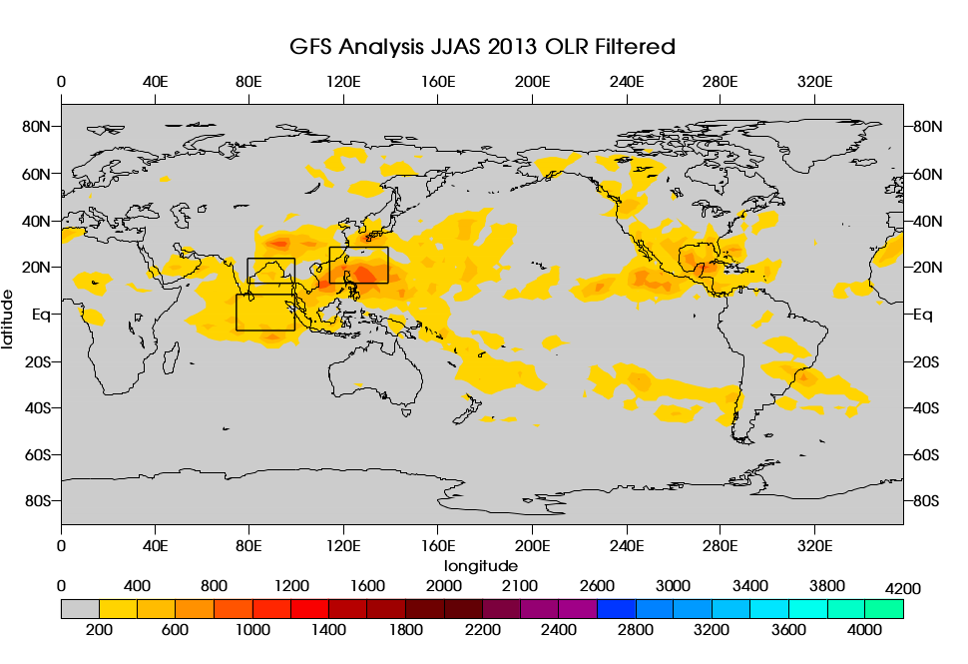
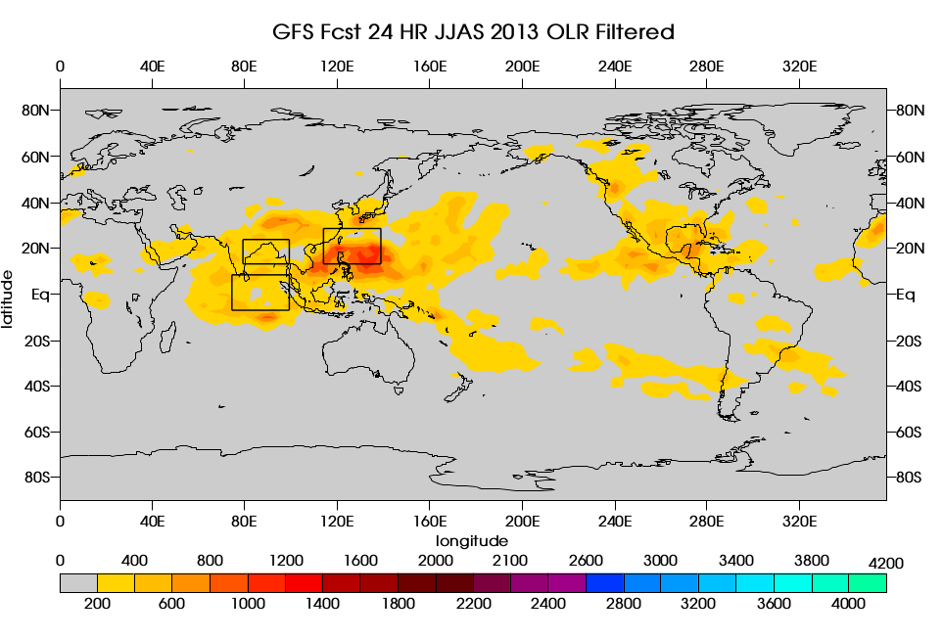
Lanczos Filtered
Anomaly Variance
90 – 120 days filter
201 Weights

Slide 47
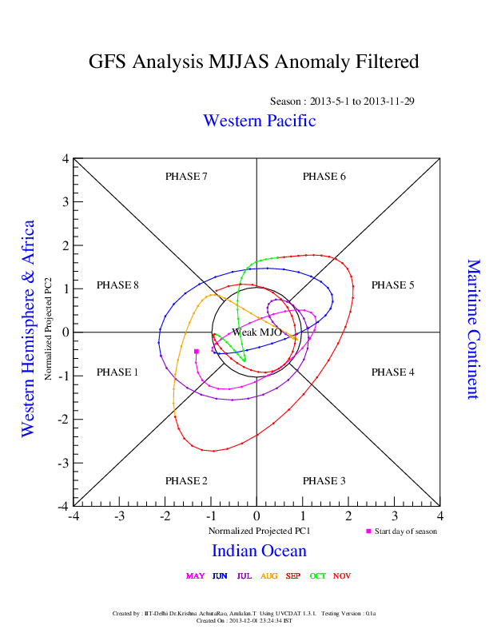

Slide 48
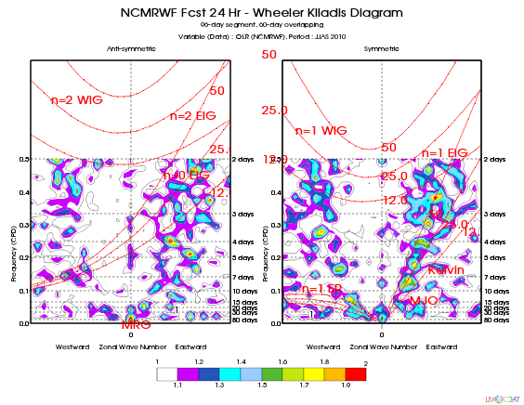

Slide 49
Parallel
One Liner Embarrasing Parallel
Python

Slide 50
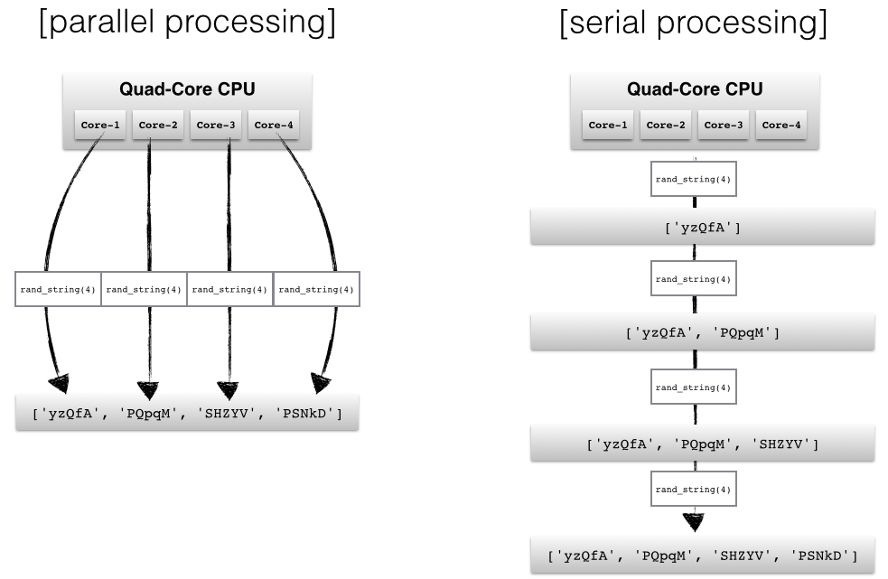

Slide 51
3D, 4D
Visualization
Python

Slide 52
SCIENCE IS SEXY
Source : https://github.com/mjucker/pv_atmos
Jucker, M 2014. Scientific Visualisation of Atmospheric Data with ParaView. Journal of Open Research Software 2(1):e4, DOI: http://dx.doi.org/10.5334/jors.al.

Slide 53
SCIENCE IS SEXY
Source : https://github.com/mjucker/pv_atmos
Jucker, M 2014. Scientific Visualisation of Atmospheric Data with ParaView. Journal of Open Research Software 2(1):e4, DOI: http://dx.doi.org/10.5334/jors.al.

Slide 54
My
Visualization
Contribution
To
UV-CDAT

Slide 55
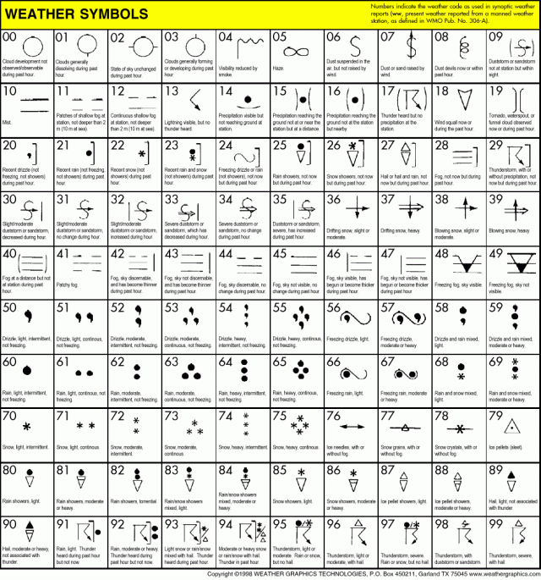
World Meteorological Organization Weather Symbols

Slide 56
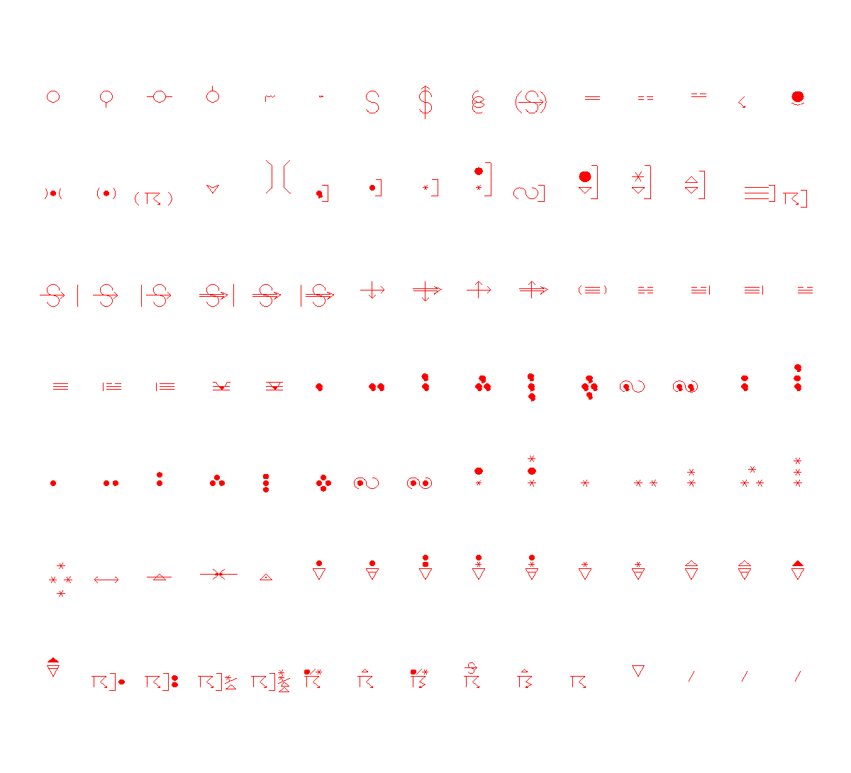
WMO Weather Symbols in UVCDAT Created by me

Slide 57
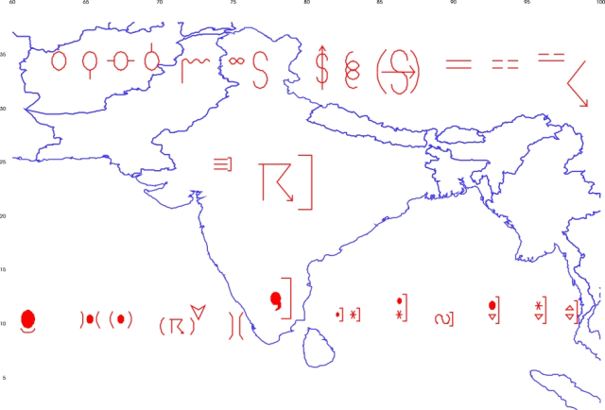
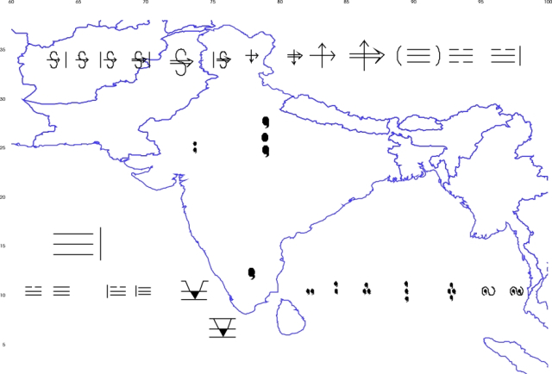
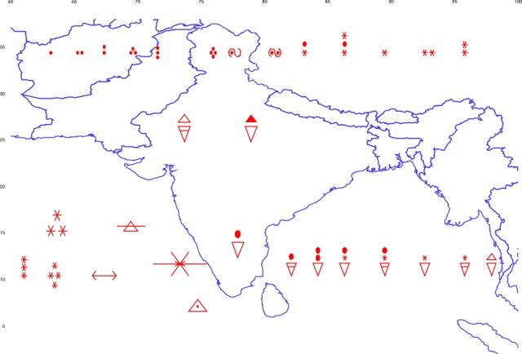
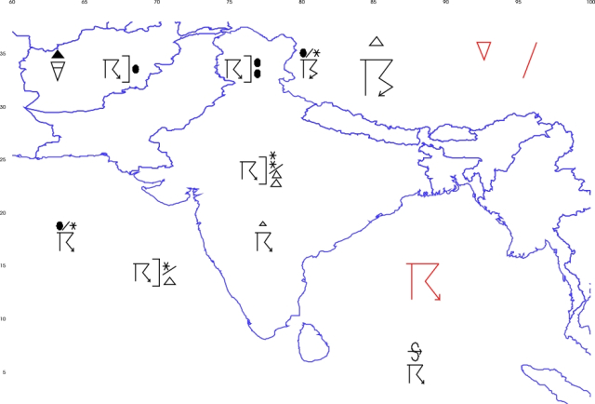
WMO Weather Symbols in UVCDAT Created by me

Slide 58


Plant
Save

Slide 59



