Slide 1

Welcome
Data Skills 1
Week 2: Maths recap

Slide 2
Today’s lesson
Reading and writing whole numbers
Rounding whole numbers
Adding whole numbers
Subtracting whole numbers
Using a calculator
Multiplying whole numbers (using a calculator)
Dividing whole numbers (using a calculator)
Language for maths

Slide 3

1. Reading and writing whole numbers

Slide 4

Key terms
Whole numbers: a number from the set of numbers including zero: 0, 1, 2, 3, 4…….
Integers: the set of numbers that includes the positives of whole numbers, the negatives of whole numbers, and zero.

Slide 5
Practice
Which of the following are not whole numbers?
5
-14
20.5
9,483
23,976
153,725
300,000,000
205,309,841.2
124,996,348,771

Slide 6
Answers
5
-14
20.5
9,483
23,976
153,725
300,000,000
205,309,841.2
124,996,348,771

Slide 7
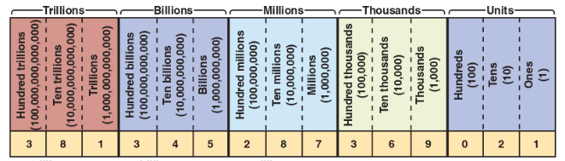
The place-value system
Reading numbers is based on an understanding of the place-value system. The chart below shows that system applied to a very long number!

Slide 8
How to read a whole number
Identify the value name of the leftmost value.
For each value, beginning with the leftmost value, read the three-digit number from left to write.
Values

Slide 9
Examples
7,835
111,356,075
17,000,017,000
Seven thousand, eight hundred and thirty-five
One hundred and eleven million, three hundred and fifty-six thousand
and seventy-five
Seventeen billion, seventeen thousand
***Difference between British and American English: Generally speaking, in British English we usually connect large numbers with double or single digit figures with and, but in American English and is not used***
Ref. englishlessonsbrighton.co.uk

Slide 10
Big number bingo!
We’re going to practice our understanding of large numbers.
Step 1: Draw a 3x3 grid on a piece of paper or on your computer.
Step 2: Go to the document called ‘Bingo!’ on the week 2 tile and write or copy and paste nine of the numbers on to your grid.

Slide 11
How to write large numbers
Record the numbers from left to write.
Insert a comma after the value name.
Example: 12567890
12,567,890
Twelve million, five hundred and sixty seven thousand, eight hundred and ninety.

Slide 12
Practice
Write the numbers for the following.
A Fortune 500 company reported gross sales of eighteen billion, seventy-eight million, three hundred and ninety-seven thousand, two hundred and three dollars.
Jason’s annual salary is thirty-six thousand and seventeen dollars.
Krispy Kreme had profits of nine hundred and thirty-two thousand, eight hundred and six dollars.
Jet Blue, one of the nation’s most profitable airlines, sold fifty-two thousand, eight hundred and ninety-six tickets.

Slide 13
Answers
1. A Fortune 500 company reported gross sales of eighteen billion, seventy-eight million, three hundred and ninety-seven thousand, two hundred and three dollars.
$18,078,397,203
2. Jason’s annual salary is thirty-six thousand and seventeen dollars.
$36,017
3. Krispy Kreme had profits of nine hundred and thirty-two thousand, eight hundred and six dollars.
$932,806
4. Jet Blue, one of the nation’s most profitable airlines, sold fifty-two thousand, eight hundred and ninety-six tickets.
52,896
Notes:
Answer #1: point out that the zero is often not included when the value is less than 100 million, so $18,78,397,203 is also fine.

Slide 14
2. Rounding whole numbers

Slide 15
Rounding whole numbers
Exact numbers are not always necessary or desirable. For example, a board of directors does not want to know to the penny how much was spent on office supplies (although the accounting staff should know!). Approximate or rounded numbers are often used instead.
A rounded number does not represent an exact amount. It is instead an approximate number. You round a number to a specified place, which may be the first digit from the left of the number.

Slide 16
How to round whole numbers
Step 1: Locate the place to which the number is to be rounded. Draw a line under that place.
Step 2: If the first digit to the right of the underlined place is 5 or more, increase the digit in the place to which you are rounding by 1. If the first digit to the right of the underlined place is 4 or less, do not change the digit in the place to which you are rounding.
Step 3: Change all digits to the right of the underlined digit to zeros.

Slide 17
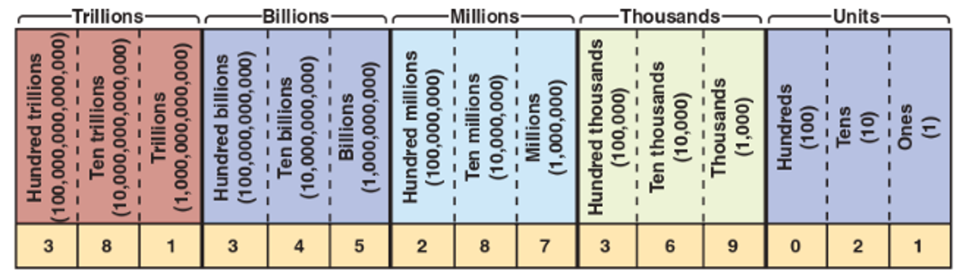
Example
Round 579 to the nearest 10.
Step 1: 579.
Step 2: ‘9’ is above 5, so increase ‘7’ by 1.
Step 3: Change digits to the right of the underlined digit to zero.
Answer: 580

Slide 18
Practice
Round the following. Use the values chart on the previous slide to help you.
57 to the nearest ten.
117 to the nearest hundred.
6,088 to the nearest ten.
52,973 to the nearest hundred.
3,784,921 to the nearest thousand.
17,439 to the nearest ten thousand.
584,917 to the nearest hundred thousand.
18,432,987 to the nearest million.

Slide 19
Answers
1. 57 to the nearest ten.
60
2. 117 to the nearest hundred.
100
3. 6,088 to the nearest ten.
6,090
4. 52,973 to the nearest hundred.
53,000
5. 3,784,921 to the nearest thousand.
3,785,000
6. 17,439 to the nearest ten thousand.
20,000
7. 584,917 to the nearest hundred thousand.
600,000
8. 18,432,987 to the nearest million.
18,000,000

Slide 20
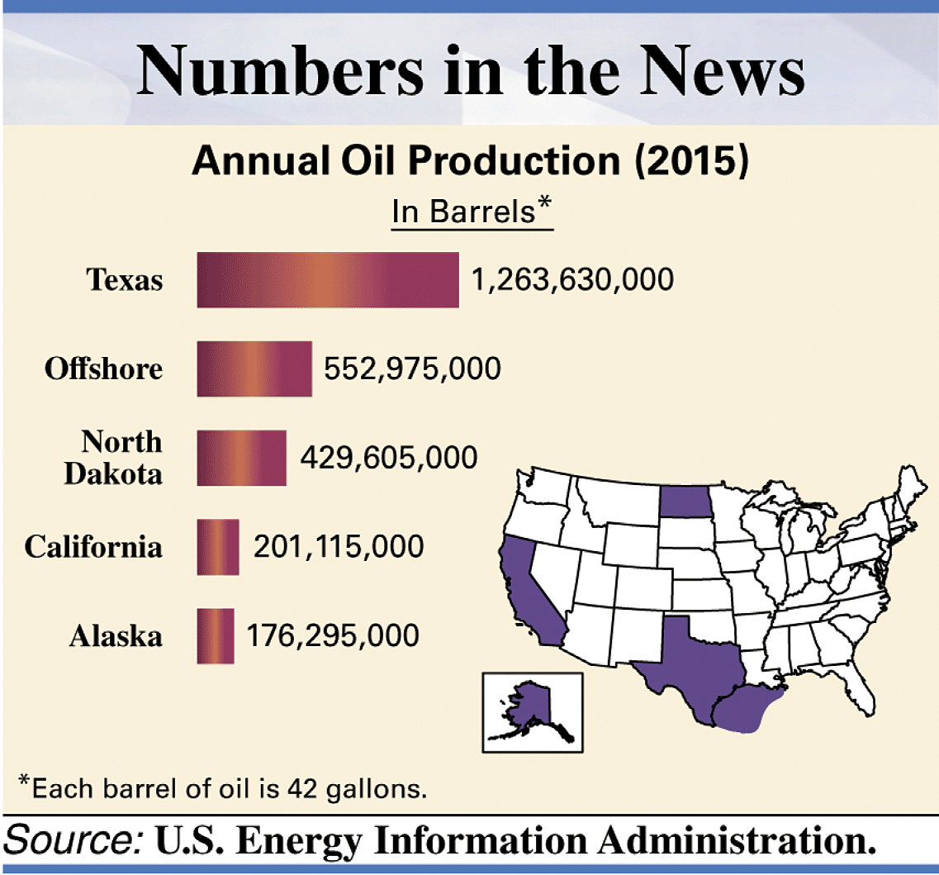
Front-end rounding
Front-end rounding is used to provide an estimate. It involves rounding the first digit and changing the others to zeros.
The graphic below shows the top oil producing areas in the U.S. We can apply front-end rounding to estimate total oil production from these areas.

Slide 21
Results
State Actual Front-End Rounded
Texas 1,263,630,000 1,000,000,000
Offshore 552,975,000 600,000,000
N. Dakota 429,605,000 400,000,000
California 201,115,000 200,000,000
Alaska 176,295,000 200,000,000
2,623,620,000 2,400,000,000
How would you say both totals?

Slide 22

Let’s take a break

Slide 23
3. Adding whole numbers

Slide 24
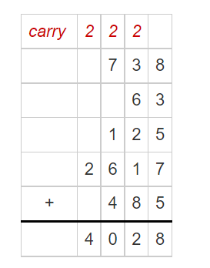
Adding Whole Numbers
With addition, the numbers being added are called addends, and the answer is the sum, or total, or amount.
It is easy to do this manually: align numbers in columns according to their place value and add vertically. If the total in one column goes above 10, add 1 to the column to the left. If it goes above 20, add 2, and so on and so forth.

Slide 25
Practice
Complete the following additions, manually:
46 + 93
728 + 3441
751,097 + 12,847
999,999 + 306,523

Slide 26
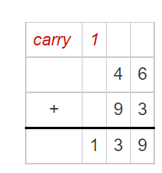
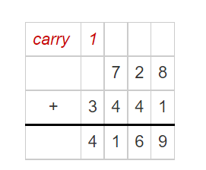
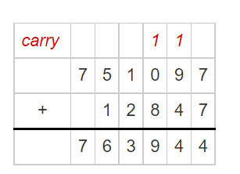
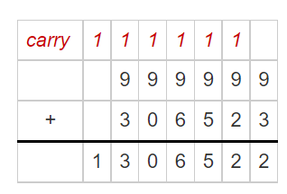
Answers
a. b. c.
d.

Slide 27
4. Subtracting whole numbers

Slide 28
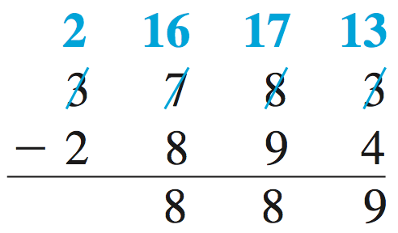
Manual Subtraction
A subtraction problem is set up much like an addition problem. The top number is the minuend, the number being subtracted is the subtrahend, and the answer is the difference.
When a digit in the subtrahend is larger than the corresponding digit in the minuend, use a method called borrowing: add 10 to the minuend, then subtract one from the minuend in the column to the left.
Notes:
In this example, the tens are borrowed from the hundreds column, and the hundreds are borrowed from the thousands column.

Slide 29
Practice
Complete the following subtractions, manually:
716 - 382
40,285 – 33,571
3,050,742 - 999,999

Slide 30
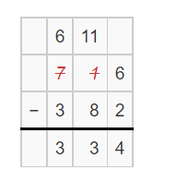
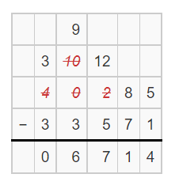
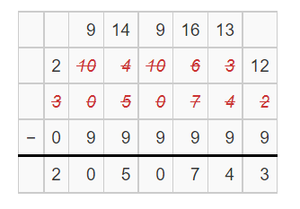
Answers
a. b. c.
Notes:
Depending on the level of your students, you may need to go through this several times. There are different ways of displaying the ‘borrowed’ numbers.

Slide 31
5. Using a calculator

Slide 32
Using a calculator
Whereas addition and subtraction can be done quite easily, manually, the same is not the case for many maths problems, including multiplication and division.
You will be happy to know that you can use a calculator throughout the module, including during the exam!
Your laptop/tablet/smart phone will have a calculator that is adequate for the most tasks.

Slide 33
Basic functions
The following video introduces you to the basic functions of the type of calculator found on a PC.
https://youtu.be/x-2HjO4iGXI
Watch from: 0.00-1 minute 15 seconds
Then watch from: 2 minutes 43 seconds to 4 minutes 20 seconds
We will look at other functions of the calculator as we go through the module.

Slide 34
6. Multiplying whole numbers using a calculator

Slide 35
Practice
Multiply the following numbers using a calculator:
346 x 498 (Give the exact answer first, then round to the nearest hundred)
12,519 x 11,987 (Give the exact answer first, then round to the nearest hundred thousand)
190 x 45,670 (Give the exact number first, then round to the nearest million)

Slide 36
Answers
Multiply the following numbers using a calculator:
346 x 498
172,308 or 172,300 rounded to nearest hundred
12,519 x 11,987
150,065,253 or 150,100,000 rounded to nearest hundred thousand
190 x 45,670
8,677,300 or 9,000,000 rounded to nearest million

Slide 37
7. Dividing whole numbers using a calculator

Slide 38
Practice
Total sales at a car boot sale were £3,584. The money was divided equally among the:
boys' football club
girls’ football club
boys’ softball team
girls’ softball team
Use a calculator to work out how much each group received.

Slide 39
Answer
£3584 divided by 4.
Each group will get £896

Slide 40
8. Language for maths

Slide 41
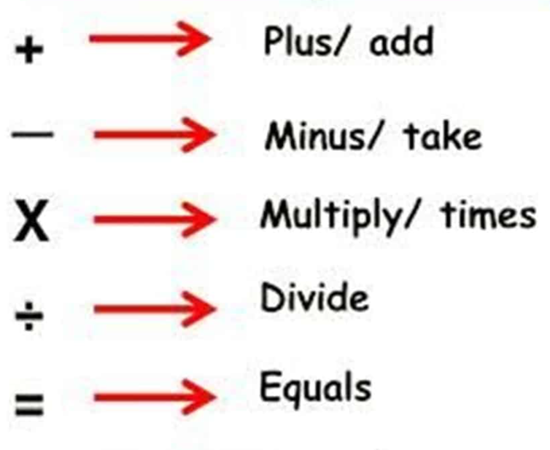
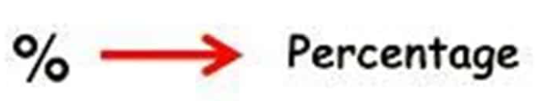
Common words in maths
Mathematics has its own vocabulary. Especially if English is not your first language, you may be unfamiliar with some of the words used. Throughout the course, you will develop your vocabulary of maths related terminology.
On the right are a few of the words/symbols we have been using in today’s lesson. We will use new words, each lesson.

Slide 42
Homework
Complete the Week 2 quiz on the VLE.
Read through the Week 2 PPT for anything you didn’t understand.

Slide 43
End of Week 2

