Slide 1

Department of Computer Science and Engineering
191CS67A – Mini Project Work – Review I
EXPERT CARDIOVASCULAR DISEASE PREDICTION USING MACHINE LEARNING
Guided by,
Ms. Mythili.B
Dept of CSE.
Team Members:
AJAY ABISHEK .T.K – 113121UG03007
ARULJOTHI.S – 113121UG03012
MUTHURAJ.C- 113121UG03071
Batch No: 12
Date : 09/07/2024

Slide 2
OUTLINE OF THE PRESENTATION
Problem Statement
Objective
Abstract
Introduction
Existing System
Proposed System
Architecture Diagram
Requirements
Implementation Module
References

Slide 3
Problem Statement
To automate the heart disease prediction process (real-time) based on customer detail provided while filling out online data .
These details are Gender, age , FBS, cps, cholesterol, BP and others, To automate this process, they have provided a dataset to identify the whether a person who affect to heart disease or not
problem: binary problem heart disease has to predict Yes or No
Yes: affected
No: not affected

Slide 4
Objective
Compile patient data for cardiac tests to develop predictive models for cardiac disease risk.
Analyze demographics and clinical features to inform prevention strategies.
Standardize algorithm for reliable data analysis.
Used advanced statistics to create precise predictive models for cardio vascular disease risk.

Slide 5
Abstract
Cardiovascular diseases (CVDs) uses machine learning algorithms to analyze medical data and detect patterns that could suggest potential heart problems. Early detection and accurate risk assessment are crucial for effective prevention and management of CVDs.
In this project, we propose a machine learning-based approach to develop a predictive model for cardiovascular disease risk assessment that enables early detection and ultimately save life's and cost.

Slide 6
Introduction
This CVDs predicts heart disease risk using machine learning models, analyzing various health factors.
It evaluates the accuracy of decision trees, random forests, and logistic regression for heart disease prediction.
Users can input personal health data to receive instant predictions about heart disease likelihood.
With stratified sampling and thorough model evaluation, it ensures reliable predictions for proactive healthcare.

Slide 7
Existing System
In the past, the diagnosis of heart disease was primarily based on medical history, physical examination, and electrocardiography.
ECG measures the electrical activity of the heart and can detect abnormal heart rhythms, damage to the heart muscle, and other signs of heart disease but some times it need further clarification.
Current diagnostic tools for heart disease lack precision, necessitating the development of more accurate methods.
Enhancing diagnostic approaches is critical to address limitations in identifying subtle signs of heart disease progression.

Slide 8
Proposed system
1. Proposed System: Implementing a machine learning-based predictive model to improve heart disease diagnosis precision.
2. Benefits: Enhances diagnostic accuracy, enabling early detection and personalized treatment plans.
3. Ease of Use: Simplifies diagnosis with automated analysis of patient data, aiding healthcare professionals in decision-making.
4.Patient Impact: Empowers patients with timely detection and proactive management strategies, improving overall health outcomes.

Slide 9
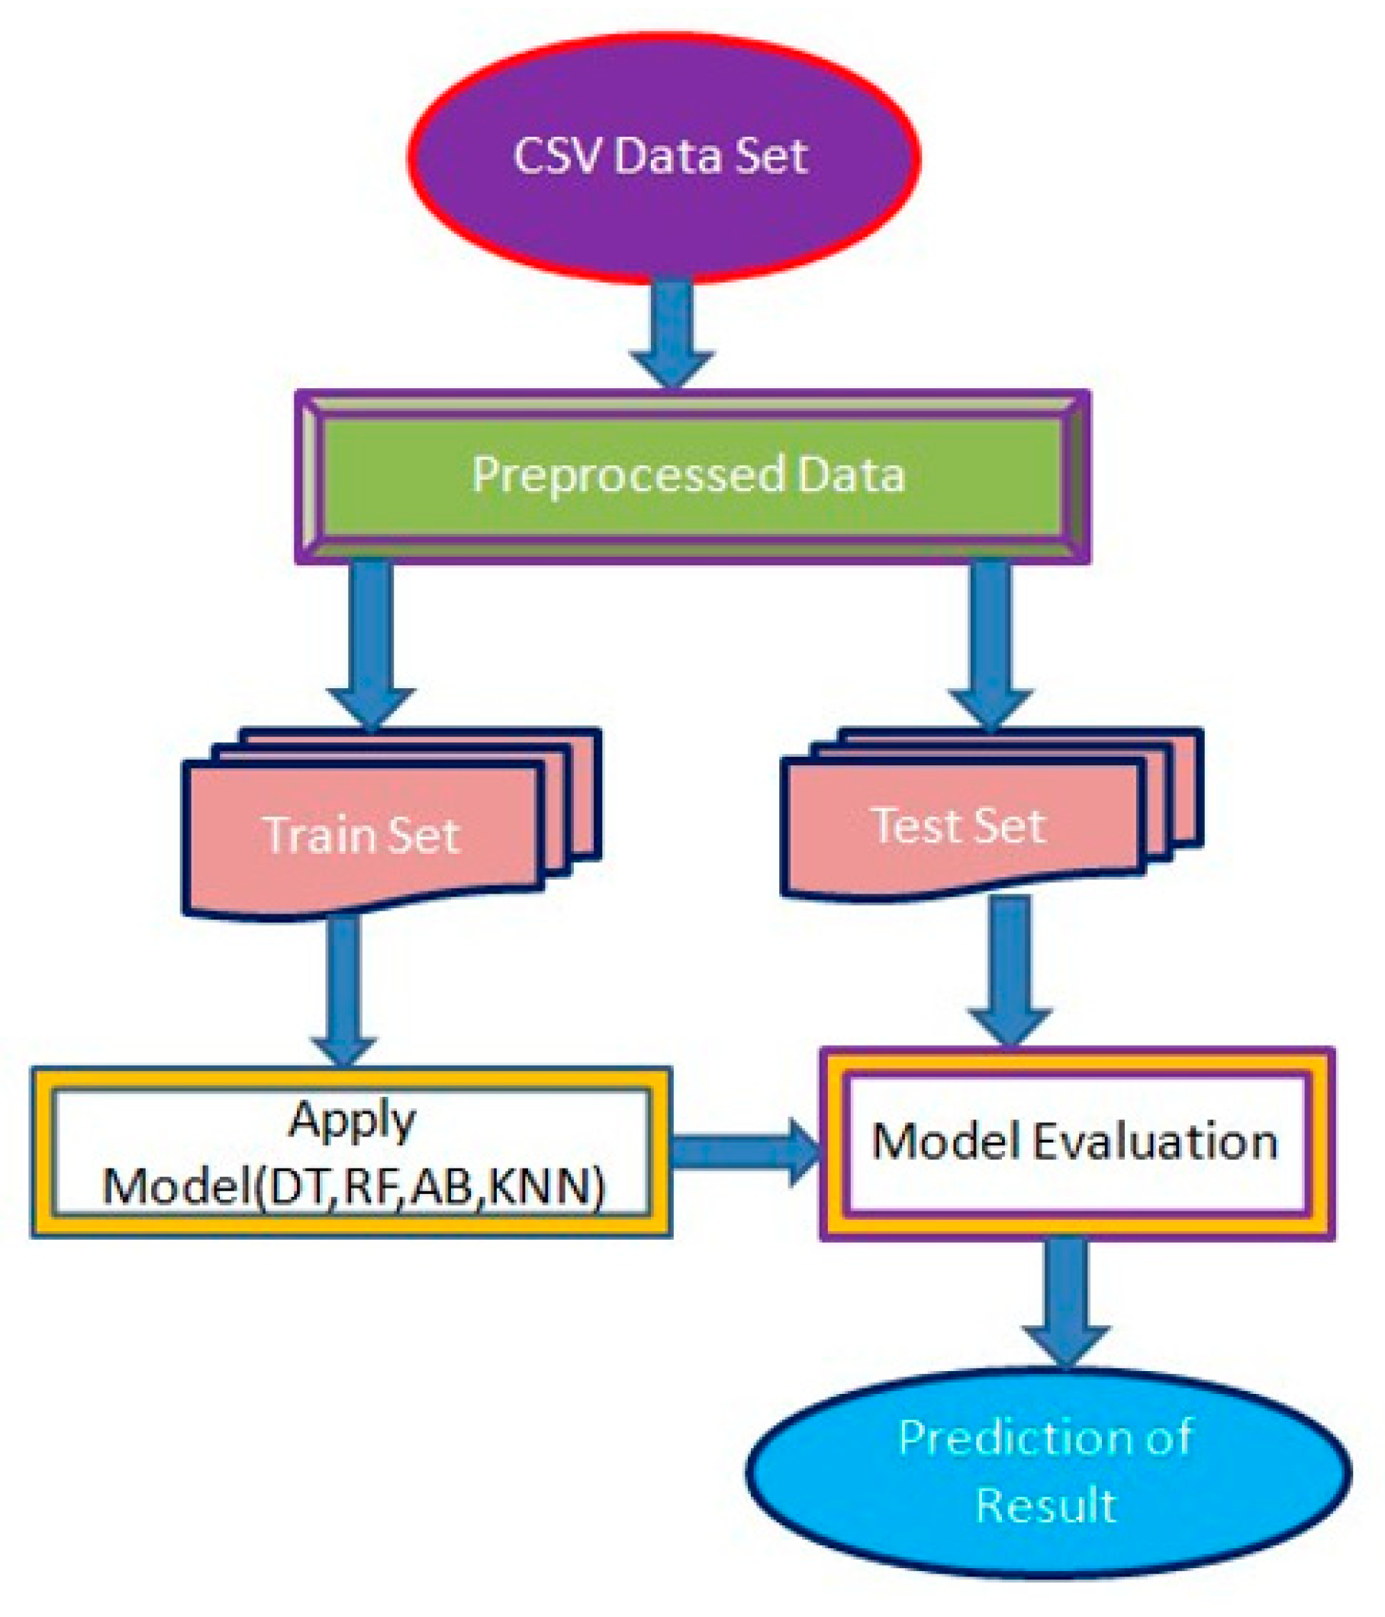
Architecture Diagram

Slide 10

SW/HW Requirements
HARDWARE REQUIREMENTS:
Windows 10
Minimum RAM 2GB
Intel core i5 processor
SOFTWARE REQUIREMENTS:
Visual studio code
Python

Slide 11
IMPLEMENTED MODULES:
RANDOM FOREST
supervised machine learning algorithms, used for classification.
Random Forest is a classifier that contains a number of decision trees on various subsets of the given dataset and takes the average to improve the predictive accuracy of that dataset.

Slide 12
NAIVE BAYES
supervised machine learning algorithms, based on Bayes theorem and used for classification problem.
It is a probabilistic classifier, which means it predicts on the basis of the probability of an object.

Slide 13
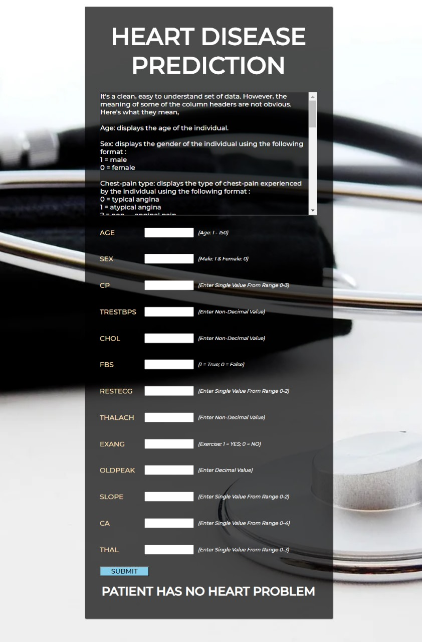
LOGIN PAGE

Slide 14
References
National Heart, Lung, and Blood Institute. (2021). What Are the Signs and Symptoms of Heart Disease? Retrieved from https://www.nhlbi.nih.gov/health-topics/what-are-signs-and-symptoms-heart-disease
World Health Organization. (2021). Cardiovascular Diseases (CVDs). Retrieved from https://www.who.int/news-room/fact-sheets/detail/cardiovascular-diseases-(cvds)
Mozaffarian, D., Benjamin, E. J., Go, A. S., Arnett, D. K., Blaha, M. J., Cushman, M., ... & Turner, M. B. (2016). Executive summary: Heart disease and stroke statistics—2016 update: a report from the American Heart Association. Circulation, 133(4), 447-454.
Dey, D., Slomka, P. J., Leeson, P., Comaniciu, D., Shrestha, S., Sengupta, P. P., ... & Marwick, T. H. (2016). Artificial intelligence in cardiovascular imaging: JACC state-of-the-art review. Journal of the American College of Cardiology, 73(11), 1317-1335

Slide 15
THANK YOU!

