Slide 1
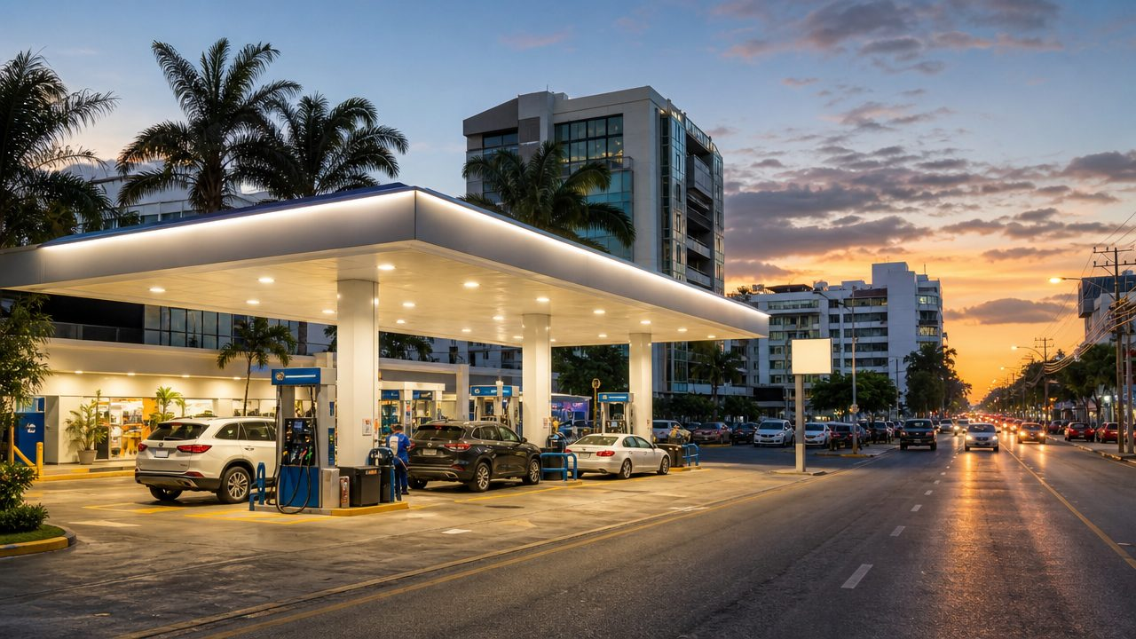
SPONSOR-BANK BRIEFING · DOMINICAN REPUBLIC
Card acceptance built for gasoline stations.
Bombero Partners: a fuel-retail acquiring program for the Dominican Republic, cleared in US dollars and operated by Wallet Partners LLC under the sponsorship of a licensed member bank.
Wallet Partners LLC d/b/a Bombero Partners · bomberopartners.com.do · September 2026 · Confidential
Notes:
Opening. Frame the meeting: we are asking for sponsorship of a vertical acquiring program, we bring a launch cohort of 20 stations and a pricing model the segment has publicly asked for.

Slide 2



Executive summary
Three things to take away from this briefing
The moment
The program
The ask
In July 2026 fuel retailers (ANADEGAS) threatened to pull card terminals from 780+ stations over 1.95–2.50% fees.
Those fees equal RD$6.59–8.45 per gallon: 25–36% of a State-set RD$25 gross margin.
Government-brokered talks with the banks are ongoing; the segment asked for per-gallon pricing.
Wallet Partners LLC, trading in the DR as Bombero Partners, operates as payment facilitator / program manager under your membership and oversight.
Merchant pricing 25 bps below each station's current contract, no monthly minimum, terminals on monthly rental, transactions cleared in US dollars.
Launch cohort: 20 stations in Santo Domingo's Polígono Central, 9 of them open 24 h.
Sponsorship agreement and registration of Wallet Partners as payment facilitator.
Program settlement account with agreed reserves; merchant approval SLA of 10 business days.
Named relationship and compliance contacts. Target: first live station within one quarter.
Wallet Partners LLC d/b/a Bombero Partners · Sponsor-bank briefing · September 2026 · Confidential
2
Notes:
Keep to 90 seconds. The rest of the deck is evidence for these three columns.

Slide 3
The moment: retailers went public on card fees
Timeline of the June–July 2026 dispute between ANADEGAS and the acquirers
30 Jun
2 Jul
5–6 Jul
7 Jul
8 Jul
20 Jul
ANADEGAS announces members will stop accepting cards, citing 1.95–2.50% commissions.
Vice-President says the Government expects an agreement; press notes similar fights abroad.
Staged removal of terminals from 780+ stations begins. Fees estimated at RD$584 M per month.
After meeting MICM and Pro Consumidor, a 30-day window is agreed. ANADEGAS proposes per-gallon or margin-based fees.
Diario Libre: card payments at stations total about RD$41 bn per year.
ANADEGAS and the banking sector agree to open formal talks on terminal commissions.
Why it matters to a sponsor. The retailers' own numbers show that price, not card acceptance, is the issue. A program priced 25 bps below each station's current contract, with no monthly minimum, gives a bank a defensible way to grow fuel-segment volume while the incumbents are locked in a public dispute with the segment.
Wallet Partners LLC d/b/a Bombero Partners · Sponsor-bank briefing · September 2026 · Confidential
3
Notes:
Sources: Listín Diario 30 Jun 2026; Diario Libre 2, 5, 6, 7, 8 and 20 Jul 2026; Infobae 8 Jul 2026. Full list in the appendix.

Slide 4
Card fees take a quarter to a third of gross margin
Pesos per gallon: acquirer fee versus what the station keeps, on a regulated gross margin of about RD$25
25–36%
of gross margin goes to card fees
ANADEGAS, July 2026
RD$6.59–8.45
per gallon at 1.95–2.50%
Infobae / Diario Libre, Jul 2026
RD$5–6 bn
paid yearly in commissions by stations
≈RD$584 M per month
Wallet Partners LLC d/b/a Bombero Partners · Sponsor-bank briefing · September 2026 · Confidential
4
Notes:
Retail price and retailer margin are fixed weekly by the Ministry (MICM). A percentage fee therefore rises with pump prices while the margin does not. Bars use ANADEGAS per-gallon figures against a RD$25 margin.

Slide 5
The card economy keeps compounding
Banco Central data: a payments market still early in its shift from cash
RD$1.07 tn
63.6%
value of card payments, 2025
cards' share of value settled
+12.8% year on year
retail instruments, 2025
757 / 373
19,038
debit / credit cards per 1,000 people
POS terminals per million people
Q1 2026
Q1 2026
≈75%
81
of payments still made in cash
e-payment accounts per 1,000 (from 62)
Diario Libre, Dec 2025
Q1 2026, +31%
Wallet Partners LLC d/b/a Bombero Partners · Sponsor-bank briefing · September 2026 · Confidential
5
Notes:
Sources: elDinero (BCRD) for 2008/2025 transaction counts; Invertix (BCRD) for 2025 value and instrument shares; Infobae 25 Apr 2026 for Q1 2026 bulletin figures; Diario Libre 4 Dec 2025 for cash share.

Slide 6



Fuel retail: regulated, price-controlled, high volume
A concentrated market with three incumbent acquirers and no vertical product
≈1,025 stations
Three acquirers
Weekly price setting
ANADEGAS estimate for the country; 780+ affiliated. MICM approved 33 new stations and LPG plants in 2024–Oct 2025 and keeps an open registry. Every new licence must pick an acquirer on day one.
CardNET (bank-owned), AZUL (Grupo Popular, 2014) and Visanet Dominicana. All three price fuel like any other retail category; none offers a fuel-specific program, fleet cards or forecourt integration.
MICM publishes retail prices every week. 2025: premium RD$290.10, regular RD$272.50 per gallon. Price and margin are fixed; the percentage fee is the only cost the station cannot control.
Indicator | Value | Period
Card payments at fuel stations | ≈RD$41,000 MM per year | 2026 (Diario Libre)
Commissions paid by stations | ≈RD$584 MM / month; RD$5–6 bn / year | 2026 (Diario Libre)
Fee per transaction | 1.95%–2.50% | 2026 (ANADEGAS)
Implied card volume per station | ≈RD$40 MM / year (≈RD$3.3 MM / month) | RD$41 bn ÷ ≈1,025 stations
Wallet Partners LLC d/b/a Bombero Partners · Sponsor-bank briefing · September 2026 · Confidential
6
Notes:
The per-station figure is a national average; Polígono Central sites are expected to run above it. Use it only as the basis for the scenario slide.

Slide 7
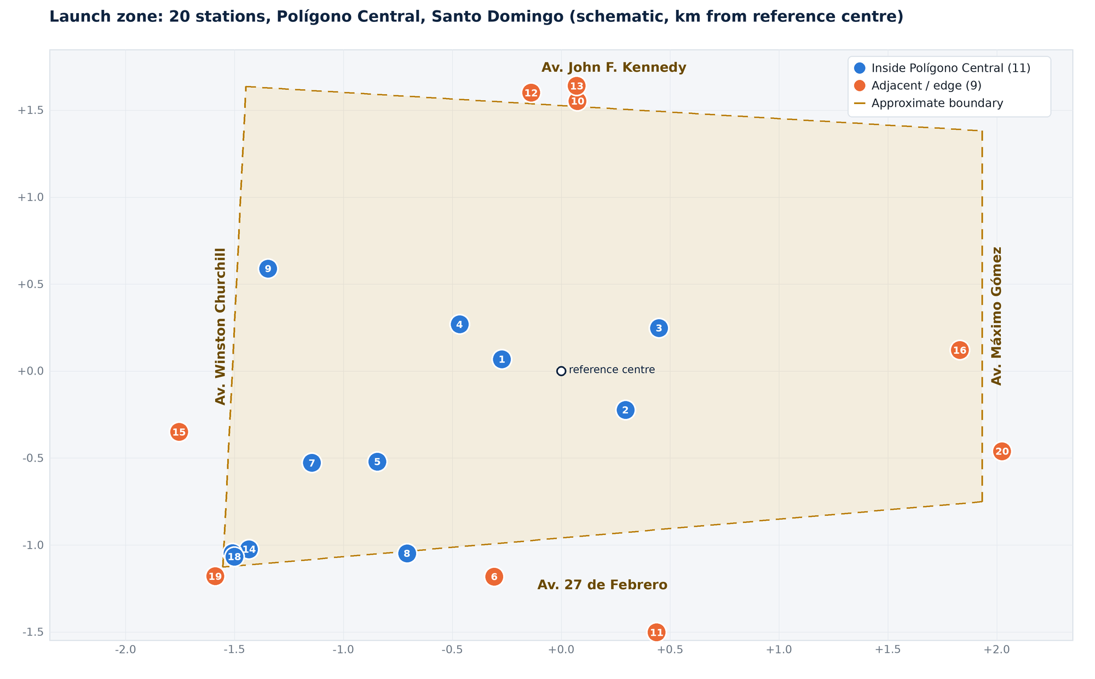
Launch cohort: 20 stations in one district
Santo Domingo's Polígono Central, bounded by Av. Kennedy, 27 de Febrero, Churchill and Máximo Gómez
20
stations within 2.1 km of the centre
11 inside the polygon, 9 adjacent
9
open 24 hours
45% of the cohort
11
fuel brands
TotalEnergies 9, Next 2, nine others
Warm pipeline: these stations have indicated they are ready to sign once the sponsorship and merchant-of-record arrangement are in place. Merchant files are being assembled to the bank's standard.
Wallet Partners LLC d/b/a Bombero Partners · Sponsor-bank briefing · September 2026 · Confidential
7
Notes:
Station list compiled from public map listings on 8 Sep 2026. The polygon is an approximation of the four avenues. Interactive version at /zona/ on the website.

Slide 8
Launch cohort: station list (1 of 2)
Hours and phones from public listings; re-verified during onboarding
# | Station | Brand | Address | Phone | Hours | Zone | km
1 | Estación de Gasolina La Lira | Independiente | Av. Lope de Vega Esq. | — | Abierto 24 horas | Inside | 0.28
2 | TotalEnergies La 27 | TotalEnergies | Av. 27 de Febrero | (809) 227-4300 | Abierto 24 horas | Inside | 0.37
3 | TotalEnergies Tiradentes | TotalEnergies | Av. Tiradentes 49 | (829) 745-3201 | Abierto 24 horas | Inside | 0.51
4 | Next • Lincoln | Next | Av. Abraham Lincoln 504 | — | Abierto 24 horas | Inside | 0.54
5 | TotalEnergies On The Boulevard | TotalEnergies | Av. Winston Churchill 36 | (809) 567-0441 | Cierra 10:00 p.m. | Inside | 0.99
6 | Axxon • Bella Vista | Axxon | Av. Enrique Jiménez Moya (F359+82G) | (809) 532-0880 | Abierto 24 horas | Adjacent | 1.23
7 | Tropigás Piantini | Tropigás | C. Paseo de los Locutores 53 | — | Abierto 24 horas | Inside | 1.26
8 | TotalEnergies Millennium | TotalEnergies | Av. Rómulo Betancourt 267 | (809) 563-5058 | Cierra 12:00 a.m. | Inside | 1.27
9 | TotalEnergies Paraíso | TotalEnergies | Av. Winston Churchill 80 | (809) 567-7737 | Abierto 24 horas | Inside | 1.47
10 | TotalEnergies La Kennedy | TotalEnergies | Av. John F. Kennedy | (809) 227-4300 | Abierto 24 horas | Adjacent | 1.56
Wallet Partners LLC d/b/a Bombero Partners · Sponsor-bank briefing · September 2026 · Confidential
8
Notes:
Distances measured from the reference centre 18.4690, -69.9295. Coordinates and Google Maps links are in the CSV/GeoJSON files.

Slide 9
Launch cohort: station list (2 of 2)
Hours and phones from public listings; re-verified during onboarding
# | Station | Brand | Address | Phone | Hours | Zone | km
11 | Next (Bernardo Correa y Cidrón) | Next | Av. Dr. Bernardo Correa y Cidrón (F34F+5V6) | — | Cierra 11:55 p.m. | Adjacent | 1.57
12 | TotalEnergies Mega | TotalEnergies | Av. Lope de Vega Esq. | (809) 567-2870 | Abierto 24 horas | Adjacent | 1.62
13 | TotalEnergies San Martín | TotalEnergies | Av. San Martín esq. Tiradentes | (809) 227-4300 | Cierra 10:00 p.m. | Adjacent | 1.65
14 | VP Racing Store Santo Domingo | VP Racing | C. Emile Boyrie de Moya | (809) 692-5745 | Cierra 5:00 p.m. | Inside | 1.77
15 | Óptimo Gas | Óptimo Gas | C. Rafael Augusto Sánchez 114 | (849) 876-5977 | Cierra 11:00 p.m. | Adjacent | 1.79
16 | Texaco (Av. Máximo Gómez / F3CQ+24P) | Texaco | F3CQ+24P, Santo Domingo | (809) 682-6899 | Cierra 12:00 a.m. | Adjacent | 1.83
17 | Trovasa Hand Wash & Store | Trovasa | Av. 27 de Febrero 349 | (809) 566-4313 | Cierra 9:30 p.m. | Inside | 1.84
18 | Shell (27 de Febrero) | Shell | Av. 27 de Febrero 349 | (809) 542-4752 | Cierra 8:00 p.m. | Inside | 1.85
19 | Sigma 27 de Febrero | Sigma | Av. 27 de Febrero | (809) 530-8531 | Cierra 12:00 a.m. | Adjacent | 1.98
20 | TotalEnergies Quisqueya | TotalEnergies | Av. Máximo Gómez 2 | (809) 686-7204 | Cierra 11:00 p.m. | Adjacent | 2.08
Wallet Partners LLC d/b/a Bombero Partners · Sponsor-bank briefing · September 2026 · Confidential
9
Notes:
Distances measured from the reference centre 18.4690, -69.9295. Coordinates and Google Maps links are in the CSV/GeoJSON files.

Slide 10




How a transaction flows
Wallet Partners runs the merchant side; the sponsoring bank holds membership, funds and oversight
1
2
3
4
5
Customer pays at the forecourt
Authorisation
Settlement
Reporting
Disputes and risk
Attendant keys the sale or the pump controller pushes it to a wireless EMV/contactless terminal. Stripe disabled by policy.
›
P2PE-encrypted transaction goes through our certified gateway to the bank's acquiring host and on to Visa, Mastercard or domestic debit under the bank's BINs.
›
Networks settle to the bank's program account in US dollars. We pay each station in dollars, net of the agreed rate.
›
Stations reconcile by shift and pump; the bank gets portfolio dashboards, exception reports and regulatory data.
›
Chargebacks worked under network rules; per-station reserves and velocity limits protect the bank's exposure.
Wallet Partners LLC d/b/a Bombero Partners · Sponsor-bank briefing · September 2026 · Confidential
10
Notes:
Settlement (step 3) is highlighted because it is where the bank's control sits: the program account is the bank's, reserves are set with the bank, and Wallet Partners never holds merchant funds outside it.

Slide 11
Who does what
Division of responsibilities between Wallet Partners LLC and the sponsoring bank
Function | Wallet Partners LLC | Sponsoring bank
Card-network membership and BINs | — | Holds membership; registers Wallet Partners as payment facilitator
Merchant prospecting and sales | Owns pipeline and station relationships | —
Merchant KYC/KYB and underwriting | Collects documents, screens owners and sanctions lists, prepares file | Approves, conditions or declines each merchant
Terminals and integration | Supplies certified EMV/contactless terminals; installs and supports | Certifies terminal and gateway on its host
Pricing to the station | Quotes 25 bps below the station's current contract, no monthly minimum, terminal rental | Approves pricing floors and interchange pass-through
Settlement | Pays stations in US dollars from program account; maintains reserves | Settles network funds into program account; controls the account
Transaction monitoring and AML | First-line monitoring, alerts, escalation | Second-line review; regulatory reporting
Disputes and chargebacks | Representment and merchant recovery | Network-facing dispute processing
PCI DSS | Own compliance; P2PE terminals, no cardholder data stored | Validates Wallet Partners as service provider
Audit and oversight | Records access, monthly reporting, right-to-audit | Periodic reviews; can suspend merchants or program
Wallet Partners LLC d/b/a Bombero Partners · Sponsor-bank briefing · September 2026 · Confidential
11
Notes:
This matrix is the starting point for the sponsorship term sheet. Rows can move; the principle is that the bank keeps approval, funds and oversight.

Slide 12
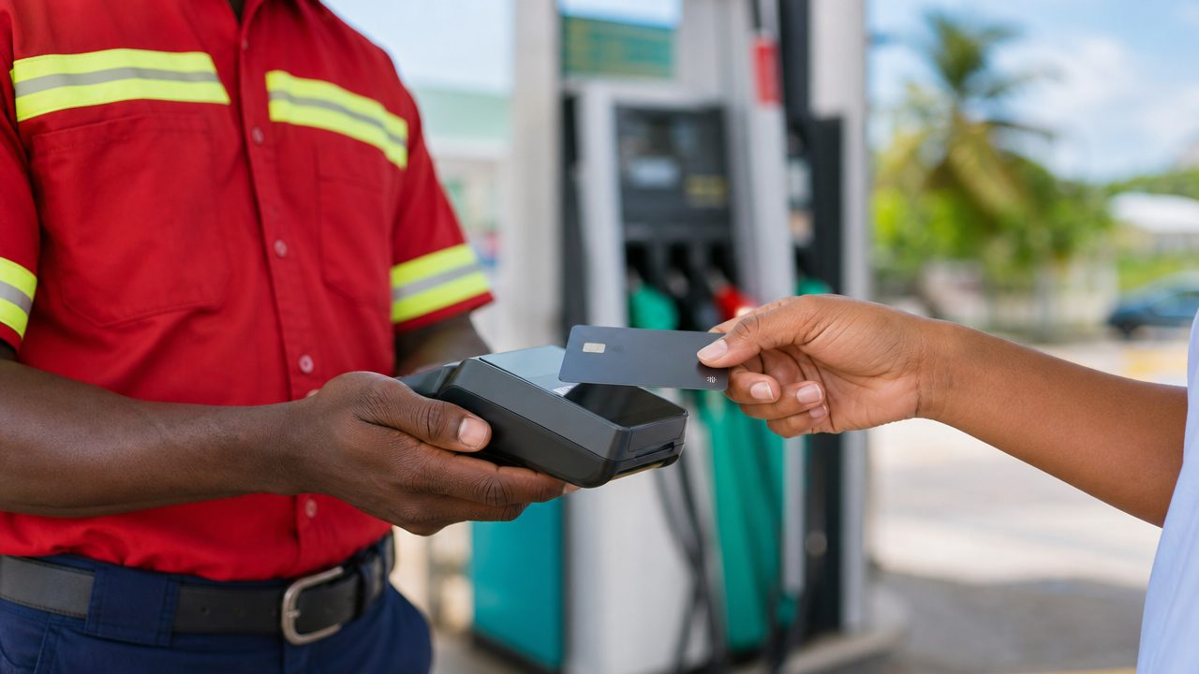




What the station gets
A product built around forecourts, night shifts and a simple price
25 bps below today
Cleared in dollars
Rate 0.25 points below the station's current contract, no monthly minimum; interchange-plus statements the owner can compare line by line.
Transactions cleared in US dollars, per station, with shift-level reconciliation; terminals on monthly rental with replacement included.
Forecourt-ready terminals
Owner dashboard
Rugged wireless EMV/contactless, pre-auth and completion, Spanish prompts, pump-controller integration where supported.
Sales by pump, shift and product; card mix; chargebacks; statements formatted for the accountant and DGII.
Illustrative image
Fraud and dispute desk
Fleet and loyalty ready
Velocity limits per pump and card, EMV liability-shift compliance, disputes worked on the station's behalf.
Phase two adds fleet-card acceptance and station loyalty, with issuing and co-brand upside for the bank.
Wallet Partners LLC d/b/a Bombero Partners · Sponsor-bank briefing · September 2026 · Confidential
12
Notes:
Fleet and loyalty are deliberately phase two: they need the acquiring rails live first and they are where the bank's issuing side can participate.

Slide 13
What the launch cohort could represent
Illustrative scenarios, not a forecast. Assumptions are editable in the website calculator.
Scenario | Annual volume | Gross MDR @1.95% | US$ equiv.
10 stations | RD$396 MM | RD$7.7 MM | US$125 k
20 stations | RD$792 MM | RD$15.4 MM | US$249 k
40 stations | RD$1,584 MM | RD$30.9 MM | US$498 k
Assumptions. Card volume per station RD$3.3 MM per month, the national average implied by RD$41 bn a year across about 1,025 stations; Polígono Central sites are expected to run above it. Effective MDR 1.95%, i.e. 25 bps below a station currently paying 2.20%. Exchange rate RD$62 per US$. Interchange, network fees, terminal costs and the bank's share are not deducted; the revenue split is a negotiation item.
Wallet Partners LLC d/b/a Bombero Partners · Sponsor-bank briefing · September 2026 · Confidential
13
Notes:
Walk through the 20-station case only; the 10 and 40 cases show sensitivity. Merchant pricing is 25 bps below each station's current contract, so the gross MDR shown at 1.95% is a ceiling for stations currently at 2.20%.

Slide 14


Compliance framework
Built to the standard a sponsoring bank's second line will require; validated before the first live transaction
Dominican Republic
United States and international
Law 183-02 and the Monetary Board's Payment Systems Regulation (SIPARD, amended Aug 2025); BCRD oversight, Superintendencia de Bancos supervision of the sponsor.
Law 155-17 AML/CFT: merchant due diligence, beneficial owners at 10%+, monitoring, 5–10 year record-keeping, STRs through the bank to the UAF.
Law 172-13 data protection; Law 358-05 consumer protection (Pro Consumidor).
DGII card-withholding rules (Norma 08-04 and successors) reconciled with the fuel tax regime (Laws 112-00 / 557-05); parameters confirmed with the bank and tax counsel.
Only stations with a valid MICM operating resolution are eligible.
BSA/AML programme aligned with the sponsor; FinCEN registration where applicable; OFAC and sanctions screening of all merchants and owners.
Visa Core Rules and Mastercard Rules for payment facilitators; MCC 5541/5542; AFD authorisation and completion rules; MATCH checks.
PCI DSS v4.0 as a Level 1 service provider; P2PE terminals; no PAN, track or CVV stored.
Information security: segmented cloud, encryption at rest, dual-control keys, MFA, central logging, annual pen test, incident-response plan with agreed notification timelines.
Governance: compliance officer, board-approved policies, annual independent review, staff training, contractual right-to-audit for the bank.
Wallet Partners LLC d/b/a Bombero Partners · Sponsor-bank briefing · September 2026 · Confidential
14
Notes:
Document set available under NDA: AML programme and risk assessment, sanctions procedure, underwriting policy and file template, fuel monitoring rule set, infosec policies and PCI plan, privacy programme, BCP/IR plans, draft sponsorship term sheet and reserve model.

Slide 15
From sponsorship to live stations in one quarter
Staged go-live inside the Polígono Central, then expansion on the same playbook
1
Weeks 1–4
2
Weeks 3–8
3
Weeks 8–12
4
Quarter 2+
Program set-up
Merchant underwriting
Staged go-live
Expansion
Sponsorship agreement; payment-facilitator registration; gateway and terminal certification on the bank's host; program account and reserve structure.
Bank review of the 20 pipeline files; site surveys; connectivity checks; terminal provisioning.
Five stations inside the polygon in wave one, then the remaining fifteen in two waves. Daily settlement and monitoring from the first transaction.
Rest of Distrito Nacional and Santiago; fleet cards; pricing review with the bank against actual interchange.
Wallet Partners LLC d/b/a Bombero Partners · Sponsor-bank briefing · September 2026 · Confidential
15
Notes:
The 10-business-day merchant approval SLA is what keeps weeks 3–8 on schedule.

Slide 16
THE ASK
A sponsorship agreement, then one merchant file at a time.
Proposed next steps
NDA and exchange of the document set (AML programme, underwriting policy, PCI plan, reserve model)
Working session with merchant-acquiring and compliance teams, in English or Spanish
Joint review of three sample merchant files from the cohort
Draft term sheet within 30 days of the working session
Target: first live station within one quarter of signature
Visa and Mastercard acquiring membership in the DR, or a correspondent arrangement permitting program sponsorship
Registration of Wallet Partners LLC as payment facilitator / program manager
Program settlement account with agreed reserve and release terms
Merchant-approval SLA of ten business days per file
A named relationship contact and a compliance contact
info@walletpartnersllc.com · bomberopartners.com.do
Wallet Partners LLC d/b/a Bombero Partners · Confidential
Notes:
Close by agreeing the date for the working session and who from the bank attends.

Slide 17
Appendix: sources
All market figures quoted as published; links current as of 8 September 2026
Listín Diario, 30 Jun 2026 — Dueños de estaciones de combustible retirarán uso verifone para pago automático
Diario Libre, 2 Jul 2026 — RD se suma a los países donde las gasolineras pelean con la banca por comisiones de tarjetas
Diario Libre, 5 Jul 2026 — Anadegas iniciará este lunes el retiro de verifones en más de 780 estaciones
Diario Libre, 6 Jul 2026 — La amenaza de retirar los verifones: ¿en qué consiste el conflicto entre Anadegas y la banca?
Diario Libre, 7 Jul 2026 — Anadegas acuerda plazo de 30 días para solucionar conflicto por pagos con tarjetas
Infobae, 8 Jul 2026 — Plazo de 30 días en República Dominicana para resolver uso de tarjetas en gasolineras
Diario Libre, 8 Jul 2026 — Pagos con tarjetas en estaciones de combustibles suma RD$41,000 MM
Diario Libre, 20 Jul 2026 — Anadegas y la banca iniciarán diálogo sobre comisión de verifones
El Nuevo Diario, 2026 — Anadegas retirará lectores de tarjetas (≈1,025 stations nationwide)
elDinero — Pagos con tarjetas de crédito y débito en RD (BCRD: 117 M transactions in 2008, 806 M in 2025)
Invertix — Sistema de Pago y Liquidación de Valores al cierre del 2025 (BCRD: RD$1,072.5 bn, +12.8%, 63.6% share)
Infobae, 25 Apr 2026 — Cuentas de pago electrónicas +31.3% (BCRD Q1 2026 bulletin: cards and POS per capita)
Banco Central de la República Dominicana — Boletín de Estadísticas de Sistemas de Pago
Diario Libre, 4 Dec 2025 — El 75 % de los pagos de los dominicanos son en efectivo
Mastercard, May 2026 — Estudio sobre el punto de inflexión de los pagos digitales en RD
MICM — Avisos semanales de precios de combustibles (2025 prices)
EHPLUS+ — MICM aprobó 33 estaciones y envasadoras entre 2024 y octubre de 2025
MICM — Datos abiertos: registro de estaciones de combustible 2023–2026
U.S. ITA — Dominican Republic Country Commercial Guide: eCommerce (Cardnet, Visanet, Azul)
Station list: Google Maps search "gasolinera", 8 Sep 2026, 20 nearest to 18.4690, -69.9295
Wallet Partners LLC d/b/a Bombero Partners · Sponsor-bank briefing · September 2026 · Confidential
17
Notes:
Clickable versions of every source are on the website (docs/DATA.md in the repository lists them with URLs).

