Slide 1

Salesforce Smart Health Assistant
Continuous Glucose Monitoring
Intelligent patient support with Agentforce and Data Cloud.
Streamlined glucose data analysis enables proactive care.
Empowering patients and providers through real-time insights.

Slide 2

The Challenge: Reactive Diabetes Management
Traditional Limitations
Patient Struggles
Scheduled visits delay critical diabetes management.
Self-management is often inconsistent and challenging.
Cost Implications
Emergency care costs reach $327B annually in US.

Slide 3

Solution: Smart Health Assistant Overview
Integrated Platform
Proactive Monitoring
Combines Agentforce AI bot with Data Cloud analytics.
Real-time glucose data drives risk assessment.
Patient Engagement
Automated alerts and personalized advice improve outcomes.

Slide 4



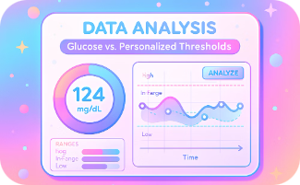
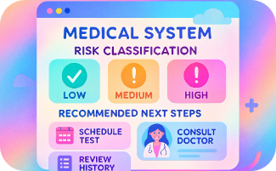
Workflow: From Patient Inquiry to Actionable Insights
Patient Initiates Contact
Bot Identifies Intent & Verifies
Retrieve Real-Time Data
Compare With Thresholds
Engages via chat or voice assistant.
Confirms glucose request through ID validation.
Connected device sends current glucose metrics.
Data Cloud analyzes measurements against personalized values.
Determine Risk & Next Steps
System classifies risk and suggests actions.

Slide 5
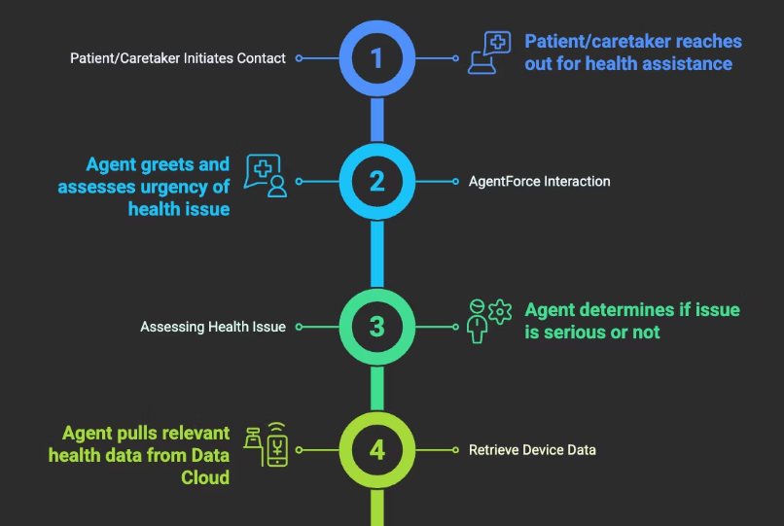
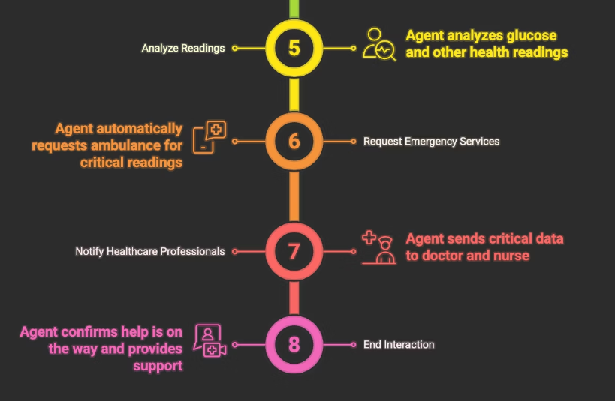
Usecase Lifecycle

Slide 6
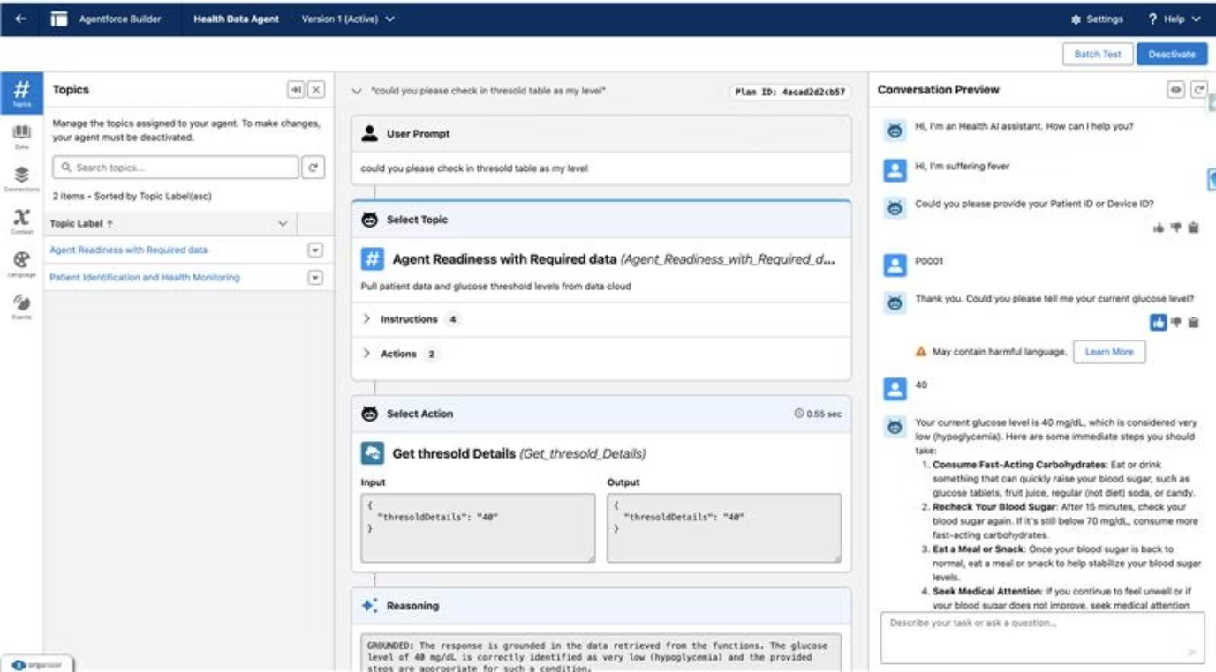

Slide 7
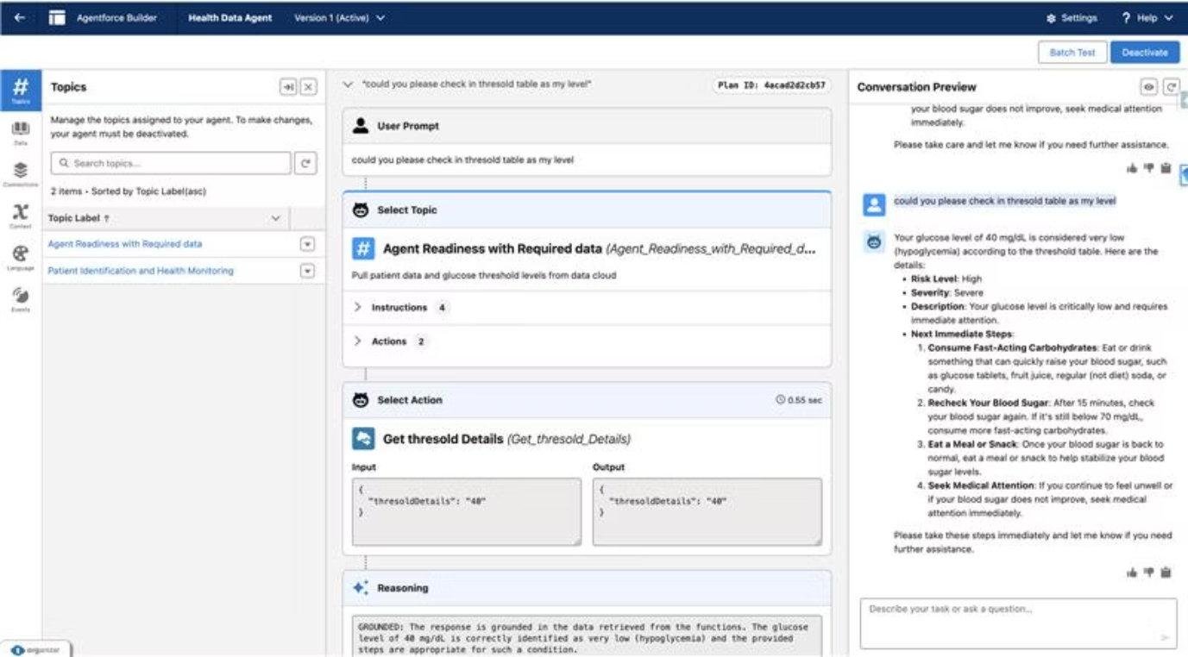

Slide 8



Key Components: Agentforce and Data Cloud Connectors
Agentforce
Data Cloud (Databricks)
Security & Compliance
AI-driven chatbot providing real-time patient engagement.
Centralized platform for patient data ingestion and analysis.
Protecting patient information with stringent regulatory standards.

Slide 9
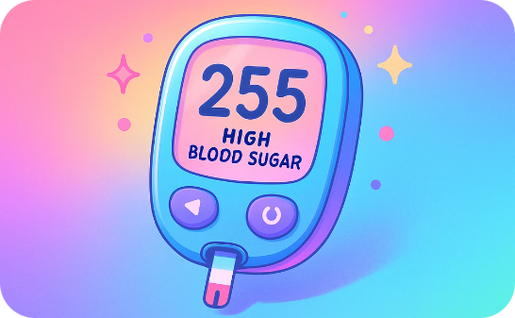
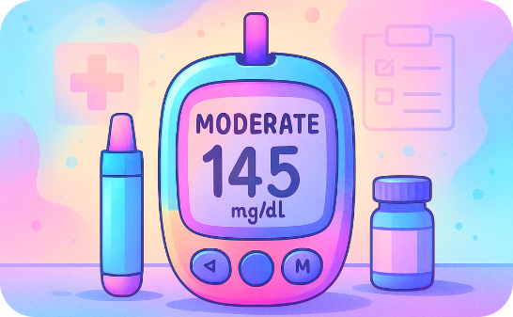
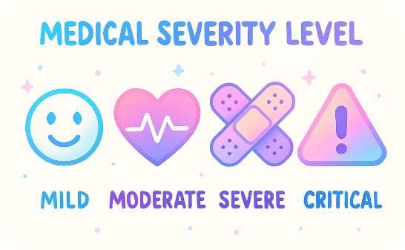
Data Cloud Deep Dive: Personalized Thresholds and Risk Assessment
High Risk
Moderate Risk
Severity Levels
Glucose > 250 mg/dL or < 70 mg/dL
Glucose between 200-250 or 70-80 mg/dL
Mild
Moderate
Severe
Critical

Slide 10

Actionable Insights and Next Steps
Care Coordination
Low Risk
Integrate with Salesforce Health Cloud for seamless care.
Moderate Risk
Provide positive reinforcement and ongoing monitoring.
High Risk
Suggest lifestyle changes and medication reminders.
Recommend immediate medical attention.

Slide 11

Benefits and ROI
15%
327B
Cost Savings
US Emergency Care Cost
Administrative burdens reduced by 15%.
Potential reduction in $327 billion expenses.
Ensures better quality of life (QALY)

Slide 12

Next Steps: Empowering Diabetes Management
Expand Patient Outreach
Enhance Data Analytics
Leverage AI to support more patients actively.
Refine thresholds and risk models continuously.
Integrate Care Teams
Focus on Education
Streamline coordination through Health Cloud platforms.
Empower patients with actionable glucose insights.

