Slide 1

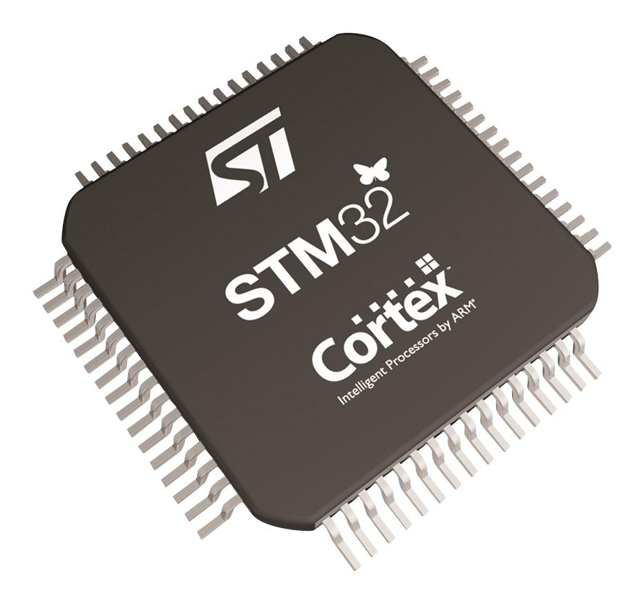
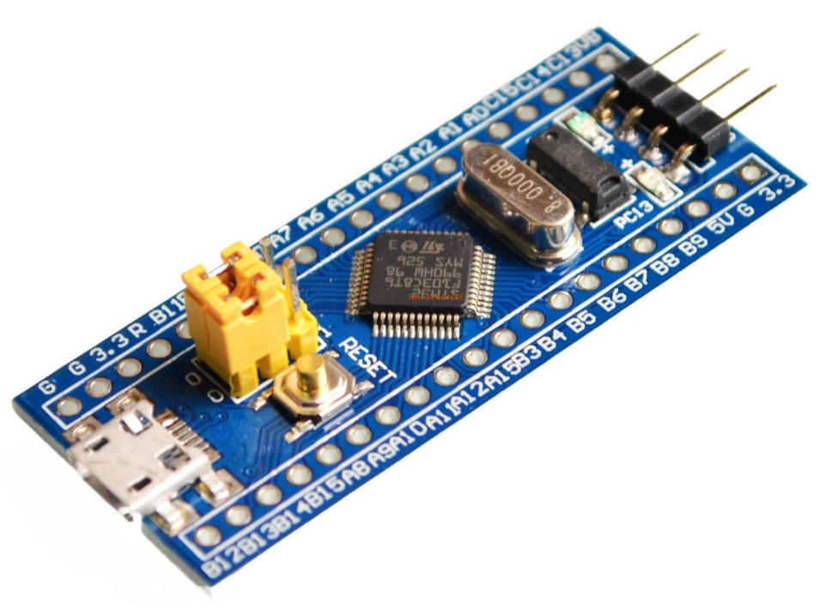
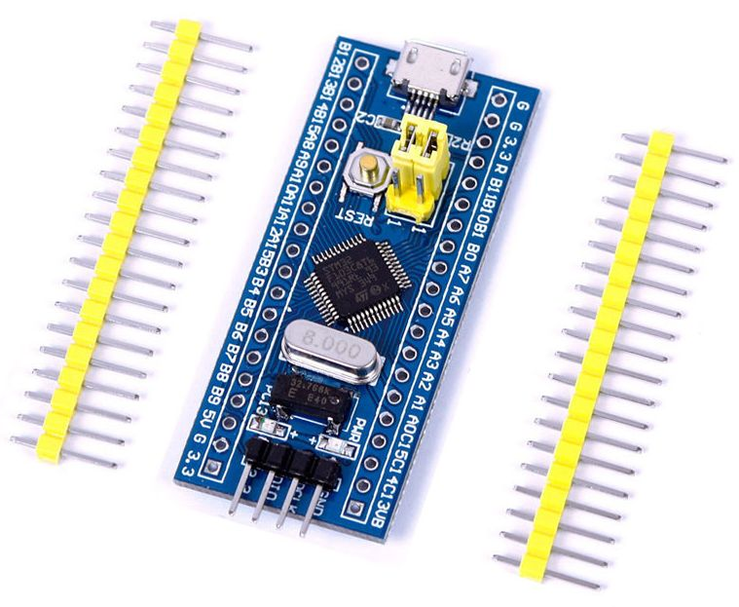

Slide 2
Interfacing 7 segment display with STM32F103C8 microcontroller

Slide 3
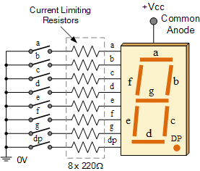
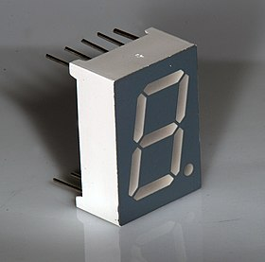
Seven Segment Display
The name 7 segments imply there are 7 LED segments arranged as shown in figure.
After LEDs, these are the easiest interfaces to a microcontroller.
There is also a decimal point or dp. It is used when decimal digits like 5.1 etc are displayed.
Seven segments are widely used in applications where digits[0-9] are required to be displayed.
Although they also display letters A to F .
This is a very simple and convenient way to display numbers in a bright fashion.

Slide 4
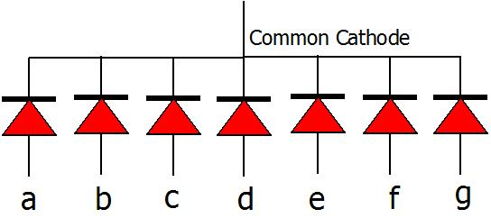
Common Cathode
Common Cathode: In this type of segments all the cathode terminals are made common and tied to GND.
Thus the segments a to g needs a logic High signal(5v) in order to glow.

Slide 5
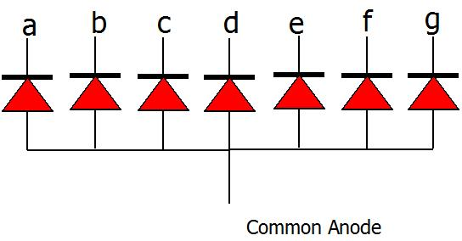
Common Anode
Common Anode: In this type of segments all the anodes terminals are made common and tied to VCC(5v).
Thus the segments a to g needs a logic LOW signal(GND) in order to glow.

Slide 6
Common Cathode Hex values
Below table shows the binary/hex values for displaying the digits on Common cathode seven segment display.
Digit | h | g | f | e | d | c | b | a | Hex Value
0 | 0 | 0 | 1 | 1 | 1 | 1 | 1 | 1 | 0x3f
1 | 0 | 0 | 0 | 0 | 0 | 1 | 1 | 0 | 0x06
2 | 0 | 1 | 0 | 1 | 1 | 0 | 1 | 1 | 0x5b
3 | 0 | 1 | 0 | 0 | 0 | 1 | 1 | 0 | 0x4f
4 | 0 | 1 | 1 | 0 | 0 | 1 | 1 | 0 | 0x66
5 | 0 | 1 | 1 | 0 | 1 | 1 | 0 | 1 | 0x6d
6 | 0 | 1 | 1 | 1 | 1 | 1 | 0 | 1 | 0x7d
7 | 0 | 0 | 0 | 0 | 0 | 1 | 1 | 1 | 0x07
8 | 0 | 1 | 1 | 1 | 1 | 1 | 1 | 1 | 0x7f
9 | 0 | 1 | 1 | 0 | 1 | 1 | 1 | 1 | 0x6f

Slide 7
Common Anode Hex values
Below table shows the binary/hex values for displaying the digits on CommonAnode seven segment display.
Digit | h | g | f | e | d | c | b | a | Hex Value
0 | 1 | 1 | 0 | 0 | 0 | 0 | 0 | 0 | 0xC0
1 | 1 | 1 | 1 | 1 | 1 | 0 | 0 | 1 | 0xF9
2 | 1 | 0 | 1 | 0 | 0 | 1 | 0 | 0 | 0xA4
3 | 1 | 0 | 1 | 1 | 0 | 0 | 0 | 0 | 0xB0
4 | 1 | 0 | 0 | 1 | 1 | 0 | 0 | 1 | 0x99
5 | 1 | 0 | 0 | 1 | 0 | 0 | 1 | 0 | 0x92
6 | 1 | 0 | 0 | 0 | 0 | 0 | 1 | 0 | 0x82
7 | 1 | 1 | 1 | 1 | 1 | 0 | 0 | 0 | 0xF8
8 | 1 | 0 | 0 | 0 | 0 | 0 | 0 | 0 | 0x80
9 | 1 | 0 | 0 | 1 | 0 | 0 | 0 | 0 | 0x90

Slide 8
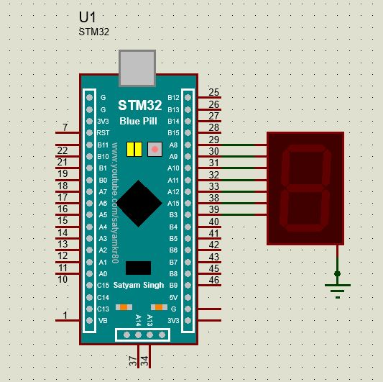
Interfacing 7 segment With STM32

Slide 9
Heading
contents

Slide 10
Heading
contents

Slide 11
Heading
contents

Slide 12
Heading
contents

Slide 13
Heading
contents

Slide 14
Heading
contents

Slide 15
Heading
contents

Slide 16
Heading
contents

Slide 17
Heading
contents

Slide 18
Heading
contents

Slide 19
Heading
contents

