Slide 1

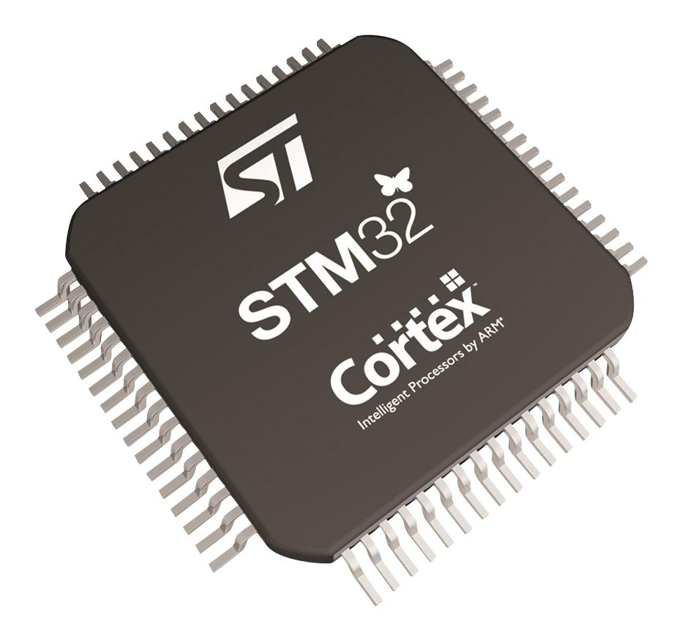
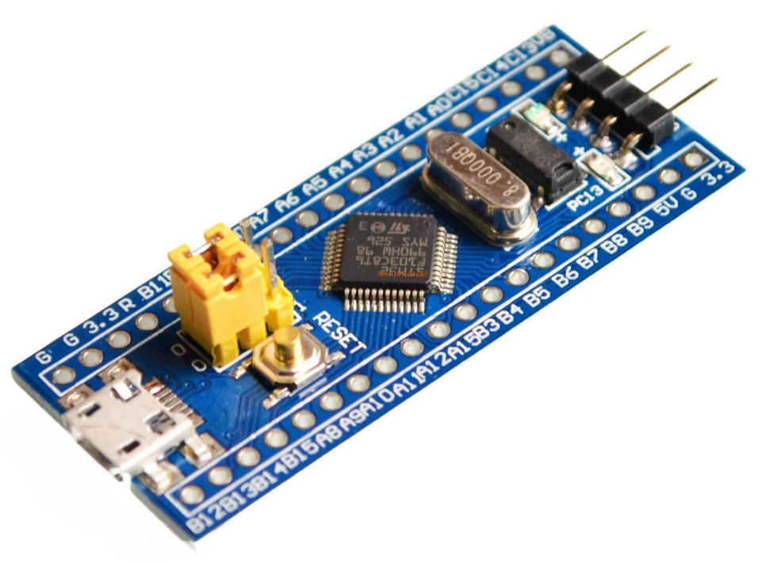
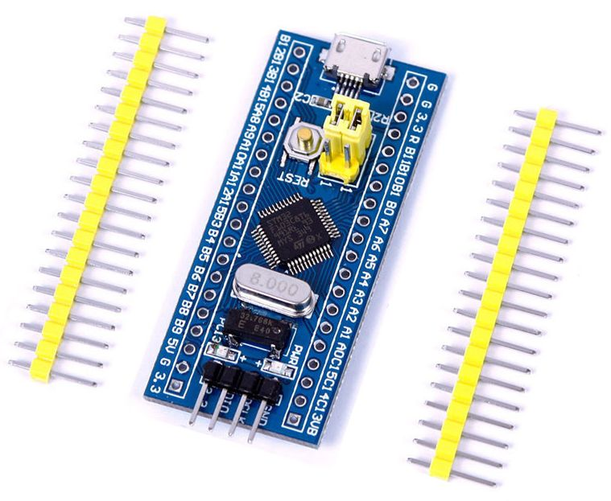

Slide 2
STM32

Slide 3
What is STM32 ?
The STM32 series are some of the most popular microcontrollers used in a wide variety of products. They also have an excellent support base from multiple microcontroller development forums.
This family of microcontrollers from STMicroelectronics is based on the ARM Cortex-M 32-bit processor core.
STM32 microcontrollers offer a large number of serial and parallel communication peripherals which can be interfaced with all kinds of electronic components including sensors, displays, cameras, motors, etc. All STM32 variants come with internal Flash memory and RAM.
The more advanced models are available with Floating Point Units (FPU) for applications with serious numerical processing requirements. These more advanced models blur the line between a microcontroller and a microprocessor.
The STM32 family consists of 14 series of microcontrollers: H7, F7, F4, F3, F2, F1, F0, G4, G0, L5, L4, L4+ L1, L0. Each STM32 microcontroller series is based upon either a Cortex-M7F, Cortex-M4F, Cortex-M33, Cortex-M3, Cortex-M0+, or Cortex-M0 ARM processor core.

Slide 4
STM32 F1 series
The STM32 F1-series was the first group of STM32 microcontrollers based on the ARM Cortex-M3 core and considered their mainstream ARM microcontrollers.
The F1-series has evolved over time by increasing CPU speed, size of internal memory, variety of peripherals.
There are five F1 lines:
STM32F107
STM32F105
STM32F103
STM32F102
STM32F101

Slide 5
Family Group Of STM32F103
The STM32F103xx family microcontrollers are divided into three groups:
Low-density: The STM32F103x4 and STM32F103x6 are Low-density devices.
Medium-density: The STM32F103x8 and STM32F103xB are Medium-density devices.
High-density: The STM32F103xC, STM32F103xD and STM32F103xE are High-density devices.
These three groups are made according to the feature of the microcontroller STM32F103xx family members.
Low-density microcontrollers have lower Flash memory and RAM (Random Access Memory), less timer and peripherals in compare to the other two groups.
Medium density and High-density consist of higher Flash memory, RAM capacities and also have more additional peripherals.

Slide 6
Low-density
Low-density families include 16 KB to 32 KB Flash memory and 6 KB to 10 KB RAM capacities.
They consist of 1 × CAN, 1 × USB, 1 × PWM timer, 1 × I²C, 1 × SPI and 2 × ADCs, 2 × USARTs, and 2 × 16-bits timers.
The differences between Low-density families are regarding the number of their pinout packages.
There are three kinds of pinout packages which they made up 36, 48 and 64 pins.
Their Flash memory is improved from 64 KB to 128 KB and RAM capacity is 20 KB.

Slide 7
Medium-density
Medium-density families have more properties in compare to Low-density families.
The number of peripherals and pinouts of them are improved.
They have 1 × CAN, 1 × USB, 1 × PWM timer, 2 × I²C, 2 × SPI, 2 × ADCs, 3 × USARTs, and 3 × 16-bits timers.
They also have three kinds of pinout packages that consist of 48, 64 and 100 pins
High-density
High-density families are completed more than others and have more peripherals.
They made up these peripherals, such as 1 × CAN, 1 × USB, 1 × PWM timer, 2 × I²Ss (SPI), 2 × I²C, 3 × SPI, 2 × ADCs, 1 × DAC, 5 × USARTs, 2 × basic timers, 4 × 16-bits timers, 1 × SDIO (Secure Digital Input Output), and 1 ×FSMC (Flexible Static Memory Controller).

Slide 8
STM32F103C8 Features
ARM Cortex M3 32-bit 72 MHz
64 KB Flash
20 KB RAM
2.0 – 3.6V I/O Pin
LED on PIN PC13
32 Khz Real time clock crystal
On board 3.3V voltage regulator
Internal RTC clock
Jump links on Boot0 and Boot1
Micro USB connector for power and data
ST-Link header on the top of the board
Reset button

Slide 9
STM32F103C8 Specifications
Core: Cortex-M3 32-bit
Operating frequency: 72MHz
Storage resources: 64K Byte Flash, 20KByte SRAM
Interface Resources: 2x SPI, 3x USART, 2x I2C, 1x CAN, 37x I / O ports
Analog-to-digital conversion: ADC (12-bit / 16-channel)
PWM: 16-bit/15 channel
Timers: 3 general timers and 1 advanced timer
Debug Download: Support JTAG / SWD debug interface to download, support for IAP

Slide 10
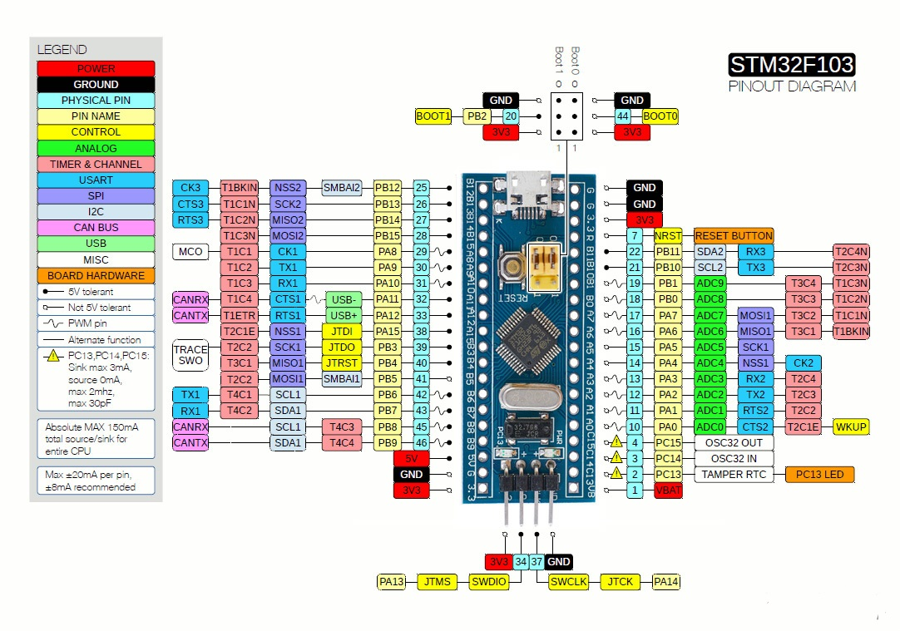
STM32F103C8 Pin Configuration

Slide 11
STM32F103C8 ARCHITECTURE

Slide 12
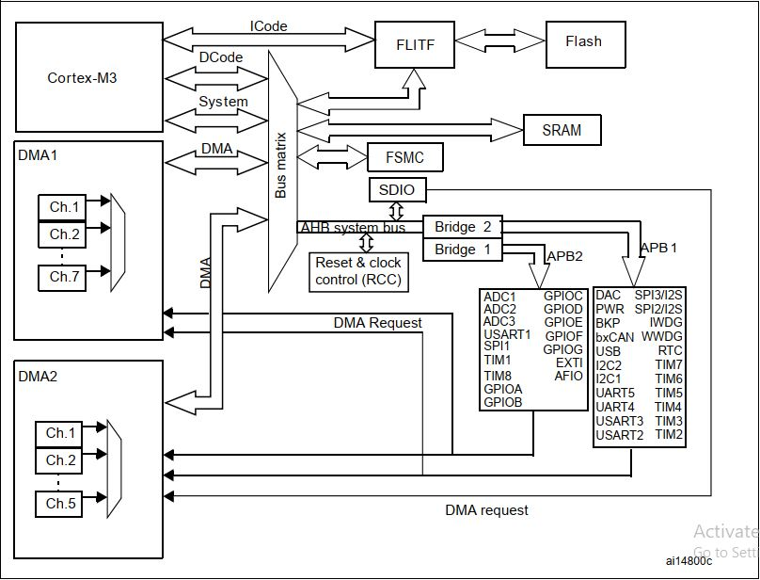

Slide 13
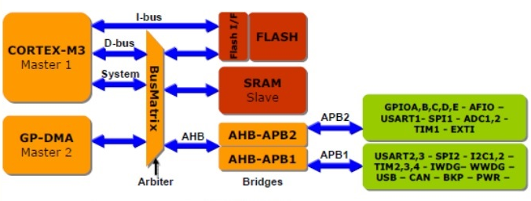
System Architecture
System Architecture consists of Buses, and General purpose DMA (Direct Memory Access), Internal SRAM, Internal Flash Memory which some of them consider as masters and others consider as slaves.
The below shown figure is the bus Architecture of STM32 family microcontrollers.
The access between Core system bus and DMA bus are controlled by Bus Matrix
There are four master parts and three slave parts in the architecture

Slide 14
Masters
I-bus (Cortex-M3 ICode bus): It connects the Cortex M3 core to the Flash memory instruction in order to do prefeching.
D-bus (DCode bus): It connects the Cortex-M3 core to the Flash memory Data interface.
S-bus (System bus): It connects the Cortex-M3 core peripheral bus to a Bus Matrix in order to control the arbitration between the DMA and Core.
GP-DMA bus (General Purpose DMA): It connects CPU(Central Processing Unit) and DMA to the Flash memory, SRAM and Peripherals through Bus Matrix in order to make communication between them.

Slide 15
Slaves
Internal SRAM
Internal Flash Memory
AHB (Advanced High Performance Bus) to APB (Advanced Peripheral Bus) bridge:
This bridge divides AHP bus into two buses, APB1 and APB2. APB1 is for peripheral which their frequency is 36 MHz and APB2 is for peripherals which they operate with 72 MHz frequency.

Slide 16
ARM Cortex-M3
ARM Cortex-M3 core is the microcontroller CPU and is one of the most significant parts of the microcontroller.
This core is the last version of ARM processors which is applied for embedded system.
It has well specifications :
72 MHz maximum frequency
90DIMPS (Distributed Integrated message Processing System) with 1.25 DIMPS/MHz,
performance at zero state memory access, Single-cycle multiplication and hardware division,
Nested interrupt controller (mask able interrupt 43 channels, Interrupt processing), Low power consumption, Low-price, Low-gate count, etc.

Slide 17
Memory system
Memory system of this microcontroller consists of two parts which they are Flash memory and SRAM (Static Random Access Memory) memory.
Flash memory is for storing data and program and its capacity is up to 128 Kbytes.
SRAM memory is to read/write at CPU with zero wait state in order to store data for processing by USB and its capacity is up to 20 Kbytes.

