Slide 1

Interfacing Keypad with PIC16F877A Microcontroller

Slide 2
How Keypads Work
The buttons on a keypad are arranged in rows and columns. A 3X4 keypad has 4 rows and 3 columns, and a 4X4 keypad has 4 rows and 4 columns
Beneath each key is a membrane switch. Each switch in a row is connected to the other switches in the column by a conductive trace underneath the pad.
Each switch in a column is connected the same way – one side of the switch is connected to all of the other switches in that column by a conductive trace.
Each row and column is brought out to a single pin, for a total of 8 pins on a 4X4 keypad

Slide 3
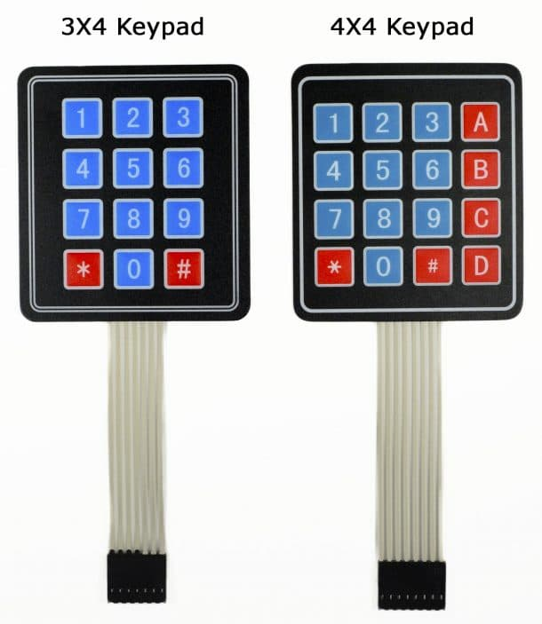
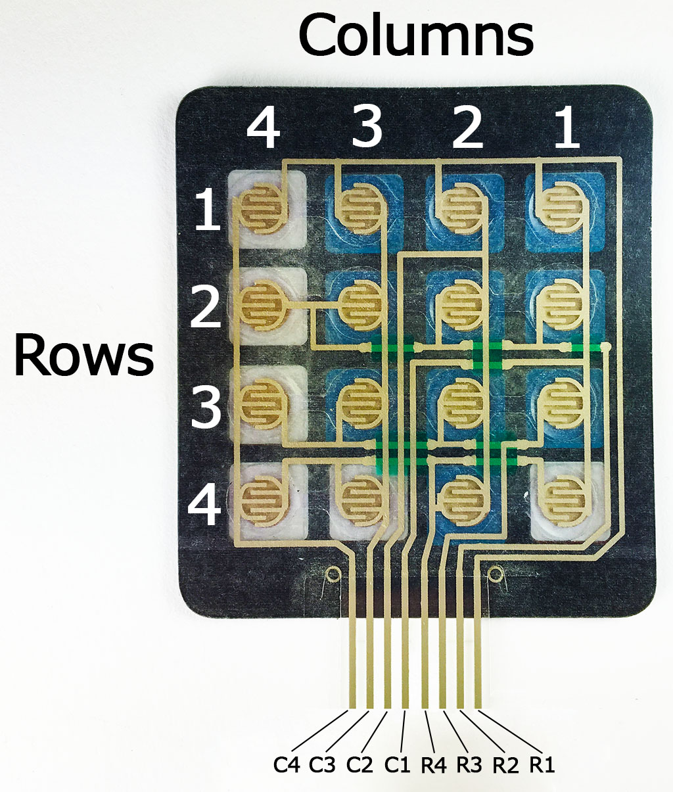

Slide 4
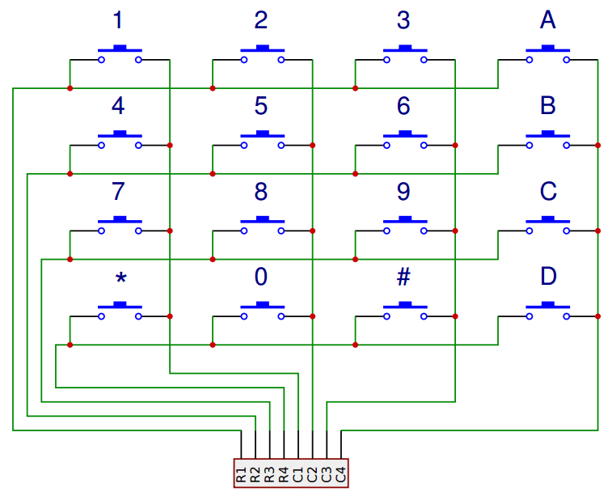
Pressing a button closes the switch between a column and a row trace, allowing current to flow between a column pin and a row pin.
The schematic for a 4X4 keypad shows how the rows and columns are connected

Slide 5
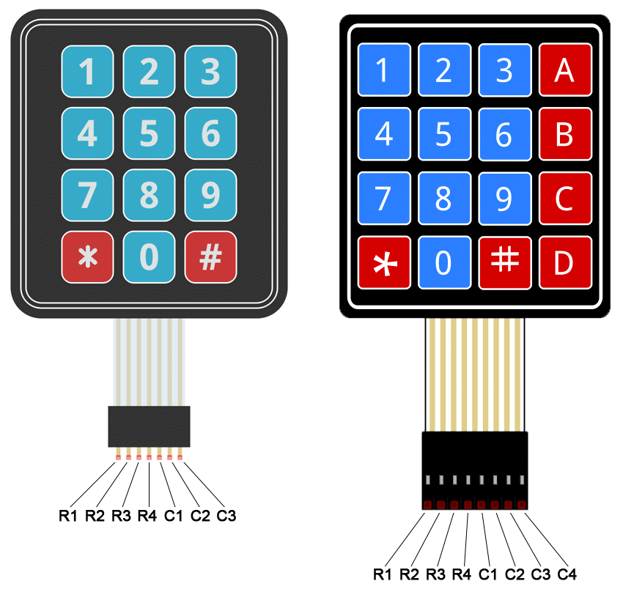
Connect the keypad to the PIC16F877A
The pin layout for most membrane keypads will look like this:

Slide 6
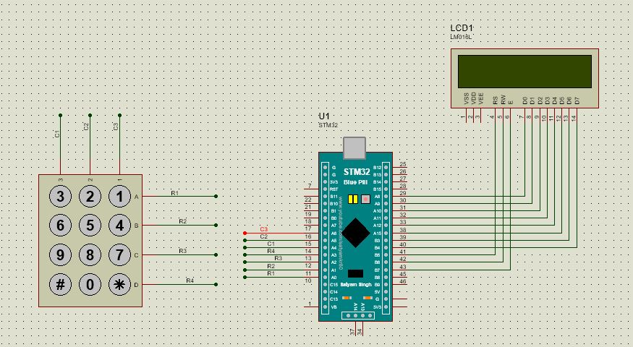
Interfacing lcd and keypad

Slide 7
Program for 3x4 keypad
#include "stm32f10x.h" // Device header
#include "gpio.h"
void delay( unsigned int time){
unsigned int i,j;
for(i=0;i<time;i++)
for(j=0;j<0x2AFF;j++);
}
void GPIO_Init(void){
unsigned char i=0;
/*Clk Enable for PORTA and PORTB */
PORTA_CLOCK_ENABLE();
PORTB_CLOCK_ENABLE();
/*Data Pins for LCD */
GPIO_Config pa[6],pb[5];
pa[0].CurrentPort = PA;
pa[0].CurrentPin = P8;
pa[0].PinMode = Speed_50MHz_Output;
pa[0].PinState = Output_PushPull;
pa[1].CurrentPort = PA;
pa[1].CurrentPin = P9;
pa[1].PinMode = Speed_50MHz_Output;
pa[1].PinState = Output_PushPull;
pa[2].CurrentPort = PA;
pa[2].CurrentPin = P10;
pa[2].PinMode = Speed_50MHz_Output;
pa[2].PinState = Output_PushPull;
pa[3].CurrentPort = PA;
pa[3].CurrentPin = P11;
pa[3].PinMode = Speed_50MHz_Output;
pa[3].PinState = Output_PushPull;
pa[4].CurrentPort = PA;
pa[4].CurrentPin = P12;
pa[4].PinMode = Speed_50MHz_Output;
pa[4].PinState = Output_PushPull;
pa[5].CurrentPort = PA;
pa[5].CurrentPin = P15;
pa[5].PinMode = Speed_50MHz_Output;
pa[5].PinState = Output_PushPull;
pb[0].CurrentPort = PB;
pb[0].CurrentPin = P3;
pb[0].PinMode = Speed_50MHz_Output;
pb[0].PinState = Output_PushPull;
pb[1].CurrentPort = PB;
pb[1].CurrentPin = P4;
pb[1].PinMode = Speed_50MHz_Output;
pb[1].PinState = Output_PushPull;

Slide 8
/*Control Pins for LCD */
pb[2].CurrentPort = PB;
pb[2].CurrentPin = P6;
pb[2].PinMode = Speed_50MHz_Output;
pb[2].PinState = Output_PushPull;
pb[3].CurrentPort = PB;
pb[3].CurrentPin = P7;
pb[3].PinMode = Speed_50MHz_Output;
pb[3].PinState = Output_PushPull;
pb[4].CurrentPort = PB;
pb[4].CurrentPin = P8;
pb[4].PinMode = Speed_50MHz_Output;
pb[4].PinState = Output_PushPull;
//PORTA Config
for(i=0;i<6;i++)
{
GPIO_Config_Pin(&pa[i]);
}
//PORTB Config
for(i=0;i<5;i++)
{
GPIO_Config_Pin(&pb[i]);
}
}

Slide 9
void keypad_Init()
{
unsigned char i=0;
PORTA_CLOCK_ENABLE();
//GPIO pins for Keypad
GPIO_Config pa[7];
//PA0,PA1,PA2 and PA3 rows pins as input
pa[0].CurrentPort = PA;
pa[0].CurrentPin = P0;
pa[0].PinMode = Input;
pa[0].PinState = Input_Floating;
pa[1].CurrentPort = PA;
pa[1].CurrentPin = P1;
pa[1].PinMode = Input;
pa[1].PinState = Input_Floating;
pa[2].CurrentPort = PA;
pa[2].CurrentPin = P2;
pa[2].PinMode = Input;
pa[2].PinState = Input_Floating;
pa[3].CurrentPort = PA;
pa[3].CurrentPin = P3;
pa[3].PinMode = Input;
pa[3].PinState = Input_Floating;
//PA4,PA5 and PA6 column pins as output
pa[4].CurrentPort = PA;
pa[4].CurrentPin = P4;
pa[4].PinMode = Speed_50MHz_Output;
pa[4].PinState = Output_PushPull;
pa[5].CurrentPort = PA;
pa[5].CurrentPin = P5;
pa[5].PinMode = Speed_50MHz_Output;
pa[5].PinState = Output_PushPull;
pa[6].CurrentPort = PA;
pa[6].CurrentPin = P6;
pa[6].PinMode = Speed_50MHz_Output;
pa[6].PinState = Output_PushPull;
//PORTA Config
for(i=0;i<7;i++)
{
GPIO_Config_Pin(&pa[i]);
}
}

Slide 10
unsigned char keyScan()
{
//column1 keys
GPIO_Write_Data(PA,P4,1);//C1
GPIO_Write_Data(PA,P5,0);//C2
GPIO_Write_Data(PA,P6,0);//C3
if(GPIO_Read_Data(PA,P0)==1)
{
while(GPIO_Read_Data(PA,P0)==1);
return '1';
}
else if(GPIO_Read_Data(PA,P1)==1)
{
while(GPIO_Read_Data(PA,P1)==1);
return '4';
}
else if(GPIO_Read_Data(PA,P2)==1)
{
while(GPIO_Read_Data(PA,P2)==1);
return '7';
}
else if(GPIO_Read_Data(PA,P3)==1)
{
while(GPIO_Read_Data(PA,P3)==1);
return '*';
}

Slide 11
//column2 keys
GPIO_Write_Data(PA,P4,0);//C1
GPIO_Write_Data(PA,P5,1);//C2
GPIO_Write_Data(PA,P6,0);//C3
if(GPIO_Read_Data(PA,P0)==1)
{
while(GPIO_Read_Data(PA,P0)==1);
return '2';
}
else if(GPIO_Read_Data(PA,P1)==1)
{
while(GPIO_Read_Data(PA,P1)==1);
return '5';
}
else if(GPIO_Read_Data(PA,P2)==1)
{
while(GPIO_Read_Data(PA,P2)==1);
return '8';
}
else if(GPIO_Read_Data(PA,P3)==1)
{
while(GPIO_Read_Data(PA,P3)==1);
return '0';
}

Slide 12
//column3 keys
GPIO_Write_Data(PA,P4,0);//C1
GPIO_Write_Data(PA,P5,0);//C2
GPIO_Write_Data(PA,P6,1);//C3
if(GPIO_Read_Data(PA,P0)==1)
{
while(GPIO_Read_Data(PA,P0)==1);
return '3';
}
else if(GPIO_Read_Data(PA,P1)==1)
{
while(GPIO_Read_Data(PA,P1)==1);
return '6';
}
else if(GPIO_Read_Data(PA,P2)==1)
{
while(GPIO_Read_Data(PA,P2)==1);
return '9';
}
else if(GPIO_Read_Data(PA,P3)==1)
{
while(GPIO_Read_Data(PA,P3)==1);
return '#';
}
return 'n';
}

Slide 13
void LCD_Command(unsigned char cmd)
{
unsigned char i,val[8];
//RS for cmd mode
GPIO_Write_Data(PB,P3,0);
//RW
GPIO_Write_Data(PB,P4,0);
//Command send to LCD
for(i=0;i<8;i++)
{
//Cmd hex to bin conversion
val[i]= (cmd>>i)&1;
}
GPIO_Write_Data(PA,P8,val[0]);
GPIO_Write_Data(PA,P9,val[1]);
GPIO_Write_Data(PA,P10,val[2]);
GPIO_Write_Data(PA,P11,val[3]);
GPIO_Write_Data(PA,P12,val[4]);
GPIO_Write_Data(PA,P15,val[5]);
GPIO_Write_Data(PB,P3,val[6]);
GPIO_Write_Data(PB,P4,val[7]);
//EN on
GPIO_Write_Data(PB,P8,1);
delay(10);
//EN off
GPIO_Write_Data(PB,P8,0);
}
void LCD_Char(unsigned char data)
{
unsigned char i,val[8];
//RS for data mode
GPIO_Write_Data(PB,P3,1);
//RW
GPIO_Write_Data(PB,P4,0);
//Command send to LCD
for(i=0;i<8;i++)
{
//Cmd hex to bin conversion
val[i]= (data>>i)&1;
}
GPIO_Write_Data(PA,P8,val[0]);
GPIO_Write_Data(PA,P9,val[1]);
GPIO_Write_Data(PA,P10,val[2]);
GPIO_Write_Data(PA,P11,val[3]);
GPIO_Write_Data(PA,P12,val[4]);
GPIO_Write_Data(PA,P15,val[5]);
GPIO_Write_Data(PB,P3,val[6]);
GPIO_Write_Data(PB,P4,val[7]);
//EN on
GPIO_Write_Data(PB,P8,1);
delay(10);
//EN off
GPIO_Write_Data(PB,P8,0);
}

Slide 14
void LCD_String(unsigned char * data)
{
while(*data)
{
LCD_Char(*data++);
}
}
void LCD_Init()
{
GPIO_Init();
LCD_Command(0xc0);//LCD ON
LCD_Command(0x80); //Set Cursor to Row0,Colun0
}
int main()
{
unsigned char key;
LCD_Init();
keypad_Init();
LCD_Char('0');
while(1)
{
key=keyScan();
if(key!='n')
{
LCD_Char(key);
}
}
return 0;
}

