Slide 1

I2C in STM32

Slide 2
Introduction
Inter Integrated Circuit (I2C) is a serial communication protocol developed by Philips Semiconductors. The main purpose of this protocol is to provide easiness to connect peripheral chips with microcontroller. In embedded systems, all peripheral devices are connected as memory mapped devices to the microcontroller.
I2C necessitates two wires SDA (Serial Data Line) and SCL (Serial Clock Line) to carry information between devices. These two active wires are said to be bidirectional.
I2C protocol is a master to slave communication protocol. Each slave is been provided with unique address. In order to establish communication, master device initially sends the target slave address along with R/W (Read/Write) flag. The corresponding slave device will move into active mode leaving other devices in off state.
Once the slave device is ready, communication starts between master and slave devices. One bit acknowledgment is replied by the receiver if transmitter transmits 1 byte (8 bits) of data. A stop condition is issued at the end of communication between devices.

Slide 3
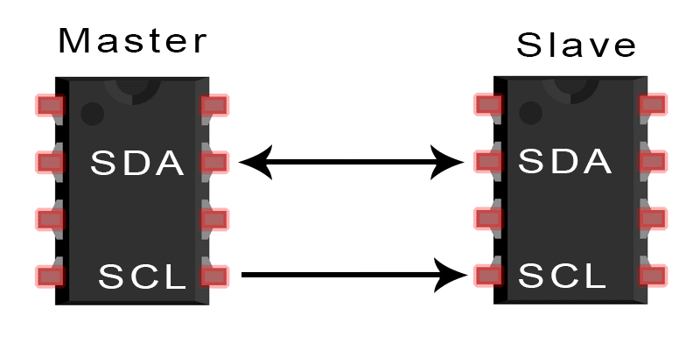
2 wire serial synchronous protocol(SDA,SCL)
Multi master multi slave connection
Max distance 15cm
Max speed 100khz-or 400khz
Software Address based protocol
127 slaves can connect in 7bit slave address ,1023 slaves can connect in 10 bit slave address
Half duplex data transmission only
2 operating mode :
Master (tx /rx )
Slave (tx /rx )

Slide 4
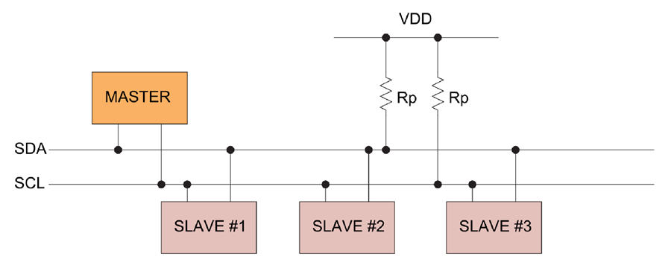
I2C Buses
In I2C the buses SDA & SCL are pull up with resistors.
Because of A pull up resistor is used to provide a default state for a signal line or general purpose input/ouput (GPIO) pin. ... Typically they are of high resistance thousands or tens of thousands of ohms of resistance.

Slide 5
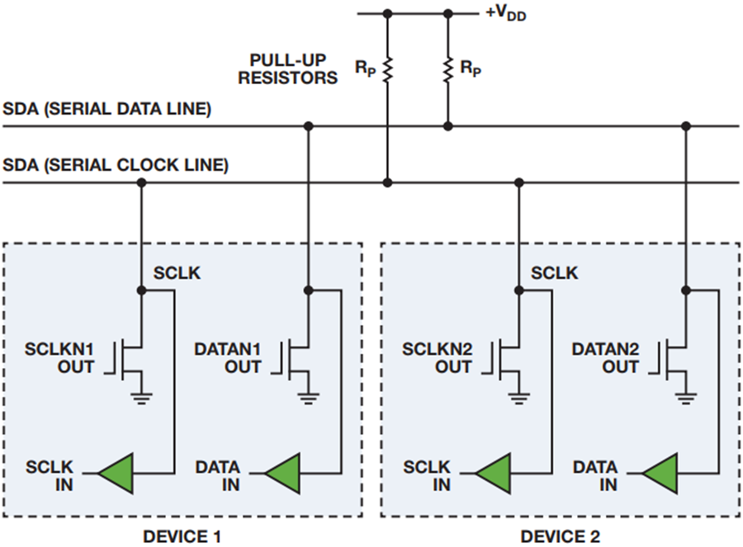
HOW I2C WORKS
With I2C, data is transferred in messages. Messages are broken up into frames of data.
Each message has an address frame that contains the binary address of the slave, and one or more data frames that contain the data being transmitted.
The message also includes start and stop conditions, read/write bits, and ACK/NACK bits between each data frame

Slide 6
I2C Data Frame Format
WRITE
START | SLAVE ADDRESS | Write | ACK | DATA | ACK | STOP
READ
START | SLAVE ADDRESS | Write | ACK | RESTART | SLAVE ADDRESS | Read | DATA | NACK | STOP

Slide 7
DATA FRAMES
Start Condition: The SDA line switches from a high voltage level to a low voltage level before the SCL line switches from high to low.
Stop Condition: The SDA line switches from a low voltage level to a high voltage level after the SCL line switches from low to high.
Address Frame: A 7 or 10 bit sequence unique to each slave that identifies the slave when the master wants to talk to it.
Read/Write Bit: A single bit specifying whether the master is sending data to the slave (low voltage level) or requesting data from it (high voltage level).
ACK/NACK Bit: Each frame in a message is followed by an acknowledge/no-acknowledge bit. If an address frame or data frame was successfully received, an ACK bit is returned to the sender from the receiving device.

Slide 8
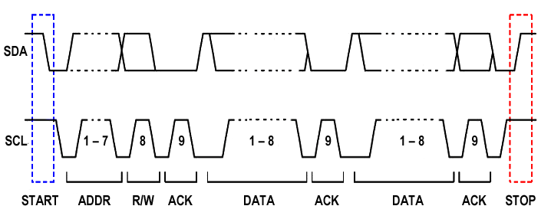
I2C Clock Diagram
SLEW RATE
Slew rate is transition time to change from low to high or high to low

Slide 9
I2C Features
Clock stretch →slave hold master clock line by low ,on that stage master cant send data further
Arbitration→if two master send data at same time ,which master has logic low bit in their data bits which will win arbitration .
Broadcast →all slave communicate with master at same time by general call bit which only applicable if slaves are controller and it should have general call bit

Slide 10
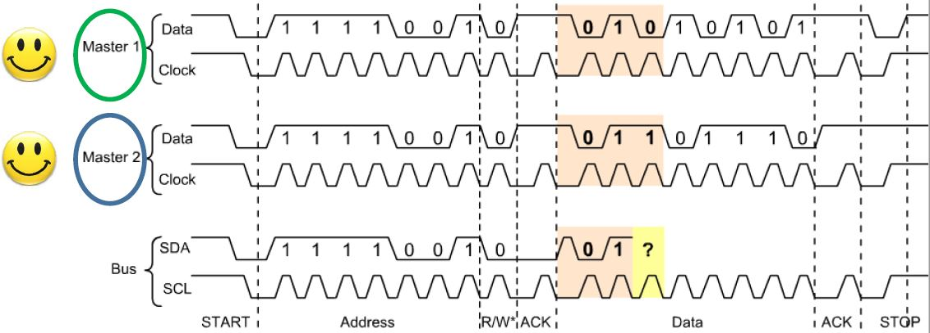
I2C Arbitration
If two master send data to one slave device at same time ,depends upon its data logic bits master will win arbitration (logic low bit have high priority than logic high in I2C communication)

Slide 11
I2C in STM32
I2C (inter-integrated circuit) bus Interface serves as an interface between the microcontroller and the serial I2C bus.
It provides multimaster capability, and controls all I2C bus-specific sequencing, protocol, arbitration and timing. It supports the standard mode (Sm, up to 100 kHz) and Fast mode (Fm, up to 400 kHz).
It may be used for a variety of purposes, including CRC generation and verification, SMBus (system management bus) and PMBus (power management bus).
Depending on specific device implementation DMA capability can be available for reduced CPU overload.

Slide 12
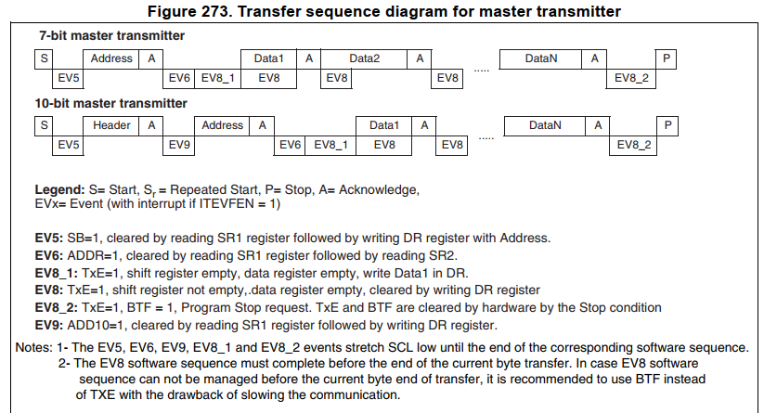
Master Transmitter

Slide 13
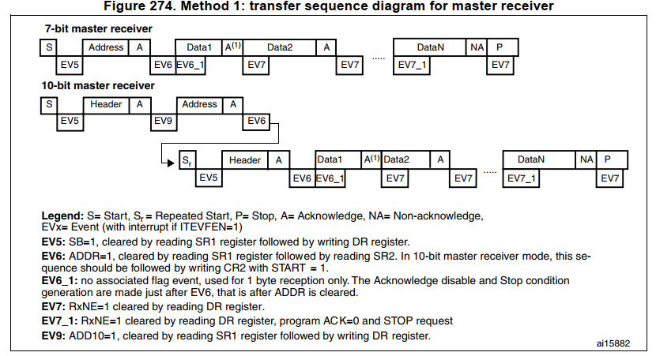
Master receiver

Slide 14
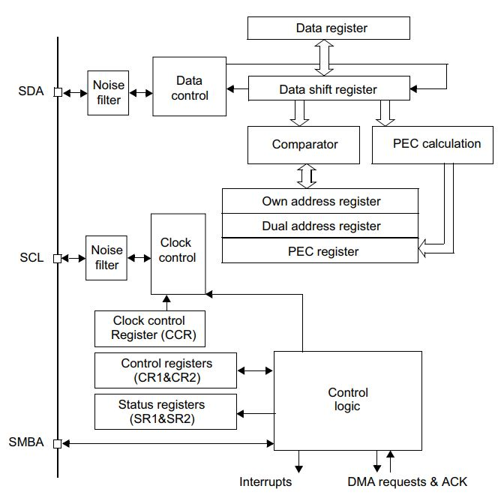
I2C block diagram

Slide 15
I2C Master Clock Calculation
Sm mode or SMBus: T-high = CCR * TPCLK1 T-low = CCR * TPCLK1
Fm mode: If DUTY = 0: T-high = CCR * TPCLK1 T-low = 2 * CCR * TPCLK1
If DUTY = 1: (to reach 400 kHz) T-high = 9 * CCR * TPCLK1 T-low = 16 * CCR * TPCLK1
For instance: in Sm mode, to generate a 100 kHz SCL frequency: If FREQR = 08, TPCLK1 = 125 ns so CCR must be programmed with 0x28
The CCR register must be configured only when the I2C is disabled (PE = 0).
For instance: in Sm mode, the maximum allowed SCL rise time is 1000 ns. If, in the I2C_CR2 register, the value of FREQ[5:0] bits is equal to 0x08 and TPCLK1 = 125 ns therefore the TRISE[5:0] bits must be programmed with 09h. (1000 ns / 125 ns = 8 + 1)

Slide 16
I2C Master Clock Calculation
If required master clock 100khz,sysclk 8mhz
Master_Clock = Sysclk / 2*CCR
CCR =sysclk /(Master_Clk *2)
CCR = 8mhz/(100khz*2)
CCR =8mhz/200khz
CCR=8000000/200000
CCR=0d40

Slide 17
I2C Registers
I2C Control register 1 (I2C_CR1)
I2C Control register 2 (I2C_CR2)
I2C Own address register 1 (I2C_OAR1)
I2C Data register (I2C_DR)
I2C Status Register 1 (I2C_SR2)
I2C Status Register 2 (I2C_SR2)
I2C Clock Control Register (I2C_CCR)
I2C TRISE register (I2C_TRISE)

Slide 18
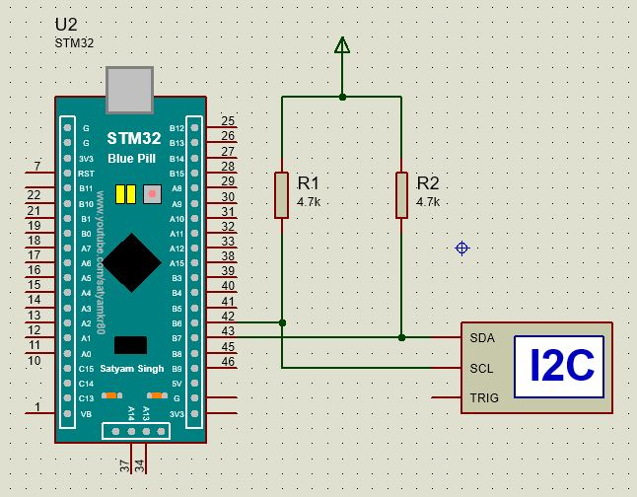
I2C Transmitter

Slide 19
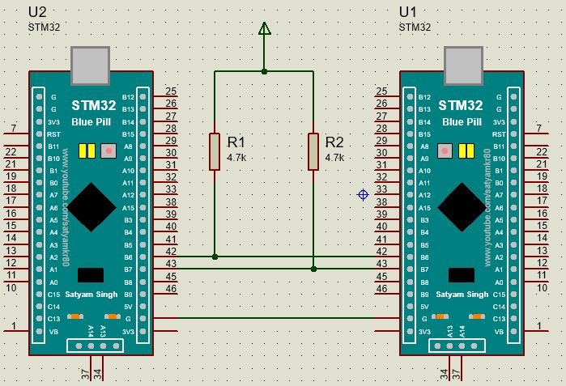
I2C Receiver

Slide 20
I2C Program
#include "stm32f10x.h" // Device header
#include<string.h>
void i2c_gpio_init(void);
void i2c_init(void);
void i2c_start(void);
void i2c_slave_address(unsigned char data);
void i2c_write(unsigned char data);
void i2c_clearAddr(void);
void i2c_write_string(unsigned char *data);
void i2c_stop(void);
void delay(void);
unsigned char * msg=(unsigned char *) "hello embedded world";
unsigned short int dummy_read=0x0000;
int main(void)
{
i2c_gpio_init();//delay();
i2c_init();//delay();
i2c_start();
i2c_slave_address(0xA0);
i2c_write_string(msg);
i2c_stop();
return 0;
}

Slide 21
void delay(void)
{
unsigned int i;
for(i=0;i<1000;i++);
for(i=0;i<1000;i++);
}
void i2c_gpio_init(void)
{
//i2c and port clk enable
RCC->APB1ENR &= 0x00000000;
RCC->APB2ENR &= 0x00000000;
RCC->APB1ENR |= (1<<21); //enable i2c clk
RCC->APB2ENR |= (1<<3); //enable portb clk
//alternate function clk enable
//RCC->APB2ENR |=(1<<0);
GPIOB->CRL &=0x00000000;
//scl
GPIOB->CRL |= (3<<24); //pb6-output
GPIOB->CRL |= (3<<26); //pb6-alterante open drain
//sda
GPIOB->CRL |= (3<<28); //pb7-output
GPIOB->CRL |= (3<<30); //pb7-alterante open drain
}
void i2c_init(void)
{
//i2c master mode
I2C1->CR1 &=0x0000;
I2C1->CR2 &=0x0000;
I2C1->CR1 |= (1<<10); //ack enable
I2C1->CR2 |= 8<<0; //freq :8mhz
I2C1->CCR =0x28; //100khz
I2C1->TRISE &=0x0000;
I2C1->TRISE |=9; //scal rise time config
I2C1->CR1 |= (1<<0); //i2c peripheral enable
}

Slide 22
void i2c_start()
{
//1.i2c start
I2C1->CR1 |= (1<<8);
while( ! (I2C1->SR1 & (1<<0)));
dummy_read=I2C1->SR1;
(void)dummy_read;
}
void i2c_slave_address(unsigned char data)
{
//2.i2c slave address+write
I2C1->DR = data;//delay();
i2c_clearAddr();
}
void i2c_clearAddr()
{
//2.a) check addr clear
while( ! (I2C1->SR1 & (1<<1)));
dummy_read=I2C1->SR1;
dummy_read=I2C1->SR2;
(void)dummy_read;
}

Slide 23
void i2c_write_string(unsigned char *data)
{
unsigned char len= (unsigned char ) strlen((char*)data);
//3. before i2c master write check txe empty
while(len>0)
{
while( ! (I2C1->SR1 & (1<<7)));
I2C1->DR = *data++; //delay();
len--;
}
}
void i2c_stop()
{
//before stop check txe and btf are set
while( ! (I2C1->SR1 & (1<<7)));
while( ! (I2C1->SR1 & (1<<2)));
//4.i2c stop
I2C1->CR1 |= (1<<9);
}

