Slide 1

ADC in STM32

Slide 2
What is an ADC
An analog to digital converter is a circuit that converts a continuous voltage value (analog) to a binary value (digital) that can be understood by a digital device which could then be used for digital computation.
These ADC circuits can be found as an individual ADC ICs by themselves or embedded into a microcontroller. They’re called ADCs for short.
Usually, transducers are also used to convert the input analog variables in the form of currents or voltages. Basically, the digital numbers used here are binary i,e ‘0’ and ‘1’.
The ‘0’ indicates the ‘off’ state and ‘1’ represents the ‘on’ state. Hence all the analog values are converted into digital binary values by an ADC.
For example, if we have to install an alarm in our house or at some facility, whose function is to set off in case of fire or overheating. Our whole alarm system will be electronic but the temperature sensor will give analog values at the output after sensing the temperature. Therefore to convert the varying values of temperature in digital or discrete values, we have to use an analog to digital converter.

Slide 3
ADC Applications
Either we notice or not, we are using hundred to thousands of ADCs and DACs in our daily life. Some of the popular applications are:
Audio applications: For example, when listening to music on your mobile phone, music is stored in your mobile phone memory in digital form and a speaker accepts an electrical signal which is an analog signal. Therefore, we need an ADC to convert a digital bit-stream of music into an analog signal to play the music that we can hear through a mobile speaker. Hence, our mobile phone contains many ADCs for Audio and many other applications.
Call Receiver and Transmitter on mobile phone
Video Streaming
Data Acquisition

Slide 4
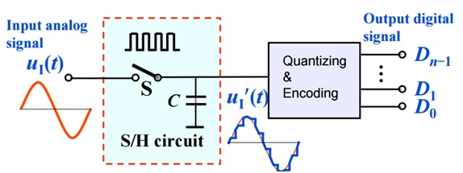
A/D Conversion Process
Mainly there are two steps for the analog to digital conversion:
S/H: Sampling and holding
Q/E: Quantizing and Encoding

Slide 5
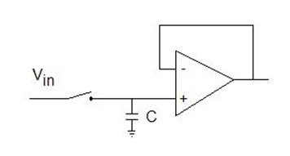
Sampling and Holding
An analog signal continuously changes with time, in order to measure the signal we have to keep it steady for a short duration so that it can be sampled.
We could measure the signal repeatedly and very fast, and then find out the right time scale. or we could measure the signal at different timings and then average it. Or preferably we can hold the signal for a specific duration and then digitize the signal and sample the value.
This is done by a sample and hold circuit. For, at least the time required for digitization, it keeps the value stable.
Figure shows the circuit for sampling and holding of a signal.

Slide 6
Quantizing and Encoding
On the output of (S/H), a certain voltage level is present. We assign a numerical value to it.
The nearest value, in correspondence with the amplitude of sampling and holding signal, is searched. And this value cannot be just any value, it should be from a limited set of possible values.
It depends on the range of the quantizer and the range in given in a power of 2 i,e 2n (28 = 256, 210=1024 etc).
After identifying the closest value, a numerical value is assigned to it and it is encoded in the form of a binary number.
The binary encoded numbers generated by quantizer are represented by ‘n’ bits.
The resolution of an ADC can also be denoted by ‘n’ bit.

Slide 7
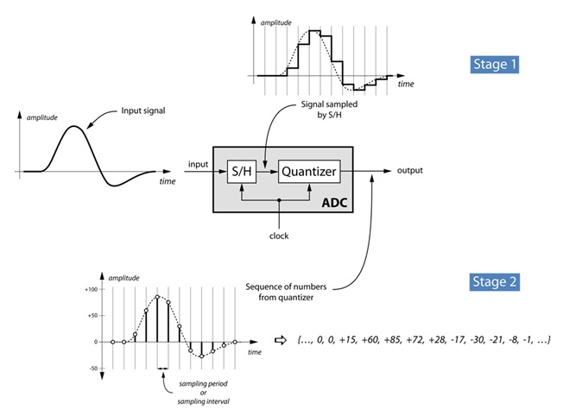
ADC conversion process

Slide 8
ADC Types
Flash Analog to Digital converter.
Dual slope Analog to Digital converter.
Successive Approximation Analog to Digital Converter.

Slide 9
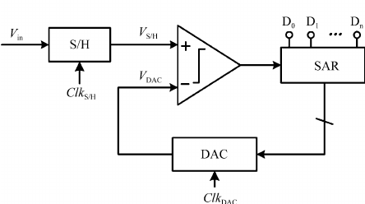
Successive Approximation ADC
It is the most frequently used ADC technique for general applications. The ADC comprises a comparator, digital to analog converter, register, and a control circuit.
At the point when the new conversion begins, the sample and hold circuit samples the input voltage and then this sampled signal is compared with the output signal of the digital to analog converter.

Slide 10
Voltage Table For 3-bit SAR
SAMPLING | BINARY NUMBER | VOLTAGE
0 | 000 | 0V
1 | 001 | 0.7V
2 | 010 | 1.4V
3 | 011 | 2.1V
4 | 100 | 2.8V
5 | 101 | 3.5V
6 | 110 | 4.1V
7 | 111 | 4.9V

Slide 11
ADC in STM32
The STM32 has 12-bit of ADC Resolution and is a successive approximation analog-to-digital converter.
It has up to 18 multiplexed channels allowing it measure signals from sixteen external and two internal sources.
A/D conversion of the various channels can be performed in single, continuous, scan or discontinuous mode.
The result of the ADC is stored in a left-aligned or right-aligned 16-bit data register.
The analog watchdog feature allows the application to detect if the input voltage goes outside the user-defined high or low thresholds.
The ADC input clock is generated from the PCLK2 clock divided by a prescaler and it must not exceed 14 MHz

Slide 12
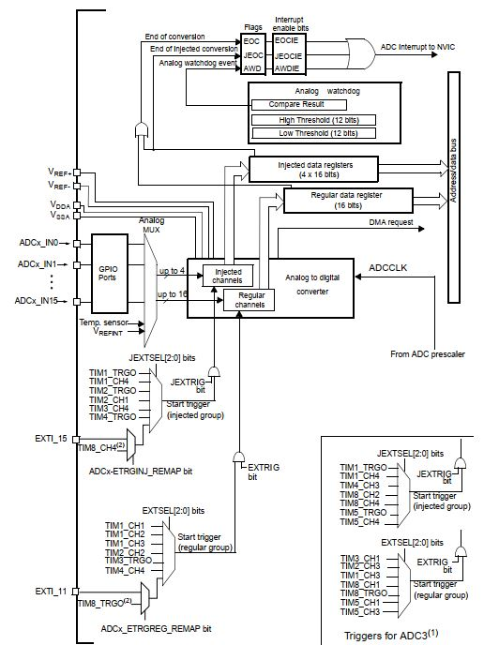
Block
Diagram

Slide 13
Registers Used For ADC
APB2 peripheral clock enable register (RCC_APB2ENR)
ADC control register 2 (ADC_CR2)
ADC sample time register 2 (ADC_SMPR2)
ADC regular sequence register 1 (ADC_SQR1)
ADC regular sequence register 3 (ADC_SQR3)
ADC status register (ADC_SR)
ADC regular data register (ADC_DR)

Slide 14
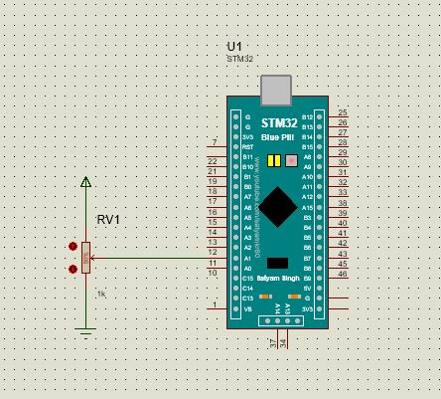
ADC interface

Slide 15
ADC Program
#include "stm32f10x.h" // Device header
void gpio_init(void);
void adc_init(void);
unsigned short int adc_value(void);
unsigned short int adc_val=0;
int main()
{
gpio_init();
adc_init();
while(1)
{
adc_val=adc_value();
}
return 0;
}
void gpio_init()
{
//porta clk enable,PA0 adc0 channel,PA1 adc1
RCC->APB2ENR = (1<<2);
RCC->APB2ENR |=(1<<0);//afio clk enable
//input,analog mode
GPIOA->CRL =0x00000000;
}

Slide 16
void adc_init()
{
RCC->APB2ENR |= (1<<9);//adc1 clk enable
/*ADC should on before config other registeres*/
ADC1->CR2 |=(1<<0);//ADCON
ADC1->CR2 |=(1<<1);//continuous convertion //+sample time reg 1.5 cycle
ADC1->SMPR2 &= ~(0x7<<0);
ADC1->SMPR2 |= (1<<0);//chanel 0 output enable
/*Set Single conversion length*/
ADC1->SQR1 &= ~(0xf<<20); //single conversion
//ADC regular sequence register 3,
//ADC_SQR,0 channel
ADC1->SQR3 &= ~(0x1f<<0);
}
unsigned short int adc_value()
{
/*start conversion*/
ADC1->CR2 |=(1<<0);//ADCON and start conversion
while(!(ADC1->SR & (1<<1))); //EOC
return (unsigned short int)ADC1->DR; //result
}

