Slide 1

STM32 Input & Output

Slide 2
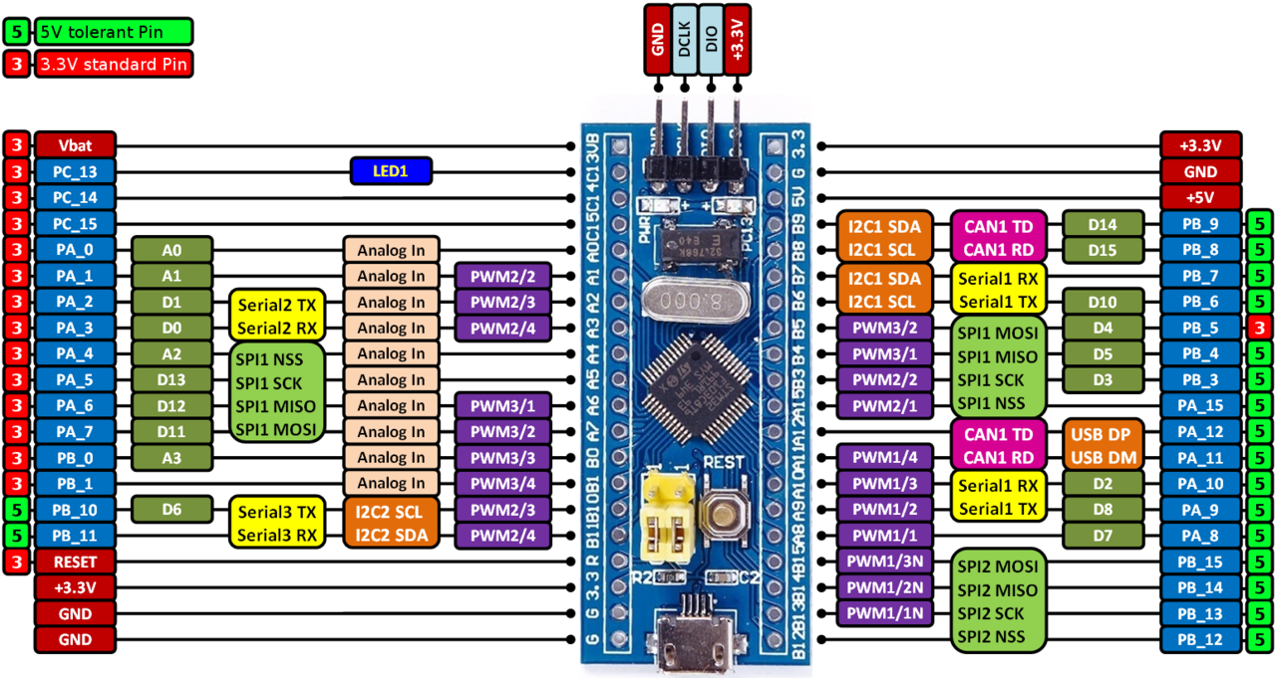
Pin details

Slide 3
INPUT & OUTPUT Register Configuration
No of usable GPIO pins in stm32f103c8 is 35.
PA0-PA15 -16pins
PB0-PB15 -16pins
PC13-PC15 -3 pins
Each of the general-purpose I/O ports has two 32-bit configuration registers (GPIOx_CRL,GPIOx_CRH), two 32-bit data registers (GPIOx_IDR, GPIOx_ODR), a 32-bit set/reset register (GPIOx_BSRR), a 16-bit reset register (GPIOx_BRR) and a 32-bit locking register(GPIOx_LCKR).
Subject to the specific hardware characteristics of each I/O port listed in the datasheet, each port bit of the General Purpose IO (GPIO) Ports, can be individually configured by software in several modes:
Analog
Input Floating
Input Pushpull
Output open-drain
Output push-pull
Alternate function push-pull
Alternate function open-drain

Slide 4
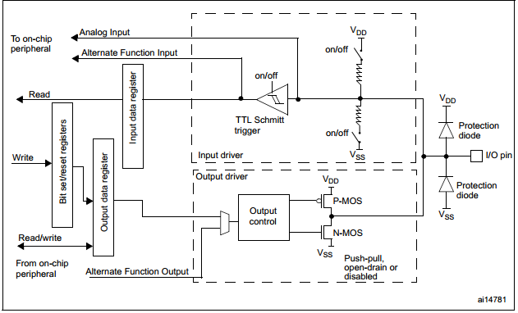
Block diagram of input and output circuit

Slide 5
GPIO Registers
GPIOx_CRL[x=A,B,C] -GPIO Control register low
GPIOx_CRH[x=A,B,C] - GPIO Control register high
GPIOx_IDR[x=A,B,C] -GPIO Input Register
GPIOx_ODR[x=A,B,C] –GPIO Output Register

Slide 6
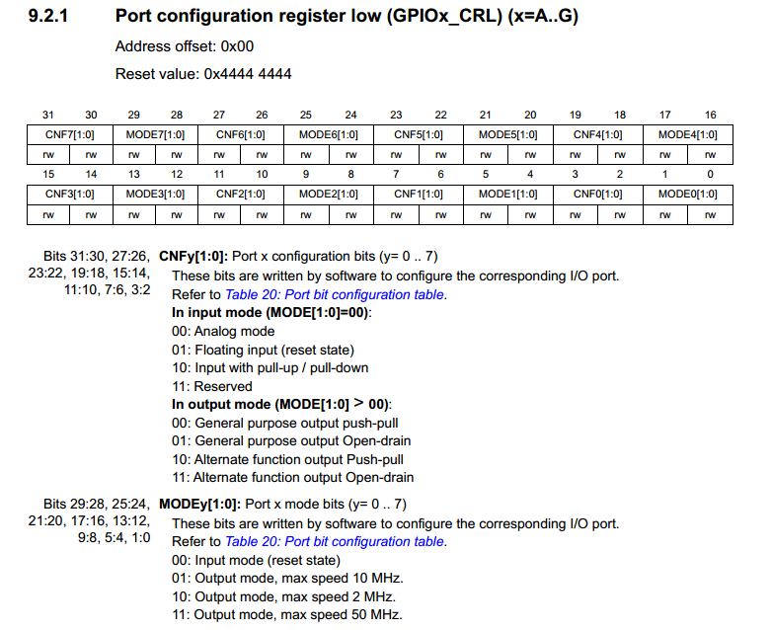
GPIO Control Register Low

Slide 7
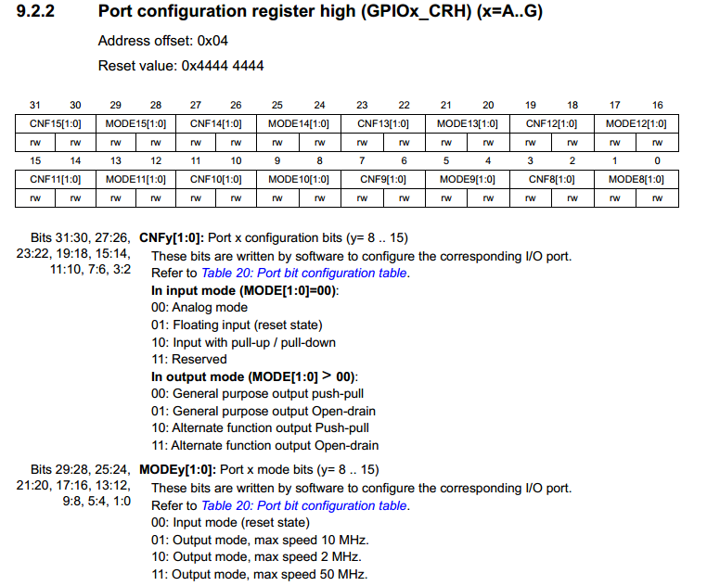
GPIO Control Register high

Slide 8
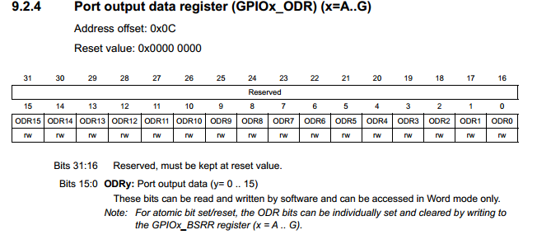
GPIO Output Register

Slide 9
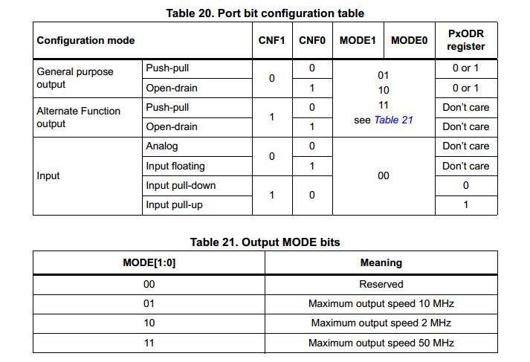
GPIOx_CRL/CRH low and high Control Register Modes
To configure input or output mode we have to use this register in which for configurae one pin we have to use 4bits.i.e mode bits (2bits) and configuration bits(2bits)

Slide 10
To Configure PC13 as output
First select GPIOx_CRL or GPIOx_CRH register
If pin range 0-7 we have to use GPIOx_CRL
If pin range 8-15 we have to use GPIOx_CRH
X- will be PORT [A or B or C] ,for PC13 we have to select GPIOC->CRH register
To configure PC13 as output ,mode bits and config bit totally 4bits should write binary values.
Mode bits should be 1,2 or 3 for digital output
Config bits should be 0 or 1 for digital output type

Slide 11
LED Blinking
#include "stm32f10x.h" // Device header
void delay( unsigned int time)
{ unsigned int i,j;
for(i=0;i<time;i++)
for(j=0;j<0x2AFF;j++);
}
int main()
{ RCC->APB2ENR = 1<<4 ; //port c clock enable
GPIOC->CRH &= 0x00000000; //clear all bits
GPIOC->CRH |= 1 <<22 ; //config bits 00: General purpose output push-pull
GPIOC->CRH |= 1 <<20 ; //mode bits 01: Output mode, max speed 10 MHz
while(1)
{
GPIOC->ODR ^= 1<< 13 ; //Toggle PC13
delay(100); //100ms delay
}
return 0;
}

Slide 12
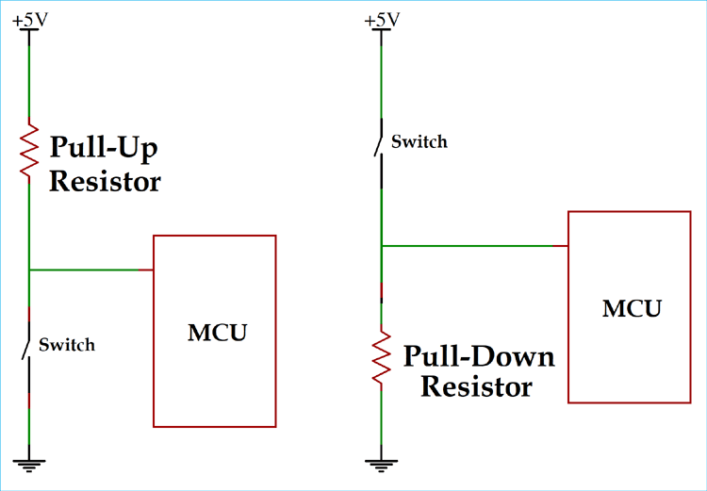
Switch interface with MCU

Slide 13
To Configure PA0 as input
First select GPIOx_CRL or GPIOx_CRH register
If pin range 0-7 we have to use GPIOx_CRL
If pin range 8-15 we have to use GPIOx_CRH
X- will be PORT [A or B or C] ,for PC13 we have to select GPIOC->CRH register
To configure PA0 as input,mode bits and config bit totally 4bits should write binary values.
Mode bits should be 0 for digital input
Config bits should be 1 or 2 for digital input type

Slide 14
Switch interface
#include "stm32f10x.h" // Device header
void delay( unsigned int time)
{ unsigned int i,j;
for(i=0;i<time;i++)
for(j=0;j<0x2AFF;j++);
}
int main()
{ RCC->APB2ENR = 1<<4 ; //port C clock enable
RCC->APB2ENR |= 1<<2 ; //port A clock enable
GPIOC->CRH &= 0x00000000; //clear all bits
/*PA0 as input*/
GPIOA->CRL |=( 1 <<2) ; //config bits 01: Floating input (reset state)
GPIOA->CRL &= ~(3 <<0) ; //mode bits 00: Input mode (reset state)
/*PC13 as output */
GPIOC->CRH |= 1 <<22 ; //config bits 00: General purpose output push-pull
GPIOC->CRH |= 1 <<20 ; //mode bits 01: Output mode, max speed 10 MHz
while(1)
{
if((GPIOA->IDR & (1<<0) )==1 )
{
//delay(100); //100ms delay for debounce
GPIOC->ODR |= 1<< 13 ; //on PC13
while((GPIOA->IDR & (1<<0) )==1);//to avoid repeat process used blocking statement
}
else
{
GPIOC->ODR &= ~(1<< 13) ; //off PC13
}
}
return 0;
}

