Slide 1

STM32 NVIC&EXTI

Slide 2
What is Interrupt
Interrupt is signal to CPU which holds all tasks and execute interrupt tasks first then resume all others tasks.
Interrupt used to do task automatically when event occurs into processor which saves processor monitoring time for task and reduces power consumption.
It also used to implement schedulers in RTOS.
Interrupt in mobiles phones -> notifications,calls,volume keys,power keys.

Slide 3
Process handling in CPU
There will be two types of process handling in CPU one is polling and other one is interrupt handling
Interrupt | Polling
It occurs automatically from software or hardware tasks which we didn’t expect at run time. e.g SMS,Calls | It occurs from our written software which we can know at run time. e.G Turn on flash light,Mobile data.
CPU execute interrupt task only when it occurs | CPU monitor tasks continuously for the execution
Power will save in interrupt process | Power will consume in polling process

Slide 4
Types of Interrupt
Software interrupt
Hardware interrupt
Hardware interrupt has two types
Maskable interrupt
Non-Maskable interrupt
Vector interrupt – CPU know address of interrupt,fast execution than Non-vector interrupt.
Non-vector interrupt –CPU doesn’t know about address of interrupt,Slow execution

Slide 5
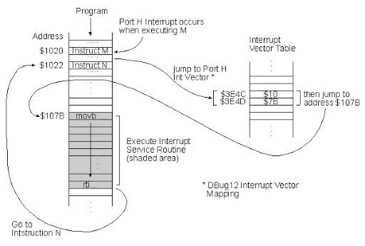
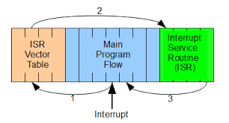
How Interrupt Works

Slide 6
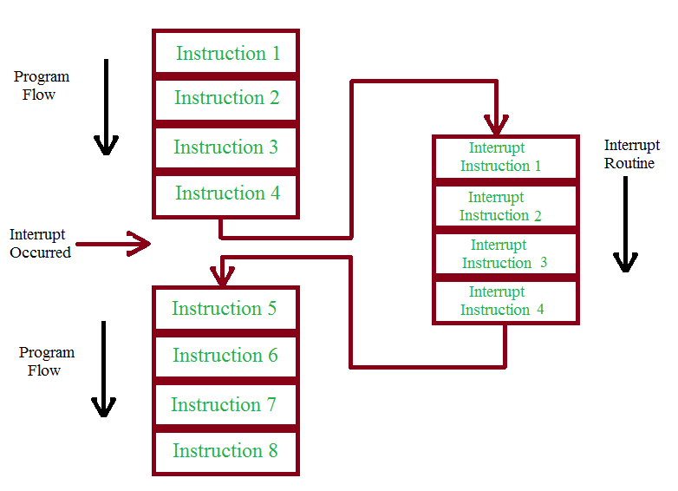
How Interrupt Works

Slide 7
How Interrupt Works
CPU will execute instructions one by one from program memory.
If interrupt will occur while CPU execution ,CPU will hold current tasks and execute interrupt tasks by storing current task address in link register or stack register and jumping to interrupt vector table(IVT).
Interrupt vector table is a memory table for all interrupt which used to provide all interrupt address to CPU
CPU ,After getting ISR address from IVT ,it will execute ISR as per its statements and after execution it return to last execution task by getting address from link register or stack register.

Slide 8
What is NVIC (Nested Vector Interrupt Controller
STM32F103c8 has 240 interrupts in its interrupt vector table,every interrupt has its default position and priority levels/
NVIC interrupt has 16 level of priority ,Low level will have high priority and high level have low priority
High priority task will execute first than low priority tasks

Slide 9
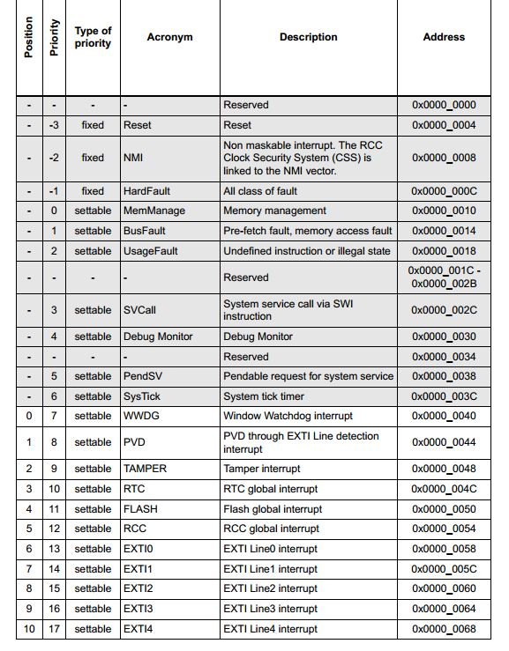
Interrupt Vector Table

Slide 10
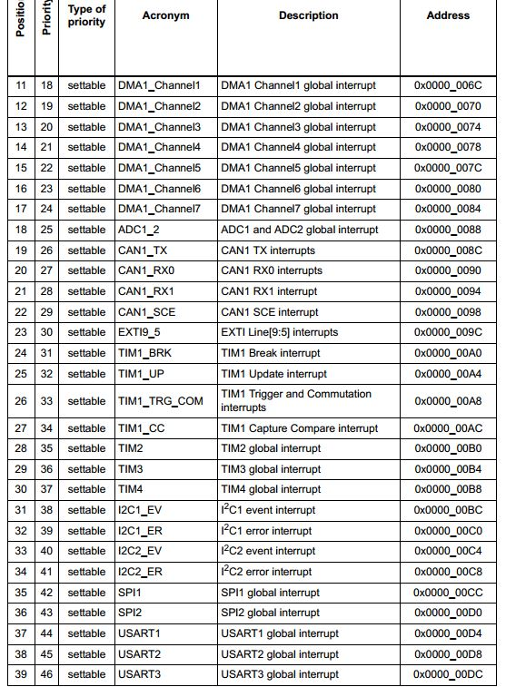
Interrupt Vector Table

Slide 11
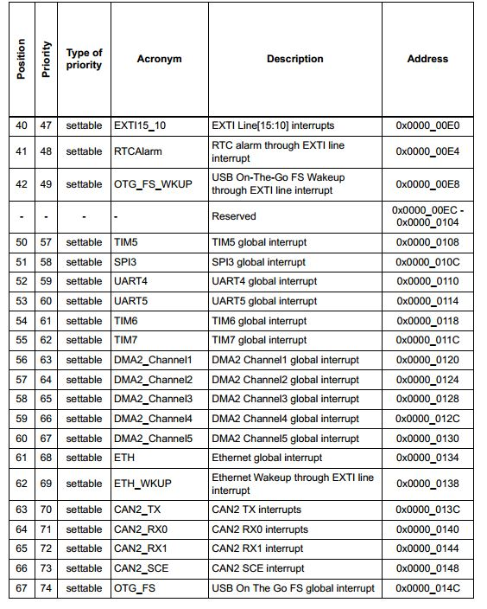
Interrupt Vector Table

Slide 12
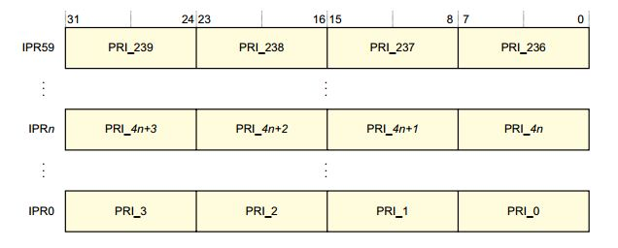
NVIC Registers
NVIC_ISER[0-7]
.
.
NVIC_IPR[0-59]
31
0
ISER7
256
 |  |  |  |  |  |  |  |  |  |  |  |  |  |  |  |  |  |  |  |  |  |  |  |  |  |  |  |  |  |  | 0
ISER0

Slide 13
Interrupt Program
#include "stm32f10x.h" // Device header
void TIM2_IRQHandler()
{
//timer delay =fosc/prec+1
//fosc=8mhz pre=8000-1
if(TIM2->SR & (1<<0))
{
TIM2->SR &=~ (1<<0);
GPIOC->ODR ^= (1<<13);
}
}
int main()
{
RCC->APB1ENR = (1<<0); //timer 2clk on
RCC->APB2ENR = (1<<4); //portc clk on
RCC->APB2ENR |= (1<<0); //alter func clk on
//pc13
GPIOC->CRH = (3<<20);
GPIOC->CRH &= ~(1<<22);
//timer 2 interrupt config
TIM2->PSC = 59999; //1ms
TIM2->ARR =1000; //1s
TIM2->DIER=1<<0; //interrupt flag set
//interrupt set enable for timer2
NVIC->ISER[28/32]=1<<(28%32);
TIM2->CR1 = (1<<0);// timer 2 on
while(1)
{
}
return 0;
}

Slide 14
EXTI (External Interrupt Controller)
The external interrupt/event controller consists of up to 20 edge detectors in connectivity line devices, or 19 edge detectors in other devices for generating event/interrupt requests.
Each input line can be independently configured to select the type (event or interrupt) and the corresponding trigger event (rising or falling or both).
Each line can also masked independently. A pending register maintains the status line of the interrupt requests.

Slide 15
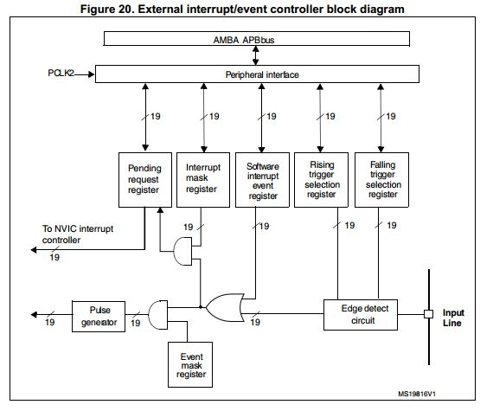
EXTI Block Diagram

Slide 16
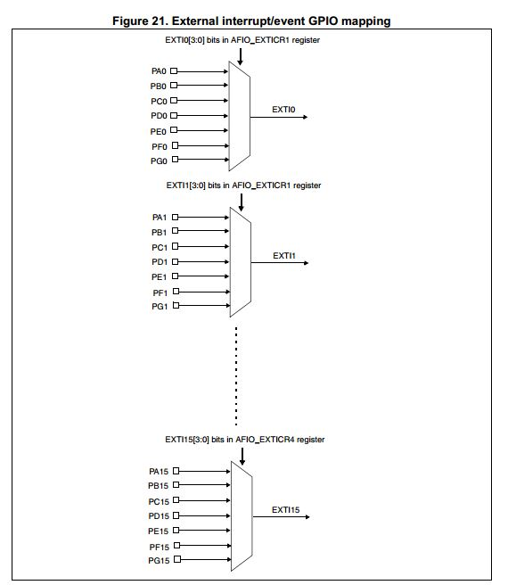
EXTI GPIO Mapping

Slide 17
EXTI Registers
EXTI_IMR -Interrupt Mask Register
EXTI_RTSR -Rising Trigger Selection Register
EXTI_FTSR -Falling Trigger Selection Register
EXTI_PR -Pending Register
AFIO->EXTICR[x] -External Interrupt Configuration Register[x-0,1,2 or 3]

Slide 18
EXTI Program
#include "stm32f10x.h" // Device header
int main()
{
RCC->APB2ENR = (1<<0);//afio
RCC->APB2ENR |= (1<<2);//port a-pa12
RCC->APB2ENR |= (1<<4);//port c
//pc13 output
GPIOC->CRH=(3<<20);
GPIOC->CRH &= ~(3<<22);
//pa12 input
GPIOA->CRH &= ~(3<<16);
GPIOA->CRH |= (1<<18);
//EXTI pin config
EXTI->IMR=(1<<12); //no mask
EXTI->RTSR =(1<<12); //rising edge
EXTI->FTSR &=~(1<<12);
//exti pin map-pa12
AFIO->EXTICR[3] &= ~(16<<0);
NVIC->ISER[40/32] = (1<<(40%32)); //exti10_15
while(1)
{
}
return 0;
}
void EXTI15_10_IRQHandler()
{
if(EXTI->PR&(1<<12))
{
EXTI->PR =(1<<12);
}
GPIOC->ODR ^= (1<<13);
}

