Slide 1

STM32 Timers

Slide 2
What is Timer
The timer is an important application in Embedded systems, it maintains the timing of an operation in sync with a system clock or an external clock. The timer has so many applications such as measure time generating delays
Timer is internal peripheral which used to generate accurate delay for device time controls
Timer is independent to CPU which means we can run CPU tasks and timer delay generation simultaneously
Timer can also used for other applications such as Counter, Capture, Compare and PWM

Slide 3
STM32 Timer Classifications
Advanced Timers (TIM1 and TIM8)
General Purpose Timers (TIM2 to TIM5 and TIM9 to TIM14)
Basic Timers(TIM6 and TIM7)

Slide 4
Advanced Timers(TIM1 and TIM8)
The advanced-control timers (TIM1 and TIM8) consist of a 16-bit auto-reload counter driven by a programmable prescaler.
It may be used for a variety of purposes, including measuring the pulse lengths of input signals (input capture) or generating output waveforms (output compare, PWM,complementary PWM with dead-time insertion).Pulse lengths and waveform periods can be modulated from a few microseconds to several milliseconds using the timer prescaler and the RCC clock controller prescalers.
The advanced-control (TIM1 and TIM8) and general-purpose (TIMx) timers are completely independent, and do not share any resources.
Advanced timers are almost the same as GP timers but they additionally have the ability to generate complementary PWM signals as well as generate brake and dead-time for such signals. These features make them suitable for applications related to motor control, inverters, SMPSs and other power electronics-related tasks

Slide 5
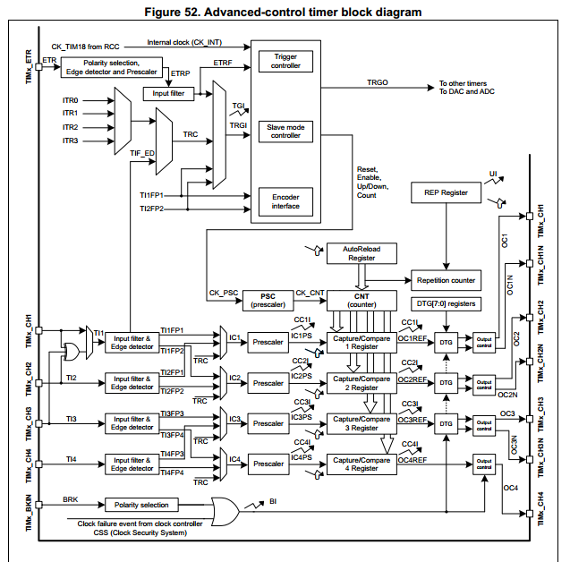
Advance Timer Block Diagram

Slide 6
General Purpose Timers(TIM2 to TIM5 and
TIM9 to TIM14 )
The general-purpose timers consist of a 16-bit auto-reload counter driven by a programmable prescaler.
They may be used for a variety of purposes, including measuring the pulse lengths of input signals (input capture) or generating output waveforms (output compare and PWM). Pulse lengths and waveform periods can be modulated from a few microseconds to several milliseconds using the timer prescaler and the RCC clock controller prescalers.
The timers are completely independent, and do not share any resources

Slide 7
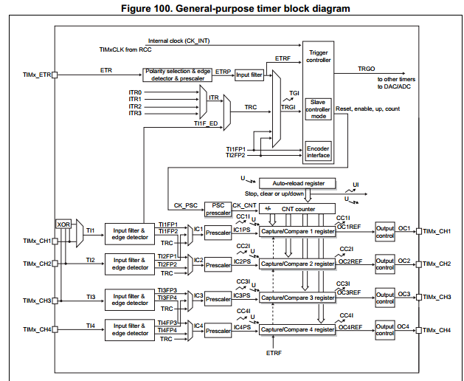
General Purpose Timers block diagram

Slide 8
Basic Timers (TIM6 and TIM7)
The basic timers TIM6 and TIM7 consist of a 16-bit auto-reload counter driven by a programmable prescaler.
They may be used as generic timers for time-base generation but they are also specifically used to drive the digital-to-analog converter (DAC). In fact, the timers are internally connected to the DAC and are able to drive it through their trigger outputs.
The timers are completely independent, and do not share any resources.

Slide 9
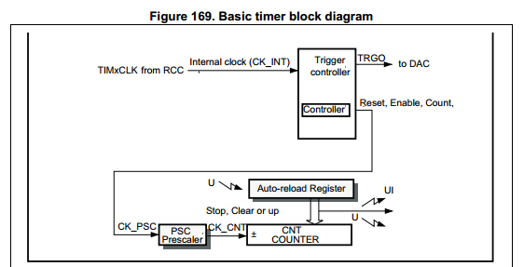
Basic timer Block diagram

Slide 10
Timer working
System clock given to timer module which will prescale by prescalar register(TIMx_PSC)(divide frequency further as per time requirement).
Divided pulses given to count register(TIMx_CNT) which will count per one pulse and also compare with auto reload register (TIMx_ARR).
When auto reload register value and counter register values get matched,timer counter will overflow and flag will set
Hence we can generate accurate delay from timer modules.

Slide 11
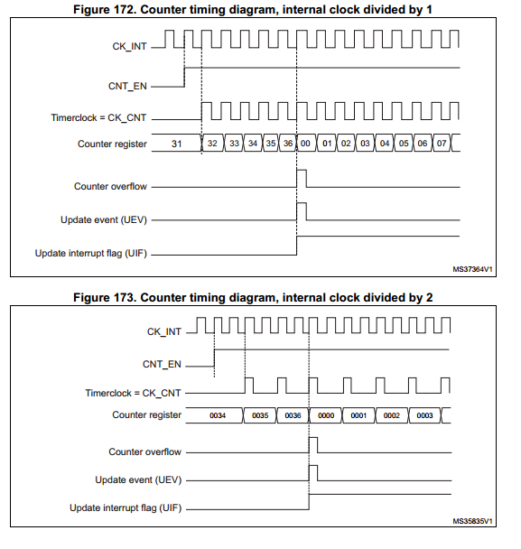
Counting diagram

Slide 12
Timer Registers-each 16bit registers
TIMx_CR1 -timer control register
TIMx_SR -timer status register
TIMx_CNT -timer counter register
TIMx_PSC -timer prescaler register
TIMx_ARR -timer auto reload register

Slide 13
Timer Calculation
/*Timer calculation*/
SysClk = 8Mhz
Required_TimerClk=1Khz
Required_Time=1ms
TimerClk=SysClk/(Prescaler+1)
Prescaler+1 =(SysClk/(TimerClk)
Prescaler+1= 8mhz/(1khz) =8000000/1000
Prescaler+1=8000
Prescaler=7999
AutoReloadRegister(ARR)=1 //1 for 1ms

Slide 14
Program
#include "stm32f10x.h" // Device header
void timer2_delay_ms(unsigned int delay)
{
RCC->APB1ENR= 1<<0; //timer2 clk enable
TIM2->PSC=7999; //prescale value set
TIM2->ARR=delay;
TIM2->CR1|=1<<0; //timer 2 on CEN=1
TIM2->CR1|=1<<7; //timer 2 ARR enable
//wait untill UIF flag set(timer2 flag)
while(!(TIM2->SR &(1<<0)));
TIM2->SR &=0x0000; //UIF flag reset(timer2 flag)
}

Slide 15
int main()
{
RCC->APB2ENR = (1<<4); //portc clk on
RCC->APB2ENR |= (1<<0); //alter func clk on
//pc13
GPIOC->CRH = (3<<20);//output 50mhz
GPIOC->CRH &= ~(1<<22); //GPIO push pull mode
while (1)
{
GPIOC->ODR ^= (1<<13);
timer2_delay_ms(1000);
}
return 0;
}

