Slide 1

Communication Protocols in Embedded Systems

Slide 2
What is Communication
Communication is simply the act of transferring information from one place, person or group to another.
Every communication involves (at least) one sender, a message and a recipient.
The transmission of the message from sender to recipient can be affected by a huge range of things.

Slide 3
Communication Protocols in Embedded Systems
Embedded System is an electronic system or device which employs both hardware and software. A processor or controller takes input from the physical world peripherals like sensors, actuators etc., processes the same through appropriate software and provides the desired output.
In this case, the components have to communicate with each other to provide the anticipated output. Each communicating entity should agree to some protocol to exchange information. Many different protocols are available for embedded systems and are deployed depending upon the application area.
In general, the communication protocols is associated with physical layer describing the signals incorporated, signal strength, hand shaking mechanism, bus arbitration, device addressing, wired or wireless, data lines etc.
The processes such as system configuration, selection of baud rate and transmitting & receiving data is associated with application layer.

Slide 4
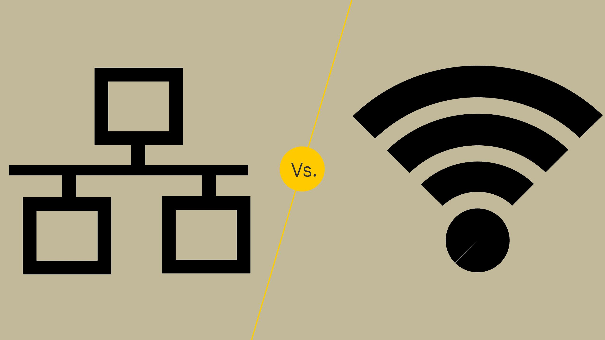
Types of Communications

Slide 5
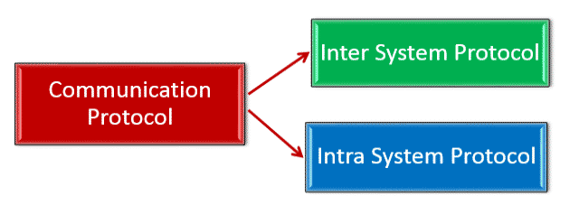
Types of Communication Protocols in Embedded Systems
Communication protocols are broadly classified into two types:
Inter System Protocol
Intra System Protocol
The inter-system protocol using to communicate the two different devices. Like communication between computer to microcontroller kit. The communication is done through an inter bus system.
The Intra system protocol is used to communicate the two devices within the circuit board. While using these intra system protocols, without going to intra system protocols we will expand the peripherals of the microcontroller.

Slide 6
Types of Wired Communication
WIRED
SERIAL
COMMNUNICATION
Asynchronous
(no clk)
Synchronous(clk)
PARALLEL
COMMNUNICATION
UART
CAN
USB
USART
SPI
I2C

Slide 7
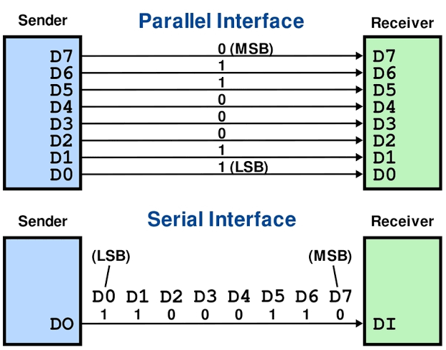
Serial vs parallel

Slide 8
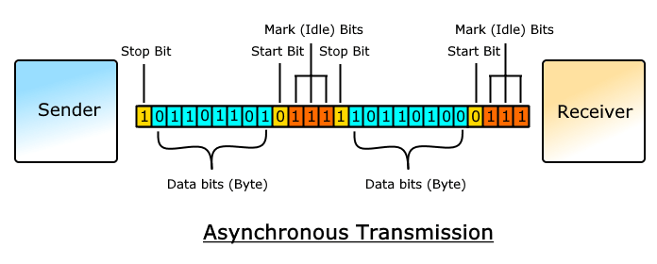
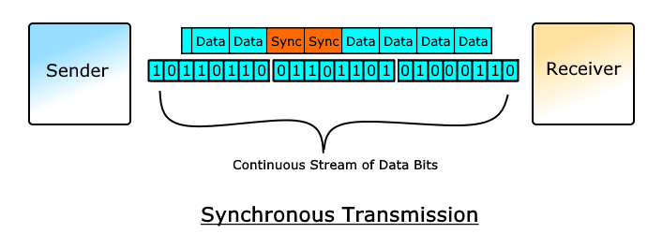
Synchronous VS Asynchronous

Slide 9
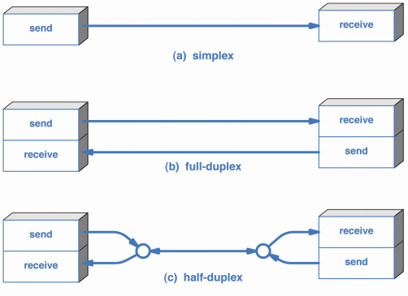
Types of Data Transmission Modes

Slide 10
UART in STM32

Slide 11
UART Communication Protocols
Universal Asynchronous Receiver/Transmitter (UART) is not a communication protocol but just a physical piece of hardware which converts parallel data into serial data. Its main purpose is to transmit and receive data serially.
UART is also two-wired i.e., the serial data is handled by Tx (Transmitter) and Rx (Receiver) pins.
UART transmits data asynchronously, which induces that no clock signal is associated in transmitting and receiving data. Instead of clock signal, UART embed start and stop bits with actual data bits, which defines the start and end of data packet.
When receiver end detects the start bit, it starts to read the data bits at specific baud rate meaning both transmitting and receiving peripherals should work under same baud rate.
UART works under half duplex communication mode meaning it either transmits or receives at a time.

Slide 12
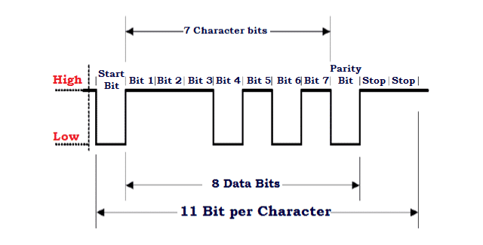
UART data Frame

Slide 13
Advantages of UART Communication Protocol
The advantages of UART/ USART Communication Protocol are as follows:
Clock signal is not required
Cost effective
Uses parity bit for error detection
Requires only 2 wires for data communication
Disadvantages of UART/ USART Communication Protocol
The disadvantages of UART/ USART Communication Protocol are as follows:
Doesn’t support multiple master slave functionality
Baud rate of communicating UART should be within 10 percent of each other

Slide 14
UART in STM32
The universal synchronous asynchronous receiver transmitter (USART) offers a flexible means of full-duplex data exchange with external equipment requiring an industry standard NRZ asynchronous serial data format.
The USART offers a very wide range of baud rates using a fractional baud rate generator.
It supports synchronous one-way communication and half-duplex single wire communication.
It also supports the LIN (local interconnection network), Smartcard Protocol and IrDA (infrared data association)
It allows multiprocessor communication. High speed data communication is possible by using the DMA for multibuffer configuration.

Slide 15
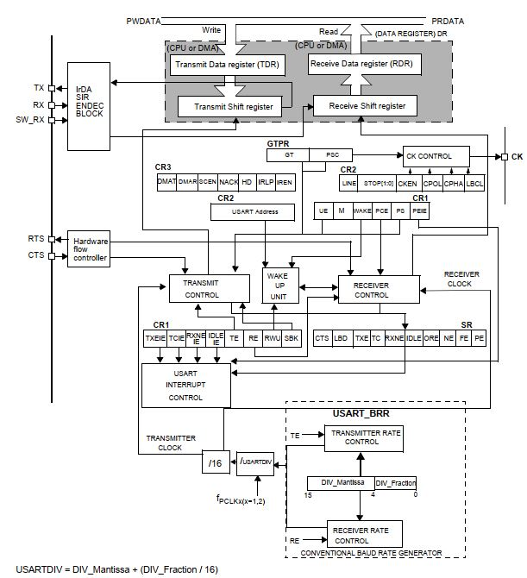
Block
diagram

Slide 16
Registers Used in UART
APB2 peripheral clock enable register (RCC_APB2ENR)
Port configuration register low (GPIOA_CRL)
Control register 1 (USART_CR1)
Control register 2 (USART_CR2)
Baud rate register (USART_BRR)
Data register (USART_DR)
Status register (USART_SR)

Slide 17
Baud Rate Calculation
Baud rate = fosc / (16*UARTDIV )
If we need baud rate 9600
9600 =8mhz/(16*UARTDIV)
UARTDIV=8000000/(16*9600) =52.083
UARTDIV =Mantissa+Fraction
To program USARTDIV = 0d52.083 This leads to: DIV_Fraction = 16*0d0.82 = 0d13 The nearest real number is 0d13 = 0xD DIV_Mantissa = mantissa (0d52.08) = 0d52 = 0x34 Then, USART_BRR = 0x34D hence USARTDIV = 0d52.08

Slide 18
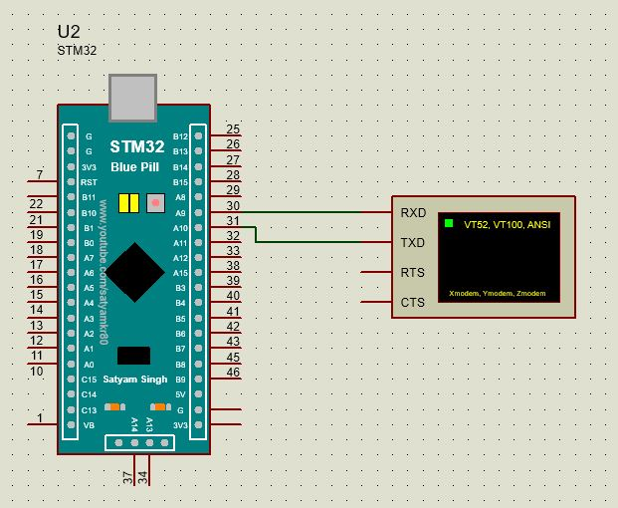
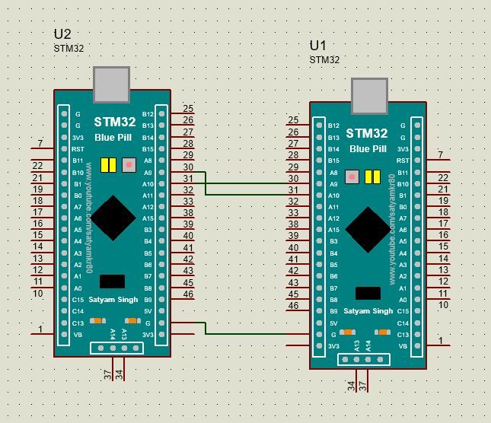
UART Interface

Slide 19
UART Program
#include "stm32f10x.h" // Device header
void gpio_init();
void uart_init();
void uart_tx(unsigned char data);
void uart_tx_string(unsigned char *data);
int main()
{
unsigned char msg[]="hello";
gpio_init();
uart_init();
uart_tx('a');
uart_tx_string(msg);
while(1);
}

Slide 20
void gpio_init()
{
//clk init()
RCC->APB2ENR &=0x00000000;//reset
RCC->APB2ENR |=(1<<2); //porta clk enable
RCC->APB2ENR |=(1<<14);//uart clk enable
//pin config
//pa9-tx
//pa10-rx
GPIOA->CRH &=0x00000000;//reset
//tx
GPIOA->CRH |=(3<<4);//output
GPIOA->CRH |=(2<<6);//alter pp
//rx
GPIOA->CRH &=~(1<<8);//input
GPIOA->CRH |=(1<<10);//input floating
}
void uart_init()
{
USART1->CR1 &=0x00000000;
USART1->CR2 &=0x00000000;
USART1->CR3 &=0x00000000;
//baud rate config
//Tx/ Rx baud rate =fclk/(16*USARTDIV)
//fclk=8mhz ; baud rate=9600; USARTDIV=DIV_Mantissa+DIV_Fraction=52.083
USART1->BRR &=0x00000000;
USART1->BRR |=(52<<4); //mantissa
USART1->BRR |=(1<<0); //Fraction
//USART_STD_BAUD_9600;
//USART_HW_FLOW_CTRL_NONE;
//USART_MODE_ONLY_TX;
//USART_STOPBITS_1;
//USART_WORDLEN_8BITS;
//USART_PARITY_DISABLE;
USART1->CR1 |=(1<<3); //tx enable
USART1->CR1 |=(1<<13); //uart enable
}

Slide 21
void uart_tx(unsigned char data)
{
while( !(USART1->SR & (1<<7))); //tx buffer empty check
USART1->DR=data;
}
void uart_tx_string(unsigned char *data)
{
while(*data)
{
uart_tx(*data++);
}
while( !(USART1->SR & (1<<6)));//tx complete check;
}

