Slide 1
ARM –advances RISC machine

Slide 2
History
Manufactures –ARM,1990 cambridge -uk
vandors
STM
Nxp/f reescle
TI
Applications –mobiles,computer,advances medical devices,robotics
Advantages –low power ,high speed,more features ,debugger,clock controls,high data size,various operating mode,high instruction set,high pricisions,more IDE,community support

Slide 3
Family
ARM 1 to ARM 7 → old core
CORTEX –A (application)
CORTEX –R (real-time) → new core
CORTEX –M (microcontroller)
ARM7 | cortex
ARM(32 bit) and Thumb(16bit) instruction set Switchable | Thum-2 fixed 16 and 32 bit instruction set
Support 7 operating modes | No operating modes
Used in old small application | Used in advance application
3.3 v operating volt | 3.3 v operating volt
Register map registers | No register map,have to use plugins or have to write own drivers from scratch

Slide 4
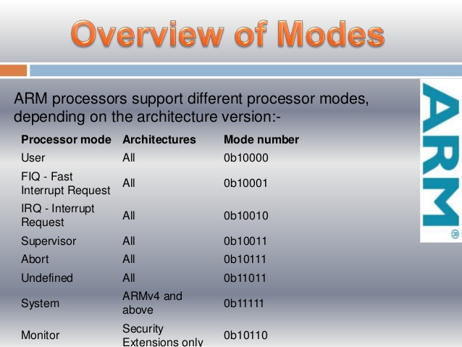
Operate modes

Slide 5
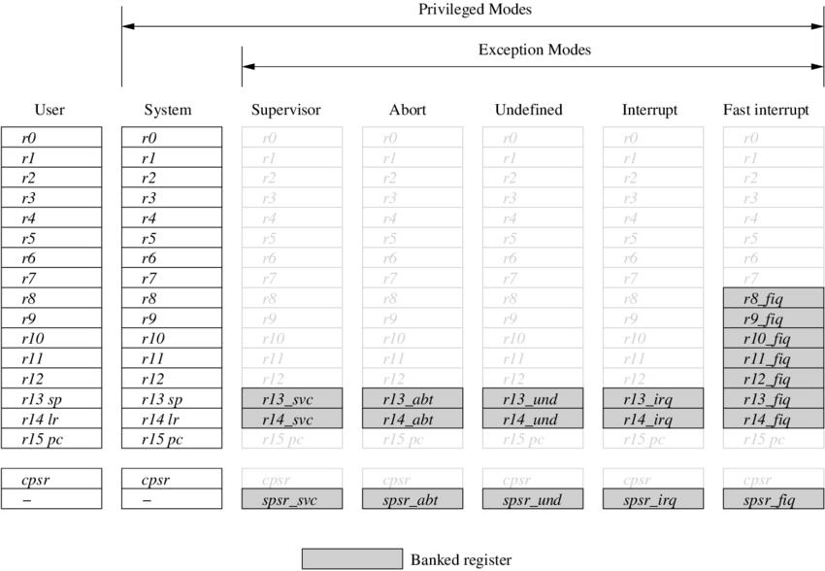
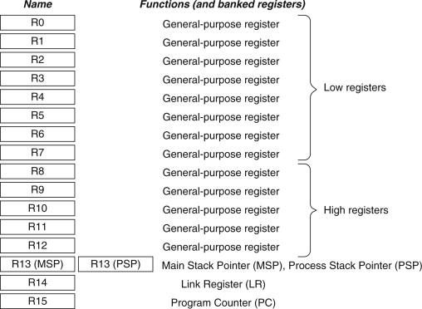
Arm cpu reg

Slide 6
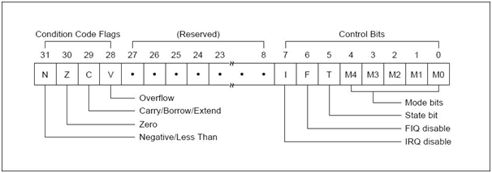
Cpsr vs spsr
A Saved Program Status Register (SPSR) stores the current value of the CPSR when an exception is taken so that the CPSR can be restored after handling the exception. Each exception handling mode can access its own SPSR. User mode and System mode do not have an SPSR because they are not exception handling modes.

Slide 7
STM32F103c8 core specs
32bit controller , RISC, Harvard architecture
32 bit address and data bus
Program memory -64/128kb
Data memory -20kb
Interrupts -256 ->240 usable NVIC
Peripherals- 14 timers,adc,ccp,3 uart,2 spi,2 i2c,can,usb
GPIO pins -48 → 35 usable
Instruction cycle – 3 pipeline stage
Clock
Int -8mhz
Ext-4-20mhz
PLL-max 72 max

Slide 8
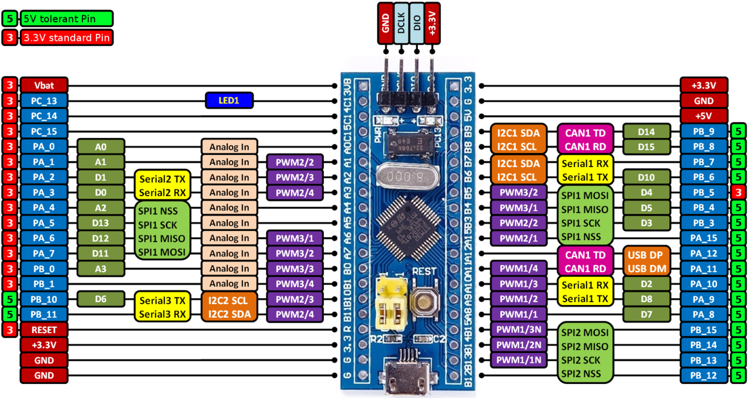
Pin details

Slide 9
Bus
Address bus
Data bus
Control bus
System bus
AHB
APB1,APB2

Slide 10
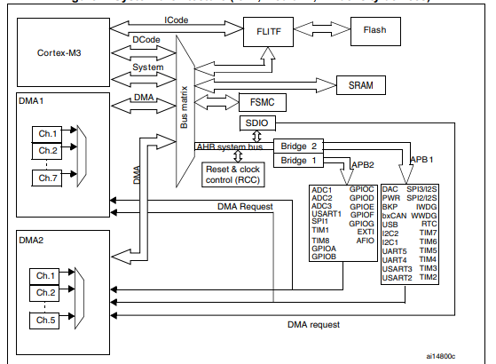
Core architecture

Slide 11
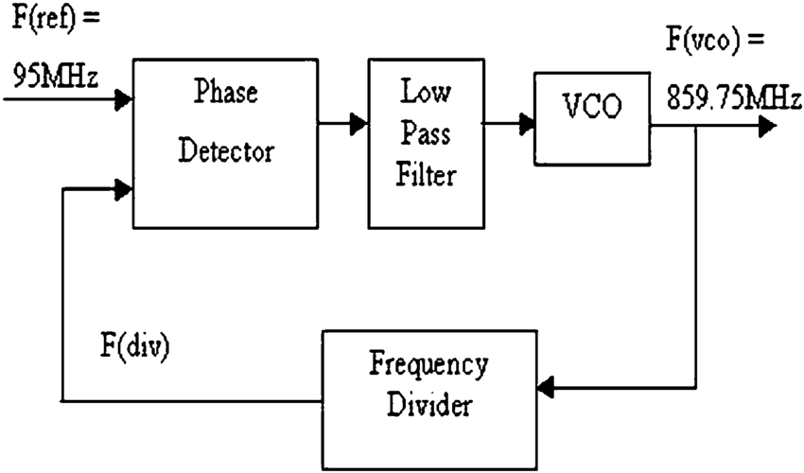
PLL- phase lock loop

Slide 12
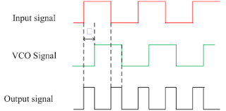
PLL waveform

Slide 13
GPIO Registers
GPIOx_CRL - below pin 8
GPIOx_CRH - above pin 7 & below pin 16
GPIOx_IDR
GPIOx_ODR
Each 32bit registers
Modes in GPIO_CRL
00- input
01- output-10mhz
10-output-2mhz
11-output-50mhz
Config type GPIO_CRH
input output
00-anolog 00-GPIO pushpull
01-input floating 01-GPIO open drain
10-input push pull 10-alterfunction pushpull
11-Reserved 11-alterfunction opendrain

Slide 14
Driver code explanation
Project creation in keil with legacy package install
Stm32 cube clock configuration
Software debug in keil
Hardware debug in keil
Register map
Pll config →sys_stm32f1X.c(startup) edit for 60mhz
Gpio.h
Gpio.c
Src.c →led blinking ,switch

