Slide 1

Interfacing LCD with STM32

Slide 2
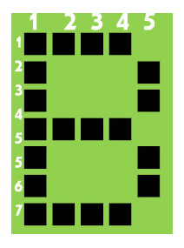
8-bit mode
As per the name the 2x16 has 2 lines with 16 chars on each lines.
It supports all the ascii chars and is basically used for displaying the alpha numeric characters.
Here each character is displayed in a matrix of 5x7 pixels.
Apart from alpha numeric chars it also provides the provision to display the custom characters by creating the pattern.

Slide 3
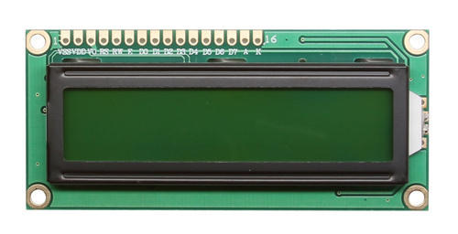
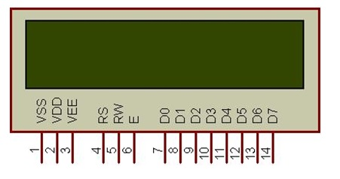
LCD UNIT
Let us look at a pin diagram of a commercially available LCD like LM016L which uses a HD44780 controller and then describe its operation.

Slide 4
Pin Diagram
Pin Number | Symbol | Pin Function
1 | VSS | Ground
2 | VCC | +5v
3 | VEE | Contrast adjustment (VO)
4 | RS | Register Select. 0:Command, 1: Data
5 | R/W | Read/Write, R/W=0: Write & R/W=1: Read
6 | EN | Enable. Falling edge triggered
7 | D0 | Data Bit 0
8 | D1 | Data Bit 1
9 | D2 | Data Bit 2
10 | D3 | Data Bit 3
11 | D4 | Data Bit 4
12 | D5 | Data Bit 5
13 | D6 | Data Bit 6
14 | D7 | Data Bit 7/Busy Flag

Slide 5
Data Bus
As shown in the above figure and table, an alpha numeric lcd has a 8-bit data bus referenced as D0-D7.
As it is a 8-bit data bus, we can send the data/cmd to LCD in bytes.
It also provides the provision to send the the data/cmd in chunks of 4-bit, which is used when there are limited number of GPIO lines on the microcontroller.
Register Select(RS)
The LCD has two register namely a Data register and Command register. Any data that needs to be displayed on the LCD has to be written to the data register of LCD. Command can be issued to LCD by writing it to Command register of LCD. This signal is used to differentiate the data/cmd received by the LCD.
If the RS signal is LOW then the LCD interprets the 8-bit info as Command and writes it Command register and performs the action as per the command.
If the RS signal is HIGH then the LCD interprets the 8-bit info as data and copies it to data register. After that the LCD decodes the data for generating the 5x7 pattern and finally displays on the LCD.

Slide 6
Read/Write(RW)
This signal is used to write the data/cmd to LCD and reads the busy flag of LCD. For write operation the RW should be LOW and for read operation the R/W should be HIGH.
Enable(EN)
This pin is used to send the enable trigger to LCD. After sending the data/cmd, Selecting the data/cmd register, Selecting the Write operation.
A HIGH-to-LOW pulse has to be send on this enable pin which will latch the info into the LCD register and triggers the LCD to act accordingly.

Slide 7
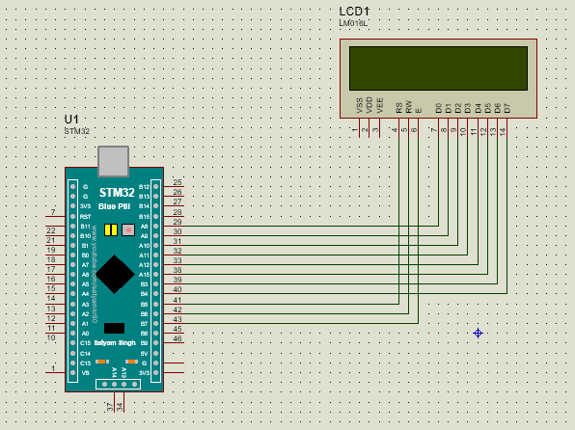
Circuit Diagram

Slide 8
Program
#include "stm32f10x.h" // Device header
#include "gpio.h"
void delay( unsigned int time)
{
unsigned int i,j;
for(i=0;i<time;i++)
for(j=0;j<0x2AFF;j++);
}
void GPIO_Init(void)
{
unsigned char i=0;
/*Clk Enable for PORTA and PORTB */
PORTA_CLOCK_ENABLE();
PORTB_CLOCK_ENABLE();

Slide 9
/*Data Pins for LCD */
GPIO_Config pa[6],pb[5];
pa[0].CurrentPort = PA;
pa[0].CurrentPin = P8;
pa[0].PinMode = Speed_50MHz_Output;
pa[0].PinState = Output_PushPull;
pa[1].CurrentPort = PA;
pa[1].CurrentPin = P9;
pa[1].PinMode = Speed_50MHz_Output;
pa[1].PinState = Output_PushPull;
pa[2].CurrentPort = PA;
pa[2].CurrentPin = P10;
pa[2].PinMode = Speed_50MHz_Output;
pa[2].PinState = Output_PushPull;
pa[3].CurrentPort = PA;
pa[3].CurrentPin = P11;
pa[3].PinMode = Speed_50MHz_Output;
pa[3].PinState = Output_PushPull;
pa[4].CurrentPort = PA;
pa[4].CurrentPin = P12;
pa[4].PinMode = Speed_50MHz_Output;
pa[4].PinState = Output_PushPull;
pa[5].CurrentPort = PA;
pa[5].CurrentPin = P15;
pa[5].PinMode = Speed_50MHz_Output;
pa[5].PinState = Output_PushPull;
pb[0].CurrentPort = PB;
pb[0].CurrentPin = P3;
pb[0].PinMode = Speed_50MHz_Output;
pb[0].PinState = Output_PushPull;
pb[1].CurrentPort = PB;
pb[1].CurrentPin = P4;
pb[1].PinMode = Speed_50MHz_Output;
pb[1].PinState = Output_PushPull;
/*Control Pins for LCD */
pb[2].CurrentPort = PB;
pb[2].CurrentPin = P6;
pb[2].PinMode = Speed_50MHz_Output;
pb[2].PinState = Output_PushPull;
pb[3].CurrentPort = PB;
pb[3].CurrentPin = P7;
pb[3].PinMode = Speed_50MHz_Output;

Slide 10
pb[3].PinState = Output_PushPull;
pb[4].CurrentPort = PB;
pb[4].CurrentPin = P8;
pb[4].PinMode = Speed_50MHz_Output;
pb[4].PinState = Output_PushPull;
//PORTA Config
for(i=0;i<6;i++)
{
GPIO_Config_Pin(&pa[i]);
}
//PORTB Config
for(i=0;i<5;i++)
{
GPIO_Config_Pin(&pb[i]);
}
}

Slide 11
void LCD_Command(unsigned char cmd)
{
unsigned char i,val[8];
//RS for cmd mode
GPIO_Write_Data(PB,P3,0);
//RW
GPIO_Write_Data(PB,P4,0);
//Command send to LCD
for(i=0;i<8;i++)
{
//Cmd hex to bin conversion
val[i]= (cmd>>i)&1;
}
GPIO_Write_Data(PA,P8,val[0]);
GPIO_Write_Data(PA,P9,val[1]);
GPIO_Write_Data(PA,P10,val[2]);
GPIO_Write_Data(PA,P11,val[3]);
GPIO_Write_Data(PA,P12,val[4]);
GPIO_Write_Data(PA,P15,val[5]);
GPIO_Write_Data(PB,P3,val[6]);
GPIO_Write_Data(PB,P4,val[7]);
//EN on
GPIO_Write_Data(PB,P8,1);
delay(10);
//EN off
GPIO_Write_Data(PB,P8,0);
}

Slide 12
void LCD_Char(unsigned char data)
{
unsigned char i,val[8];
//RS for data mode
GPIO_Write_Data(PB,P3,1);
//RW
GPIO_Write_Data(PB,P4,0);
//Command send to LCD
for(i=0;i<8;i++)
{
//Cmd hex to bin conversion
val[i]= (data>>i)&1;
}
GPIO_Write_Data(PA,P8,val[0]);
GPIO_Write_Data(PA,P9,val[1]);
GPIO_Write_Data(PA,P10,val[2]);
GPIO_Write_Data(PA,P11,val[3]);
GPIO_Write_Data(PA,P12,val[4]);
GPIO_Write_Data(PA,P15,val[5]);
GPIO_Write_Data(PB,P3,val[6]);
GPIO_Write_Data(PB,P4,val[7]);
//EN on
GPIO_Write_Data(PB,P8,1);
delay(10);
//EN off
GPIO_Write_Data(PB,P8,0);
}
void LCD_String(unsigned char * data)
{
while(*data)
{
LCD_Char(*data++);
}
}

Slide 13
void LCD_Init()
{
LCD_Command(0xc0);//LCD ON
LCD_Command(0x80); //Set Cursor to Row0,Colun0
}
int main()
{
GPIO_Init();
LCD_Init();
LCD_Char('0');
while(1)
{
}
return 0;
}

Slide 14
Heading
content

