Slide 1

I2C Communication Protocols In STM32

Slide 2
Introduction
Inter Integrated Circuit (I2C) is a serial communication protocol developed by Philips Semiconductors. The main purpose of this protocol is to provide easiness to connect peripheral chips with microcontroller. In embedded systems, all peripheral devices are connected as memory mapped devices to the microcontroller.
I2C necessitates two wires SDA (Serial Data Line) and SCL (Serial Clock Line) to carry information between devices. These two active wires are said to be bidirectional.
I2C protocol is a master to slave communication protocol. Each slave is been provided with unique address. In order to establish communication, master device initially sends the target slave address along with R/W (Read/Write) flag. The corresponding slave device will move into active mode leaving other devices in off state.
Once the slave device is ready, communication starts between master and slave devices. One bit acknowledgment is replied by the receiver if transmitter transmits 1 byte (8 bits) of data. A stop condition is issued at the end of communication between devices.

Slide 3
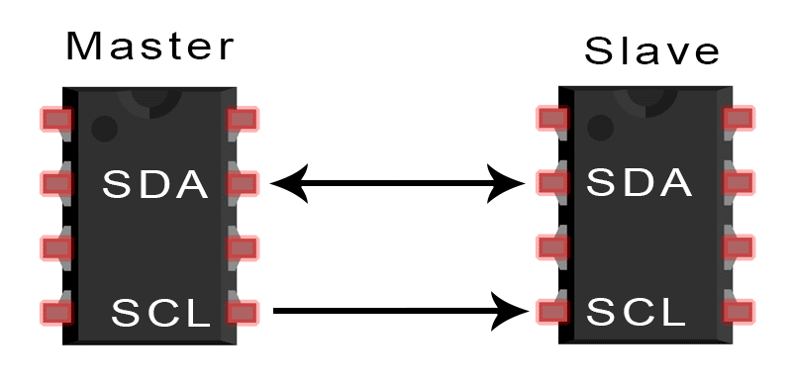
2 wire serial synchronous protocol(SDA,SCL)
Multi master multi slave connection
Max distance 15cm
Max speed 100khz-or 400khz
Software Address based protocol
127 slaves can connect in 7bit slave address ,1023 slaves can connect in 10 bit slave address
Half duplex data transmission only
2 operating mode :
Master (tx /rx )
Slave (tx /rx )

Slide 4
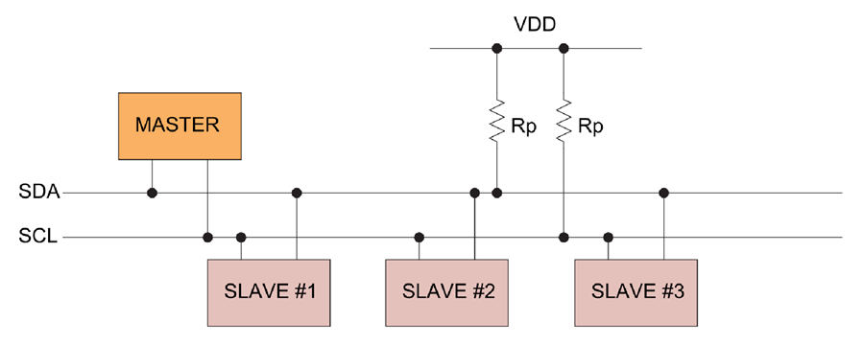
I2C Buses
In I2C the buses SDA & SCL are pull up with resistors.
Because of A pull up resistor is used to provide a default state for a signal line or general purpose input/ouput (GPIO) pin. ... Typically they are of high resistance thousands or tens of thousands of ohms of resistance.

Slide 5
HOW I2C WORKS
With I2C, data is transferred in messages. Messages are broken up into frames of data.
Each message has an address frame that contains the binary address of the slave, and one or more data frames that contain the data being transmitted.
The message also includes start and stop conditions, read/write bits, and ACK/NACK bits between each data frame:

Slide 6
I2C Data Frame Format

Slide 7
Heading
Start Condition: The SDA line switches from a high voltage level to a low voltage level before the SCL line switches from high to low.
Stop Condition: The SDA line switches from a low voltage level to a high voltage level after the SCL line switches from low to high.
Address Frame: A 7 or 10 bit sequence unique to each slave that identifies the slave when the master wants to talk to it.
Read/Write Bit: A single bit specifying whether the master is sending data to the slave (low voltage level) or requesting data from it (high voltage level).
ACK/NACK Bit: Each frame in a message is followed by an acknowledge/no-acknowledge bit. If an address frame or data frame was successfully received, an ACK bit is returned to the sender from the receiving device.

Slide 8
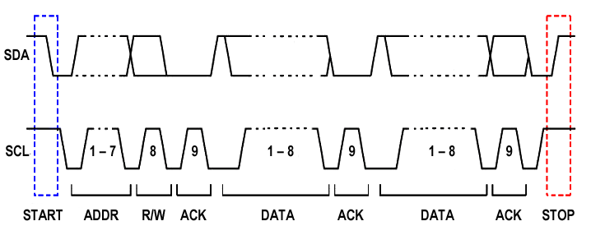
Clock Frame

Slide 9
I2C in STM32
I2C (inter-integrated circuit) bus Interface serves as an interface between the microcontroller and the serial I2C bus.
It provides multimaster capability, and controls all I2C bus-specific sequencing, protocol, arbitration and timing. It supports the standard mode (Sm, up to 100 kHz) and Fm mode (Fm, up to 400 kHz).
It may be used for a variety of purposes, including CRC generation and verification, SMBus (system management bus) and PMBus (power management bus).
Depending on specific device implementation DMA capability can be available for reduced CPU overload.

Slide 10
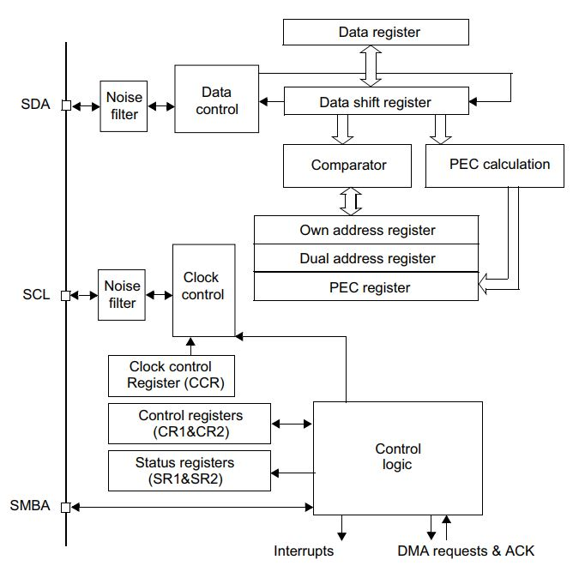
I2C block diagram

Slide 11
Heading
conte

Slide 12
Heading
conte

Slide 13
Heading
conte

Slide 14
Heading
conte

Slide 15
Heading
conte

Slide 16
Heading
conte

